Slide 1
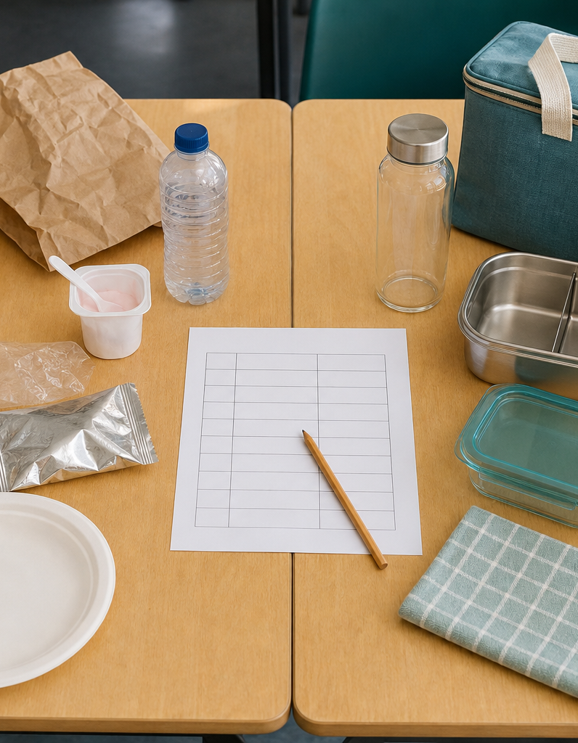
MODULE 3 OF 10
Sustainable lunch choices
Connect reusable products, material choices and personal action.
Year 7/8 Technology Mandatory · Student learning presentation
Notes:
Open by connecting this module to the student project and current teacher instructions.
[Sources]
- Lunch Is Packed authorised Classroom and Drive teaching sequence, inspected 11 August 2026.
- NSW Education Standards Authority, Technology 7–8 (2023): https://curriculum.nsw.edu.au/learning-areas/tas/technology-7-8-2023/overview

Slide 2
LUNCH IS PACKED
MODULE 3 · LEARNING PATH
Three ideas build one design decision
Read, notice, explain and apply each section in order.
1
3.1 The single-use problem
2
3.2 Product life cycle thinking
3
3.3 Personal action with evidence
Notes:
[Sources]
- Lunch Is Packed authorised Classroom and Drive teaching sequence, inspected 11 August 2026.
- NSW Education Standards Authority, Technology 7–8 (2023): https://curriculum.nsw.edu.au/learning-areas/tas/technology-7-8-2023/overview

Slide 3
LUNCH IS PACKED
MODULE 3 · SECTION 3.1
3.1 The single-use problem
Key ideas to understand before you write.
1
Single-use items are designed to be used briefly before disposal.
2
It must be used enough times, cared for and kept in service to replace disposable alternatives.
3
The strongest action targets a frequent item, suits the user and includes a routine for washing, returning or storing the replacement so that reuse actually occurs.
Notes:
[Sources]
- Lunch Is Packed authorised Classroom and Drive teaching sequence, inspected 11 August 2026.
- NSW Education Standards Authority, Technology 7–8 (2023): https://curriculum.nsw.edu.au/learning-areas/tas/technology-7-8-2023/overview

Slide 4
LUNCH IS PACKED
MODULE 3 · APPLY THE THEORY
Make the theory visible
Audit one packed lunch and identify three possible reductions.
WHAT THIS IS ASKING
Name real items, frequency and a suitable action without exaggerating the effect.
STARTER
The lunch contains… I could reduce… by…
Return to the matching website section, complete the ten checks, then save your response.
Notes:
Students should write their own response. The website provides steps and an appropriate response example without revealing quiz answers.
[Sources]
- Lunch Is Packed authorised Classroom and Drive teaching sequence, inspected 11 August 2026.
- NSW Education Standards Authority, Technology 7–8 (2023): https://curriculum.nsw.edu.au/learning-areas/tas/technology-7-8-2023/overview

Slide 5
LUNCH IS PACKED
MODULE 3 · SECTION 3.2
3.2 Product life cycle thinking
Key ideas to understand before you write.
1
Life cycle thinking follows a product through raw materials, manufacture, transport, use, care, repair and end of life.
2
Life-cycle decisions are connected.
3
A repairable closure may extend use, while a product that is difficult to clean may be abandoned early.
Notes:
[Sources]
- Lunch Is Packed authorised Classroom and Drive teaching sequence, inspected 11 August 2026.
- NSW Education Standards Authority, Technology 7–8 (2023): https://curriculum.nsw.edu.au/learning-areas/tas/technology-7-8-2023/overview

Slide 6
LUNCH IS PACKED
MODULE 3 · APPLY THE THEORY
Use evidence, not guesses
Create a life-cycle map for a reusable lunch bag.
WHAT THIS IS ASKING
Include at least six stages and one design opportunity at three stages.
STARTER
At the… stage, the product… A better choice could…
Return to the matching website section, complete the ten checks, then save your response.
Notes:
Students should write their own response. The website provides steps and an appropriate response example without revealing quiz answers.
[Sources]
- Lunch Is Packed authorised Classroom and Drive teaching sequence, inspected 11 August 2026.
- NSW Education Standards Authority, Technology 7–8 (2023): https://curriculum.nsw.edu.au/learning-areas/tas/technology-7-8-2023/overview

Slide 7
LUNCH IS PACKED
MODULE 3 · SECTION 3.3
3.3 Personal action with evidence
Key ideas to understand before you write.
1
Personal action is strongest when it is specific and measurable.
2
State the action, the likely effect and the evidence you would collect.
3
For example, a student might count disposable carrier bags for one week, use the reusable bag for four weeks and compare the two records.
Notes:
[Sources]
- Lunch Is Packed authorised Classroom and Drive teaching sequence, inspected 11 August 2026.
- NSW Education Standards Authority, Technology 7–8 (2023): https://curriculum.nsw.edu.au/learning-areas/tas/technology-7-8-2023/overview

Slide 8
MODULE 3 REVIEW
Show what you understand.
1. Revisit all three theory sections.
2. Complete 30 knowledge checks and three guided responses.
3. Continue the Lunch-waste action investigation and keep authentic evidence.
Exact practical instructions and formal submission arrangements: Teacher to confirm.
Notes:
Use the website module and project activity for the interactive evidence tasks.
[Sources]
- Lunch Is Packed authorised Classroom and Drive teaching sequence, inspected 11 August 2026.
- NSW Education Standards Authority, Technology 7–8 (2023): https://curriculum.nsw.edu.au/learning-areas/tas/technology-7-8-2023/overview

