Slide 1
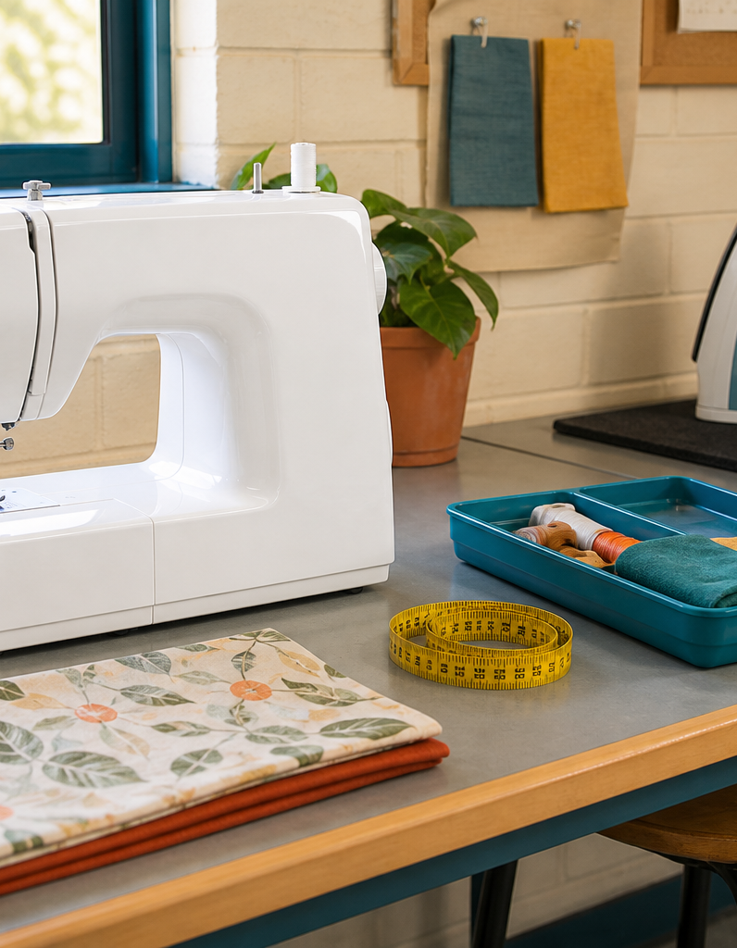
MODULE 4 OF 10
Tools, materials and safety
Prepare a safe textile workspace and select each tool for its function.
Year 7/8 Technology Mandatory · Student learning presentation
Notes:
Open by connecting this module to the student project and current teacher instructions.
[Sources]
- Lunch Is Packed authorised Classroom and Drive teaching sequence, inspected 11 August 2026.
- NSW Education Standards Authority, Technology 7–8 (2023): https://curriculum.nsw.edu.au/learning-areas/tas/technology-7-8-2023/overview

Slide 2
LUNCH IS PACKED
MODULE 4 · LEARNING PATH
Three ideas build one design decision
Read, notice, explain and apply each section in order.
1
4.1 Safe textile-work routines
2
4.2 Pins, scissors and steam irons
3
4.3 A purposeful equipment list
Notes:
[Sources]
- Lunch Is Packed authorised Classroom and Drive teaching sequence, inspected 11 August 2026.
- NSW Education Standards Authority, Technology 7–8 (2023): https://curriculum.nsw.edu.au/learning-areas/tas/technology-7-8-2023/overview

Slide 3
LUNCH IS PACKED
MODULE 4 · SECTION 4.1
4.1 Safe textile-work routines
Key ideas to understand before you write.
1
Before using equipment, secure loose clothing and hair, remove or control jewellery as directed, prepare a clear workspace and ask for the teacher’s demonstration.
2
The operator controls the pace and should never use speed to hide uncertainty.
3
The general rule is consistent: do not guess around moving parts.
Notes:
[Sources]
- Lunch Is Packed authorised Classroom and Drive teaching sequence, inspected 11 August 2026.
- NSW Education Standards Authority, Technology 7–8 (2023): https://curriculum.nsw.edu.au/learning-areas/tas/technology-7-8-2023/overview

Slide 4
LUNCH IS PACKED
MODULE 4 · APPLY THE THEORY
Make the theory visible
Write the before-sewing safety routine in order.
WHAT THIS IS ASKING
Use the source safety rules and keep model-specific actions under teacher direction.
STARTER
Before sewing I will…
Return to the matching website section, complete the ten checks, then save your response.
Notes:
Students should write their own response. The website provides steps and an appropriate response example without revealing quiz answers.
[Sources]
- Lunch Is Packed authorised Classroom and Drive teaching sequence, inspected 11 August 2026.
- NSW Education Standards Authority, Technology 7–8 (2023): https://curriculum.nsw.edu.au/learning-areas/tas/technology-7-8-2023/overview

Slide 5
LUNCH IS PACKED
MODULE 4 · SECTION 4.2
4.2 Pins, scissors and steam irons
Key ideas to understand before you write.
1
Never place pins or needles in your mouth.
2
Think in zones.
3
It reduces reaching across hazards, makes missing pins easier to notice and creates space to rotate or support fabric without pulling it.
Notes:
[Sources]
- Lunch Is Packed authorised Classroom and Drive teaching sequence, inspected 11 August 2026.
- NSW Education Standards Authority, Technology 7–8 (2023): https://curriculum.nsw.edu.au/learning-areas/tas/technology-7-8-2023/overview

Slide 6
LUNCH IS PACKED
MODULE 4 · APPLY THE THEORY
Use evidence, not guesses
Pair six textile-room hazards with specific controls.
WHAT THIS IS ASKING
Include sewing-machine, pin, scissor, iron and electrical examples.
STARTER
The hazard is… I will control it by…
Return to the matching website section, complete the ten checks, then save your response.
Notes:
Students should write their own response. The website provides steps and an appropriate response example without revealing quiz answers.
[Sources]
- Lunch Is Packed authorised Classroom and Drive teaching sequence, inspected 11 August 2026.
- NSW Education Standards Authority, Technology 7–8 (2023): https://curriculum.nsw.edu.au/learning-areas/tas/technology-7-8-2023/overview

Slide 7
LUNCH IS PACKED
MODULE 4 · SECTION 4.3
4.3 A purposeful equipment list
Key ideas to understand before you write.
1
The source folio asks students to record the real lining, closure, outer material and any other materials used.
2
A useful equipment record links each item to a task.
3
Photographs should show the actual classroom item at a readable scale, with a caption that names what the viewer should notice.
Notes:
[Sources]
- Lunch Is Packed authorised Classroom and Drive teaching sequence, inspected 11 August 2026.
- NSW Education Standards Authority, Technology 7–8 (2023): https://curriculum.nsw.edu.au/learning-areas/tas/technology-7-8-2023/overview

Slide 8
MODULE 4 REVIEW
Show what you understand.
1. Revisit all three theory sections.
2. Complete 30 knowledge checks and three guided responses.
3. Continue the Safety scenario studio and keep authentic evidence.
Exact practical instructions and formal submission arrangements: Teacher to confirm.
Notes:
Use the website module and project activity for the interactive evidence tasks.
[Sources]
- Lunch Is Packed authorised Classroom and Drive teaching sequence, inspected 11 August 2026.
- NSW Education Standards Authority, Technology 7–8 (2023): https://curriculum.nsw.edu.au/learning-areas/tas/technology-7-8-2023/overview

