Slide 1
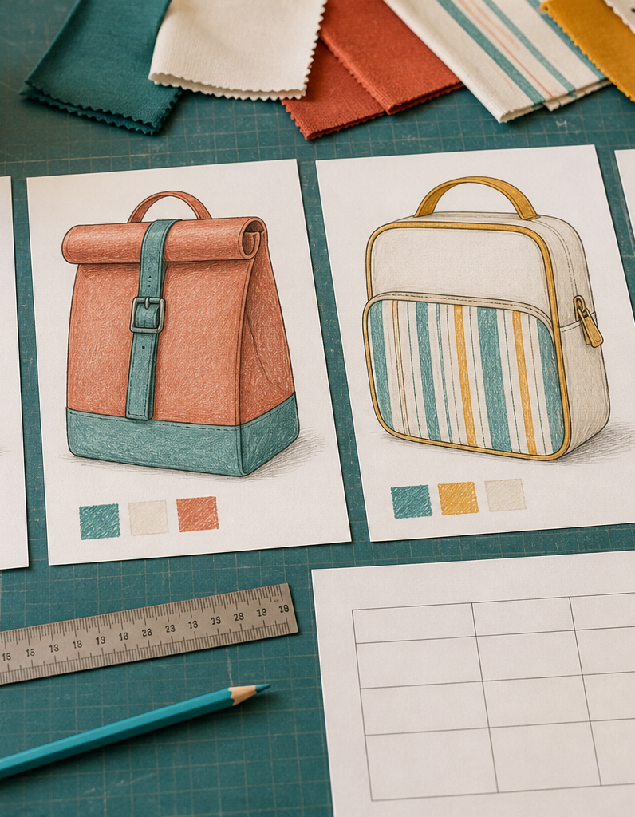
MODULE 5 OF 10
Develop and communicate ideas
Generate alternatives, annotate decisions and present a final design.
Year 7/8 Technology Mandatory · Student learning presentation
Notes:
Open by connecting this module to the student project and current teacher instructions.
[Sources]
- Lunch Is Packed authorised Classroom and Drive teaching sequence, inspected 11 August 2026.
- NSW Education Standards Authority, Technology 7–8 (2023): https://curriculum.nsw.edu.au/learning-areas/tas/technology-7-8-2023/overview

Slide 2
LUNCH IS PACKED
MODULE 5 · LEARNING PATH
Three ideas build one design decision
Read, notice, explain and apply each section in order.
1
5.1 Research and inspiration
2
5.2 Generate different concepts
3
5.3 Final design communication
Notes:
[Sources]
- Lunch Is Packed authorised Classroom and Drive teaching sequence, inspected 11 August 2026.
- NSW Education Standards Authority, Technology 7–8 (2023): https://curriculum.nsw.edu.au/learning-areas/tas/technology-7-8-2023/overview

Slide 3
LUNCH IS PACKED
MODULE 5 · SECTION 5.1
5.1 Research and inspiration
Key ideas to understand before you write.
1
Research helps a designer understand existing lunch bags, alternative packaging, closures, decorative approaches and user preferences.
2
Good research compares patterns across products.
3
A clear opening from one product and a compact carrying idea from another can inspire a new response, provided the final design fits the brief and approved constructi…
Notes:
[Sources]
- Lunch Is Packed authorised Classroom and Drive teaching sequence, inspected 11 August 2026.
- NSW Education Standards Authority, Technology 7–8 (2023): https://curriculum.nsw.edu.au/learning-areas/tas/technology-7-8-2023/overview

Slide 4
LUNCH IS PACKED
MODULE 5 · APPLY THE THEORY
Make the theory visible
Analyse three existing lunch-bag solutions.
WHAT THIS IS ASKING
Identify a feature, strength, limitation and possible influence for each.
STARTER
This product uses… A strength is… I could adapt…
Return to the matching website section, complete the ten checks, then save your response.
Notes:
Students should write their own response. The website provides steps and an appropriate response example without revealing quiz answers.
[Sources]
- Lunch Is Packed authorised Classroom and Drive teaching sequence, inspected 11 August 2026.
- NSW Education Standards Authority, Technology 7–8 (2023): https://curriculum.nsw.edu.au/learning-areas/tas/technology-7-8-2023/overview

Slide 5
LUNCH IS PACKED
MODULE 5 · SECTION 5.2
5.2 Generate different concepts
Key ideas to understand before you write.
1
Strong design development produces several genuinely different concepts.
2
Add annotations that explain function, material, construction, safety or user benefit.
3
Then annotate each option with function, user benefit and possible production challenge.
Notes:
[Sources]
- Lunch Is Packed authorised Classroom and Drive teaching sequence, inspected 11 August 2026.
- NSW Education Standards Authority, Technology 7–8 (2023): https://curriculum.nsw.edu.au/learning-areas/tas/technology-7-8-2023/overview

Slide 6
LUNCH IS PACKED
MODULE 5 · APPLY THE THEORY
Use evidence, not guesses
Develop four genuinely different concepts.
WHAT THIS IS ASKING
Describe form, closure, carrying feature, decoration and user benefit for each.
STARTER
Concept A differs because…
Return to the matching website section, complete the ten checks, then save your response.
Notes:
Students should write their own response. The website provides steps and an appropriate response example without revealing quiz answers.
[Sources]
- Lunch Is Packed authorised Classroom and Drive teaching sequence, inspected 11 August 2026.
- NSW Education Standards Authority, Technology 7–8 (2023): https://curriculum.nsw.edu.au/learning-areas/tas/technology-7-8-2023/overview

Slide 7
LUNCH IS PACKED
MODULE 5 · SECTION 5.3
5.3 Final design communication
Key ideas to understand before you write.
1
A final design drawing should be clear enough for another person to understand.
2
Convergent thinking narrows the options using evidence.
3
A final communication should include the selected view, useful detail views, labels, a colour/material indication and notes that distinguish confirmed decisions from …
Notes:
[Sources]
- Lunch Is Packed authorised Classroom and Drive teaching sequence, inspected 11 August 2026.
- NSW Education Standards Authority, Technology 7–8 (2023): https://curriculum.nsw.edu.au/learning-areas/tas/technology-7-8-2023/overview

Slide 8
MODULE 5 REVIEW
Show what you understand.
1. Revisit all three theory sections.
2. Complete 30 knowledge checks and three guided responses.
3. Continue the Four-concept design studio and keep authentic evidence.
Exact practical instructions and formal submission arrangements: Teacher to confirm.
Notes:
Use the website module and project activity for the interactive evidence tasks.
[Sources]
- Lunch Is Packed authorised Classroom and Drive teaching sequence, inspected 11 August 2026.
- NSW Education Standards Authority, Technology 7–8 (2023): https://curriculum.nsw.edu.au/learning-areas/tas/technology-7-8-2023/overview

