Slide 1
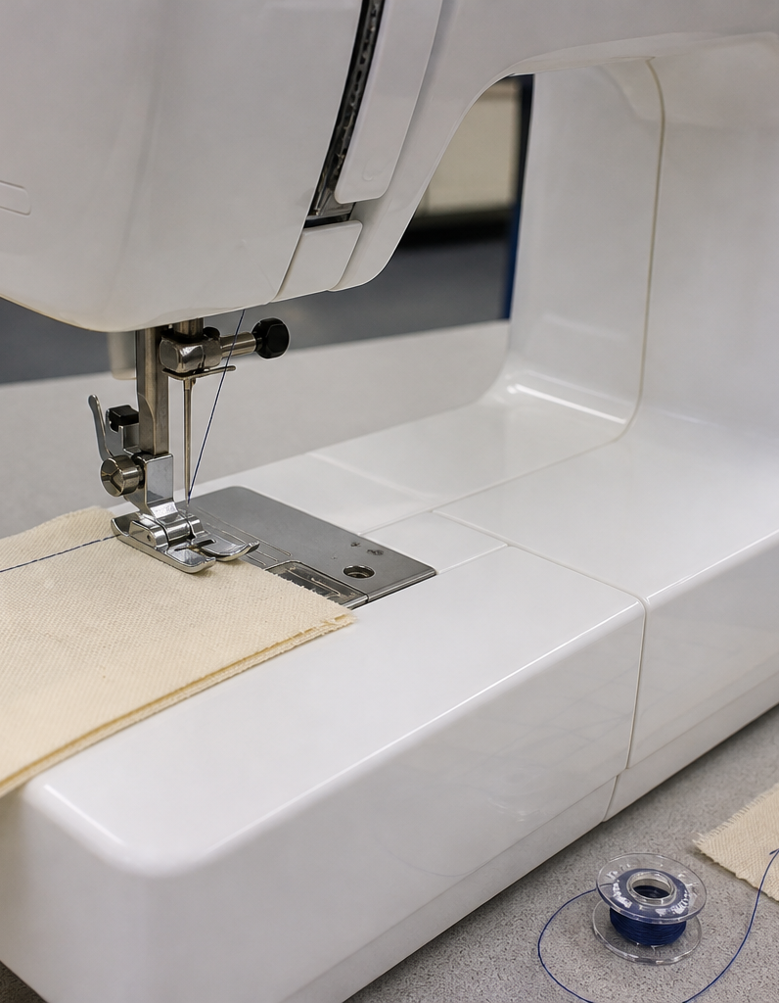
MODULE 6 OF 10
Know the sewing machine
Identify major parts and explain what each part controls.
Year 7/8 Technology Mandatory · Student learning presentation
Notes:
Open by connecting this module to the student project and current teacher instructions.
[Sources]
- Lunch Is Packed authorised Classroom and Drive teaching sequence, inspected 11 August 2026.
- NSW Education Standards Authority, Technology 7–8 (2023): https://curriculum.nsw.edu.au/learning-areas/tas/technology-7-8-2023/overview

Slide 2
LUNCH IS PACKED
MODULE 6 · LEARNING PATH
Three ideas build one design decision
Read, notice, explain and apply each section in order.
1
6.1 Thread path and stitch-forming parts
2
6.2 Holding and moving fabric
3
6.3 Controls and their purpose
Notes:
[Sources]
- Lunch Is Packed authorised Classroom and Drive teaching sequence, inspected 11 August 2026.
- NSW Education Standards Authority, Technology 7–8 (2023): https://curriculum.nsw.edu.au/learning-areas/tas/technology-7-8-2023/overview

Slide 3
LUNCH IS PACKED
MODULE 6 · SECTION 6.1
6.1 Thread path and stitch-forming parts
Key ideas to understand before you write.
1
The upper thread travels from the spool through guides and tension controls to the needle.
2
A sewing machine creates a lockstitch by coordinating motion and thread.
3
Skipping one stage can change the stitch even when the thread reaches the needle.
Notes:
[Sources]
- Lunch Is Packed authorised Classroom and Drive teaching sequence, inspected 11 August 2026.
- NSW Education Standards Authority, Technology 7–8 (2023): https://curriculum.nsw.edu.au/learning-areas/tas/technology-7-8-2023/overview

Slide 4
LUNCH IS PACKED
MODULE 6 · APPLY THE THEORY
Make the theory visible
Describe the upper and lower thread systems.
WHAT THIS IS ASKING
Explain spool-to-needle and bobbin roles without inventing machine-specific steps.
STARTER
The upper thread travels… The bobbin…
Return to the matching website section, complete the ten checks, then save your response.
Notes:
Students should write their own response. The website provides steps and an appropriate response example without revealing quiz answers.
[Sources]
- Lunch Is Packed authorised Classroom and Drive teaching sequence, inspected 11 August 2026.
- NSW Education Standards Authority, Technology 7–8 (2023): https://curriculum.nsw.edu.au/learning-areas/tas/technology-7-8-2023/overview

Slide 5
LUNCH IS PACKED
MODULE 6 · SECTION 6.2
6.2 Holding and moving fabric
Key ideas to understand before you write.
1
The presser foot holds fabric against the feed dogs.
2
Keep fingers clear of the moving needle and presser-foot area.
3
Pulling the fabric fights this system and can distort the seam or place sideways force on the needle.
Notes:
[Sources]
- Lunch Is Packed authorised Classroom and Drive teaching sequence, inspected 11 August 2026.
- NSW Education Standards Authority, Technology 7–8 (2023): https://curriculum.nsw.edu.au/learning-areas/tas/technology-7-8-2023/overview

Slide 6
LUNCH IS PACKED
MODULE 6 · APPLY THE THEORY
Use evidence, not guesses
Explain how fabric is held and moved during sewing.
WHAT THIS IS ASKING
Name the presser foot, feed dogs and needle plate and describe the student’s role.
STARTER
The presser foot… The feed dogs… I will guide…
Return to the matching website section, complete the ten checks, then save your response.
Notes:
Students should write their own response. The website provides steps and an appropriate response example without revealing quiz answers.
[Sources]
- Lunch Is Packed authorised Classroom and Drive teaching sequence, inspected 11 August 2026.
- NSW Education Standards Authority, Technology 7–8 (2023): https://curriculum.nsw.edu.au/learning-areas/tas/technology-7-8-2023/overview

Slide 7
LUNCH IS PACKED
MODULE 6 · SECTION 6.3
6.3 Controls and their purpose
Key ideas to understand before you write.
1
Common controls may include a handwheel, presser-foot lifter, reverse control, stitch selector, stitch-length control and speed control.
2
The handwheel positions the needle under the demonstrated method; the reverse control may secure stitching; stitch selectors and length controls change stitch formati…
3
Record model-specific values only after teacher confirmation.
Notes:
[Sources]
- Lunch Is Packed authorised Classroom and Drive teaching sequence, inspected 11 August 2026.
- NSW Education Standards Authority, Technology 7–8 (2023): https://curriculum.nsw.edu.au/learning-areas/tas/technology-7-8-2023/overview

Slide 8
MODULE 6 REVIEW
Show what you understand.
1. Revisit all three theory sections.
2. Complete 30 knowledge checks and three guided responses.
3. Continue the Sewing machine systems lab and keep authentic evidence.
Exact practical instructions and formal submission arrangements: Teacher to confirm.
Notes:
Use the website module and project activity for the interactive evidence tasks.
[Sources]
- Lunch Is Packed authorised Classroom and Drive teaching sequence, inspected 11 August 2026.
- NSW Education Standards Authority, Technology 7–8 (2023): https://curriculum.nsw.edu.au/learning-areas/tas/technology-7-8-2023/overview

