Slide 1
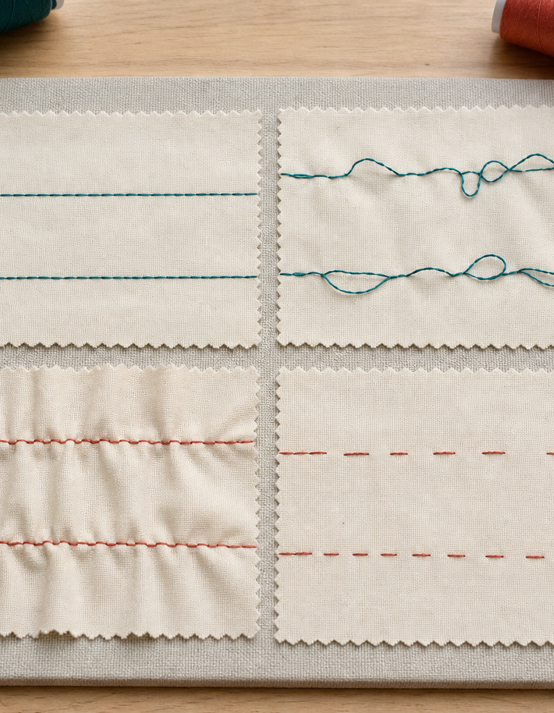
MODULE 7 OF 10
Set up and practise
Build control before sewing the project pieces.
Year 7/8 Technology Mandatory · Student learning presentation
Notes:
Open by connecting this module to the student project and current teacher instructions.
[Sources]
- Lunch Is Packed authorised Classroom and Drive teaching sequence, inspected 11 August 2026.
- NSW Education Standards Authority, Technology 7–8 (2023): https://curriculum.nsw.edu.au/learning-areas/tas/technology-7-8-2023/overview

Slide 2
LUNCH IS PACKED
MODULE 7 · LEARNING PATH
Three ideas build one design decision
Read, notice, explain and apply each section in order.
1
7.1 Threading and the bobbin
2
7.2 Starting, guiding and finishing
3
7.3 Reading stitch quality
Notes:
[Sources]
- Lunch Is Packed authorised Classroom and Drive teaching sequence, inspected 11 August 2026.
- NSW Education Standards Authority, Technology 7–8 (2023): https://curriculum.nsw.edu.au/learning-areas/tas/technology-7-8-2023/overview

Slide 3
LUNCH IS PACKED
MODULE 7 · SECTION 7.1
7.1 Threading and the bobbin
Key ideas to understand before you write.
1
A correct setup follows the machine’s approved thread path, places the bobbin in the correct orientation and brings both threads into the starting position.
2
Trace the complete upper path, check the needle-area threading direction, confirm the bobbin orientation and bring threads to the demonstrated starting position.
3
One change at a time makes the cause easier to identify and prevents random settings from creating a second problem.
Notes:
[Sources]
- Lunch Is Packed authorised Classroom and Drive teaching sequence, inspected 11 August 2026.
- NSW Education Standards Authority, Technology 7–8 (2023): https://curriculum.nsw.edu.au/learning-areas/tas/technology-7-8-2023/overview

Slide 4
LUNCH IS PACKED
MODULE 7 · APPLY THE THEORY
Make the theory visible
Write a setup checklist for the classroom machine.
WHAT THIS IS ASKING
Use observed local steps and avoid claiming one universal thread path.
STARTER
With the machine switched off, I will…
Return to the matching website section, complete the ten checks, then save your response.
Notes:
Students should write their own response. The website provides steps and an appropriate response example without revealing quiz answers.
[Sources]
- Lunch Is Packed authorised Classroom and Drive teaching sequence, inspected 11 August 2026.
- NSW Education Standards Authority, Technology 7–8 (2023): https://curriculum.nsw.edu.au/learning-areas/tas/technology-7-8-2023/overview

Slide 5
LUNCH IS PACKED
MODULE 7 · SECTION 7.2
7.2 Starting, guiding and finishing
Key ideas to understand before you write.
1
Begin with the presser foot down, threads positioned as demonstrated and hands safely guiding the fabric.
2
Secure stitching using the teacher-approved method, stop with control and remove work without pulling against the needle.
3
Support the fabric so its weight does not drag the seam sideways.
Notes:
[Sources]
- Lunch Is Packed authorised Classroom and Drive teaching sequence, inspected 11 August 2026.
- NSW Education Standards Authority, Technology 7–8 (2023): https://curriculum.nsw.edu.au/learning-areas/tas/technology-7-8-2023/overview

Slide 6
LUNCH IS PACKED
MODULE 7 · APPLY THE THEORY
Use evidence, not guesses
Explain how you will sew an accurate straight seam.
WHAT THIS IS ASKING
Describe setup, hand position, visual focus, speed and finishing.
STARTER
I will begin by… While sewing I will watch…
Return to the matching website section, complete the ten checks, then save your response.
Notes:
Students should write their own response. The website provides steps and an appropriate response example without revealing quiz answers.
[Sources]
- Lunch Is Packed authorised Classroom and Drive teaching sequence, inspected 11 August 2026.
- NSW Education Standards Authority, Technology 7–8 (2023): https://curriculum.nsw.edu.au/learning-areas/tas/technology-7-8-2023/overview

Slide 7
LUNCH IS PACKED
MODULE 7 · SECTION 7.3
7.3 Reading stitch quality
Key ideas to understand before you write.
1
Balanced stitches look even on both sides of the fabric, without loops, puckering, skipped stitches or broken thread.
2
Do not keep sewing over a fault—check with the teacher and record the cause and correction.
3
Loops can indicate a threading or setup issue; puckering may involve material, stitch choice, handling or setup; skipped stitches may require a teacher check of the n…
Notes:
[Sources]
- Lunch Is Packed authorised Classroom and Drive teaching sequence, inspected 11 August 2026.
- NSW Education Standards Authority, Technology 7–8 (2023): https://curriculum.nsw.edu.au/learning-areas/tas/technology-7-8-2023/overview

Slide 8
MODULE 7 REVIEW
Show what you understand.
1. Revisit all three theory sections.
2. Complete 30 knowledge checks and three guided responses.
3. Continue the Stitch detective lab and keep authentic evidence.
Exact practical instructions and formal submission arrangements: Teacher to confirm.
Notes:
Use the website module and project activity for the interactive evidence tasks.
[Sources]
- Lunch Is Packed authorised Classroom and Drive teaching sequence, inspected 11 August 2026.
- NSW Education Standards Authority, Technology 7–8 (2023): https://curriculum.nsw.edu.au/learning-areas/tas/technology-7-8-2023/overview

