Slide 1
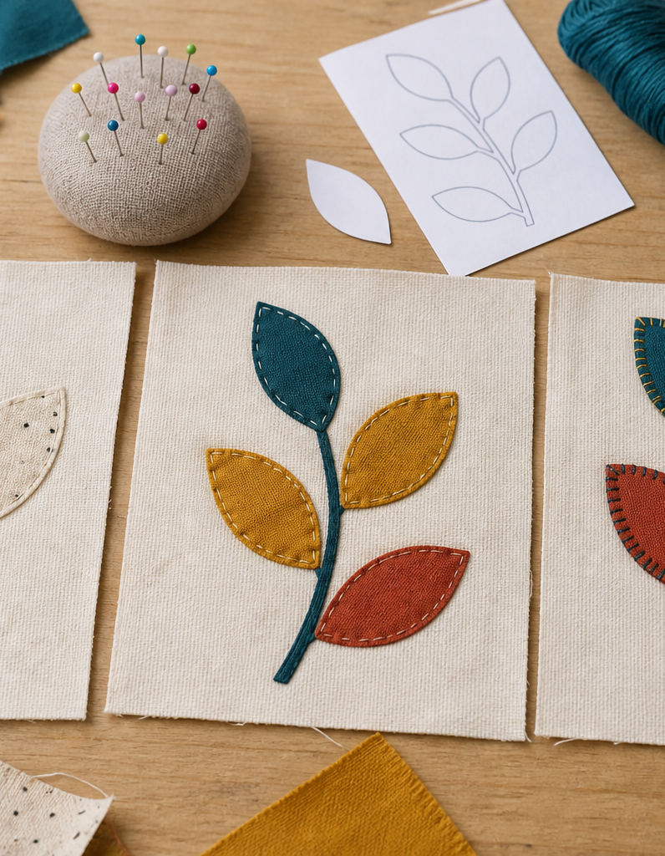
MODULE 8 OF 10
Decoration and surface design
Use colour, shape and appliqué purposefully.
Year 7/8 Technology Mandatory · Student learning presentation
Notes:
Open by connecting this module to the student project and current teacher instructions.
[Sources]
- Lunch Is Packed authorised Classroom and Drive teaching sequence, inspected 11 August 2026.
- NSW Education Standards Authority, Technology 7–8 (2023): https://curriculum.nsw.edu.au/learning-areas/tas/technology-7-8-2023/overview

Slide 2
LUNCH IS PACKED
MODULE 8 · LEARNING PATH
Three ideas build one design decision
Read, notice, explain and apply each section in order.
1
8.1 Visual design choices
2
8.2 Appliqué as a technique
3
8.3 Test before committing
Notes:
[Sources]
- Lunch Is Packed authorised Classroom and Drive teaching sequence, inspected 11 August 2026.
- NSW Education Standards Authority, Technology 7–8 (2023): https://curriculum.nsw.edu.au/learning-areas/tas/technology-7-8-2023/overview

Slide 3
LUNCH IS PACKED
MODULE 8 · SECTION 8.1
8.1 Visual design choices
Key ideas to understand before you write.
1
Colour, line, shape, texture, pattern and proportion influence how a textile product communicates.
2
Use contrast so a motif is visible, repetition to create rhythm, scale to suit the available area and proportion so decoration supports rather than overwhelms the form.
3
A motif that looks balanced alone may clash with a seam, closure or handle once positioned on the bag.
Notes:
[Sources]
- Lunch Is Packed authorised Classroom and Drive teaching sequence, inspected 11 August 2026.
- NSW Education Standards Authority, Technology 7–8 (2023): https://curriculum.nsw.edu.au/learning-areas/tas/technology-7-8-2023/overview

Slide 4
LUNCH IS PACKED
MODULE 8 · APPLY THE THEORY
Make the theory visible
Develop a colour and surface-design plan.
WHAT THIS IS ASKING
Explain how elements and principles support the intended user and product identity.
STARTER
I will use… because…
Return to the matching website section, complete the ten checks, then save your response.
Notes:
Students should write their own response. The website provides steps and an appropriate response example without revealing quiz answers.
[Sources]
- Lunch Is Packed authorised Classroom and Drive teaching sequence, inspected 11 August 2026.
- NSW Education Standards Authority, Technology 7–8 (2023): https://curriculum.nsw.edu.au/learning-areas/tas/technology-7-8-2023/overview

Slide 5
LUNCH IS PACKED
MODULE 8 · SECTION 8.2
8.2 Appliqué as a technique
Key ideas to understand before you write.
1
Appliqué places one fabric shape onto another surface and secures it with stitching or another approved method.
2
Applique quality depends on a chain of decisions: template accuracy, grain and fabric behaviour, cutting control, placement, temporary holding, edge treatment and sti…
3
They can be easier to cut and control, more readable from a distance and more durable around edges than shapes with many tight corners.
Notes:
[Sources]
- Lunch Is Packed authorised Classroom and Drive teaching sequence, inspected 11 August 2026.
- NSW Education Standards Authority, Technology 7–8 (2023): https://curriculum.nsw.edu.au/learning-areas/tas/technology-7-8-2023/overview

Slide 6
LUNCH IS PACKED
MODULE 8 · APPLY THE THEORY
Use evidence, not guesses
Plan an appliqué feature for the lunch bag.
WHAT THIS IS ASKING
Describe purpose, shape, placement and the teacher-controlled production details.
STARTER
My appliqué will… It is placed… The approved method is…
Return to the matching website section, complete the ten checks, then save your response.
Notes:
Students should write their own response. The website provides steps and an appropriate response example without revealing quiz answers.
[Sources]
- Lunch Is Packed authorised Classroom and Drive teaching sequence, inspected 11 August 2026.
- NSW Education Standards Authority, Technology 7–8 (2023): https://curriculum.nsw.edu.au/learning-areas/tas/technology-7-8-2023/overview

Slide 7
LUNCH IS PACKED
MODULE 8 · SECTION 8.3
8.3 Test before committing
Key ideas to understand before you write.
1
A sample lets you check colour contrast, edge finish, stitch appearance, fabric behaviour and the time needed.
2
Keep the question focused: Does the colour contrast work?
3
Record the setup, observe the result and change one feature before repeating when time allows.
Notes:
[Sources]
- Lunch Is Packed authorised Classroom and Drive teaching sequence, inspected 11 August 2026.
- NSW Education Standards Authority, Technology 7–8 (2023): https://curriculum.nsw.edu.au/learning-areas/tas/technology-7-8-2023/overview

Slide 8
MODULE 8 REVIEW
Show what you understand.
1. Revisit all three theory sections.
2. Complete 30 knowledge checks and three guided responses.
3. Continue the Designer and appliqué sample studio and keep authentic evidence.
Exact practical instructions and formal submission arrangements: Teacher to confirm.
Notes:
Use the website module and project activity for the interactive evidence tasks.
[Sources]
- Lunch Is Packed authorised Classroom and Drive teaching sequence, inspected 11 August 2026.
- NSW Education Standards Authority, Technology 7–8 (2023): https://curriculum.nsw.edu.au/learning-areas/tas/technology-7-8-2023/overview

