Slide 1
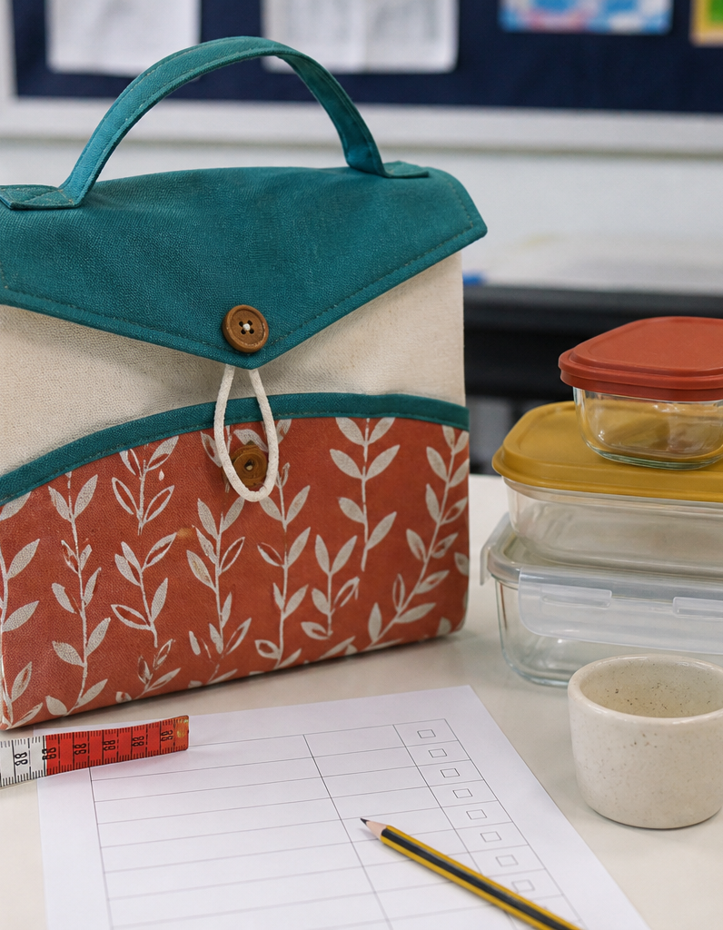
MODULE 10 OF 10
Test, evaluate and improve
Judge the finished solution against the brief using evidence.
Year 7/8 Technology Mandatory · Student learning presentation
Notes:
Open by connecting this module to the student project and current teacher instructions.
[Sources]
- Lunch Is Packed authorised Classroom and Drive teaching sequence, inspected 11 August 2026.
- NSW Education Standards Authority, Technology 7–8 (2023): https://curriculum.nsw.edu.au/learning-areas/tas/technology-7-8-2023/overview

Slide 2
LUNCH IS PACKED
MODULE 10 · LEARNING PATH
Three ideas build one design decision
Read, notice, explain and apply each section in order.
1
10.1 Testing the product
2
10.2 Evidence-based evaluation
3
10.3 Specific improvement and reflection
Notes:
[Sources]
- Lunch Is Packed authorised Classroom and Drive teaching sequence, inspected 11 August 2026.
- NSW Education Standards Authority, Technology 7–8 (2023): https://curriculum.nsw.edu.au/learning-areas/tas/technology-7-8-2023/overview

Slide 3
LUNCH IS PACKED
MODULE 10 · SECTION 10.1
10.1 Testing the product
Key ideas to understand before you write.
1
Testing should match the criteria.
2
A fair test controls what can be controlled and records what actually happened.
3
This makes it harder to change the test simply because the product performed differently from the prediction.
Notes:
[Sources]
- Lunch Is Packed authorised Classroom and Drive teaching sequence, inspected 11 August 2026.
- NSW Education Standards Authority, Technology 7–8 (2023): https://curriculum.nsw.edu.au/learning-areas/tas/technology-7-8-2023/overview

Slide 4
LUNCH IS PACKED
MODULE 10 · APPLY THE THEORY
Make the theory visible
Design four safe tests for the finished lunch bag.
WHAT THIS IS ASKING
Link each test to one criterion, method, evidence and limit.
STARTER
For the criterion… I will test by… I will record…
Return to the matching website section, complete the ten checks, then save your response.
Notes:
Students should write their own response. The website provides steps and an appropriate response example without revealing quiz answers.
[Sources]
- Lunch Is Packed authorised Classroom and Drive teaching sequence, inspected 11 August 2026.
- NSW Education Standards Authority, Technology 7–8 (2023): https://curriculum.nsw.edu.au/learning-areas/tas/technology-7-8-2023/overview

Slide 5
LUNCH IS PACKED
MODULE 10 · SECTION 10.2
10.2 Evidence-based evaluation
Key ideas to understand before you write.
1
An evaluation combines a criterion, evidence and judgement.
2
A successful feature can still be refined.
3
Include limitations because they reveal where the evidence is incomplete or where performance is mixed.
Notes:
[Sources]
- Lunch Is Packed authorised Classroom and Drive teaching sequence, inspected 11 August 2026.
- NSW Education Standards Authority, Technology 7–8 (2023): https://curriculum.nsw.edu.au/learning-areas/tas/technology-7-8-2023/overview

Slide 6
LUNCH IS PACKED
MODULE 10 · APPLY THE THEORY
Use evidence, not guesses
Evaluate the bag against at least six criteria.
WHAT THIS IS ASKING
For each, provide evidence, a judgement and any limitation.
STARTER
For the criterion… my evidence is… Therefore…
Return to the matching website section, complete the ten checks, then save your response.
Notes:
Students should write their own response. The website provides steps and an appropriate response example without revealing quiz answers.
[Sources]
- Lunch Is Packed authorised Classroom and Drive teaching sequence, inspected 11 August 2026.
- NSW Education Standards Authority, Technology 7–8 (2023): https://curriculum.nsw.edu.au/learning-areas/tas/technology-7-8-2023/overview

Slide 7
LUNCH IS PACKED
MODULE 10 · SECTION 10.3
10.3 Specific improvement and reflection
Key ideas to understand before you write.
1
A useful improvement changes a feature, process or decision and explains the expected benefit.
2
It may refine a feature, alter a sequence, improve a quality checkpoint or change how evidence is collected.
3
Use one real moment as evidence for each claim.
Notes:
[Sources]
- Lunch Is Packed authorised Classroom and Drive teaching sequence, inspected 11 August 2026.
- NSW Education Standards Authority, Technology 7–8 (2023): https://curriculum.nsw.edu.au/learning-areas/tas/technology-7-8-2023/overview

Slide 8
MODULE 10 REVIEW
Show what you understand.
1. Revisit all three theory sections.
2. Complete 30 knowledge checks and three guided responses.
3. Continue the Product test and evaluation lab and keep authentic evidence.
Exact practical instructions and formal submission arrangements: Teacher to confirm.
Notes:
Use the website module and project activity for the interactive evidence tasks.
[Sources]
- Lunch Is Packed authorised Classroom and Drive teaching sequence, inspected 11 August 2026.
- NSW Education Standards Authority, Technology 7–8 (2023): https://curriculum.nsw.edu.au/learning-areas/tas/technology-7-8-2023/overview

