Slide 1
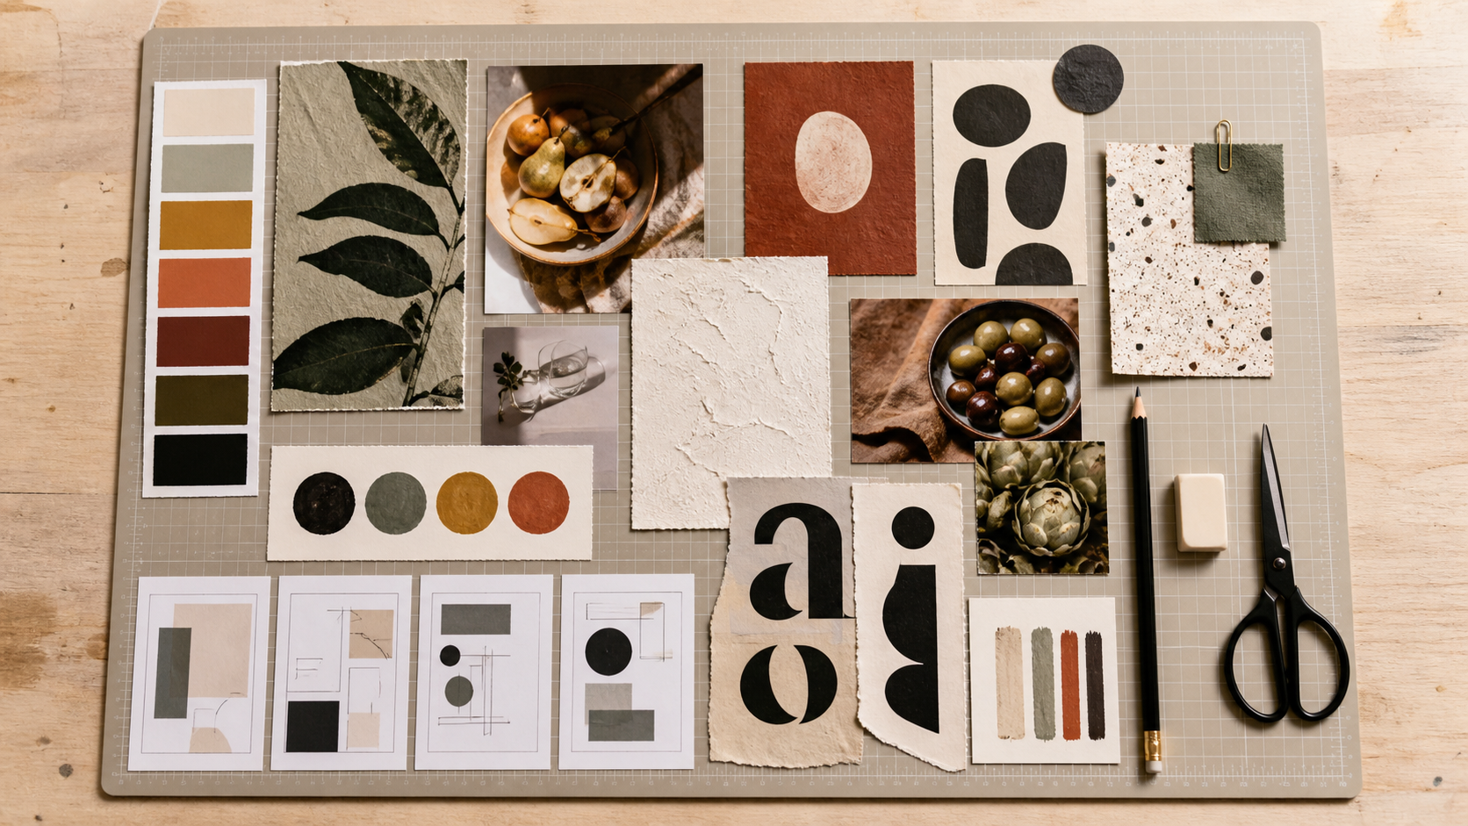
MODULE 02
Visual language
Use colour, typography, hierarchy and mood boards deliberately.
TEACHING QUESTION
Where does your eye go first on a strong poster—and why?
YEAR 7 MULTIMEDIA • MODULE 02 • VISUAL LANGUAGE
01
Notes:
Teacher talk: Introduce the module as one connected learning package, not a list of software clicks.
State the outcome: Use colour, typography, hierarchy and mood boards deliberately.
Prompt: Where does your eye go first on a strong poster—and why?
Listen for a purposeful link to audience, evidence or communication.
Transition: Preview the three named sections on the next slide.
[Sources]
- Course sequence: data/course-map.js, Module 2.
- Theory: data/course-content.js, m02-s01, m02-s02, m02-s03.
- Visual: assets/visuals/generated-moodboard-workspace.png.

Slide 2
TODAY'S LEARNING PATH
Where are we going?
1
Colour and meaning
RETRIEVAL WARM-UP
Where does your eye go first on a strong poster—and why?
2
Typography and tone
Think silently → pair → share one reason.
3
Hierarchy, layout and mood boards
YEAR 7 MULTIMEDIA • MODULE 02 • VISUAL LANGUAGE
02
Notes:
Teacher talk: Read the three section titles aloud and explain how each one prepares the next.
Warm-up: Where does your eye go first on a strong poster—and why?
Give silent thinking time before pair discussion.
Listen for: a reason, not only a preference.
Transition: Start with Colour and meaning.
[Sources]
- Theory sequence: data/course-content.js, m02-s01, m02-s02, m02-s03.
- Module summary: data/course-map.js, Module 2.

Slide 3
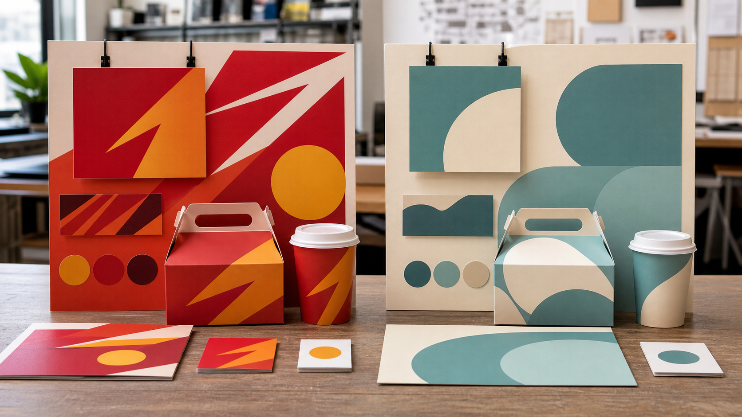
2.1 COLOUR AND MEANING
Colour and meaning
THREE IDEAS TO PUT ON THE BOARD
A palette is a system with named roles.
Colour meaning depends on context.
Two fictional brand directions combine warm angular energy or cool rounded calm across signs and packaging.
Essential information needs contrast and a non-colour cue.
Notice: How do colour, shape and spacing work together to change the first impression?
ASK THE ROOM
What makes a palette more than favourite colours?
YEAR 7 MULTIMEDIA • MODULE 02 • VISUAL LANGUAGE
03
Notes:
Teacher talk: Build and test a limited colour palette that supports meaning, recognition and readable contrast.
Explain: Colour can attract attention, separate information and support recognition. A palette is a planned set of colours with roles, such as a main brand colour, support colour, background and text colour. Naming each role is more useful than choosing colours only because they look good together. Meaning changes with culture, context and surrounding imagery, so one colour cannot guarantee one message for every audience.
Clarify: Contrast is the visible difference between elements. Test text and backgrounds at the real viewing size, in colour and greyscale, and on more than one screen when possible. A call to action may need stronger contrast than supporting detail. Never rely on colour alone for an essential category or choice; reinforce it with words, icons or patterns.
Worked example: A student chooses deep green, warm cream and bright orange. Green carries large brand areas, cream provides calm reading surfaces and orange highlights one action. Dark text is tested on cream and cream text on green at poster and phone size. Orange text fails a small-size test, so orange remains an accent shape rather than carrying essential information. Repeated roles keep the palette recognisable.
Ask: What makes a palette more than favourite colours?
Listen for: Each colour has a role in a repeated system. Correct. Roles make the palette purposeful.
Misconception to correct: A bright colour is automatically readable. → Readability depends on foreground-background contrast at the actual size.
Transition: Connect this idea to Typography and tone.
[Sources]
- Theory and check: data/course-content.js, m02-s01 and m02-s01-q01.
- Image-first teaching visual: assets/visuals/generated-brand-direction-comparison.png. AI-generated with the built-in image tool on 24 August 2026; no source or student image used.

Slide 4
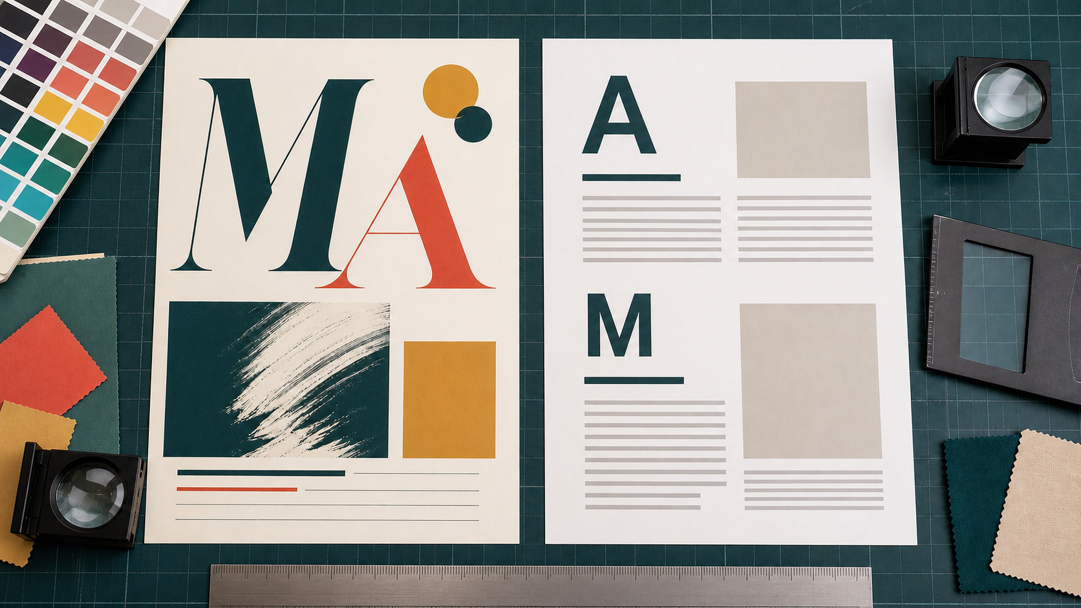
2.2 TYPOGRAPHY AND TONE
Typography and tone
THREE IDEAS TO PUT ON THE BOARD
Typography combines several controllable features.
Tone is tested, not assumed.
Two proof sheets show that type tone and readability must be judged together at the intended size.
A small set of type roles supports hierarchy.
Notice: Compare the personality of the letterforms, then check spacing, contrast and scanability.
ASK THE ROOM
Which group contains typography decisions?
YEAR 7 MULTIMEDIA • MODULE 02 • VISUAL LANGUAGE
04
Notes:
Teacher talk: Use typography as a readable hierarchy that supports an appropriate brand voice.
Explain: Typography includes typeface, size, weight, spacing, line length and alignment. These features work together to create hierarchy and tone. A display style may suit a short brand name but become tiring in a paragraph. A useful system gives distinct roles to the name, headings, product information and small details. Limiting styles makes those relationships easier to understand.
Clarify: Rounded letters may feel informal and condensed capitals may feel forceful, but tone is an interpretation to test with the audience. Legibility concerns recognising characters; readability concerns following words comfortably. Decorative effects, tight spacing and long lines can reduce both. Essential names, prices and actions must remain clear at the size and distance where they will be viewed.
Worked example: A poster uses one distinctive face for a two-word name and one plain face for the slogan, product details and action. The name is largest, the offer next and supporting detail smaller but readable. Weight and spacing strengthen the levels, so four unrelated fonts are unnecessary. A phone test shows the slogan is too thin, so its weight increases while the friendly tone remains.
Ask: Which group contains typography decisions?
Listen for: Typeface, size, weight, spacing and alignment. Correct. These features shape hierarchy and readability.
Misconception to correct: More fonts make a more creative design. → A controlled type system often communicates more clearly and consistently.
Transition: Connect this idea to Hierarchy, layout and mood boards.
[Sources]
- Theory and check: data/course-content.js, m02-s02 and m02-s02-q01.
- Image-first teaching visual: assets/visuals/generated-m02-typography-tone-proof-v3.png. AI-generated with the built-in OpenAI image creator on 24 August 2026; no source or student image used.

Slide 5
2.3 HIERARCHY, LAYOUT AND MOOD BOARDS
Hierarchy, layout and mood boards
THREE IDEAS TO PUT ON THE BOARD
Rank information before styling.
Alignment, proximity and space show relationships.
A flat-lay mood board groups a restrained palette, food imagery, textures, letterforms and layout thumbnails into one direction.
A mood board is an annotated filter, not a final collage.
Notice: Which repeated visual qualities make these different samples feel connected?
ASK THE ROOM
What is visual hierarchy?
YEAR 7 MULTIMEDIA • MODULE 02 • VISUAL LANGUAGE
05
Notes:
Teacher talk: Organise elements so viewers notice, understand and act in a useful order.
Explain: Visual hierarchy is the order in which elements attract attention. Size, contrast, position, spacing and repetition can make one message dominant and another supporting. It does not mean making everything large. If the logo, image, slogan, price and action all shout equally, there is no entry point. Rank information according to the communication purpose before styling it.
Clarify: Alignment and proximity show what belongs together. White space protects readability and can separate groups without boxing every item. A grid keeps edges and spacing consistent while allowing one focal element to break the pattern deliberately. The supplied canteen menu and poster can be analysed for grouping and scanning, but the menu’s historical prices and products are not current information to republish.
Worked example: A useful mood board groups a small set of colours, type references, shapes, textures and image treatments around a direction such as “bold, quick and friendly”. The student annotates why each fits and removes attractive items that point elsewhere. The board becomes a filter for later choices. It guides original work; it is not copied into the final brand as a page of other people’s designs.
Ask: What is visual hierarchy?
Listen for: The planned order in which elements are noticed. Correct. Hierarchy creates an entry point and path.
Misconception to correct: Empty space is wasted space. → Purposeful space separates groups, protects reading and focuses attention.
Transition: Connect this idea to the retrieval check.
[Sources]
- Theory and check: data/course-content.js, m02-s03 and m02-s03-q01.
- Image-first teaching visual: assets/visuals/generated-moodboard-workspace.png. AI-generated with the built-in image tool on 24 August 2026; no source image used.

Slide 6
CHECK FOR UNDERSTANDING
Stop. Think. Explain.
Answer silently first, then justify with a partner.
1
What makes a palette more than favourite colours?
2
Which group contains typography decisions?
3
What is visual hierarchy?
YEAR 7 MULTIMEDIA • MODULE 02 • VISUAL LANGUAGE
06
Notes:
Teacher routine: 60 seconds silent retrieval, pair justification, then whole-class feedback.
Question 1: Each colour has a role in a repeated system. Feedback: Correct. Roles make the palette purposeful.
Question 2: Typeface, size, weight, spacing and alignment. Feedback: Correct. These features shape hierarchy and readability.
Question 3: The planned order in which elements are noticed. Feedback: Correct. Hierarchy creates an entry point and path.
Do not score this as a formal assessment. Use responses to decide whether to reteach or continue.
Transition: Model how the same knowledge becomes a longer written explanation.
[Sources]
- Formative checks: data/course-content.js, m02-s01-q01, m02-s02-q01, m02-s03-q01.

Slide 7
FORMATIVE LEARNING EVIDENCE
Read → Select → Explain → Check
THE QUESTION
WHAT THIS IS ASKING
Plan one visual-language system: name colour roles, type roles and the intended scanning path, then explain how each will be tested.
Assign jobs, not favourites
Protect legibility
Rank first, next and later
1 SELECT
2 EXPLAIN
3 CHECK
Choose precise theory and examples that answer the question.
Link ideas with because, so or therefore.
Answer every part; keep claims specific and source-safe.
Sentence starter: The viewer should notice… first because… My palette and type system will…
YEAR 7 MULTIMEDIA • MODULE 02 • VISUAL LANGUAGE
07
Notes:
Teacher talk: Read the prompt once, then unpack it using Select, Explain and Check.
Model one sentence aloud using the supplied starter.
Prompt: Which section provides the strongest evidence for each part of the question?
Remind students: this is formative learning evidence. A local save is not a submission.
Transition: Finish with a three-part exit ticket and save the response in the matching module.
[Sources]
- Section capstones: data/course-content.js, m02-s01-capstone, m02-s02-capstone, m02-s03-capstone.
- Integrated prompt: Stage 07 synthesis of the three source-grounded section capstones.
- Evidence boundary: data/course-content.js evidenceLabel, saveNotice and moduleEvidenceKey.

Slide 8
Before you pack up…
1. One idea I can now explain is…
SAVE
YOUR
EVIDENCE
2. One design decision or practical action this changes is…
3. One question I still need answered is…
Save in the matching course module. Local save is not submission.
YEAR 7 MULTIMEDIA • MODULE 02 • VISUAL LANGUAGE
08
Notes:
Teacher routine: Ask students to answer all three prompts in the matching module response box.
Invite one voluntary share for the first prompt.
Use the final question to plan the next explanation or support.
Remind students that browser-local saving preserves a draft on this device; it does not submit work.
[Sources]
- Exit-ticket structure and evidence boundary: data/course-content.js saveNotice, savedMessage and evidenceDestination.
- Module theory: data/course-content.js, m02-s01, m02-s02, m02-s03.

