Slide 1
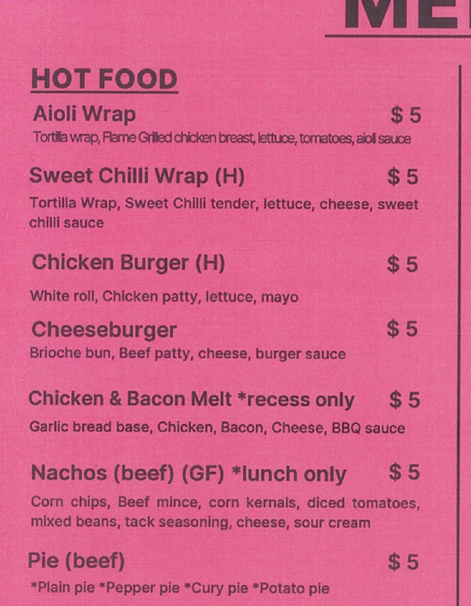
MODULE 04
Menu information design
Organise product information so it is easy to scan and trust.
TEACHING QUESTION
How could a user find one item quickly without reading every line?
SOURCE DETAIL • GROUPING + SCAN PATH • CURRENT DETAILS NOT CONFIRMED
YEAR 7 MULTIMEDIA • MODULE 04 • MENU INFORMATION DESIGN
01
Notes:
Teacher talk: Introduce the module as one connected learning package, not a list of software clicks.
State the outcome: Organise product information so it is easy to scan and trust.
Prompt: How could a user find one item quickly without reading every line?
Listen for a purposeful link to audience, evidence or communication.
Transition: Preview the three named sections on the next slide.
[Sources]
- Course sequence: data/course-map.js, Module 4.
- Theory: data/course-content.js, m04-s01, m04-s02, m04-s03.
- Visual: assets/source/drive-canteen-menu-wwhs.jpg.
- Projection enlargement: crop of the supplied Drive source; item availability and prices are not presented as current facts.

Slide 2
TODAY'S LEARNING PATH
Where are we going?
1
Grouping and information architecture
RETRIEVAL WARM-UP
How could a user find one item quickly without reading every line?
2
Readability and scanning
Think silently → pair → share one reason.
3
Honest product information
YEAR 7 MULTIMEDIA • MODULE 04 • MENU INFORMATION DESIGN
02
Notes:
Teacher talk: Read the three section titles aloud and explain how each one prepares the next.
Warm-up: How could a user find one item quickly without reading every line?
Give silent thinking time before pair discussion.
Listen for: a reason, not only a preference.
Transition: Start with Grouping and information architecture.
[Sources]
- Theory sequence: data/course-content.js, m04-s01, m04-s02, m04-s03.
- Module summary: data/course-map.js, Module 4.

Slide 3
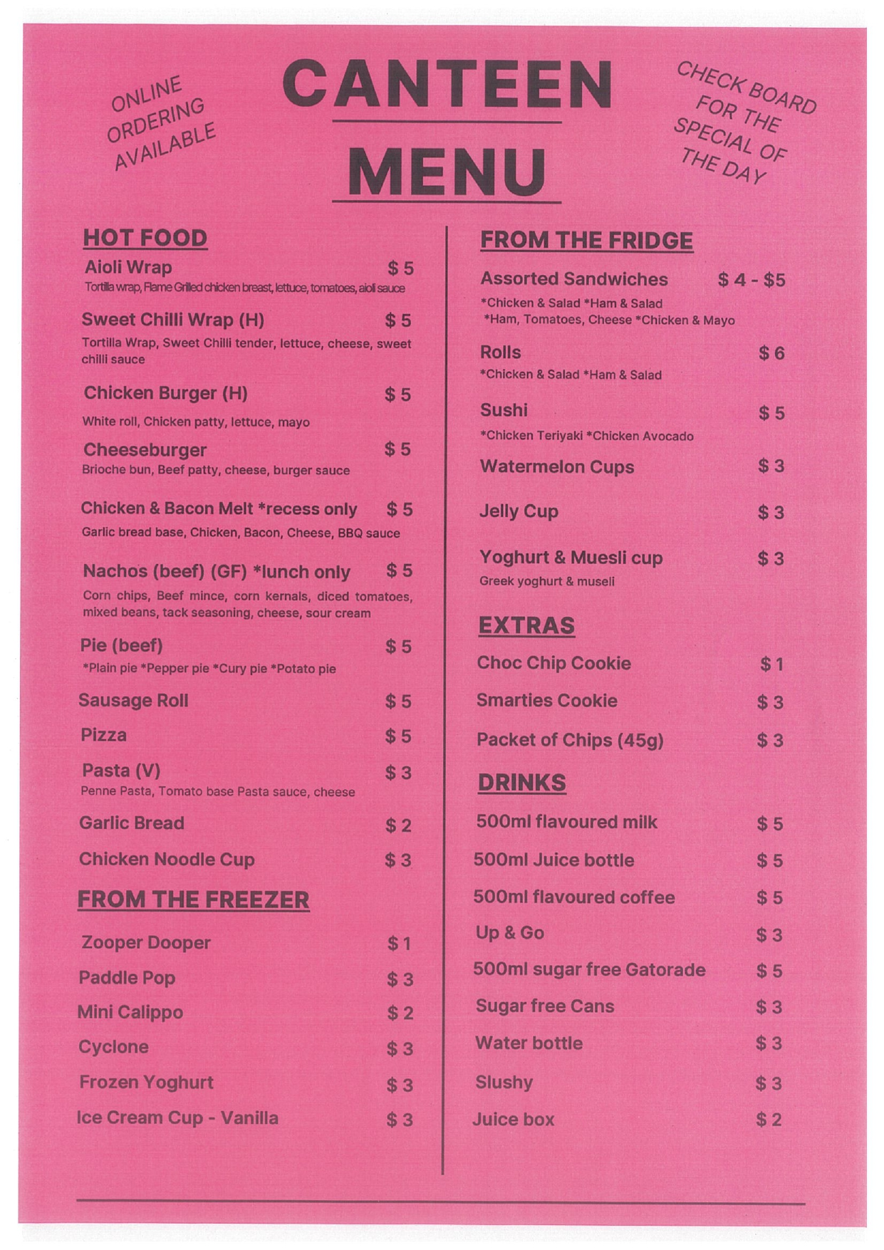
4.1 GROUPING AND INFORMATION ARCHITECTURE
Grouping and information architecture
THREE IDEAS TO PUT ON THE BOARD
Structure content before decorating it.
Labels should match audience language.
The supplied WWHS canteen menu is used only as an information-design example; its products and prices may be historical.
The source menu provides layout evidence, not current commercial facts.
Notice: How do headings, columns and aligned prices help you find and compare information?
ASK THE ROOM
What is information architecture?
YEAR 7 MULTIMEDIA • MODULE 04 • MENU INFORMATION DESIGN
03
Notes:
Teacher talk: Organise menu content into labelled groups that support quick, accurate scanning.
Explain: Information architecture is the planned grouping, naming and order of content. Before styling a menu, list the information users need and sort related items into categories. Category labels should use words the intended audience can understand. A menu is not clearer simply because every item has a box; clear headings, consistent order and useful spacing can make relationships visible with less clutter.
Clarify: The supplied WWHS canteen menu is authorised for analysing visible grouping, headings, price alignment and scanning. It is not current authority for prices or product availability. Students should view the complete image, describe what is observable and separate those observations from judgements. “Items are grouped under headings” is observable; “this is the best possible menu” is an unsupported judgement until criteria and users are considered.
Worked example: A draft list mixes meals, drinks, sides and promotional items. The designer writes each entry on a card, groups cards by the way users are likely to search, tests category names with another person and then orders groups from common choices to supporting items. One product could fit two groups, so it is placed once under the label users find fastest. This avoids duplicates and turns content structure into a reasoned decision.
Ask: What is information architecture?
Listen for: A plan for grouping, naming and ordering content. Correct. It helps users find information.
Misconception to correct: More boxes automatically make a menu easier to scan. → Grouping, labels, alignment and space must create a useful path; extra borders can add clutter.
Transition: Connect this idea to Readability and scanning.
[Sources]
- Theory and check: data/course-content.js, m04-s01 and m04-s01-q01.
- Image-first teaching visual: assets/source/drive-canteen-menu-wwhs.jpg. Authorised Drive source `Canteen Menu WWHS.jpg`, ID 13ive02RO-0Ejmm1AEXgo69uUk8wGJ822; original bytes preserved.

Slide 4
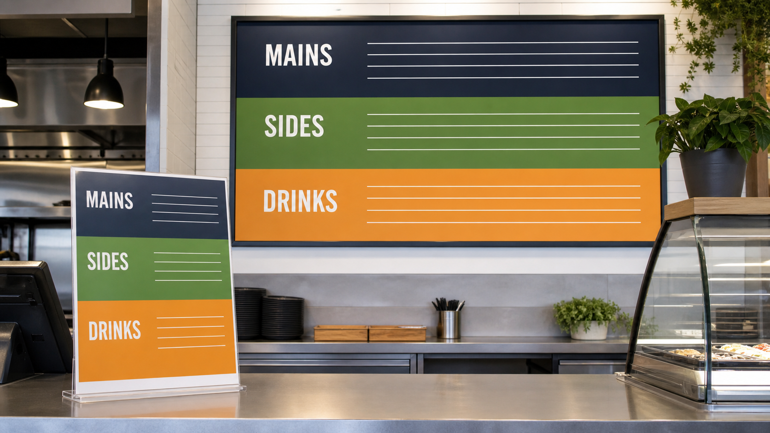
4.2 READABILITY AND SCANNING
Readability and scanning
THREE IDEAS TO PUT ON THE BOARD
Scanning needs visual landmarks.
Comparable information benefits from stable alignment.
A fictional wall menu and matching counter card repeat the same three category bands without presenting current products or prices.
Readability is tested at the intended output size.
Notice: Where does your eye begin, and how do the aligned rows help it move through each group?
ASK THE ROOM
What is a visual landmark in a menu?
YEAR 7 MULTIMEDIA • MODULE 04 • MENU INFORMATION DESIGN
04
Notes:
Teacher talk: Use hierarchy, alignment and spacing to help users scan a menu without losing important detail.
Explain: People often scan a menu for headings, familiar item names and aligned details before reading a description. The layout should provide landmarks: repeated heading styles, predictable item order and consistent alignment. Price or other comparable information is easier to inspect when its position is stable. A clear scan path does not remove useful detail; it helps users decide where closer reading is needed.
Clarify: Type size, line spacing, contrast and line length affect reading. Long centred descriptions can be harder to follow than short, aligned blocks. Decorative backgrounds may make a menu feel on-brand but should not reduce text contrast. Test the design at its intended print or screen size, not only while zoomed in. Ask a user to find a named item and explain where their attention went.
Worked example: A reviewer is asked to find a drink, a main item and a price without being coached. They find the headings but repeatedly lose the matching price because dotted lines are irregular. The designer moves all prices to one aligned column and increases space between categories. A second test is faster and produces fewer errors. The improvement is supported by observable finding behaviour rather than appearance alone.
Ask: What is a visual landmark in a menu?
Listen for: A consistent heading or alignment cue. Correct. It supports predictable scanning.
Misconception to correct: If all information fits on one page, the menu is readable. → Fit does not prove that users can perceive, scan and match the information accurately.
Transition: Connect this idea to Honest product information.
[Sources]
- Theory and check: data/course-content.js, m04-s02 and m04-s02-q01.
- Image-first teaching visual: assets/visuals/generated-menu-scan-context.png. AI-generated with the built-in image tool on 24 August 2026; no source or student image used.

Slide 5

4.3 HONEST PRODUCT INFORMATION
Honest product information
THREE IDEAS TO PUT ON THE BOARD
Visual clarity and factual accuracy work together.
Images can imply claims as strongly as words.
A menu information check separates verified product details from uncertain or unsupported claims.
Unverified current details and benefits must be checked or withheld.
Notice: Which information can be used now, and which detail must be confirmed or withheld?
ASK THE ROOM
Which menu statement most clearly needs evidence?
YEAR 7 MULTIMEDIA • MODULE 04 • MENU INFORMATION DESIGN
05
Notes:
Teacher talk: Present product information and claims clearly without inventing current prices, availability or benefits.
Explain: A clear menu can still mislead if its words, prices or images do not match the actual offer. Product names and short descriptions should distinguish items without making unsupported health, environmental or quality claims. Draft prices or availability must be checked against the current authorised source before publication. The supplied canteen image helps with layout analysis only and must not be copied as a current list.
Clarify: A large image can imply size, ingredients or presentation even without written promises. Cropping and mock-ups should not hide important differences between the designed concept and what is actually offered. If a graphic is an illustration, concept or context test, label it honestly. Essential information should be prominent enough to find, not buried in low contrast or tiny type.
Worked example: A menu draft says “the planet’s greenest fries” because the palette is green. No evidence supports the statement. The student removes the claim and replaces it with a factual description of the proposed product, then records the environmental idea as a question for later investigation. The menu becomes less dramatic but more trustworthy. Strong promotion can still be vivid without pretending an unverified benefit is a fact.
Ask: Which menu statement most clearly needs evidence?
Listen for: The planet’s greenest fries. Correct. This broad environmental comparison needs strong evidence.
Misconception to correct: Promotional language does not need evidence because it is creative. → Creative wording can persuade, but factual or implied claims still need honest support.
Transition: Connect this idea to the retrieval check.
[Sources]
- Theory and check: data/course-content.js, m04-s03 and m04-s03-q01.
- Image-first teaching visual: assets/visuals/generated-m04-honest-product-information-check-v2.png. AI-generated with the built-in OpenAI image creator on 24 August 2026; no source or student image used.

Slide 6
CHECK FOR UNDERSTANDING
Stop. Think. Explain.
Answer silently first, then justify with a partner.
1
What is information architecture?
2
What is a visual landmark in a menu?
3
Which menu statement most clearly needs evidence?
YEAR 7 MULTIMEDIA • MODULE 04 • MENU INFORMATION DESIGN
06
Notes:
Teacher routine: 60 seconds silent retrieval, pair justification, then whole-class feedback.
Question 1: A plan for grouping, naming and ordering content. Feedback: Correct. It helps users find information.
Question 2: A consistent heading or alignment cue. Feedback: Correct. It supports predictable scanning.
Question 3: The planet’s greenest fries. Feedback: Correct. This broad environmental comparison needs strong evidence.
Do not score this as a formal assessment. Use responses to decide whether to reteach or continue.
Transition: Model how the same knowledge becomes a longer written explanation.
[Sources]
- Formative checks: data/course-content.js, m04-s01-q01, m04-s02-q01, m04-s03-q01.

Slide 7
FORMATIVE LEARNING EVIDENCE
Read → Select → Explain → Check
THE QUESTION
WHAT THIS IS ASKING
Explain a menu structure, a five-second finding test and one honesty check. Keep observations separate from current price or availability claims.
Group before styling
Test the scan path
Verify or withhold claims
1 SELECT
2 EXPLAIN
3 CHECK
Choose precise theory and examples that answer the question.
Link ideas with because, so or therefore.
Answer every part; keep claims specific and source-safe.
Sentence starter: Users can find… because… The source shows… but it does not confirm…
YEAR 7 MULTIMEDIA • MODULE 04 • MENU INFORMATION DESIGN
07
Notes:
Teacher talk: Read the prompt once, then unpack it using Select, Explain and Check.
Model one sentence aloud using the supplied starter.
Prompt: Which section provides the strongest evidence for each part of the question?
Remind students: this is formative learning evidence. A local save is not a submission.
Transition: Finish with a three-part exit ticket and save the response in the matching module.
[Sources]
- Section capstones: data/course-content.js, m04-s01-capstone, m04-s02-capstone, m04-s03-capstone.
- Integrated prompt: Stage 07 synthesis of the three source-grounded section capstones.
- Evidence boundary: data/course-content.js evidenceLabel, saveNotice and moduleEvidenceKey.

Slide 8
Before you pack up…
1. One idea I can now explain is…
SAVE
YOUR
EVIDENCE
2. One design decision or practical action this changes is…
3. One question I still need answered is…
Save in the matching course module. Local save is not submission.
YEAR 7 MULTIMEDIA • MODULE 04 • MENU INFORMATION DESIGN
08
Notes:
Teacher routine: Ask students to answer all three prompts in the matching module response box.
Invite one voluntary share for the first prompt.
Use the final question to plan the next explanation or support.
Remind students that browser-local saving preserves a draft on this device; it does not submit work.
[Sources]
- Exit-ticket structure and evidence boundary: data/course-content.js saveNotice, savedMessage and evidenceDestination.
- Module theory: data/course-content.js, m04-s01, m04-s02, m04-s03.

