Slide 1
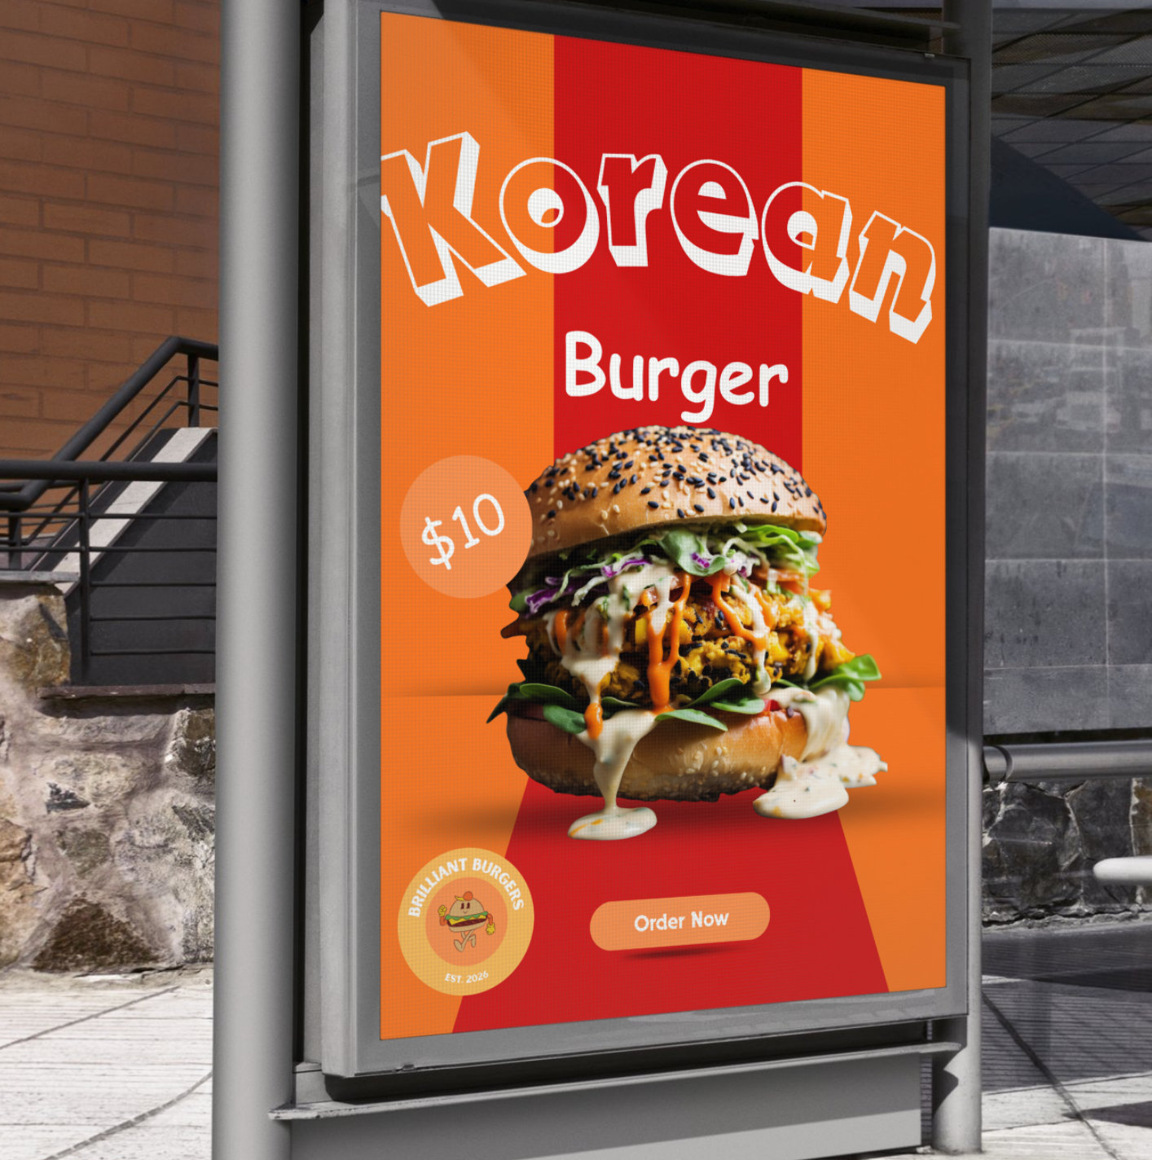
MODULE 05
Promotional poster
Build a focused poster and test it in a realistic context.
TEACHING QUESTION
What single element should begin the poster’s attention path?
YEAR 7 MULTIMEDIA • MODULE 05 • PROMOTIONAL POSTER
01
Notes:
Teacher talk: Introduce the module as one connected learning package, not a list of software clicks.
State the outcome: Build a focused poster and test it in a realistic context.
Prompt: What single element should begin the poster’s attention path?
Listen for a purposeful link to audience, evidence or communication.
Transition: Preview the three named sections on the next slide.
[Sources]
- Course sequence: data/course-map.js, Module 5.
- Theory: data/course-content.js, m05-s01, m05-s02, m05-s03.
- Visual: assets/source/drive-poster-outdoor-mockup.png.

Slide 2
TODAY'S LEARNING PATH
Where are we going?
1
Composition and focal point
RETRIEVAL WARM-UP
What single element should begin the poster’s attention path?
2
Image selection and background removal
Think silently → pair → share one reason.
3
Calls to action and mock-ups
YEAR 7 MULTIMEDIA • MODULE 05 • PROMOTIONAL POSTER
02
Notes:
Teacher talk: Read the three section titles aloud and explain how each one prepares the next.
Warm-up: What single element should begin the poster’s attention path?
Give silent thinking time before pair discussion.
Listen for: a reason, not only a preference.
Transition: Start with Composition and focal point.
[Sources]
- Theory sequence: data/course-content.js, m05-s01, m05-s02, m05-s03.
- Module summary: data/course-map.js, Module 5.

Slide 3

5.1 COMPOSITION AND FOCAL POINT
Composition and focal point
THREE IDEAS TO PUT ON THE BOARD
Composition arranges elements for a purpose.
A focal point starts a planned attention path.
The supplied Korean Burger poster combines brand name, product image, price, logo and an Order Now call to action.
Visual weight and spacing should be tested at realistic sizes.
Notice: Trace the first three things your eye notices. Which size, position or contrast choice creates that order?
ASK THE ROOM
What is a focal point?
YEAR 7 MULTIMEDIA • MODULE 05 • PROMOTIONAL POSTER
03
Notes:
Teacher talk: Compose a poster so one focal point begins a clear path through the message.
Explain: Composition is the deliberate arrangement of image, type, shape and space. A poster is usually seen quickly, so it needs an entry point. The focal point is the element intended to attract attention first; hierarchy then guides the viewer to the next information and action. A large element is not automatically useful if it distracts from the poster’s purpose.
Clarify: Visual weight comes from size, contrast, colour, detail and position. Symmetrical layouts can feel stable, while asymmetrical layouts can create energy, but neither is automatically better. Alignment and space keep relationships understandable. Test the poster from a distance and at thumbnail size. Squinting or viewing in greyscale can reveal whether several elements compete for first attention.
Worked example: The source poster can be examined as a complete composition. A student plans the path “product image → offer → brand and action”. The product image receives the strongest scale contrast, the offer sits nearby, and the logo has a clear but supporting position. A decorative burst competes with the offer, so it is reduced. The revision improves the intended path without copying the source poster’s brand content.
Ask: What is a focal point?
Listen for: The planned first point of attention. Correct. It begins the visual path.
Misconception to correct: The largest element is automatically the best focal point. → The focal point must serve the message and lead into a useful reading path.
Transition: Connect this idea to Image selection and background removal.
[Sources]
- Theory and check: data/course-content.js, m05-s01 and m05-s01-q01.
- Image-first teaching visual: assets/source/drive-poster-original.png. Authorised Drive source `1.png`, ID 15TN4IA_A8hVyi8y6pJm1FQLt8sgVC6lF; original bytes preserved.

Slide 4
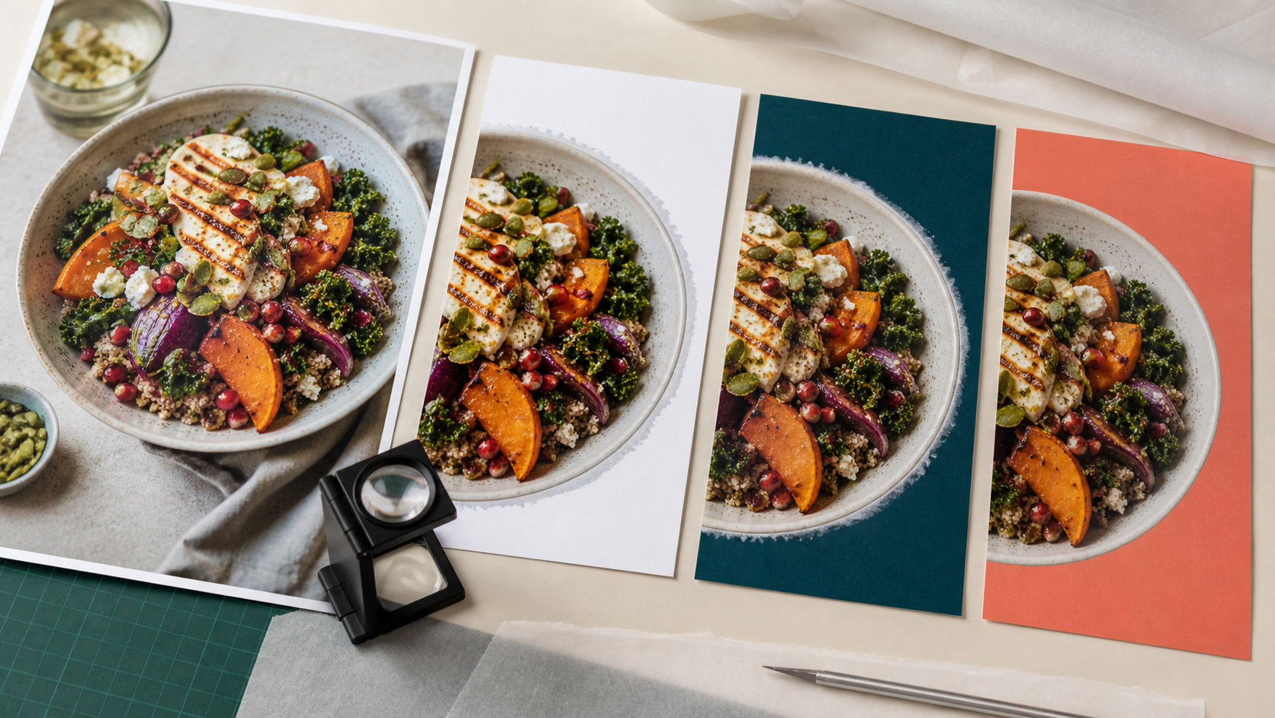
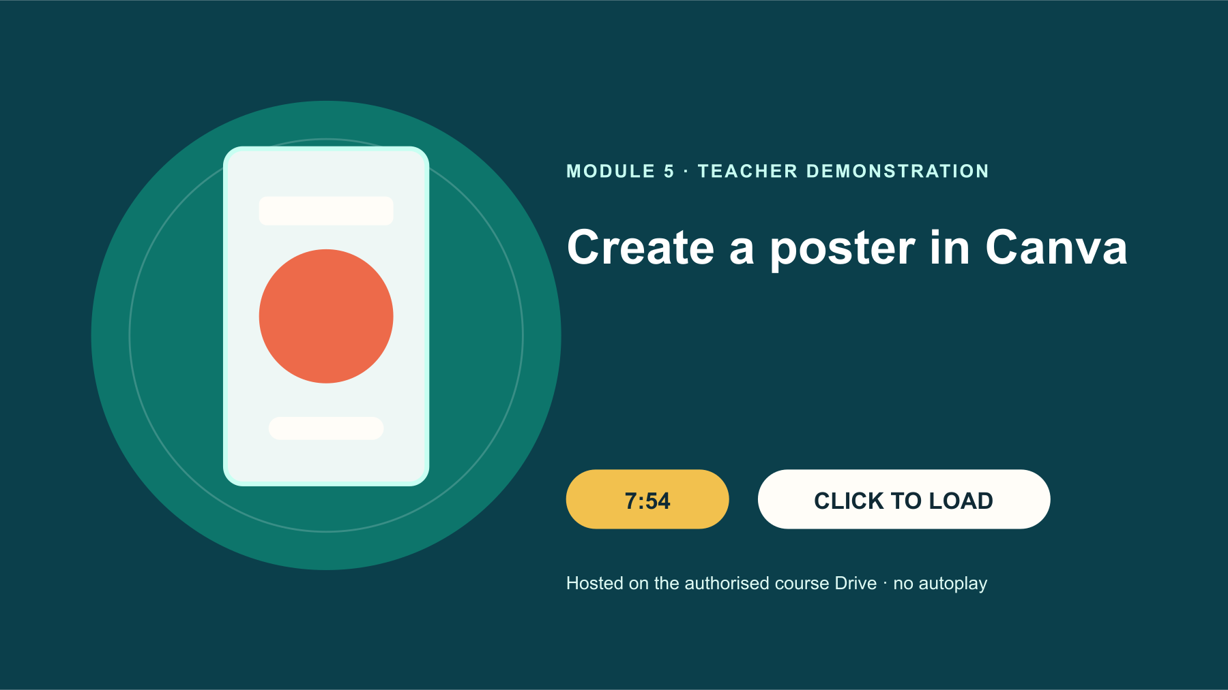
5.2 IMAGE SELECTION AND BACKGROUND REMOVAL
Image selection and background removal
THREE IDEAS TO PUT ON THE BOARD
Image relevance, rights, privacy and truthfulness all matter.
Background removal requires edge checks on varied backgrounds.
Background removal succeeds only when the subject edge still looks believable in its new context.
Preserve the original and use a separate working copy.
Notice: Inspect fine edges, shadows and colour spill before accepting the cut-out.
TEACHER: CTRL+CLICK POSTER TO OPEN DRIVE • 7:54
WATCH FOR: Which step establishes the focal point, and where should the image edge be inspected before export?
ASK THE ROOM
Which check belongs before using an image?
YEAR 7 MULTIMEDIA • MODULE 05 • PROMOTIONAL POSTER
04
Notes:
Teacher talk: Select, prepare and place images that are relevant, honest, privacy-safe and visually clean.
Explain: An image should support the poster’s message and audience, not merely fill space. Check subject relevance, viewpoint, lighting, resolution, permission and whether the scene communicates an honest scale and condition. Use original or authorised material and record attribution where required. Avoid personal details, identifying student imagery and signed-in dashboard captures in public-facing graphics.
Clarify: Removing a background isolates a subject so it can sit within a new composition. The edge needs close inspection around hair, packaging, shadows and transparent areas. A jagged halo or missing piece weakens credibility. Background removal should not distort the subject or imply a false product condition. Sometimes retaining a real background is the more honest and useful choice.
Worked example: A product photograph has a busy bench behind it. The student duplicates the original, removes the background from the working copy and checks the edge on both light and dark test colours. A grey halo appears, so the mask is refined. They keep the original photograph in the process record and compare both versions. The cut-out supports the poster hierarchy, while the original preserves the actual context.
Ask: Which check belongs before using an image?
Listen for: Confirm its purpose, source permission and privacy safety. Correct. Suitability includes more than visual appeal.
Misconception to correct: Removing a background always improves a poster. → It helps only when isolation serves the message and the result remains clean and honest.
Transition: Connect this idea to Calls to action and mock-ups.
[Sources]
- Theory and check: data/course-content.js, m05-s02 and m05-s02-q01.
- Image-first teaching visual: assets/visuals/generated-m05-background-removal-edge-test-v2.png. AI-generated with the built-in OpenAI image creator on 24 August 2026; no source or student image used.
- Google Drive source: Create a poster in Canva.mp4, Drive ID 1xN8xO5IlId6A7KnY-YQQjXK3_qygi-f3, 7:54.

Slide 5
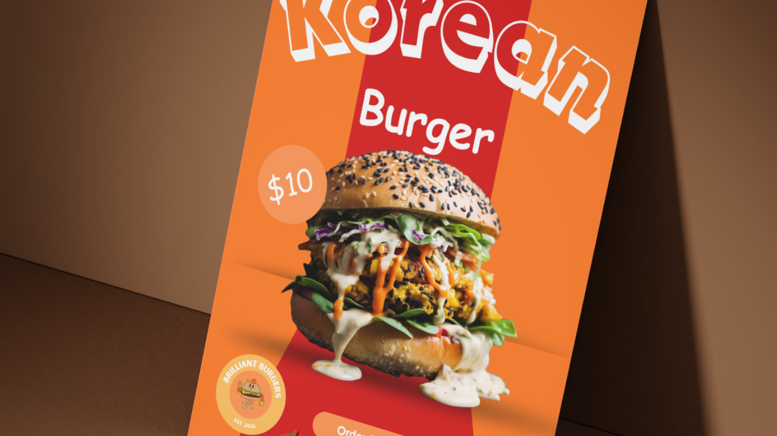
5.3 CALLS TO ACTION AND MOCK-UPS
Calls to action and mock-ups
THREE IDEAS TO PUT ON THE BOARD
An action must be specific, visible and genuinely available.
Mock-ups test context rather than prove real installation.
The supplied tabletop mock-up tests the same poster under perspective, distance and warm lighting.
Keep the complete flat artwork alongside context views.
Notice: Compared with the flat poster, which small details are now harder to read?
ASK THE ROOM
What is the purpose of a call to action?
YEAR 7 MULTIMEDIA • MODULE 05 • PROMOTIONAL POSTER
05
Notes:
Teacher talk: Write a clear action and use mock-ups to test how a design behaves in context.
Explain: A call to action tells the audience what to do next, such as view the menu, explore products or visit the portfolio. It should be brief, specific and visible without overpowering the main message. The action must match what is actually available. “Order now” would be misleading if no ordering system exists. The brief and publishing context should control the wording.
Clarify: A mock-up places artwork into a simulated location such as a poster frame, outdoor sign or street display. It can reveal scale, contrast, crop and viewing-distance problems. It is not proof that the design was manufactured, purchased or displayed publicly. Label mock-ups as context views and preserve the original flat artwork so viewers can judge the design itself.
Worked example: The Drive set contains one full poster and three context mock-ups. A student compares all four: the flat poster shows complete detail, one outdoor view reveals that the action is too small, and a street view shows background colours competing with the logo. They enlarge the action slightly and use a controlled logo variant. The mock-ups diagnose context problems; they are not copied as evidence of the student’s own public campaign.
Ask: What is the purpose of a call to action?
Listen for: Tell the audience what useful action to take next. Correct. It converts attention into a clear next step.
Misconception to correct: A realistic mock-up proves the design existed in that location. → It is a simulation unless real installation evidence is separately verified.
Transition: Connect this idea to the retrieval check.
[Sources]
- Theory and check: data/course-content.js, m05-s03 and m05-s03-q01.
- Image-first teaching visual: assets/source/drive-poster-table-mockup.png. Authorised Drive source `2.png`, ID 1HcPYwQWU8hwUQIvwTrbelmv1Oht34-bQ; original bytes preserved.

Slide 6
CHECK FOR UNDERSTANDING
Stop. Think. Explain.
Answer silently first, then justify with a partner.
1
What is a focal point?
2
Which check belongs before using an image?
3
What is the purpose of a call to action?
YEAR 7 MULTIMEDIA • MODULE 05 • PROMOTIONAL POSTER
06
Notes:
Teacher routine: 60 seconds silent retrieval, pair justification, then whole-class feedback.
Question 1: The planned first point of attention. Feedback: Correct. It begins the visual path.
Question 2: Confirm its purpose, source permission and privacy safety. Feedback: Correct. Suitability includes more than visual appeal.
Question 3: Tell the audience what useful action to take next. Feedback: Correct. It converts attention into a clear next step.
Do not score this as a formal assessment. Use responses to decide whether to reteach or continue.
Transition: Model how the same knowledge becomes a longer written explanation.
[Sources]
- Formative checks: data/course-content.js, m05-s01-q01, m05-s02-q01, m05-s03-q01.

Slide 7
FORMATIVE LEARNING EVIDENCE
Read → Select → Explain → Check
THE QUESTION
WHAT THIS IS ASKING
Plan a three-step poster path, justify one image-use decision and evaluate a truthful call to action in two mock-up contexts.
Control the focal point
Check source, privacy and edges
Treat mock-ups as tests
1 SELECT
2 EXPLAIN
3 CHECK
Choose precise theory and examples that answer the question.
Link ideas with because, so or therefore.
Answer every part; keep claims specific and source-safe.
Sentence starter: The focal point is… The image is suitable because… In the mock-up I noticed…
YEAR 7 MULTIMEDIA • MODULE 05 • PROMOTIONAL POSTER
07
Notes:
Teacher talk: Read the prompt once, then unpack it using Select, Explain and Check.
Model one sentence aloud using the supplied starter.
Prompt: Which section provides the strongest evidence for each part of the question?
Remind students: this is formative learning evidence. A local save is not a submission.
Transition: Finish with a three-part exit ticket and save the response in the matching module.
[Sources]
- Section capstones: data/course-content.js, m05-s01-capstone, m05-s02-capstone, m05-s03-capstone.
- Integrated prompt: Stage 07 synthesis of the three source-grounded section capstones.
- Evidence boundary: data/course-content.js evidenceLabel, saveNotice and moduleEvidenceKey.

Slide 8
Before you pack up…
1. One idea I can now explain is…
SAVE
YOUR
EVIDENCE
2. One design decision or practical action this changes is…
3. One question I still need answered is…
Save in the matching course module. Local save is not submission.
YEAR 7 MULTIMEDIA • MODULE 05 • PROMOTIONAL POSTER
08
Notes:
Teacher routine: Ask students to answer all three prompts in the matching module response box.
Invite one voluntary share for the first prompt.
Use the final question to plan the next explanation or support.
Remind students that browser-local saving preserves a draft on this device; it does not submit work.
[Sources]
- Exit-ticket structure and evidence boundary: data/course-content.js saveNotice, savedMessage and evidenceDestination.
- Module theory: data/course-content.js, m05-s01, m05-s02, m05-s03.

