Slide 1
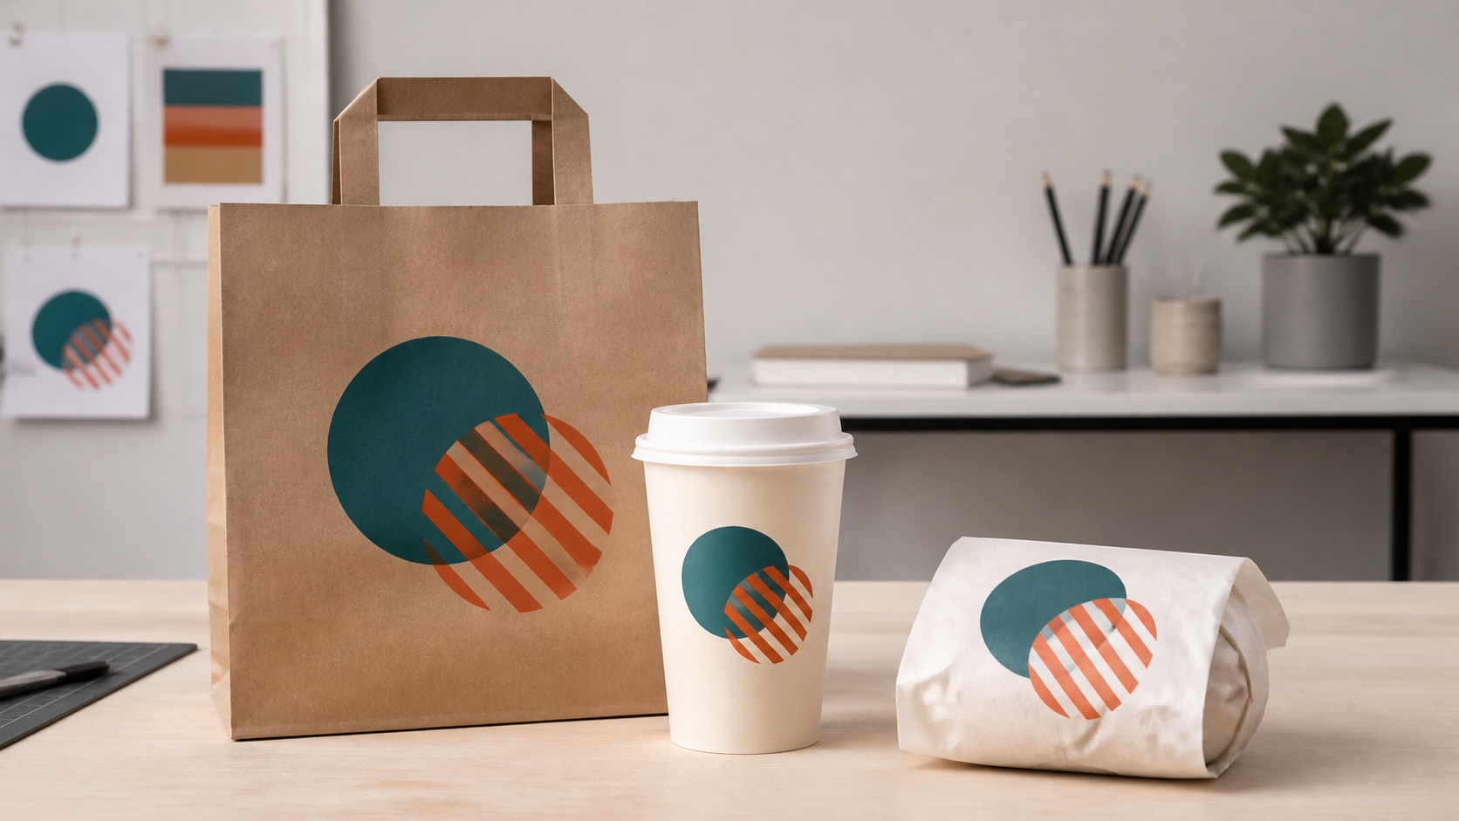
MODULE 06
Brand applications
Apply a consistent identity to a staff uniform.
TEACHING QUESTION
Which features should stay stable across a poster, cup and uniform?
YEAR 7 MULTIMEDIA • MODULE 06 • BRAND APPLICATIONS
01
Notes:
Teacher talk: Introduce the module as one connected learning package, not a list of software clicks.
State the outcome: Apply a consistent identity to a staff uniform.
Prompt: Which features should stay stable across a poster, cup and uniform?
Listen for a purposeful link to audience, evidence or communication.
Transition: Preview the three named sections on the next slide.
[Sources]
- Course sequence: data/course-map.js, Module 6.
- Theory: data/course-content.js, m06-s01, m06-s02, m06-s03.
- Visual: assets/visuals/generated-brand-touchpoints.png.

Slide 2
TODAY'S LEARNING PATH
Where are we going?
1
Consistent identity
RETRIEVAL WARM-UP
Which features should stay stable across a poster, cup and uniform?
2
Designing a staff uniform
Think silently → pair → share one reason.
3
Checking suitability and accessibility
YEAR 7 MULTIMEDIA • MODULE 06 • BRAND APPLICATIONS
02
Notes:
Teacher talk: Read the three section titles aloud and explain how each one prepares the next.
Warm-up: Which features should stay stable across a poster, cup and uniform?
Give silent thinking time before pair discussion.
Listen for: a reason, not only a preference.
Transition: Start with Consistent identity.
[Sources]
- Theory sequence: data/course-content.js, m06-s01, m06-s02, m06-s03.
- Module summary: data/course-map.js, Module 6.

Slide 3
6.1 CONSISTENT IDENTITY
Consistent identity
THREE IDEAS TO PUT ON THE BOARD
Consistency repeats meaningful relationships.
Different applications can use controlled variants.
Three unbranded takeaway touchpoints carry the same geometric motif, showing controlled identity across different forms.
A style guide makes stable and flexible rules explicit.
Notice: Which features repeat exactly, and which placement decisions adapt to each object?
ASK THE ROOM
What creates brand consistency?
YEAR 7 MULTIMEDIA • MODULE 06 • BRAND APPLICATIONS
03
Notes:
Teacher talk: Build a flexible visual system that stays recognisable across different brand applications.
Explain: A consistent identity repeats meaningful relationships: logo treatment, palette roles, type hierarchy, image style and tone. Consistency does not require every output to have the same layout. A menu and a uniform solve different problems, but the audience should still recognise the same brand. A short style guide records the stable rules and the variations allowed for different contexts.
Clarify: Rigid repetition can make a design unsuitable. A vertical poster logo may need a compact uniform version; a detailed image style may be inappropriate for a small embroidered area. Adaptation is controlled when the reason is visible and the core identity remains. Test applications side by side to find accidental changes in colour, spacing, type or tone.
Worked example: A student creates a table with logo version, colour role, type role and image treatment for the menu, poster, motion ad, uniform and site. The uniform uses a compact one-colour mark because the full slogan is unreadable. The site keeps the full palette and primary logo. The matrix shows why the difference is controlled. An accidental purple heading on one page is corrected because it has no defined system role.
Ask: What creates brand consistency?
Listen for: Stable logo, palette, type and tone relationships. Correct. These make the system recognisable.
Misconception to correct: Consistency means using the exact same layout everywhere. → The core system remains recognisable while layouts adapt to context.
Transition: Connect this idea to Designing a staff uniform.
[Sources]
- Theory and check: data/course-content.js, m06-s01 and m06-s01-q01.
- Image-first teaching visual: assets/visuals/generated-brand-touchpoints.png. AI-generated with the built-in image tool on 24 August 2026; no brand or source image used.

Slide 4
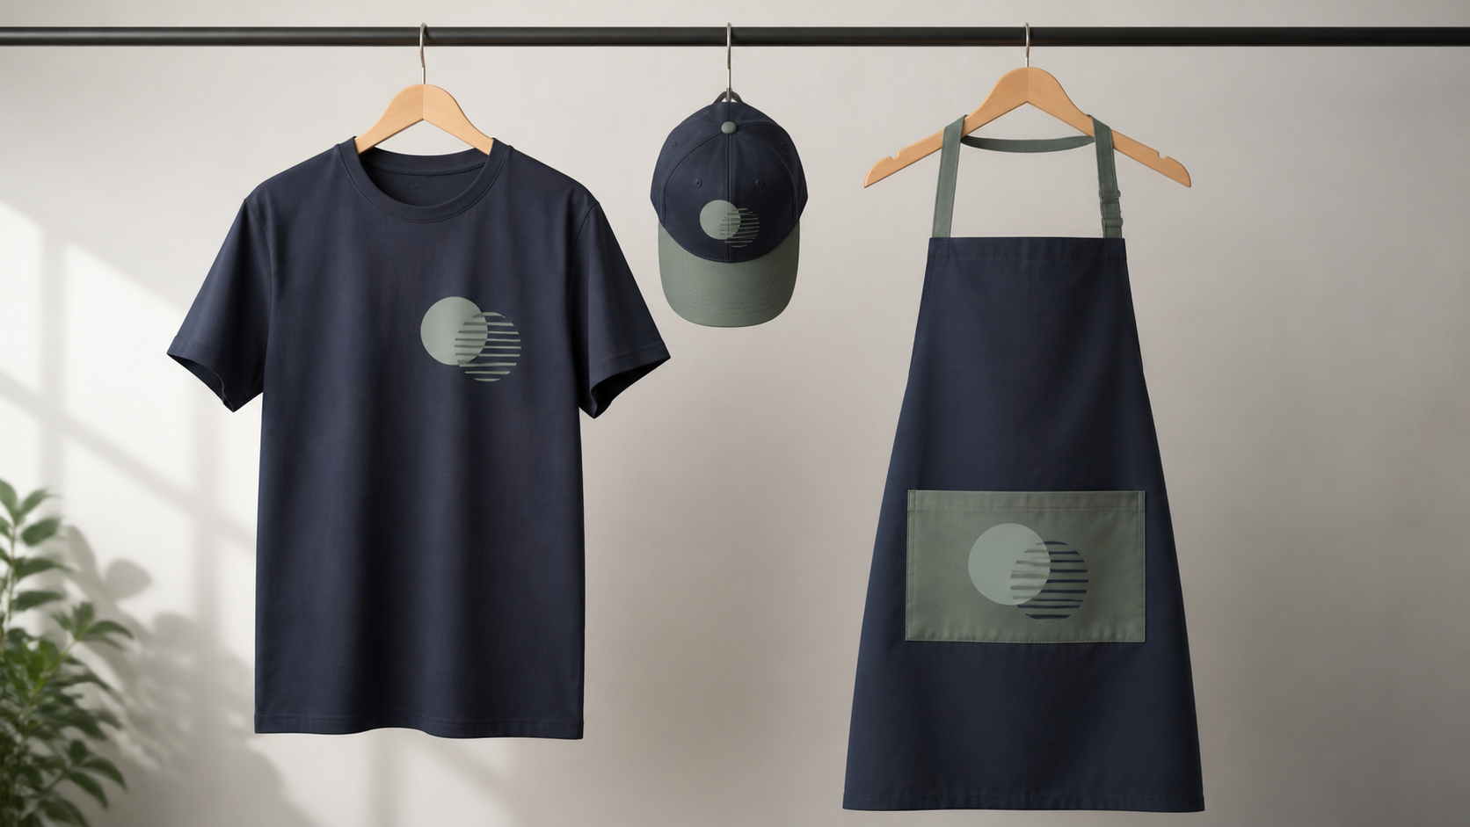
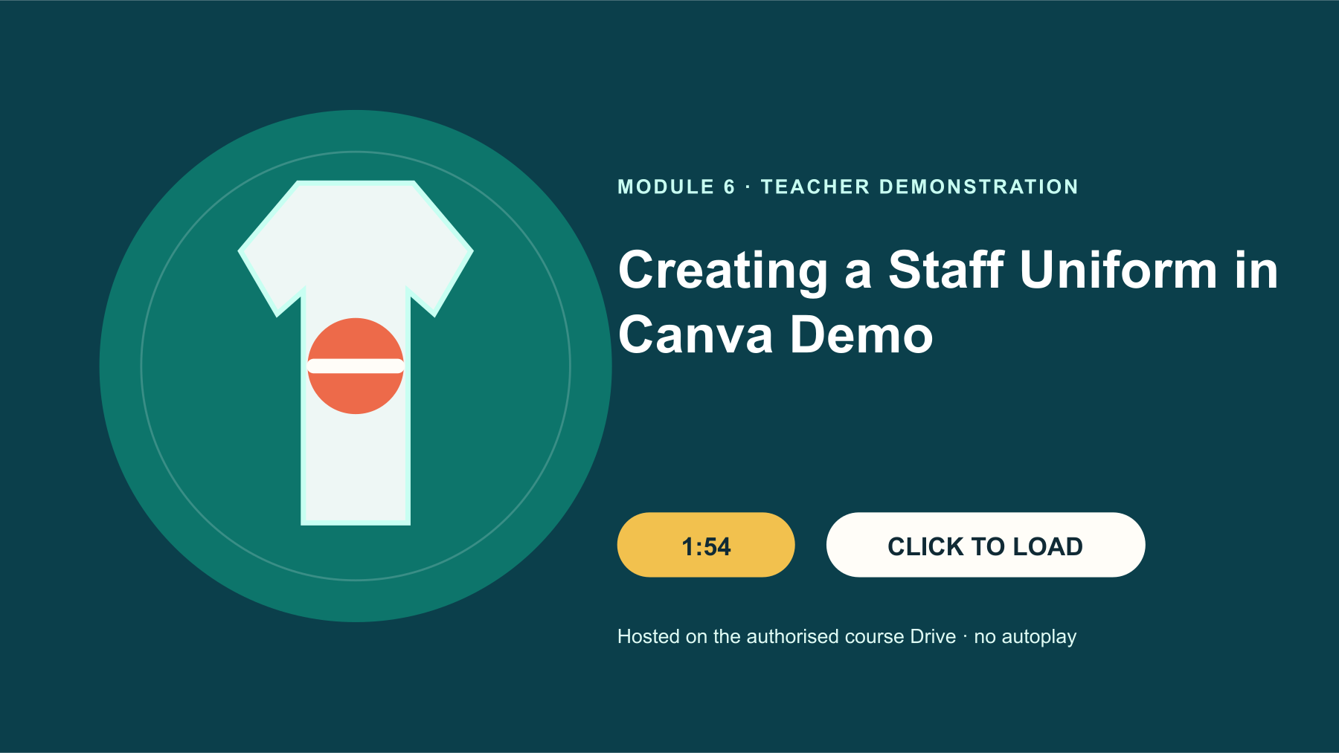
6.2 DESIGNING A STAFF UNIFORM
Designing a staff uniform
THREE IDEAS TO PUT ON THE BOARD
The uniform is a brand-application concept, not proof of manufacture.
Placement and scale change recognition.
A T-shirt, cap and apron repeat one restrained motif while adapting its scale and placement to each garment.
Unverified garment and production facts stay out.
Notice: Which placement remains visible without interfering with the garment’s practical use?
TEACHER: CTRL+CLICK POSTER TO OPEN DRIVE • 1:54
WATCH FOR: Where is the identity placed, and what would you check for visibility, contrast and practical suitability?
ASK THE ROOM
What does the source confirm about the uniform task?
YEAR 7 MULTIMEDIA • MODULE 06 • BRAND APPLICATIONS
04
Notes:
Teacher talk: Apply the brand identity to a staff-uniform concept while considering placement, scale and role.
Explain: A staff-uniform concept can identify the business and connect staff with the visual identity. The source verifies a Canva demonstration of applying the identity to a uniform concept, but it does not confirm a required garment, supplier, material, production method or school licence. Treat the output as a design concept unless the teacher supplies further production facts.
Clarify: A mark placed on a moving person is viewed from varied distances and angles. Test front, back or other proposed positions for visibility without assuming that every position is required. Large graphics may dominate or fold across garment shapes; tiny marks may disappear. Use a suitable logo variant, preserve clear area and check contrast against the garment colour.
Worked example: A student tests the full logo across the front and a compact mark in a smaller upper-area position. The full version distorts over the mock-up shape and its slogan becomes hard to read. The compact version stays clear but needs stronger colour contrast. The student selects the second direction and records that real manufacture, material performance and exact placement remain outside this digital concept evidence.
Ask: What does the source confirm about the uniform task?
Listen for: A digital brand application to a staff-uniform concept. Correct. That is the supported scope.
Misconception to correct: A realistic uniform mock-up proves the garment can be manufactured exactly as shown. → It tests visual application only unless production details are separately verified.
Transition: Connect this idea to Checking suitability and accessibility.
[Sources]
- Theory and check: data/course-content.js, m06-s02 and m06-s02-q01.
- Image-first teaching visual: assets/visuals/generated-uniform-system.png. AI-generated with the built-in image tool on 24 August 2026; no student, crest or source image used.
- Google Drive source: Creating a Staff Uniform in Canva Demo.mp4, Drive ID 1hIuwMunPHaPjdVAjPsKlIWJEm9vYMkxl, 1:54.

Slide 5

6.3 CHECKING SUITABILITY AND ACCESSIBILITY
Checking suitability and accessibility
THREE IDEAS TO PUT ON THE BOARD
Suitability joins audience, purpose and context.
Accessibility includes contrast, text, shape and non-colour cues.
Suitability checks compare the same brand application at real size, in contrast and without colour alone.
Small tests provide evidence but do not prove universal success.
Notice: Can the identity still be recognised when size, contrast or colour perception changes?
ASK THE ROOM
What makes an application suitable?
YEAR 7 MULTIMEDIA • MODULE 06 • BRAND APPLICATIONS
05
Notes:
Teacher talk: Evaluate a brand application for recognition, inclusion, readability and honest representation.
Explain: A visually consistent application can still be unsuitable if it is difficult to recognise, uncomfortable in tone or inaccessible. Review the concept against its audience profile and use context. Consider reading distance, contrast, image meaning, respectful representation and whether essential information survives. Do not assume that one reviewer represents the whole audience.
Clarify: Accessibility checks include contrast, clear shapes, readable text and cues that do not depend on colour alone. On a uniform concept, a simple mark may be more recognisable than small supporting text. Use privacy-safe silhouettes or mock-ups rather than identifiable student photographs. If real-user testing is possible under approved arrangements, ask focused questions and avoid collecting unnecessary personal data.
Worked example: Two reviewers identify the business from the front concept, but neither can read the slogan at the proposed size. One reviewer also confuses two low-contrast palette colours. The designer removes the slogan from the compact version and strengthens contrast while preserving the main palette roles. They report the small test honestly and do not claim universal accessibility from two responses.
Ask: What makes an application suitable?
Listen for: It fits the intended purpose, audience and context. Correct. Suitability is relational.
Misconception to correct: If two people can use a design, it is accessible for everyone. → A small test reveals issues but cannot represent every user or access need.
Transition: Connect this idea to the retrieval check.
[Sources]
- Theory and check: data/course-content.js, m06-s03 and m06-s03-q01.
- Image-first teaching visual: assets/visuals/generated-m06-accessibility-suitability-test-v2.png. AI-generated with the built-in OpenAI image creator on 24 August 2026; no source or student image used.

Slide 6
CHECK FOR UNDERSTANDING
Stop. Think. Explain.
Answer silently first, then justify with a partner.
1
What creates brand consistency?
2
What does the source confirm about the uniform task?
3
What makes an application suitable?
YEAR 7 MULTIMEDIA • MODULE 06 • BRAND APPLICATIONS
06
Notes:
Teacher routine: 60 seconds silent retrieval, pair justification, then whole-class feedback.
Question 1: Stable logo, palette, type and tone relationships. Feedback: Correct. These make the system recognisable.
Question 2: A digital brand application to a staff-uniform concept. Feedback: Correct. That is the supported scope.
Question 3: It fits the intended purpose, audience and context. Feedback: Correct. Suitability is relational.
Do not score this as a formal assessment. Use responses to decide whether to reteach or continue.
Transition: Model how the same knowledge becomes a longer written explanation.
[Sources]
- Formative checks: data/course-content.js, m06-s01-q01, m06-s02-q01, m06-s03-q01.

Slide 7
FORMATIVE LEARNING EVIDENCE
Read → Select → Explain → Check
THE QUESTION
WHAT THIS IS ASKING
Compare two uniform concepts and justify identity, placement, scale, contrast and one accessibility revision without claiming manufacture.
Repeat the recognisable core
Adapt placement to context
Report test limits honestly
1 SELECT
2 EXPLAIN
3 CHECK
Choose precise theory and examples that answer the question.
Link ideas with because, so or therefore.
Answer every part; keep claims specific and source-safe.
Sentence starter: The identity stays recognisable because… I will revise… after testing…
YEAR 7 MULTIMEDIA • MODULE 06 • BRAND APPLICATIONS
07
Notes:
Teacher talk: Read the prompt once, then unpack it using Select, Explain and Check.
Model one sentence aloud using the supplied starter.
Prompt: Which section provides the strongest evidence for each part of the question?
Remind students: this is formative learning evidence. A local save is not a submission.
Transition: Finish with a three-part exit ticket and save the response in the matching module.
[Sources]
- Section capstones: data/course-content.js, m06-s01-capstone, m06-s02-capstone, m06-s03-capstone.
- Integrated prompt: Stage 07 synthesis of the three source-grounded section capstones.
- Evidence boundary: data/course-content.js evidenceLabel, saveNotice and moduleEvidenceKey.

Slide 8
Before you pack up…
1. One idea I can now explain is…
SAVE
YOUR
EVIDENCE
2. One design decision or practical action this changes is…
3. One question I still need answered is…
Save in the matching course module. Local save is not submission.
YEAR 7 MULTIMEDIA • MODULE 06 • BRAND APPLICATIONS
08
Notes:
Teacher routine: Ask students to answer all three prompts in the matching module response box.
Invite one voluntary share for the first prompt.
Use the final question to plan the next explanation or support.
Remind students that browser-local saving preserves a draft on this device; it does not submit work.
[Sources]
- Exit-ticket structure and evidence boundary: data/course-content.js saveNotice, savedMessage and evidenceDestination.
- Module theory: data/course-content.js, m06-s01, m06-s02, m06-s03.

