Slide 1
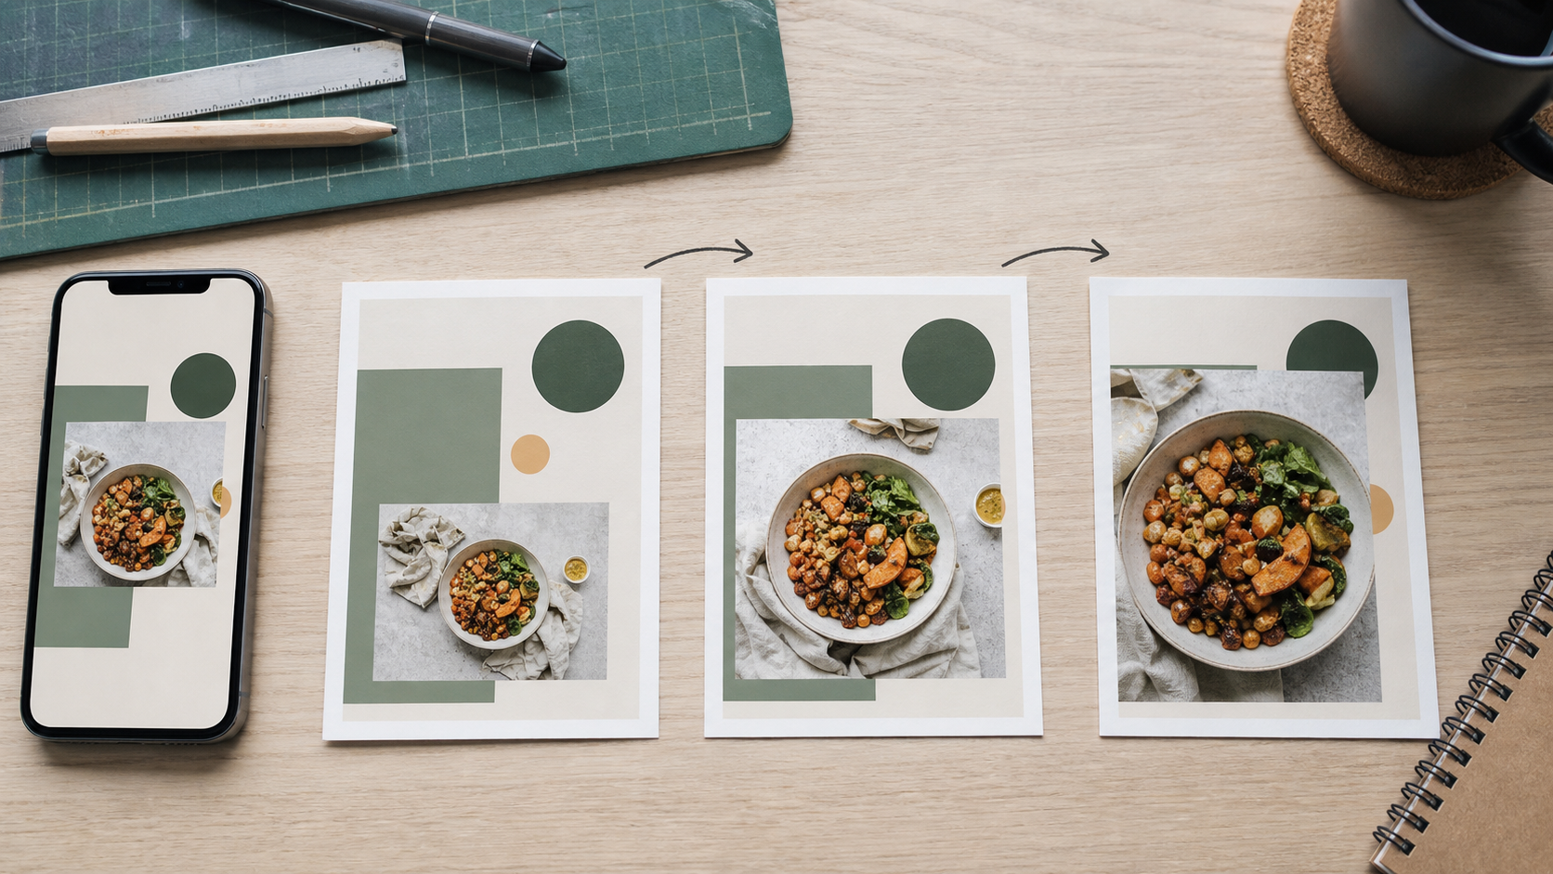
MODULE 07
Motion advertising
Plan, animate and export a Match and Move advertisement.
TEACHING QUESTION
What needs to stay connected when one visual state changes into another?
YEAR 7 MULTIMEDIA • MODULE 07 • MOTION ADVERTISING
01
Notes:
Teacher talk: Introduce the module as one connected learning package, not a list of software clicks.
State the outcome: Plan, animate and export a Match and Move advertisement.
Prompt: What needs to stay connected when one visual state changes into another?
Listen for a purposeful link to audience, evidence or communication.
Transition: Preview the three named sections on the next slide.
[Sources]
- Course sequence: data/course-map.js, Module 7.
- Theory: data/course-content.js, m07-s01, m07-s02, m07-s03.
- Visual: assets/visuals/generated-motion-storyboard-workspace.png.

Slide 2
TODAY'S LEARNING PATH
Where are we going?
1
Frames, states and transitions
RETRIEVAL WARM-UP
What needs to stay connected when one visual state changes into another?
2
Match and Move
Think silently → pair → share one reason.
3
Timing, export and quality checks
YEAR 7 MULTIMEDIA • MODULE 07 • MOTION ADVERTISING
02
Notes:
Teacher talk: Read the three section titles aloud and explain how each one prepares the next.
Warm-up: What needs to stay connected when one visual state changes into another?
Give silent thinking time before pair discussion.
Listen for: a reason, not only a preference.
Transition: Start with Frames, states and transitions.
[Sources]
- Theory sequence: data/course-content.js, m07-s01, m07-s02, m07-s03.
- Module summary: data/course-map.js, Module 7.

Slide 3
7.1 FRAMES, STATES AND TRANSITIONS
Frames, states and transitions
THREE IDEAS TO PUT ON THE BOARD
A state is a planned arrangement at one point in time.
A transition connects states.
Three physical storyboard states keep the same image and motif while changing scale and position in a controlled sequence.
Motion should support hierarchy and recognition.
Notice: Which elements stay constant, and what two properties change from the first state to the last?
ASK THE ROOM
What is a state in an animation?
YEAR 7 MULTIMEDIA • MODULE 07 • MOTION ADVERTISING
03
Notes:
Teacher talk: Plan motion as a purposeful change between visual states rather than movement added for decoration.
Explain: A state is one planned arrangement of elements at a point in an animation. The start and end states show what changes: an image may move, a logo may scale or a message may enter. A transition creates the visible change between states. Clear planning begins with what the audience should notice before, during and after the movement, not with choosing the most dramatic effect.
Clarify: Viewers follow motion more easily when the same element remains recognisable across states. Sudden unrelated changes can break attention or hide the message. Direction, distance, scale and order affect meaning. Keep essential text on screen long enough to perceive and avoid simultaneous movement that competes with the focal message. Motion should strengthen hierarchy rather than reset it every second.
Worked example: State 1 establishes the product image and background. State 2 moves the product to make room for the logo and slogan. State 3 introduces the price element and action while the logo remains stable. Arrows show movement and notes explain the attention goal. The storyboard can be checked before software work, reducing random experimentation and giving the finished MP4 an evidence-based plan. The supplied 16-second Drive clip does not show a finished animation, so it cannot be used as the comparison exemplar.
Ask: What is a state in an animation?
Listen for: An arrangement of elements at one point in time. Correct. States define what is visible before transitions.
Misconception to correct: More moving elements always make an advertisement more engaging. → Competing movement can reduce attention, readability and message recall.
Transition: Connect this idea to Match and Move.
[Sources]
- Theory and check: data/course-content.js, m07-s01 and m07-s01-q01.
- Image-first teaching visual: assets/visuals/generated-motion-storyboard-workspace.png. AI-generated with the built-in image tool on 24 August 2026; no source or student image used.

Slide 4
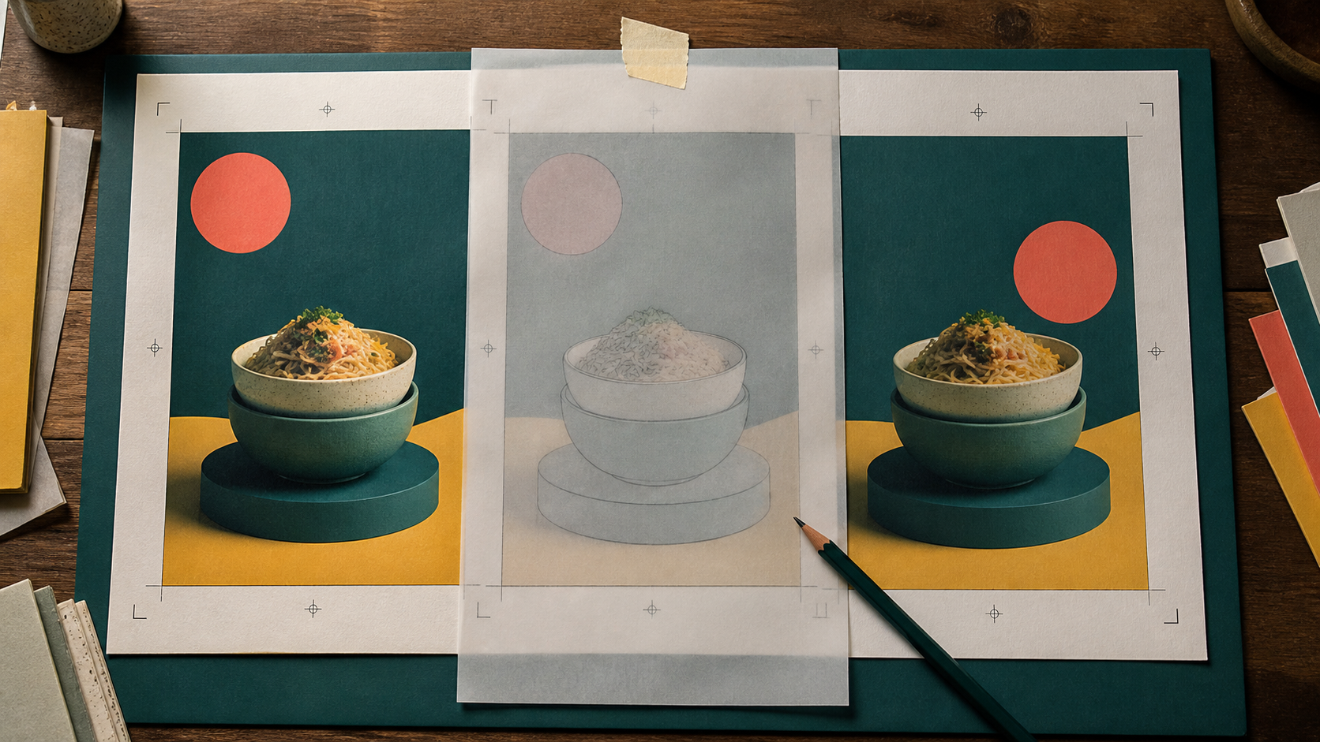
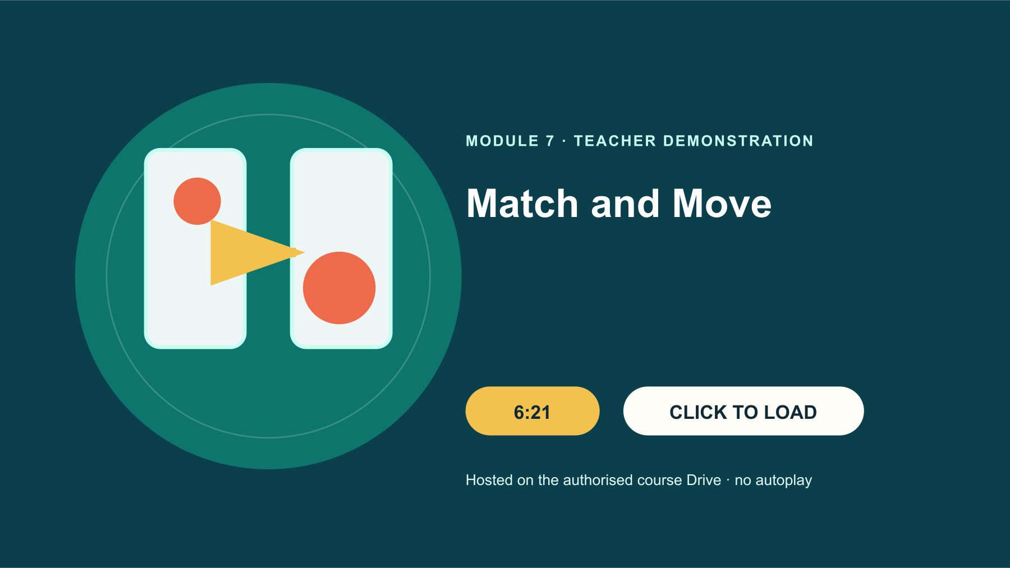
7.2 MATCH AND MOVE
Match and Move
THREE IDEAS TO PUT ON THE BOARD
Use the Drive demonstration as authority for the shown workflow.
Duplicated states preserve element correspondence.
Match and Move works when the viewer can track the same element from one state into the next.
The shown portrait size is not automatically a class requirement.
Notice: Which object, position or colour relationship creates continuity across the frames?
TEACHER: CTRL+CLICK POSTER TO OPEN DRIVE • 6:21
WATCH FOR: Which elements stay consistent between states, and which deliberate change allows Match and Move to create the transition?
ASK THE ROOM
Which action helps preserve element correspondence?
YEAR 7 MULTIMEDIA • MODULE 07 • MOTION ADVERTISING
04
Notes:
Teacher talk: Explain how duplicated states and changed element properties create a connected Match and Move transition.
Explain: The Drive demonstration shows a 1080 × 1920 portrait advertisement with background or gradient, selected imagery, logo, slogan and price element. It duplicates states, changes element positions or sizes, applies Match and Move, adjusts timing and exports MP4. These are verified features of the demonstration. The canvas size is demonstrated rather than a universal rule unless the teacher confirms it for the class output.
Clarify: Match and Move works best when the software can recognise corresponding elements in the before and after states. Duplicating a state helps preserve that relationship. Move or resize only what serves the planned transition, and check which elements should remain stable. If an object is replaced by a different one, the result may behave differently from a continuous move. Preview after each meaningful change.
Worked example: A product image should slide left and shrink, but it fades out and a second image appears. The student checks the two states and finds that the image was deleted and reinserted instead of carried across the duplicate. They restore the shared element, change its position and scale, and preview again. The corrected transition communicates one object changing state rather than two unrelated objects swapping.
Ask: Which action helps preserve element correspondence?
Listen for: Duplicate the state before moving or resizing the element. Correct. The shared element is easier to match.
Misconception to correct: Match and Move invents a good animation automatically. → It connects planned states; the designer remains responsible for hierarchy, timing and meaning.
Transition: Connect this idea to Timing, export and quality checks.
[Sources]
- Theory and check: data/course-content.js, m07-s02 and m07-s02-q01.
- Image-first teaching visual: assets/visuals/generated-m07-match-move-correspondence-v2.png. AI-generated with the built-in OpenAI image creator on 24 August 2026; no source or student image used.
- Google Drive source: Match and Move.mp4, Drive ID 1yRWtqn_jBI_IyJRJ8yyJ3KL1Fp1L8vgt, 6:21.

Slide 5

7.3 TIMING, EXPORT AND QUALITY CHECKS
Timing, export and quality checks
THREE IDEAS TO PUT ON THE BOARD
Timing affects whether information can be understood.
Inspect the whole sequence before export.
Export is a quality checkpoint: compare the editable timeline, finished file and whole-playback evidence.
Keep editable and exported files; local save is not submission.
Notice: Which check would reveal a timing, crop or playback problem before submission?
The supplied 0:16 clip is REWORK—not a finished motion exemplar.
ASK THE ROOM
What should a preflight check include?
YEAR 7 MULTIMEDIA • MODULE 07 • MOTION ADVERTISING
05
Notes:
Teacher talk: Control pace, inspect the complete animation and export an MP4 record without confusing local save with submission.
Explain: Timing includes how long a state remains visible and how quickly a transition occurs. Fast motion can create energy but may prevent reading; slow motion can weaken urgency. Test the complete sequence without pausing and ask what a viewer can recall. Essential text needs enough time to be perceived. Avoid flashing or rapid effects that add discomfort without a clear communication purpose.
Clarify: Before export, check order, crop, spelling, logo consistency, text contrast, safe-area placement and whether the final state gives a clear ending. Preview at the intended screen shape. Keep an editable working file as well as the exported version, use a meaningful file name and confirm the MP4 opens. Saving or exporting on one device does not submit the file to a teacher.
Worked example: The storyboard expects the slogan to remain visible while the price enters. In the exported preview, the slogan vanishes too early and the last state ends abruptly. The designer extends the slogan state, adds a brief final hold and exports again. They compare the new MP4 with the plan and record the change. The supplied 0:16 clip only opens a blank A4 Canva document, so the verified tutorial, storyboard and the student's own playback check provide the useful comparison evidence.
Ask: What should a preflight check include?
Listen for: Order, crop, spelling, contrast, ending and file opening. Correct. These checks cover communication and output integrity.
Misconception to correct: A successful MP4 export proves the advertisement is effective. → The file may open correctly while timing, hierarchy or truthfulness still need improvement.
Transition: Connect this idea to the retrieval check.
[Sources]
- Theory and check: data/course-content.js, m07-s03 and m07-s03-q01.
- Image-first teaching visual: assets/visuals/generated-m07-motion-export-preflight-v2.png. AI-generated with the built-in OpenAI image creator on 24 August 2026; no source or student image used.
- Source status: data/media-data.js, match-and-move-advertising outcome REWORK.

Slide 6
CHECK FOR UNDERSTANDING
Stop. Think. Explain.
Answer silently first, then justify with a partner.
1
What is a state in an animation?
2
Which action helps preserve element correspondence?
3
What should a preflight check include?
YEAR 7 MULTIMEDIA • MODULE 07 • MOTION ADVERTISING
06
Notes:
Teacher routine: 60 seconds silent retrieval, pair justification, then whole-class feedback.
Question 1: An arrangement of elements at one point in time. Feedback: Correct. States define what is visible before transitions.
Question 2: Duplicate the state before moving or resizing the element. Feedback: Correct. The shared element is easier to match.
Question 3: Order, crop, spelling, contrast, ending and file opening. Feedback: Correct. These checks cover communication and output integrity.
Do not score this as a formal assessment. Use responses to decide whether to reteach or continue.
Transition: Model how the same knowledge becomes a longer written explanation.
[Sources]
- Formative checks: data/course-content.js, m07-s01-q01, m07-s02-q01, m07-s03-q01.

Slide 7
FORMATIVE LEARNING EVIDENCE
Read → Select → Explain → Check
THE QUESTION
WHAT THIS IS ASKING
Explain a three-state motion plan, the matched elements and timing, then record the checks needed before keeping both the editable file and MP4.
Make each state purposeful
Preserve element correspondence
Preview the whole export
1 SELECT
2 EXPLAIN
3 CHECK
Choose precise theory and examples that answer the question.
Link ideas with because, so or therefore.
Answer every part; keep claims specific and source-safe.
Sentence starter: State A shows… The matched element changes by… Before export I will…
YEAR 7 MULTIMEDIA • MODULE 07 • MOTION ADVERTISING
07
Notes:
Teacher talk: Read the prompt once, then unpack it using Select, Explain and Check.
Model one sentence aloud using the supplied starter.
Prompt: Which section provides the strongest evidence for each part of the question?
Remind students: this is formative learning evidence. A local save is not a submission.
Transition: Finish with a three-part exit ticket and save the response in the matching module.
[Sources]
- Section capstones: data/course-content.js, m07-s01-capstone, m07-s02-capstone, m07-s03-capstone.
- Integrated prompt: Stage 07 synthesis of the three source-grounded section capstones.
- Evidence boundary: data/course-content.js evidenceLabel, saveNotice and moduleEvidenceKey.

Slide 8
Before you pack up…
1. One idea I can now explain is…
SAVE
YOUR
EVIDENCE
2. One design decision or practical action this changes is…
3. One question I still need answered is…
Save in the matching course module. Local save is not submission.
YEAR 7 MULTIMEDIA • MODULE 07 • MOTION ADVERTISING
08
Notes:
Teacher routine: Ask students to answer all three prompts in the matching module response box.
Invite one voluntary share for the first prompt.
Use the final question to plan the next explanation or support.
Remind students that browser-local saving preserves a draft on this device; it does not submit work.
[Sources]
- Exit-ticket structure and evidence boundary: data/course-content.js saveNotice, savedMessage and evidenceDestination.
- Module theory: data/course-content.js, m07-s01, m07-s02, m07-s03.

