Slide 1

MODULE 09
Web portfolio
Structure and publish a connected Google Sites portfolio.
TEACHING QUESTION
What should a visitor predict from the labels Home, Products and Contact Us?
YEAR 7 MULTIMEDIA • MODULE 09 • WEB PORTFOLIO
01
Notes:
Teacher talk: Introduce the module as one connected learning package, not a list of software clicks.
State the outcome: Structure and publish a connected Google Sites portfolio.
Prompt: What should a visitor predict from the labels Home, Products and Contact Us?
Listen for a purposeful link to audience, evidence or communication.
Transition: Preview the three named sections on the next slide.
[Sources]
- Course sequence: data/course-map.js, Module 9.
- Theory: data/course-content.js, m09-s01, m09-s02, m09-s03.
- Visual: assets/visuals/generated-m09-site-structure-planning-v2.png.

Slide 2
TODAY'S LEARNING PATH
Where are we going?
1
Site structure and navigation
RETRIEVAL WARM-UP
What should a visitor predict from the labels Home, Products and Contact Us?
2
Preparing and embedding media
Think silently → pair → share one reason.
3
Publishing, access and submission
YEAR 7 MULTIMEDIA • MODULE 09 • WEB PORTFOLIO
02
Notes:
Teacher talk: Read the three section titles aloud and explain how each one prepares the next.
Warm-up: What should a visitor predict from the labels Home, Products and Contact Us?
Give silent thinking time before pair discussion.
Listen for: a reason, not only a preference.
Transition: Start with Site structure and navigation.
[Sources]
- Theory sequence: data/course-content.js, m09-s01, m09-s02, m09-s03.
- Module summary: data/course-map.js, Module 9.

Slide 3
9.1 SITE STRUCTURE AND NAVIGATION
Site structure and navigation
THREE IDEAS TO PUT ON THE BOARD
The source demonstrates Home, Products and Contact Us.
Labels should predict destination content.
A tabletop site map makes the relationship among Home, Products and Contact Us visible before building begins.
Real contact information requires privacy-safe teacher direction.
Notice: Can a visitor predict what belongs on each page from the path and labels?
ASK THE ROOM
Which page structure is shown in the source demonstration?
YEAR 7 MULTIMEDIA • MODULE 09 • WEB PORTFOLIO
03
Notes:
Teacher talk: Organise a small portfolio so users can predict where to find the brand story, products and contact information.
Explain: A site structure groups related information into pages and sets a useful order. The Drive demonstration shows a blank Google Site developed with Home, Products and Contact Us pages. This is verified source workflow for the unit. Home establishes identity and orientation, Products presents relevant brand outputs, and Contact Us provides the intended contact area. Any real contact details must follow teacher-approved privacy arrangements.
Clarify: Navigation labels should match page content and remain consistent. Users need to know where they are, what each link means and how to return. A page called “Stuff” gives weaker guidance than “Products”. Avoid dead ends, duplicate pages and links whose visible label does not match the destination. Test every main link from more than one page and at phone width.
Worked example: Cards labelled logo story, poster, motion advertisement, product information, brand introduction and approved contact pathway are sorted under the three demonstrated pages. The logo story and introduction fit Home; product information and media fit Products; the approved pathway fits Contact Us. One card could fit two places, so a short link points to the main location instead of duplicating content. A peer predicts each destination before opening it.
Ask: Which page structure is shown in the source demonstration?
Listen for: Home, Products and Contact Us. Correct. These are visible in the verified workflow.
Misconception to correct: A navigation menu is successful if every link works technically. → Links must also be understandable, predictable and usable across devices.
Transition: Connect this idea to Preparing and embedding media.
[Sources]
- Theory and check: data/course-content.js, m09-s01 and m09-s01-q01.
- Image-first teaching visual: assets/visuals/generated-m09-site-structure-planning-v2.png. AI-generated with the built-in OpenAI image creator on 24 August 2026; no source or student image used.

Slide 4
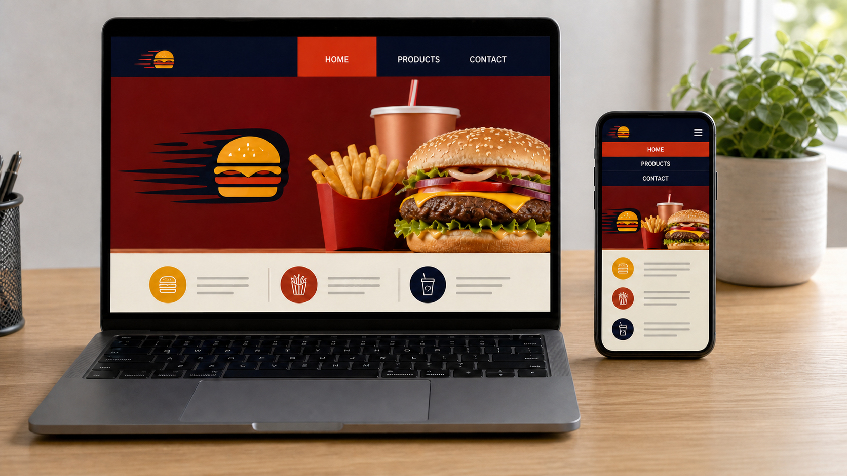
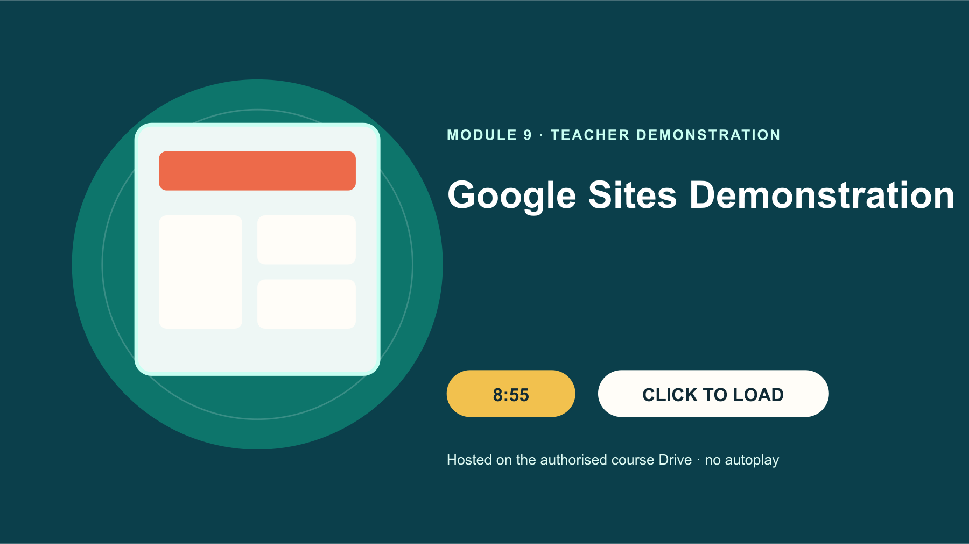
9.2 PREPARING AND EMBEDDING MEDIA
Preparing and embedding media
THREE IDEAS TO PUT ON THE BOARD
Preserve originals and prepare fit-for-purpose copies.
Alternative text describes meaningful visible content.
The same fictional portfolio keeps its identity, navigation and media hierarchy when the layout changes from laptop to phone.
Embeds inherit access rules and require independent-viewer testing.
Notice: What stays consistent across both screens, and what changes to make the smaller view easier to use?
TEACHER: CTRL+CLICK POSTER TO OPEN DRIVE • 8:55
WATCH FOR: Where is each media item placed, and what must be checked before the final site link is submitted?
ASK THE ROOM
What should alternative text do?
YEAR 7 MULTIMEDIA • MODULE 09 • WEB PORTFOLIO
04
Notes:
Teacher talk: Prepare images and video so the portfolio remains clear, accessible and honest about source and access.
Explain: Choose the correct file, crop only working copies, check resolution and use meaningful file names. Compress a copy when needed so pages do not carry unnecessarily large files, while preserving the best-quality original. Add concise alternative text that describes the important visible content. Captions can explain the design purpose or identify a mock-up as a simulated context.
Clarify: The source demonstration shows inserting posters and Drive video into Google Sites. Embedded media still depends on its sharing and privacy settings. A teacher-visible Drive file is not automatically public, and an embed that works for the owner may fail for another viewer. Use the approved access setting, provide a clear fallback when authorised and avoid exposing account details or signed-in interface frames.
Worked example: The site owner sees an embedded MP4, but a reviewer using a different approved view sees an access message. The student does not change sharing without permission. They record the failed test, ask which access level is authorised and prepare a clear placeholder or teacher-approved fallback. An image also lacks alt text, so it is revised to describe the actual poster rather than saying only “poster image”.
Ask: What should alternative text do?
Listen for: Describe the important content and function of the image. Correct. This supports users who cannot rely on the image.
Misconception to correct: If the owner can view an embed, every authorised viewer can view it. → Owner access may hide sharing problems; test from an independent approved view.
Transition: Connect this idea to Publishing, access and submission.
[Sources]
- Theory and check: data/course-content.js, m09-s02 and m09-s02-q01.
- Image-first teaching visual: assets/visuals/generated-responsive-portfolio-check.png. AI-generated with the built-in image tool on 24 August 2026; no source or student image used; a rejected text-error variant was not retained in the course.
- Google Drive source: Google Sites Demonstration.mp4, Drive ID 1PV_O58qVIZ7AtoJrjfTLl9R_xML1JcqP, 8:55.

Slide 5

9.3 PUBLISHING, ACCESS AND SUBMISSION
Publishing, access and submission
THREE IDEAS TO PUT ON THE BOARD
Preview, publish, access and submission are separate states.
Use only the audience setting directed by the teacher.
Preview, publish, independent access and submission are separate states that require separate checks.
Local save preserves a draft but does not transmit it.
Notice: Which screen proves each state, and which assumption still needs a real access test?
ASK THE ROOM
Which statement is accurate?
YEAR 7 MULTIMEDIA • MODULE 09 • WEB PORTFOLIO
05
Notes:
Teacher talk: Distinguish preview, publication, authorised access, local saving and final link submission.
Explain: Preview shows how the site may appear before publication. Publishing creates or updates an accessible site version under selected settings. Access determines who can view it. The source demonstration includes preview, publish and link checking, but the permitted audience setting is not supplied in the course source. Follow the teacher’s direction and never broaden access merely to make a link easier to open.
Clarify: The verified Website Link prompt asks for a website link. A complete link record should identify the intended site and be checked from an approved viewer context. Saving it in this local course browser preserves a working draft only; it does not send the link to a teacher. Follow the teacher’s nominated submission pathway when supplied and avoid placing edit links or private account information in a public location.
Worked example: A student previews the site and saves its address locally, but the approved viewer still receives an access request. The honest status is “previewed and link recorded; viewer access not yet confirmed”. It is not “submitted” or “public”. The student checks for an accidental edit URL, records the issue and waits for the teacher’s access direction. Precise state language prevents false confidence and unsafe permission changes.
Ask: Which statement is accurate?
Listen for: A preview does not prove publication or viewer access. Correct. These are separate states.
Misconception to correct: If a URL exists, the site has been submitted and everyone can view it. → A URL can exist before authorised access or submission is complete.
Transition: Connect this idea to the retrieval check.
[Sources]
- Theory and check: data/course-content.js, m09-s03 and m09-s03-q01.
- Image-first teaching visual: assets/visuals/generated-m09-publish-access-test-v2.png. AI-generated with the built-in OpenAI image creator on 24 August 2026; no source or student image used.

Slide 6
CHECK FOR UNDERSTANDING
Stop. Think. Explain.
Answer silently first, then justify with a partner.
1
Which page structure is shown in the source demonstration?
2
What should alternative text do?
3
Which statement is accurate?
YEAR 7 MULTIMEDIA • MODULE 09 • WEB PORTFOLIO
06
Notes:
Teacher routine: 60 seconds silent retrieval, pair justification, then whole-class feedback.
Question 1: Home, Products and Contact Us. Feedback: Correct. These are visible in the verified workflow.
Question 2: Describe the important content and function of the image. Feedback: Correct. This supports users who cannot rely on the image.
Question 3: A preview does not prove publication or viewer access. Feedback: Correct. These are separate states.
Do not score this as a formal assessment. Use responses to decide whether to reteach or continue.
Transition: Model how the same knowledge becomes a longer written explanation.
[Sources]
- Formative checks: data/course-content.js, m09-s01-q01, m09-s02-q01, m09-s03-q01.

Slide 7
FORMATIVE LEARNING EVIDENCE
Read → Select → Explain → Check
THE QUESTION
WHAT THIS IS ASKING
Create a three-page content map and a media preflight, then report preview, publish, access test and submission as separate states.
Use predictable labels
Prepare media and alternatives
Test access independently
1 SELECT
2 EXPLAIN
3 CHECK
Choose precise theory and examples that answer the question.
Link ideas with because, so or therefore.
Answer every part; keep claims specific and source-safe.
Sentence starter: I placed… on… because… The current website state is… and still needs…
YEAR 7 MULTIMEDIA • MODULE 09 • WEB PORTFOLIO
07
Notes:
Teacher talk: Read the prompt once, then unpack it using Select, Explain and Check.
Model one sentence aloud using the supplied starter.
Prompt: Which section provides the strongest evidence for each part of the question?
Remind students: this is formative learning evidence. A local save is not a submission.
Transition: Finish with a three-part exit ticket and save the response in the matching module.
[Sources]
- Section capstones: data/course-content.js, m09-s01-capstone, m09-s02-capstone, m09-s03-capstone.
- Integrated prompt: Stage 07 synthesis of the three source-grounded section capstones.
- Evidence boundary: data/course-content.js evidenceLabel, saveNotice and moduleEvidenceKey.

Slide 8
Before you pack up…
1. One idea I can now explain is…
SAVE
YOUR
EVIDENCE
2. One design decision or practical action this changes is…
3. One question I still need answered is…
Save in the matching course module. Local save is not submission.
YEAR 7 MULTIMEDIA • MODULE 09 • WEB PORTFOLIO
08
Notes:
Teacher routine: Ask students to answer all three prompts in the matching module response box.
Invite one voluntary share for the first prompt.
Use the final question to plan the next explanation or support.
Remind students that browser-local saving preserves a draft on this device; it does not submit work.
[Sources]
- Exit-ticket structure and evidence boundary: data/course-content.js saveNotice, savedMessage and evidenceDestination.
- Module theory: data/course-content.js, m09-s01, m09-s02, m09-s03.

