Slide 1

MODULE 01
The Catapult Engineering Challenge
Explain the Catapult as a connected system and read the brief with evidence in mind.
YEAR 8 • ENGINEERING TECHNOLOGIES AND SYSTEMS
Notes:
Teaching points
- State the learning purpose in one sentence.
- Use the image only as a conceptual project cue; it is not a plan or model specification.
Prompt
- What relationship or evidence do you expect to matter in this module?
Likely misconception
- A realistic image must show the exact project design.
Transition
- Move from the project cue to the three ideas students will learn.
[Sources]
- Year 8 Catapult student theory draft v1.0, module-01, 24 Aug 2026.
- Catapult Booklet 2026.pdf, pp. 1–2; source map v1.0; theory draft module-01.
- OpenAI image generation for this course, 24 Aug 2026, conceptual only; file: catapult-hero-concept.png.

Slide 2
MODULE 01 / CATAPULT CHALLENGE
The learning question
How do relationships, feedback and constraints shape an engineered system?
1
Components work together
2
Feedback closes the loop
3
Constraints and criteria differ
RETRIEVAL WARM-UP
Name one component, one interaction and one output you could observe.
YEAR 8 CATAPULT • MODULE 01
02
Notes:
Teaching points
- Frame the module as a cumulative learning sequence.
- Invite a brief retrieval response before introducing new content.
Prompt
- Name one component, one interaction and one output you could observe.
Likely misconception
- The three ideas are separate facts rather than parts of one explanation.
Transition
- Tell students that each theory slide will supply evidence for the final response.
[Sources]
- Year 8 Catapult student theory draft v1.0, module-01, 24 Aug 2026.
- Catapult Booklet 2026.pdf, pp. 1–2; source map v1.0; theory draft module-01.
- Native pathway diagram authored for this deck from the approved module sequence.

Slide 3

MODULE 01 / CATAPULT CHALLENGE
A system is defined by relationships
An engineered system is a group of connected components that work together for a purpose. Naming the base, frame, moving arm or energy store is only a start. The stronger explanation shows how one component affects another and how a change can alter the whole system.
Application: trace one component relationship and predict what else should be checked if it changes.
A mechanism works because its parts interact, not because each part exists.
NOTICE Trace how changing the pivot, arm or energy-store position could affect the other parts.
YEAR 8 CATAPULT • MODULE 01
03
Notes:
Teaching points
- An engineered system is a group of connected components that work together for a purpose. Naming the base, frame, moving arm or energy store is only a start. The stronger explanation shows how one component affects another and how a change can alter the whole system.
- Use the visual to emphasise: Trace how changing the pivot, arm or energy-store position could affect the other parts.
Prompt
- Application: trace one component relationship and predict what else should be checked if it changes.
Likely misconception
- Why is a list of parts not yet a system explanation?
Transition
- Link this idea to the next relationship in the module.
[Sources]
- Year 8 Catapult student theory draft v1.0, module-01, 24 Aug 2026.
- Catapult Booklet 2026.pdf, pp. 1–2; source map v1.0; theory draft module-01.
- Teaching visual: assets/visuals/theory/m01-system-relationships.png.
- OpenAI image generation for this course, 24 Aug 2026; conceptual teaching still life; final prompt: Abstract unassembled timber blocks, dowel pivot, separate lever strip and relaxed elastic loop; no complete Catapult or buildable geometry.

Slide 4

MODULE 01 / CATAPULT CHALLENGE
Feedback turns testing into a design loop
Inputs such as stored energy, materials and design information enter the system. Processes transfer or transform them. Outputs can include movement, sound, vibration and test data. Feedback is useful when an observed output guides the next decision.
An observed output becomes feedback only when it guides the next decision.
Evidence move: turn one observed output into a specific question for the next check.
NOTICE Look for the observation that would make a designer keep, question or change one feature.
YEAR 8 CATAPULT • MODULE 01
04
Notes:
Teaching points
- Inputs such as stored energy, materials and design information enter the system. Processes transfer or transform them. Outputs can include movement, sound, vibration and test data. Feedback is useful when an observed output guides the next decision.
- Use the visual to emphasise: Look for the observation that would make a designer keep, question or change one feature.
Prompt
- Evidence move: turn one observed output into a specific question for the next check.
Likely misconception
- What makes feedback useful in engineering?
Transition
- Link this idea to the next relationship in the module.
[Sources]
- Year 8 Catapult student theory draft v1.0, module-01, 24 Aug 2026.
- Catapult Booklet 2026.pdf, pp. 1–2; source map v1.0; theory draft module-01.
- Teaching visual: assets/visuals/theory/m01-feedback-from-observation.png.
- OpenAI image generation for this course, 24 Aug 2026; conceptual teaching still life; final prompt: Partial nonfunctional lever model beside blank observation and revision cards; no results, dimensions or complete design.

Slide 5
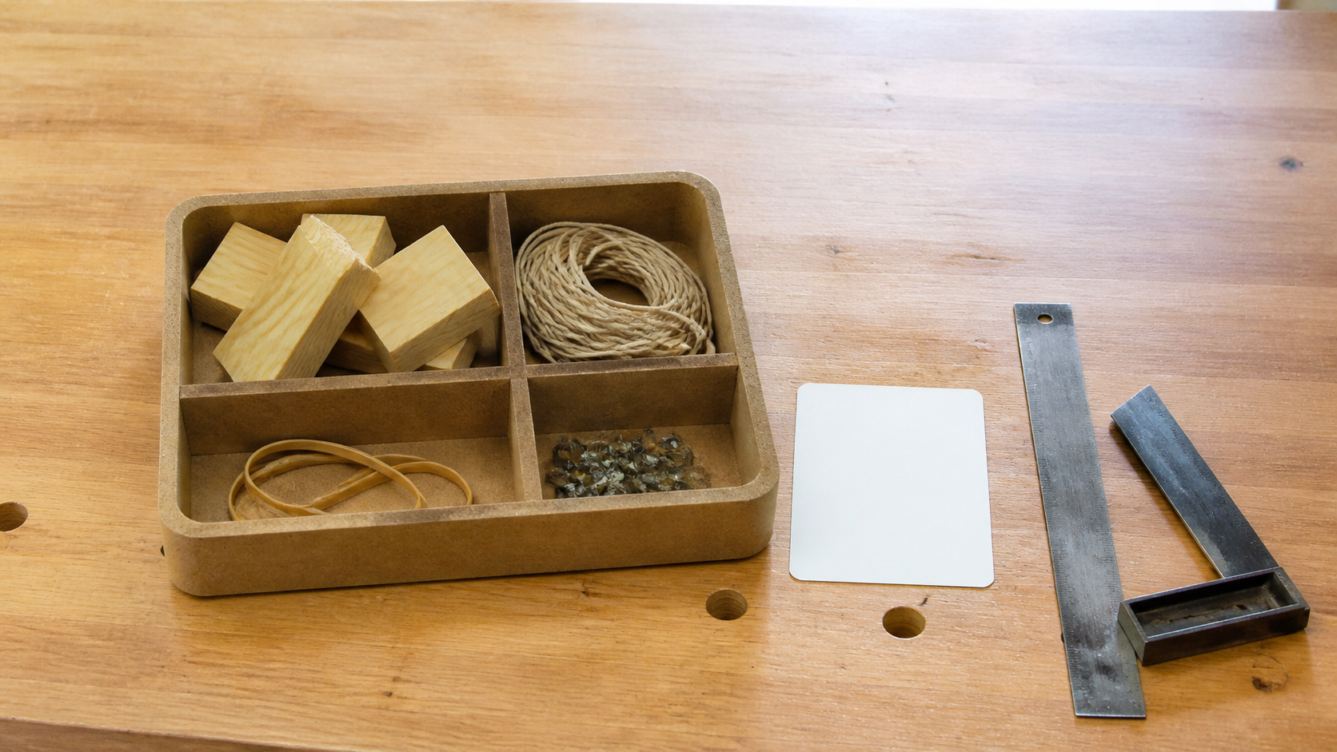
MODULE 01 / CATAPULT CHALLENGE
Constraints are boundaries; criteria judge success
The authorised brief sets materials, a practical-plus-folio expectation and a maximum planned pine length of 2400 mm. These are constraints. A criterion states what successful performance would look like and must connect to observable evidence confirmed by the teacher.
Decision: sort each statement as a boundary to respect or evidence to judge.
Constraints set the boundary; criteria need evidence.
NOTICE Separate what the design must work within from what must be observed to judge success.
YEAR 8 CATAPULT • MODULE 01
05
Notes:
Teaching points
- The authorised brief sets materials, a practical-plus-folio expectation and a maximum planned pine length of 2400 mm. These are constraints. A criterion states what successful performance would look like and must connect to observable evidence confirmed by the teacher.
- Use the visual to emphasise: Separate what the design must work within from what must be observed to judge success.
Prompt
- Decision: sort each statement as a boundary to respect or evidence to judge.
Likely misconception
- How is a criterion different from a constraint?
Transition
- Prepare students to retrieve and apply all three ideas.
[Sources]
- Year 8 Catapult student theory draft v1.0, module-01, 24 Aug 2026.
- Catapult Booklet 2026.pdf, pp. 1–2; source map v1.0; theory draft module-01.
- Teaching visual: assets/visuals/theory/m01-criteria-and-evidence.png.
- OpenAI image generation for this course, 24 Aug 2026; conceptual teaching still life; final prompt: Confirmed material categories in one tray beside a separate blank quality card and tools at rest; no project form or stock cross-section.

Slide 6
MODULE 01 / CATAPULT CHALLENGE
Stop. Think. Explain.
Answer silently first. Then justify one answer with a partner.
1
Why is a list of parts not yet a system explanation?
2
What makes feedback useful in engineering?
3
How is a criterion different from a constraint?
4
Which evidence would help explain an inconsistent result?
YEAR 8 CATAPULT • MODULE 01
06
Notes:
Teaching points
- Give individual thinking time before partner discussion.
- Ask for evidence or a because-clause, not just the answer.
Prompt
- Which answer changed after discussion, and what evidence changed it?
Likely misconception
- Retrieval is a memory race rather than a chance to repair understanding.
Transition
- Use the strongest unresolved question to launch the evidence scaffold.
[Sources]
- Year 8 Catapult student theory draft v1.0, module-01, 24 Aug 2026.
- Catapult Booklet 2026.pdf, pp. 1–2; source map v1.0; theory draft module-01.
- Questions derived from the approved module theory; no external asset used.

Slide 7
MODULE 01 / CATAPULT CHALLENGE
Build the evidence, not just an answer
THE QUESTION
A design meets every confirmed constraint but gives inconsistent results. Explain why it may still be unsuccessful and identify the evidence needed before one change is recommended.
READ
Underline the decision
SELECT
Choose precise evidence
EXPLAIN
Connect with theory
CHECK
Answer every part
SENTENCE SUPPORT
Although the design meets the constraints, the evidence shows … This matters because … Before changing … I would check …
YEAR 8 CATAPULT • MODULE 01
07
Notes:
Teaching points
- Model how to select evidence before writing the explanation.
- Read the sentence support aloud, then let students change its wording to suit their evidence.
Prompt
- A design meets every confirmed constraint but gives inconsistent results. Explain why it may still be unsuccessful and identify the evidence needed before one change is recommended.
Likely misconception
- Longer writing is automatically stronger evidence.
Transition
- Move from the scaffold to a concise exit ticket and evidence-save action.
[Sources]
- Year 8 Catapult student theory draft v1.0, module-01, 24 Aug 2026.
- Catapult Booklet 2026.pdf, pp. 1–2; source map v1.0; theory draft module-01.
- Read–Select–Explain–Check scaffold follows the TAS course presentation standard.

Slide 8
BEFORE YOU PACK UP …
Close the design loop
1. One system relationship I can now explain …
SAVE
YOUR
EVIDENCE
2. One piece of evidence that could guide a change …
3. One question about the confirmed brief …
Evidence destination: your module response and folio where your teacher directs.
Next: examine how tools and materials are selected within teacher-approved workshop systems.
YEAR 8 CATAPULT • MODULE 01
08
Notes:
Teaching points
- Collect a short answer to each exit prompt.
- Make the evidence destination explicit without turning the slide into assessment administration.
Prompt
- Which exit response best shows a changed decision or deeper explanation?
Likely misconception
- The exit ticket is a generic summary with no next evidence action.
Transition
- Next: examine how tools and materials are selected within teacher-approved workshop systems.
[Sources]
- Year 8 Catapult student theory draft v1.0, module-01, 24 Aug 2026.
- Catapult Booklet 2026.pdf, pp. 1–2; source map v1.0; theory draft module-01.
- Exit-evidence structure follows the TAS course presentation standard.

