Slide 1
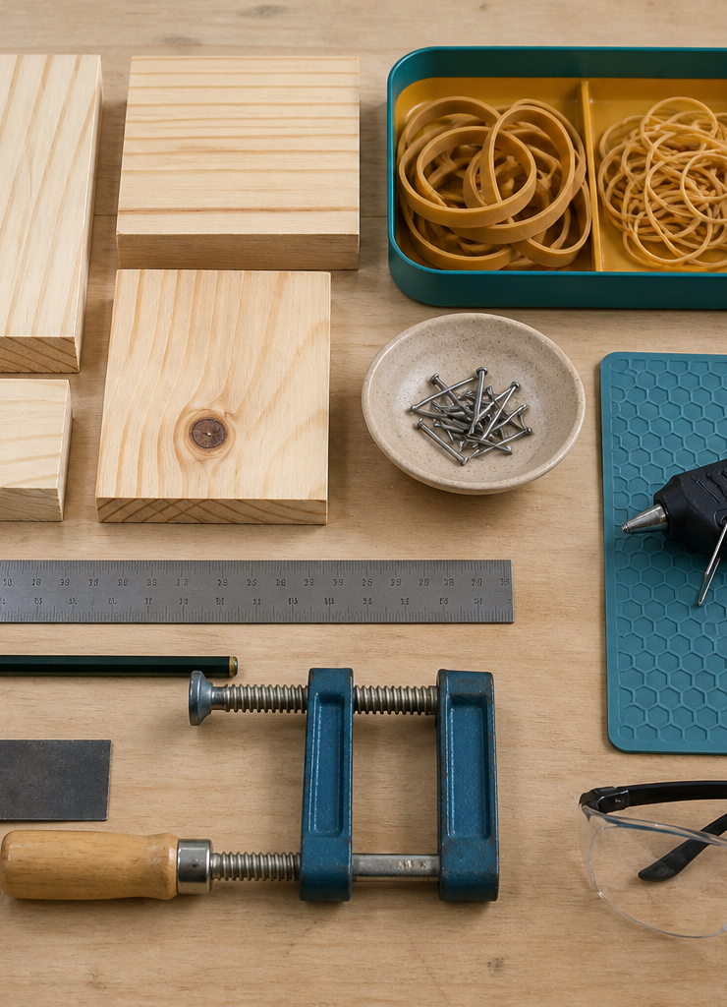
MODULE 02
Workshop Readiness, Tools and Materials
Explain how context, tool function and material behaviour shape a responsible process choice.
YEAR 8 • ENGINEERING TECHNOLOGIES AND SYSTEMS
Notes:
Teaching points
- State the learning purpose in one sentence.
- Use the image only as a conceptual project cue; it is not a plan or model specification.
Prompt
- What relationship or evidence do you expect to matter in this module?
Likely misconception
- A realistic image must show the exact project design.
Transition
- Move from the project cue to the three ideas students will learn.
[Sources]
- Year 8 Catapult student theory draft v1.0, module-02, 24 Aug 2026.
- Catapult Booklet 2026.pdf, pp. 3–7; core artefact manifest v1.0; theory draft module-02.
- OpenAI image generation for this course, 24 Aug 2026, conceptual only; file: catapult-materials-workshop.png.

Slide 2
MODULE 02 / WORKSHOP READINESS
The learning question
How do we justify a process without replacing local workshop instruction?
1
Risk depends on context
2
Select by function
3
Materials vary and respond
RETRIEVAL WARM-UP
What is the difference between a tool category and an approved operating procedure?
YEAR 8 CATAPULT • MODULE 02
02
Notes:
Teaching points
- Frame the module as a cumulative learning sequence.
- Invite a brief retrieval response before introducing new content.
Prompt
- What is the difference between a tool category and an approved operating procedure?
Likely misconception
- The three ideas are separate facts rather than parts of one explanation.
Transition
- Tell students that each theory slide will supply evidence for the final response.
[Sources]
- Year 8 Catapult student theory draft v1.0, module-02, 24 Aug 2026.
- Catapult Booklet 2026.pdf, pp. 3–7; core artefact manifest v1.0; theory draft module-02.
- Native pathway diagram authored for this deck from the approved module sequence.

Slide 3
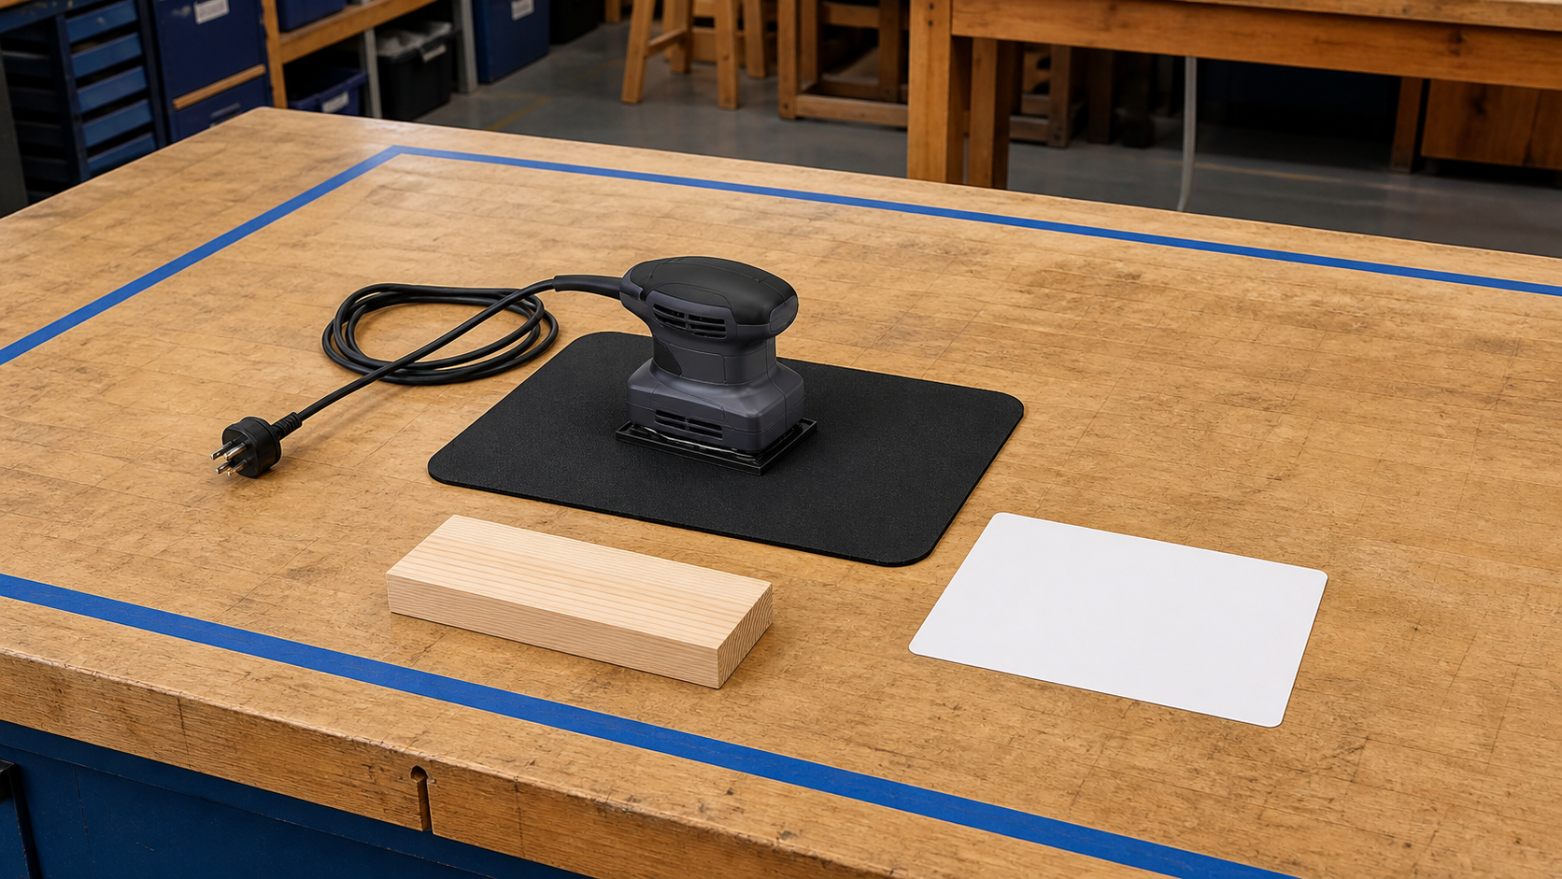
MODULE 02 / WORKSHOP READINESS
Risk depends on the situation
A hazard has the potential to cause harm. Risk considers how likely and how serious that harm could be in a particular situation. The material, task, equipment, people and controls all matter, so a general presentation cannot replace teacher demonstration or local workshop procedures.
Explain: why can the same hazard create different levels of risk in different contexts?
Risk depends on the task, condition, people and controls—not the object alone.
NOTICE Identify the hazard, then ask what context and teacher-approved control change the decision.
YEAR 8 CATAPULT • MODULE 02
03
Notes:
Teaching points
- A hazard has the potential to cause harm. Risk considers how likely and how serious that harm could be in a particular situation. The material, task, equipment, people and controls all matter, so a general presentation cannot replace teacher demonstration or local workshop procedures.
- Use the visual to emphasise: Identify the hazard, then ask what context and teacher-approved control change the decision.
Prompt
- Explain: why can the same hazard create different levels of risk in different contexts?
Likely misconception
- How is a hazard different from risk?
Transition
- Link this idea to the next relationship in the module.
[Sources]
- Year 8 Catapult student theory draft v1.0, module-02, 24 Aug 2026.
- Catapult Booklet 2026.pdf, pp. 3–7; core artefact manifest v1.0; theory draft module-02.
- Teaching visual: assets/visuals/theory/m02-risk-context-control.png.
- OpenAI image generation for this course, 24 Aug 2026; conceptual teaching still life; final prompt: Unplugged palm sander safely supported on a mat, material sample, workspace boundary and blank teacher card; no tool use or PPE claim.

Slide 4
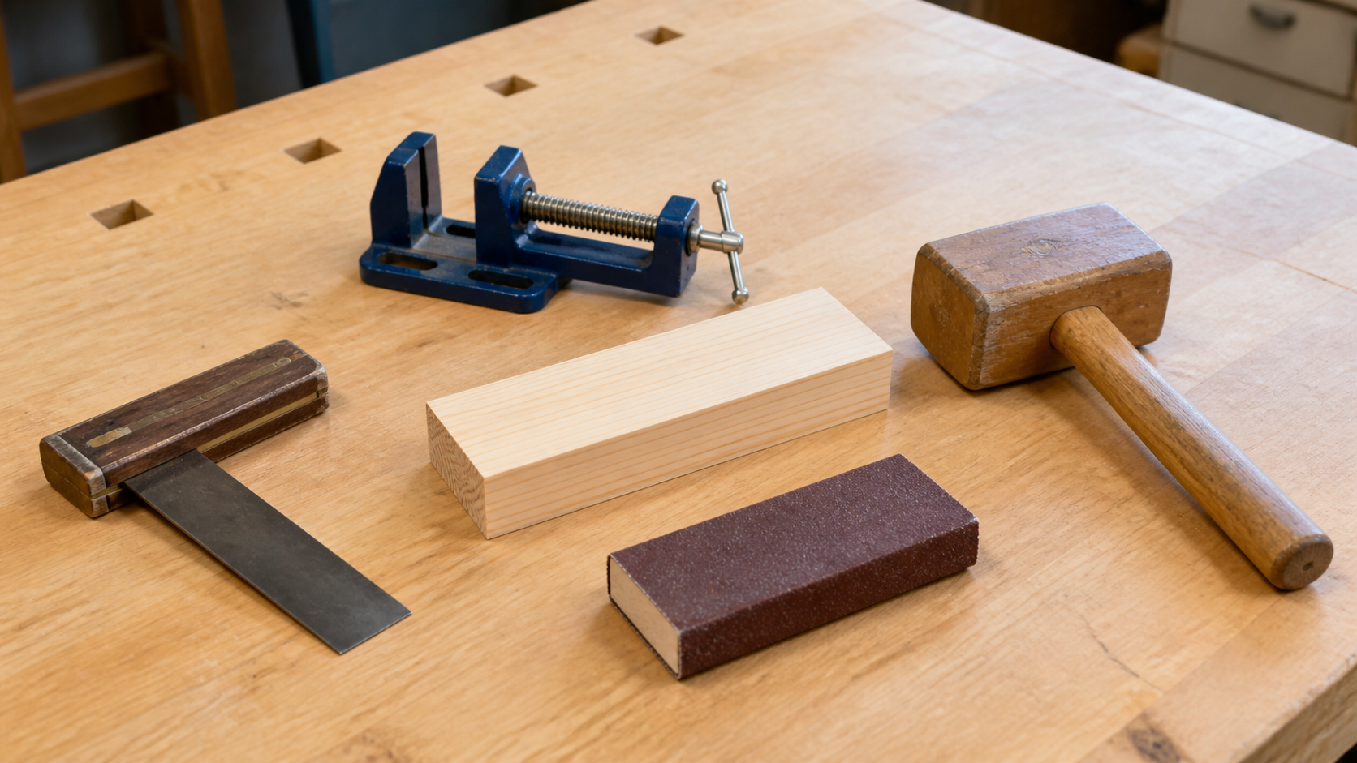
MODULE 02 / WORKSHOP READINESS
Choose tools by the function required
Measuring, holding, cutting, shaping, drilling and joining are process functions. Tool choice also depends on the material, required accuracy, access, finish and teacher-approved method. A familiar or powerful tool is not automatically the best fit.
Start with the function, then choose the approved process and check its result.
Application: name the required function before naming any tool, then identify the evidence of a suitable result.
NOTICE Match the required job to material, access and evidence—not to the most powerful tool.
YEAR 8 CATAPULT • MODULE 02
04
Notes:
Teaching points
- Measuring, holding, cutting, shaping, drilling and joining are process functions. Tool choice also depends on the material, required accuracy, access, finish and teacher-approved method. A familiar or powerful tool is not automatically the best fit.
- Use the visual to emphasise: Match the required job to material, access and evidence—not to the most powerful tool.
Prompt
- Application: name the required function before naming any tool, then identify the evidence of a suitable result.
Likely misconception
- Why should the required function be named before the tool?
Transition
- Link this idea to the next relationship in the module.
[Sources]
- Year 8 Catapult student theory draft v1.0, module-02, 24 Aug 2026.
- Catapult Booklet 2026.pdf, pp. 3–7; core artefact manifest v1.0; theory draft module-02.
- Teaching visual: assets/visuals/theory/m02-tools-by-function.png.
- OpenAI image generation for this course, 24 Aug 2026; conceptual teaching still life; final prompt: Representative measuring, holding, material-changing and joining tool categories safely at rest around one pine specimen.

Slide 5
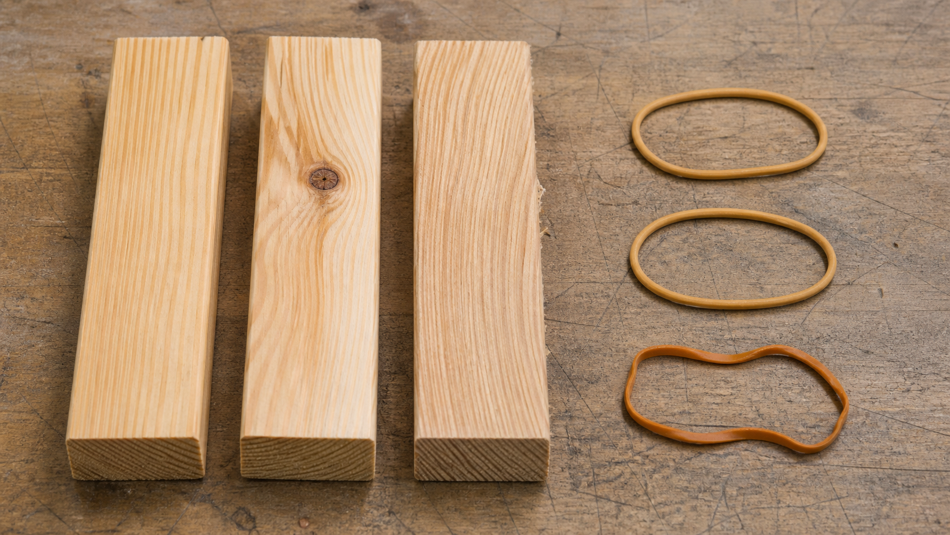
MODULE 02 / WORKSHOP READINESS
Pine and elastic materials do not behave identically
Pine varies with grain direction, knots, moisture and condition. Elastic materials can deform temporarily and return towards their earlier shape, but may deform permanently or fail beyond a suitable range. Engineers inspect the actual material and work only within teacher-set limits.
Evidence move: record one visible material feature and explain how it could affect a later decision.
Material names are not enough; inspect grain, condition, deformation and recovery.
NOTICE Compare natural variation in pine with temporary and permanent change in an elastic material.
YEAR 8 CATAPULT • MODULE 02
05
Notes:
Teaching points
- Pine varies with grain direction, knots, moisture and condition. Elastic materials can deform temporarily and return towards their earlier shape, but may deform permanently or fail beyond a suitable range. Engineers inspect the actual material and work only within teacher-set limits.
- Use the visual to emphasise: Compare natural variation in pine with temporary and permanent change in an elastic material.
Prompt
- Evidence move: record one visible material feature and explain how it could affect a later decision.
Likely misconception
- Which properties of an actual pine piece could affect production?
Transition
- Prepare students to retrieve and apply all three ideas.
[Sources]
- Year 8 Catapult student theory draft v1.0, module-02, 24 Aug 2026.
- Catapult Booklet 2026.pdf, pp. 3–7; core artefact manifest v1.0; theory draft module-02.
- Teaching visual: assets/visuals/theory/m02-pine-elastic-behaviour.png.
- OpenAI image generation for this course, 24 Aug 2026; conceptual teaching still life; final prompt: Macro comparison of varied pine grain and knots beside relaxed and permanently misshapen elastic loops, all at rest.

Slide 6
MODULE 02 / WORKSHOP READINESS
Stop. Think. Explain.
Answer silently first. Then justify one answer with a partner.
1
How is a hazard different from risk?
2
Why should the required function be named before the tool?
3
Which properties of an actual pine piece could affect production?
4
Why does training not become permission for every situation?
YEAR 8 CATAPULT • MODULE 02
06
Notes:
Teaching points
- Give individual thinking time before partner discussion.
- Ask for evidence or a because-clause, not just the answer.
Prompt
- Which answer changed after discussion, and what evidence changed it?
Likely misconception
- Retrieval is a memory race rather than a chance to repair understanding.
Transition
- Use the strongest unresolved question to launch the evidence scaffold.
[Sources]
- Year 8 Catapult student theory draft v1.0, module-02, 24 Aug 2026.
- Catapult Booklet 2026.pdf, pp. 3–7; core artefact manifest v1.0; theory draft module-02.
- Questions derived from the approved module theory; no external asset used.

Slide 7
MODULE 02 / WORKSHOP READINESS
Build the evidence, not just an answer
THE QUESTION
Two teacher-approved processes could complete the same function. Compare them for material suitability, accuracy, finish, waste and risk before recommending one.
READ
Underline the decision
SELECT
Choose precise evidence
EXPLAIN
Connect with theory
CHECK
Answer every part
SENTENCE SUPPORT
Both processes can … Process A is stronger when … Process B is stronger when … I recommend … because the evidence …
YEAR 8 CATAPULT • MODULE 02
07
Notes:
Teaching points
- Model how to select evidence before writing the explanation.
- Read the sentence support aloud, then let students change its wording to suit their evidence.
Prompt
- Two teacher-approved processes could complete the same function. Compare them for material suitability, accuracy, finish, waste and risk before recommending one.
Likely misconception
- Longer writing is automatically stronger evidence.
Transition
- Move from the scaffold to a concise exit ticket and evidence-save action.
[Sources]
- Year 8 Catapult student theory draft v1.0, module-02, 24 Aug 2026.
- Catapult Booklet 2026.pdf, pp. 3–7; core artefact manifest v1.0; theory draft module-02.
- Read–Select–Explain–Check scaffold follows the TAS course presentation standard.

Slide 8
BEFORE YOU PACK UP …
Close the design loop
1. One process function I can distinguish …
SAVE
YOUR
EVIDENCE
2. One material feature I should inspect …
3. One question I would take to the teacher …
Evidence destination: your module response and folio where your teacher directs.
Next: compare different energy stores and lever trade-offs across engineered systems.
YEAR 8 CATAPULT • MODULE 02
08
Notes:
Teaching points
- Collect a short answer to each exit prompt.
- Make the evidence destination explicit without turning the slide into assessment administration.
Prompt
- Which exit response best shows a changed decision or deeper explanation?
Likely misconception
- The exit ticket is a generic summary with no next evidence action.
Transition
- Next: compare different energy stores and lever trade-offs across engineered systems.
[Sources]
- Year 8 Catapult student theory draft v1.0, module-02, 24 Aug 2026.
- Catapult Booklet 2026.pdf, pp. 3–7; core artefact manifest v1.0; theory draft module-02.
- Exit-evidence structure follows the TAS course presentation standard.

