Slide 1

MODULE 04
Force, Motion, Energy and Prototypes
Use energy transfers, Newton’s laws and fair testing to explain prototype behaviour.
YEAR 8 • ENGINEERING TECHNOLOGIES AND SYSTEMS
Notes:
Teaching points
- State the learning purpose in one sentence.
- Use the image only as a conceptual project cue; it is not a plan or model specification.
Prompt
- What relationship or evidence do you expect to matter in this module?
Likely misconception
- A realistic image must show the exact project design.
Transition
- Move from the project cue to the three ideas students will learn.
[Sources]
- Year 8 Catapult student theory draft v1.0, module-04, 24 Aug 2026.
- Catapult Booklet 2026.pdf, pp. 14–15; NASA Newton’s laws; US DOE energy conservation; theory draft module-04.
- OpenAI image generation for this course, 24 Aug 2026, conceptual only; file: elastic-energy-still-life.png.

Slide 2
MODULE 04 / FORCE, MOTION AND PROTOTYPES
The learning question
Why can a system store energy yet still produce inconsistent motion?
1
Energy follows pathways
2
Forces act on objects
3
Fair evidence controls variables
RETRIEVAL WARM-UP
Where might stored energy transfer besides useful movement?
YEAR 8 CATAPULT • MODULE 04
02
Notes:
Teaching points
- Frame the module as a cumulative learning sequence.
- Invite a brief retrieval response before introducing new content.
Prompt
- Where might stored energy transfer besides useful movement?
Likely misconception
- The three ideas are separate facts rather than parts of one explanation.
Transition
- Tell students that each theory slide will supply evidence for the final response.
[Sources]
- Year 8 Catapult student theory draft v1.0, module-04, 24 Aug 2026.
- Catapult Booklet 2026.pdf, pp. 14–15; NASA Newton’s laws; US DOE energy conservation; theory draft module-04.
- Native pathway diagram authored for this deck from the approved module sequence.

Slide 3

MODULE 04 / FORCE, MOTION AND PROTOTYPES
Energy transfers through useful and unwanted pathways
Work done on an elastic component can store elastic potential energy. During a teacher-controlled release, energy can become kinetic energy in moving parts and the projectile, while other transfers appear as sound, heat, vibration, air movement or unwanted frame motion.
Evidence move: identify one intended and one unintended energy pathway from an observation.
Stored elastic energy can become intended motion and also spread through sound, vibration and heat.
NOTICE Find the intended moving relationship and one pathway where energy could spread elsewhere.
YEAR 8 CATAPULT • MODULE 04
03
Notes:
Teaching points
- Work done on an elastic component can store elastic potential energy. During a teacher-controlled release, energy can become kinetic energy in moving parts and the projectile, while other transfers appear as sound, heat, vibration, air movement or unwanted frame motion.
- Use the visual to emphasise: Find the intended moving relationship and one pathway where energy could spread elsewhere.
Prompt
- Evidence move: identify one intended and one unintended energy pathway from an observation.
Likely misconception
- Where can energy transfer besides useful motion?
Transition
- Link this idea to the next relationship in the module.
[Sources]
- Year 8 Catapult student theory draft v1.0, module-04, 24 Aug 2026.
- Catapult Booklet 2026.pdf, pp. 14–15; NASA Newton’s laws; US DOE energy conservation; theory draft module-04.
- Teaching visual: assets/visuals/theory/m04-energy-pathways.png.
- OpenAI image generation for this course, 24 Aug 2026; conceptual teaching still life; final prompt: Guarded macro of an incomplete elastic relationship lightly deformed against a padded stop; inactive and without projectile or release.

Slide 4
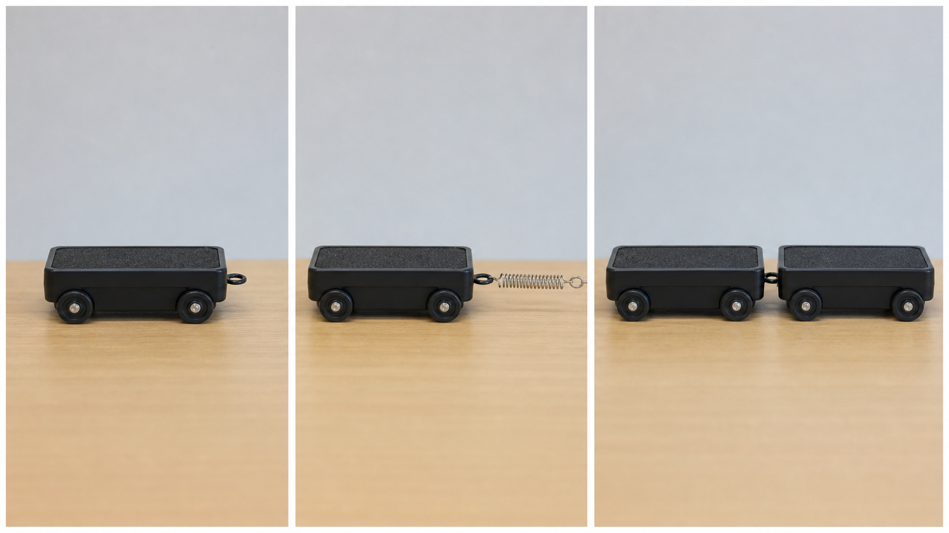
MODULE 04 / FORCE, MOTION AND PROTOTYPES
Newton’s laws describe different parts of one event
The first law describes motion changing when a net external force acts. The second links net force, mass and acceleration. The third identifies equal-and-opposite force pairs acting on different objects. Separate the objects so the forces are not incorrectly cancelled in one vague diagram.
Newton’s laws answer different questions about motion and interactions.
Explain: choose one moving object and name the force relationship that changes its motion.
NOTICE Separate the object whose motion changes from the two objects in a force pair.
YEAR 8 CATAPULT • MODULE 04
04
Notes:
Teaching points
- The first law describes motion changing when a net external force acts. The second links net force, mass and acceleration. The third identifies equal-and-opposite force pairs acting on different objects. Separate the objects so the forces are not incorrectly cancelled in one vague diagram.
- Use the visual to emphasise: Separate the object whose motion changes from the two objects in a force pair.
Prompt
- Explain: choose one moving object and name the force relationship that changes its motion.
Likely misconception
- Why do third-law force pairs not cancel on one object?
Transition
- Link this idea to the next relationship in the module.
[Sources]
- Year 8 Catapult student theory draft v1.0, module-04, 24 Aug 2026.
- Catapult Booklet 2026.pdf, pp. 14–15; NASA Newton’s laws; US DOE energy conservation; theory draft module-04.
- Teaching visual: assets/visuals/theory/m04-newton-observations.png.
- OpenAI image generation for this course, 24 Aug 2026; conceptual teaching still life; final prompt: Three photographic classroom trolley observations: rest, spring pull and contact between two trolleys; no numbers, procedure or result.

Slide 5
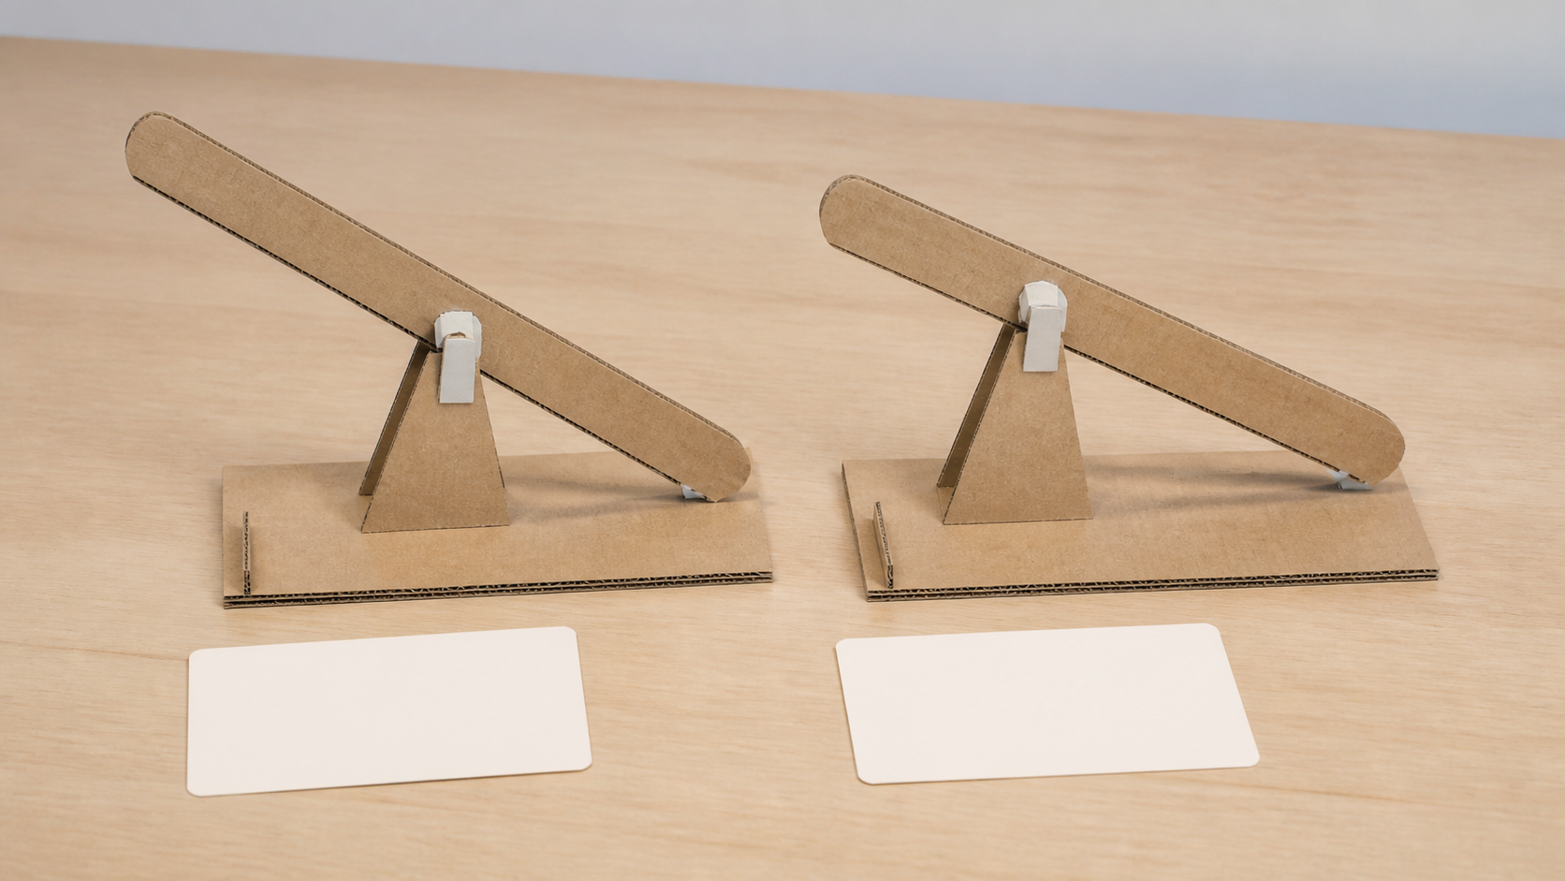
MODULE 04 / FORCE, MOTION AND PROTOTYPES
A prototype earns value through a clear question
A prototype investigates one relationship before full production. A fair comparison changes one chosen variable, keeps important conditions consistent and repeats observations. Its value is the evidence it produces, not how finished it looks. The activity and conditions remain teacher directed.
Design the evidence: name one changed variable, two controls and the observation that would answer the question.
A fair comparison changes one feature and holds important conditions steady.
NOTICE Find the one changed feature and the details that must remain consistent.
YEAR 8 CATAPULT • MODULE 04
05
Notes:
Teaching points
- A prototype investigates one relationship before full production. A fair comparison changes one chosen variable, keeps important conditions consistent and repeats observations. Its value is the evidence it produces, not how finished it looks. The activity and conditions remain teacher directed.
- Use the visual to emphasise: Find the one changed feature and the details that must remain consistent.
Prompt
- Design the evidence: name one changed variable, two controls and the observation that would answer the question.
Likely misconception
- What makes a prototype useful rather than merely unfinished?
Transition
- Prepare students to retrieve and apply all three ideas.
[Sources]
- Year 8 Catapult student theory draft v1.0, module-04, 24 Aug 2026.
- Catapult Booklet 2026.pdf, pp. 14–15; NASA Newton’s laws; US DOE energy conservation; theory draft module-04.
- Teaching visual: assets/visuals/theory/m04-one-change-prototypes.png.
- OpenAI image generation for this course, 24 Aug 2026; conceptual teaching still life; final prompt: Paired nonfunctional cardboard lever prototypes identical except for one visible relationship, with blank observation cards and no test result.

Slide 6
MODULE 04 / FORCE, MOTION AND PROTOTYPES
Stop. Think. Explain.
Answer silently first. Then justify one answer with a partner.
1
Where can energy transfer besides useful motion?
2
Why do third-law force pairs not cancel on one object?
3
What makes a prototype useful rather than merely unfinished?
4
Which variable should deliberately change in a fair comparison?
YEAR 8 CATAPULT • MODULE 04
06
Notes:
Teaching points
- Give individual thinking time before partner discussion.
- Ask for evidence or a because-clause, not just the answer.
Prompt
- Which answer changed after discussion, and what evidence changed it?
Likely misconception
- Retrieval is a memory race rather than a chance to repair understanding.
Transition
- Use the strongest unresolved question to launch the evidence scaffold.
[Sources]
- Year 8 Catapult student theory draft v1.0, module-04, 24 Aug 2026.
- Catapult Booklet 2026.pdf, pp. 14–15; NASA Newton’s laws; US DOE energy conservation; theory draft module-04.
- Questions derived from the approved module theory; no external asset used.

Slide 7
MODULE 04 / FORCE, MOTION AND PROTOTYPES
Build the evidence, not just an answer
THE QUESTION
A prototype has a large energy input but inconsistent motion. Propose two possible causes using energy pathways and Newton’s laws, then explain how to investigate only one at a time.
READ
Underline the decision
SELECT
Choose precise evidence
EXPLAIN
Connect with theory
CHECK
Answer every part
SENTENCE SUPPORT
The inconsistency could come from … or … I would first investigate … by changing … while keeping … because …
YEAR 8 CATAPULT • MODULE 04
07
Notes:
Teaching points
- Model how to select evidence before writing the explanation.
- Read the sentence support aloud, then let students change its wording to suit their evidence.
Prompt
- A prototype has a large energy input but inconsistent motion. Propose two possible causes using energy pathways and Newton’s laws, then explain how to investigate only one at a time.
Likely misconception
- Longer writing is automatically stronger evidence.
Transition
- Move from the scaffold to a concise exit ticket and evidence-save action.
[Sources]
- Year 8 Catapult student theory draft v1.0, module-04, 24 Aug 2026.
- Catapult Booklet 2026.pdf, pp. 14–15; NASA Newton’s laws; US DOE energy conservation; theory draft module-04.
- Read–Select–Explain–Check scaffold follows the TAS course presentation standard.

Slide 8
BEFORE YOU PACK UP …
Close the design loop
1. One energy pathway I can trace …
SAVE
YOUR
EVIDENCE
2. One Newton’s-law explanation I can use …
3. One variable I would control in a prototype …
Evidence destination: your module response and folio where your teacher directs.
Next: turn design ideas into drawings and a checked material plan.
YEAR 8 CATAPULT • MODULE 04
08
Notes:
Teaching points
- Collect a short answer to each exit prompt.
- Make the evidence destination explicit without turning the slide into assessment administration.
Prompt
- Which exit response best shows a changed decision or deeper explanation?
Likely misconception
- The exit ticket is a generic summary with no next evidence action.
Transition
- Next: turn design ideas into drawings and a checked material plan.
[Sources]
- Year 8 Catapult student theory draft v1.0, module-04, 24 Aug 2026.
- Catapult Booklet 2026.pdf, pp. 14–15; NASA Newton’s laws; US DOE energy conservation; theory draft module-04.
- Exit-evidence structure follows the TAS course presentation standard.

