Slide 1
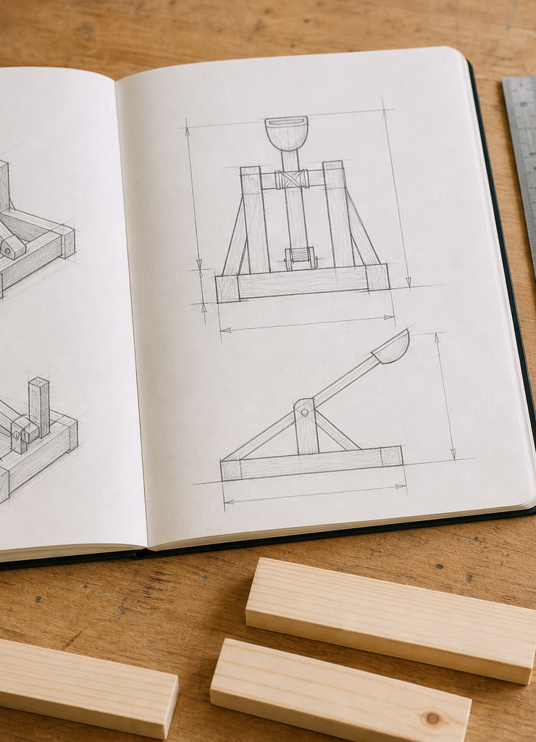
MODULE 05
Communicating a Buildable Design
Develop, justify and communicate a design through agreeing drawings and a checked cutting list.
YEAR 8 • ENGINEERING TECHNOLOGIES AND SYSTEMS
Notes:
Teaching points
- State the learning purpose in one sentence.
- Use the image only as a conceptual project cue; it is not a plan or model specification.
Prompt
- What relationship or evidence do you expect to matter in this module?
Likely misconception
- A realistic image must show the exact project design.
Transition
- Move from the project cue to the three ideas students will learn.
[Sources]
- Year 8 Catapult student theory draft v1.0, module-05, 24 Aug 2026.
- Catapult Booklet 2026.pdf, pp. 8–13; theory draft module-05.
- OpenAI image generation for this course, 24 Aug 2026, conceptual only; file: catapult-design-drawing-concept.png.

Slide 2
MODULE 05 / BUILDABLE DESIGN
The learning question
What makes design information clear enough for another person to check?
1
Compare genuine alternatives
2
Views must agree
3
Plan material with arithmetic
RETRIEVAL WARM-UP
Why is a neat sketch not yet complete production information?
YEAR 8 CATAPULT • MODULE 05
02
Notes:
Teaching points
- Frame the module as a cumulative learning sequence.
- Invite a brief retrieval response before introducing new content.
Prompt
- Why is a neat sketch not yet complete production information?
Likely misconception
- The three ideas are separate facts rather than parts of one explanation.
Transition
- Tell students that each theory slide will supply evidence for the final response.
[Sources]
- Year 8 Catapult student theory draft v1.0, module-05, 24 Aug 2026.
- Catapult Booklet 2026.pdf, pp. 8–13; theory draft module-05.
- Native pathway diagram authored for this deck from the approved module sequence.

Slide 3
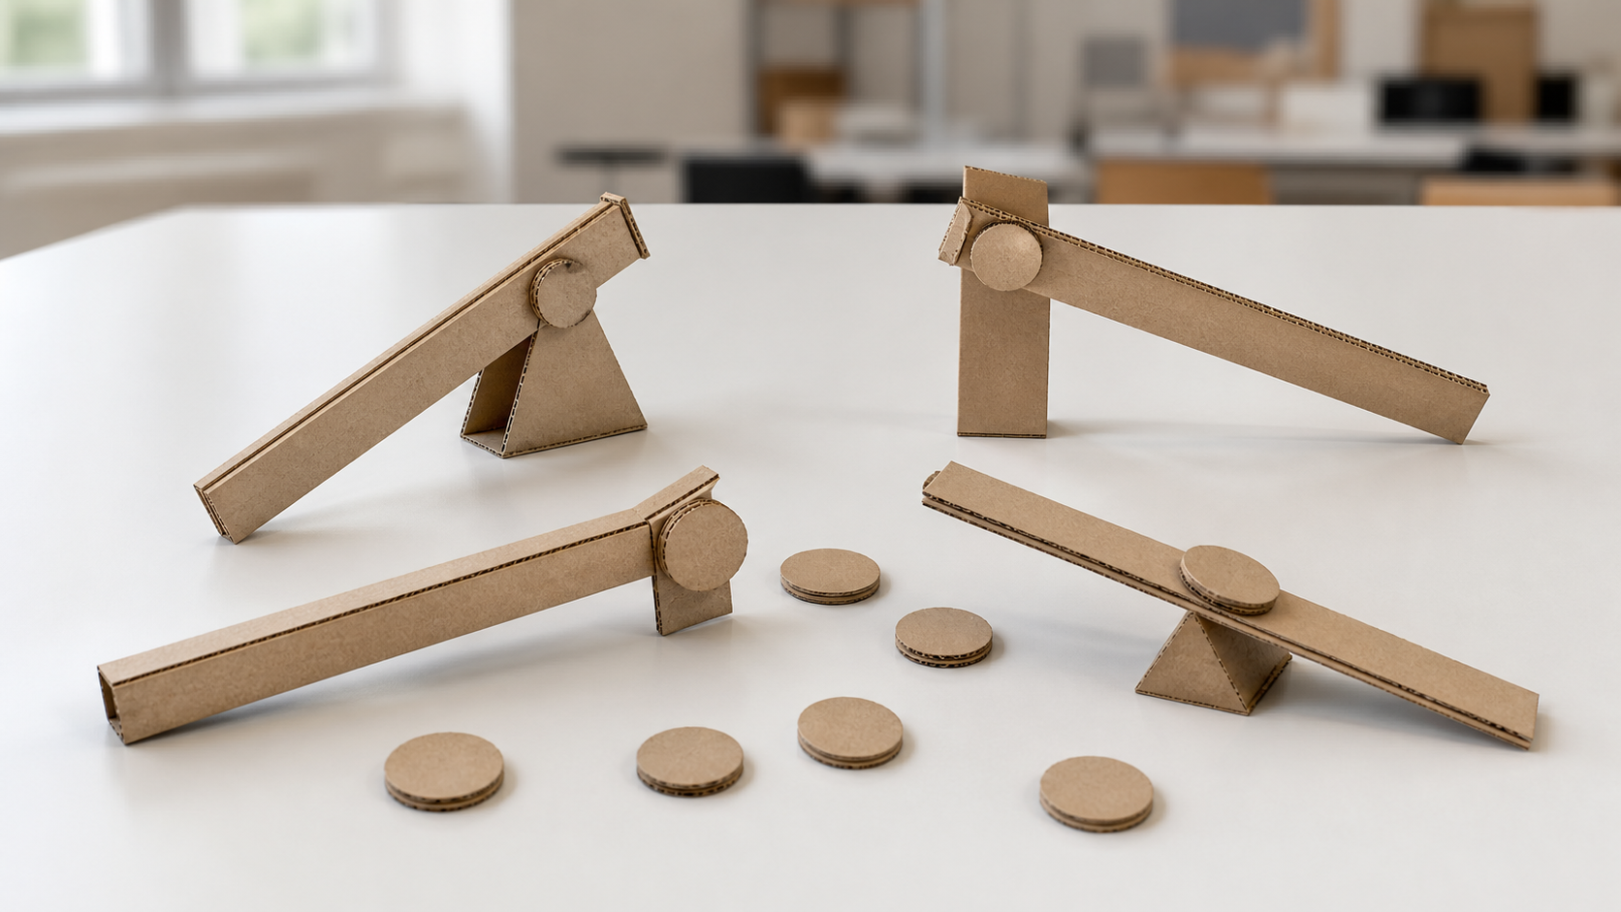
MODULE 05 / BUILDABLE DESIGN
Strong selection begins with genuinely different ideas
Divergent thinking produces alternatives that differ in system organisation, stability or component relationships—not just colour. A PMI records plusses, minusses and interesting points against the brief, materials, likely performance and production demands. The chosen concept needs an evidence-based trade-off.
Decision: identify the evidence that makes one concept a stronger candidate within the confirmed constraints.
Selection begins with genuinely different system ideas, then uses evidence and trade-offs.
NOTICE Look for differences in component relationships—not colour or decoration.
YEAR 8 CATAPULT • MODULE 05
03
Notes:
Teaching points
- Divergent thinking produces alternatives that differ in system organisation, stability or component relationships—not just colour. A PMI records plusses, minusses and interesting points against the brief, materials, likely performance and production demands. The chosen concept needs an evidence-based trade-off.
- Use the visual to emphasise: Look for differences in component relationships—not colour or decoration.
Prompt
- Decision: identify the evidence that makes one concept a stronger candidate within the confirmed constraints.
Likely misconception
- What makes two ideas genuinely different?
Transition
- Link this idea to the next relationship in the module.
[Sources]
- Year 8 Catapult student theory draft v1.0, module-05, 24 Aug 2026.
- Catapult Booklet 2026.pdf, pp. 8–13; theory draft module-05.
- Teaching visual: assets/visuals/theory/m05-genuine-alternatives.png.
- OpenAI image generation for this course, 24 Aug 2026; conceptual teaching still life; final prompt: Four genuinely different nonfunctional cardboard lever studies with blank comparison tokens; no complete Catapult, dimensions or student folio.

Slide 4
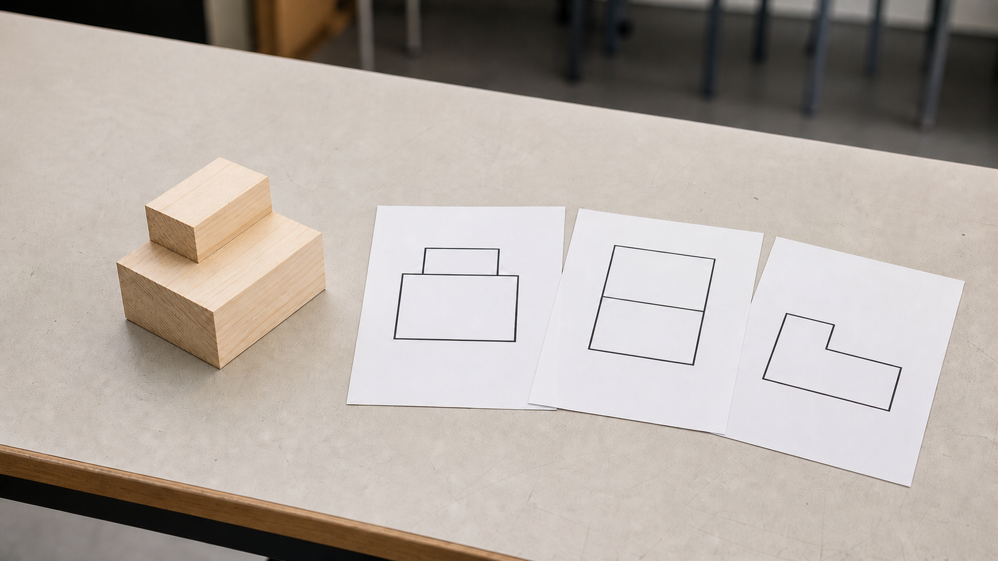
MODULE 05 / BUILDABLE DESIGN
Every view must describe the same object
A pictorial drawing communicates overall form. Orthographic front, top and side views communicate features without perspective. Labels and dimensions make the drawing useful for production only when corresponding features align and the views do not contradict one another.
Every view must describe the same object.
Check: choose one feature and trace it across the front, top and side views.
NOTICE Trace one feature across the front, top and side views and check that its position agrees.
YEAR 8 CATAPULT • MODULE 05
04
Notes:
Teaching points
- A pictorial drawing communicates overall form. Orthographic front, top and side views communicate features without perspective. Labels and dimensions make the drawing useful for production only when corresponding features align and the views do not contradict one another.
- Use the visual to emphasise: Trace one feature across the front, top and side views and check that its position agrees.
Prompt
- Check: choose one feature and trace it across the front, top and side views.
Likely misconception
- Why must orthographic views align?
Transition
- Link this idea to the next relationship in the module.
[Sources]
- Year 8 Catapult student theory draft v1.0, module-05, 24 Aug 2026.
- Catapult Booklet 2026.pdf, pp. 8–13; theory draft module-05.
- Teaching visual: assets/visuals/theory/m05-agreeing-views.png.
- OpenAI image generation for this course, 24 Aug 2026; conceptual teaching still life; final prompt: Generic stepped block beside newly created front, top and side outline views; no dimensions, project form or copied source drawing.

Slide 5

MODULE 05 / BUILDABLE DESIGN
A cutting list links drawings to material decisions
For each part, planned length multiplied by quantity gives the row total. Adding every row total checks the design against the authorised 2400 mm maximum. Correct arithmetic still needs teacher review for missing parts, realistic sequencing and any process allowance.
Worked check: 200 mm × 4 = 800 mm, leaving 1600 mm from the authorised total for other planned pine parts.
A cutting list connects each drawn component to material, quantity and total length.
NOTICE Check that every component is traceable to a view and that row totals reconcile with the confirmed limit.
YEAR 8 CATAPULT • MODULE 05
05
Notes:
Teaching points
- For each part, planned length multiplied by quantity gives the row total. Adding every row total checks the design against the authorised 2400 mm maximum. Correct arithmetic still needs teacher review for missing parts, realistic sequencing and any process allowance.
- Use the visual to emphasise: Check that every component is traceable to a view and that row totals reconcile with the confirmed limit.
Prompt
- Worked check: 200 mm × 4 = 800 mm, leaving 1600 mm from the authorised total for other planned pine parts.
Likely misconception
- How is a row total calculated?
Transition
- Prepare students to retrieve and apply all three ideas.
[Sources]
- Year 8 Catapult student theory draft v1.0, module-05, 24 Aug 2026.
- Catapult Booklet 2026.pdf, pp. 8–13; theory draft module-05.
- Teaching visual: assets/visuals/theory/m05-drawing-to-cutting-list.png.
- OpenAI image generation for this course, 24 Aug 2026; conceptual teaching still life; final prompt: Generic component samples beside blank planning cards, ruler and unlabelled calculator; no project parts, lengths, totals or readable text.

Slide 6
MODULE 05 / BUILDABLE DESIGN
Stop. Think. Explain.
Answer silently first. Then justify one answer with a partner.
1
What makes two ideas genuinely different?
2
Why must orthographic views align?
3
How is a row total calculated?
4
What can correct arithmetic still fail to reveal?
YEAR 8 CATAPULT • MODULE 05
06
Notes:
Teaching points
- Give individual thinking time before partner discussion.
- Ask for evidence or a because-clause, not just the answer.
Prompt
- Which answer changed after discussion, and what evidence changed it?
Likely misconception
- Retrieval is a memory race rather than a chance to repair understanding.
Transition
- Use the strongest unresolved question to launch the evidence scaffold.
[Sources]
- Year 8 Catapult student theory draft v1.0, module-05, 24 Aug 2026.
- Catapult Booklet 2026.pdf, pp. 8–13; theory draft module-05.
- Questions derived from the approved module theory; no external asset used.

Slide 7
MODULE 05 / BUILDABLE DESIGN
Build the evidence, not just an answer
THE QUESTION
Two concepts meet the constraints. One is simpler to produce; the other may allow better adjustment. Explain what evidence would help you choose and how drawings could reduce uncertainty.
READ
Underline the decision
SELECT
Choose precise evidence
EXPLAIN
Connect with theory
CHECK
Answer every part
SENTENCE SUPPORT
Concept A is stronger for … while Concept B allows … The most useful evidence would be … My drawings would reduce uncertainty by …
YEAR 8 CATAPULT • MODULE 05
07
Notes:
Teaching points
- Model how to select evidence before writing the explanation.
- Read the sentence support aloud, then let students change its wording to suit their evidence.
Prompt
- Two concepts meet the constraints. One is simpler to produce; the other may allow better adjustment. Explain what evidence would help you choose and how drawings could reduce uncertainty.
Likely misconception
- Longer writing is automatically stronger evidence.
Transition
- Move from the scaffold to a concise exit ticket and evidence-save action.
[Sources]
- Year 8 Catapult student theory draft v1.0, module-05, 24 Aug 2026.
- Catapult Booklet 2026.pdf, pp. 8–13; theory draft module-05.
- Read–Select–Explain–Check scaffold follows the TAS course presentation standard.

Slide 8
BEFORE YOU PACK UP …
Close the design loop
1. One feature that must agree across views …
SAVE
YOUR
EVIDENCE
2. One trade-off my selection should acknowledge …
3. One cutting-list check I can perform …
Evidence destination: your module response and folio where your teacher directs.
Next: plan a production sequence around dependencies, load paths and checkpoints.
YEAR 8 CATAPULT • MODULE 05
08
Notes:
Teaching points
- Collect a short answer to each exit prompt.
- Make the evidence destination explicit without turning the slide into assessment administration.
Prompt
- Which exit response best shows a changed decision or deeper explanation?
Likely misconception
- The exit ticket is a generic summary with no next evidence action.
Transition
- Next: plan a production sequence around dependencies, load paths and checkpoints.
[Sources]
- Year 8 Catapult student theory draft v1.0, module-05, 24 Aug 2026.
- Catapult Booklet 2026.pdf, pp. 8–13; theory draft module-05.
- Exit-evidence structure follows the TAS course presentation standard.

