Slide 1

MODULE 06
Producing the Base and Frame
Explain dependencies, load paths and evidence checkpoints during teacher-directed production.
YEAR 8 • ENGINEERING TECHNOLOGIES AND SYSTEMS
Notes:
Teaching points
- State the learning purpose in one sentence.
- Use the image only as a conceptual project cue; it is not a plan or model specification.
Prompt
- What relationship or evidence do you expect to matter in this module?
Likely misconception
- A realistic image must show the exact project design.
Transition
- Move from the project cue to the three ideas students will learn.
[Sources]
- Year 8 Catapult student theory draft v1.0, module-06, 24 Aug 2026.
- Catapult Booklet 2026.pdf, pp. 17 and 22–25; teacher sequence; theory draft module-06.
- OpenAI image generation for this course, 24 Aug 2026, conceptual only; file: radiata-pine-grain-samples.png.

Slide 2
MODULE 06 / BASE AND FRAME
The learning question
How do planned checkpoints prevent one early issue from spreading through a system?
1
Sequence around dependencies
2
Trace load paths
3
Record quality evidence
RETRIEVAL WARM-UP
What could depend on the frame being aligned before a later stage begins?
YEAR 8 CATAPULT • MODULE 06
02
Notes:
Teaching points
- Frame the module as a cumulative learning sequence.
- Invite a brief retrieval response before introducing new content.
Prompt
- What could depend on the frame being aligned before a later stage begins?
Likely misconception
- The three ideas are separate facts rather than parts of one explanation.
Transition
- Tell students that each theory slide will supply evidence for the final response.
[Sources]
- Year 8 Catapult student theory draft v1.0, module-06, 24 Aug 2026.
- Catapult Booklet 2026.pdf, pp. 17 and 22–25; teacher sequence; theory draft module-06.
- Native pathway diagram authored for this deck from the approved module sequence.

Slide 3
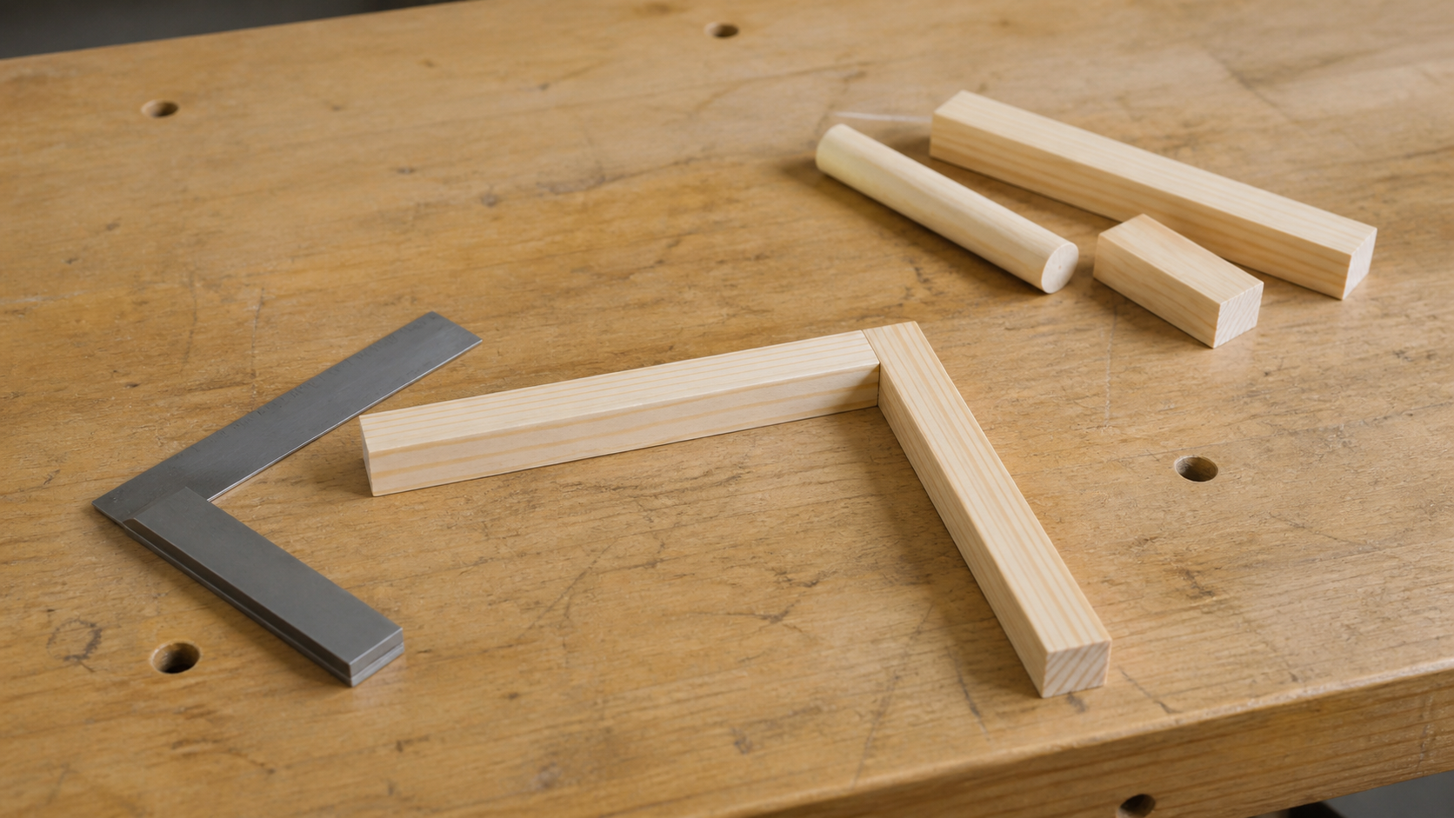
MODULE 06 / BASE AND FRAME
Dependencies determine a sensible sequence
Some production stages rely on earlier information or checks. A later component cannot be confidently fitted when the related drawing or frame alignment is unresolved. A checkpoint is a planned pause to compare the work with approved design information before a dependent stage begins.
Application: name one later stage that depends on a frame checkpoint and explain the risk of skipping it.
A checkpoint protects the next dependent stage from an earlier mismatch.
NOTICE Identify what must be checked before the set-aside components can sensibly be added.
YEAR 8 CATAPULT • MODULE 06
03
Notes:
Teaching points
- Some production stages rely on earlier information or checks. A later component cannot be confidently fitted when the related drawing or frame alignment is unresolved. A checkpoint is a planned pause to compare the work with approved design information before a dependent stage begins.
- Use the visual to emphasise: Identify what must be checked before the set-aside components can sensibly be added.
Prompt
- Application: name one later stage that depends on a frame checkpoint and explain the risk of skipping it.
Likely misconception
- What is a production dependency?
Transition
- Link this idea to the next relationship in the module.
[Sources]
- Year 8 Catapult student theory draft v1.0, module-06, 24 Aug 2026.
- Catapult Booklet 2026.pdf, pp. 17 and 22–25; teacher sequence; theory draft module-06.
- Teaching visual: assets/visuals/theory/m06-check-before-next-stage.png.
- OpenAI image generation for this course, 24 Aug 2026; conceptual teaching still life; final prompt: Loose partial timber corner relationship checked with a square while later components remain set aside; no joinery or sequence.

Slide 4
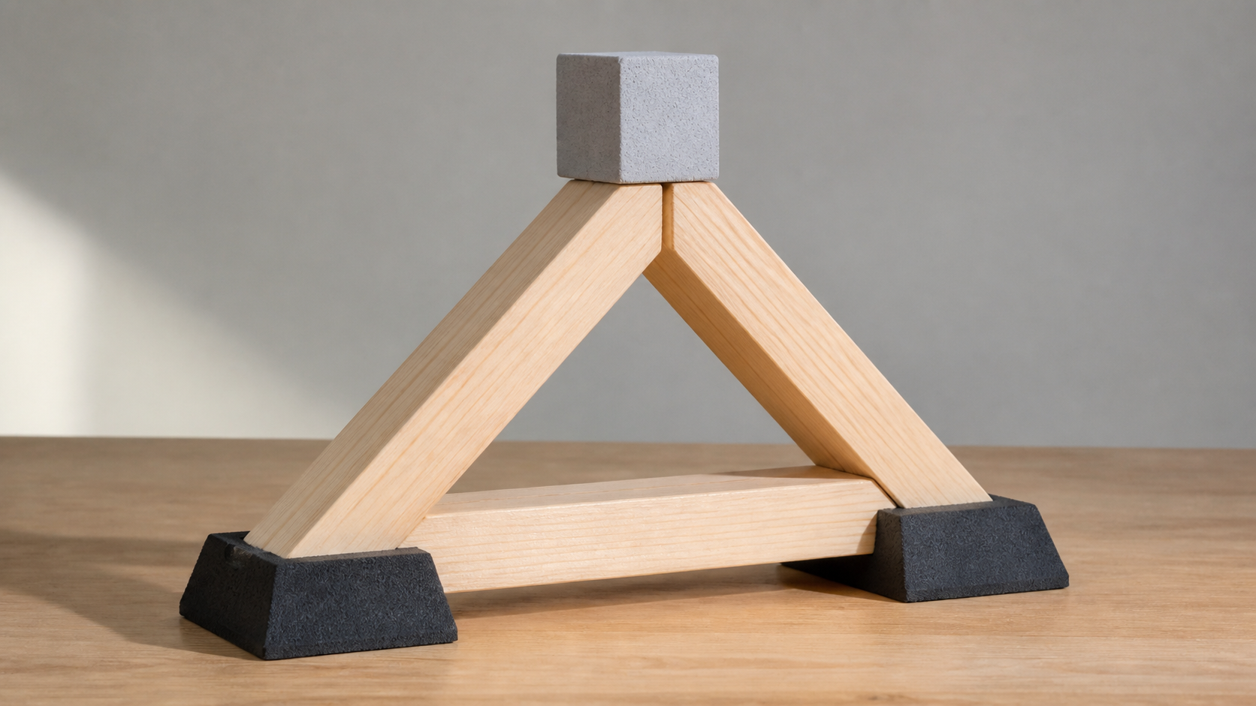
MODULE 06 / BASE AND FRAME
Structures carry forces along load paths
A load path is the route a force follows through a structure towards its supports. Members may experience compression, tension, shear, torsion or bending. Bracing and shape matter only when they suit the actual path, joints and material—not because one shape is automatically strong everywhere.
Loads travel through connected members and joints towards supports.
Reason: trace where movement begins and where the force could travel before proposing added material.
NOTICE Follow where the applied load could travel and locate an interface that might interrupt the path.
YEAR 8 CATAPULT • MODULE 06
04
Notes:
Teaching points
- A load path is the route a force follows through a structure towards its supports. Members may experience compression, tension, shear, torsion or bending. Bracing and shape matter only when they suit the actual path, joints and material—not because one shape is automatically strong everywhere.
- Use the visual to emphasise: Follow where the applied load could travel and locate an interface that might interrupt the path.
Prompt
- Reason: trace where movement begins and where the force could travel before proposing added material.
Likely misconception
- What does a load path describe?
Transition
- Link this idea to the next relationship in the module.
[Sources]
- Year 8 Catapult student theory draft v1.0, module-06, 24 Aug 2026.
- Catapult Booklet 2026.pdf, pp. 17 and 22–25; teacher sequence; theory draft module-06.
- Teaching visual: assets/visuals/theory/m06-load-path-model.png.
- OpenAI image generation for this course, 24 Aug 2026; conceptual teaching still life; final prompt: Abstract triangular timber teaching frame supporting a light neutral block above broad supports; no Catapult geometry or strength claim.

Slide 5
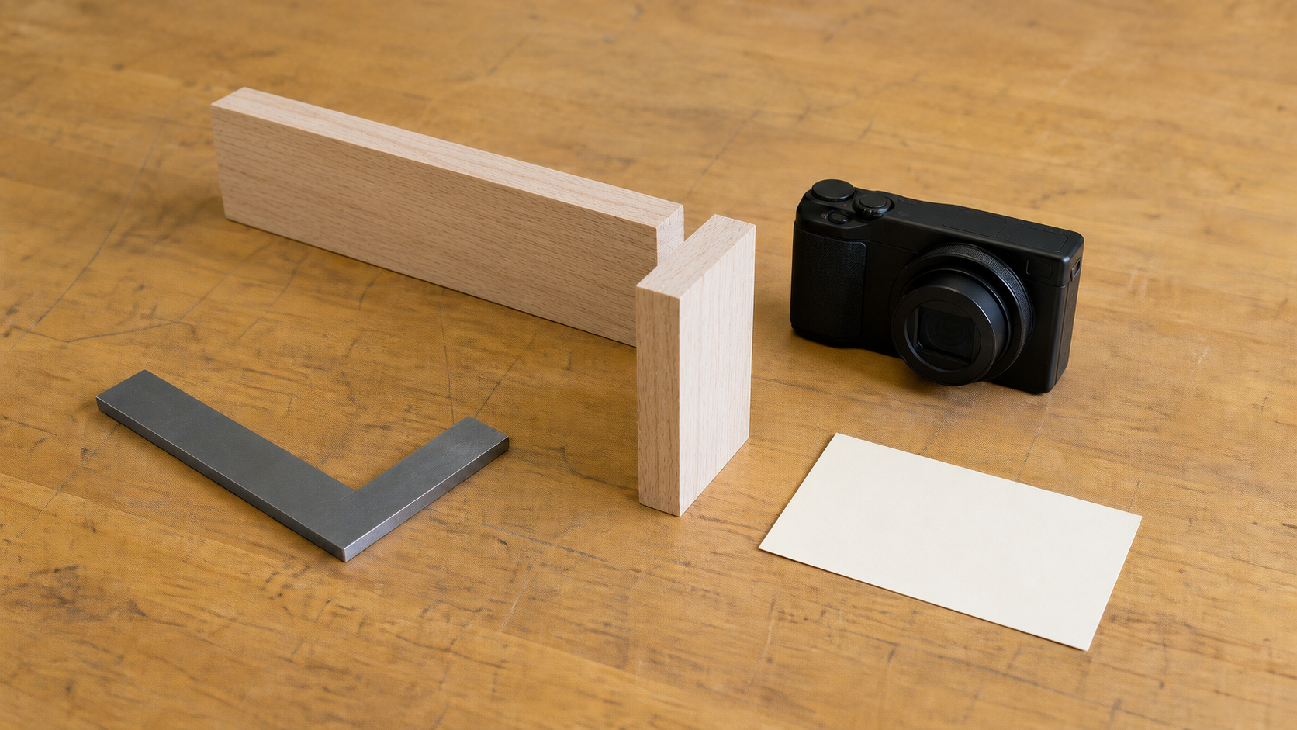
MODULE 06 / BASE AND FRAME
Quality evidence should show relationships between parts
Squareness, symmetry, joint quality, stability and efficient material use are connected. Accurate individual components can still assemble into a misaligned system. A useful photo or note identifies the feature, the check, the decision and what changed; it does not prove competence by itself.
Evidence move: caption one checkpoint image so it explains what was checked and why it mattered.
Quality evidence records the relationship checked, the observation and the reason for any adjustment.
NOTICE Look for a clear subject and the feature that the evidence would need to explain.
YEAR 8 CATAPULT • MODULE 06
05
Notes:
Teaching points
- Squareness, symmetry, joint quality, stability and efficient material use are connected. Accurate individual components can still assemble into a misaligned system. A useful photo or note identifies the feature, the check, the decision and what changed; it does not prove competence by itself.
- Use the visual to emphasise: Look for a clear subject and the feature that the evidence would need to explain.
Prompt
- Evidence move: caption one checkpoint image so it explains what was checked and why it mattered.
Likely misconception
- Why does extra material not automatically fix a frame?
Transition
- Prepare students to retrieve and apply all three ideas.
[Sources]
- Year 8 Catapult student theory draft v1.0, module-06, 24 Aug 2026.
- Catapult Booklet 2026.pdf, pp. 17 and 22–25; teacher sequence; theory draft module-06.
- Teaching visual: assets/visuals/theory/m06-quality-evidence.png.
- OpenAI image generation for this course, 24 Aug 2026; conceptual teaching still life; final prompt: Partial generic frame, square, unmarked camera and blank evidence card; no drilled holes, controls, student work or pass claim.

Slide 6
MODULE 06 / BASE AND FRAME
Stop. Think. Explain.
Answer silently first. Then justify one answer with a partner.
1
What is a production dependency?
2
What does a load path describe?
3
Why does extra material not automatically fix a frame?
4
What makes a production photograph useful evidence?
YEAR 8 CATAPULT • MODULE 06
06
Notes:
Teaching points
- Give individual thinking time before partner discussion.
- Ask for evidence or a because-clause, not just the answer.
Prompt
- Which answer changed after discussion, and what evidence changed it?
Likely misconception
- Retrieval is a memory race rather than a chance to repair understanding.
Transition
- Use the strongest unresolved question to launch the evidence scaffold.
[Sources]
- Year 8 Catapult student theory draft v1.0, module-06, 24 Aug 2026.
- Catapult Booklet 2026.pdf, pp. 17 and 22–25; teacher sequence; theory draft module-06.
- Questions derived from the approved module theory; no external asset used.

Slide 7
MODULE 06 / BASE AND FRAME
Build the evidence, not just an answer
THE QUESTION
A frame looks neat but shifts sideways during a teacher-approved check. Explain possible load-path, alignment and joint causes, then state the evidence needed before one change.
READ
Underline the decision
SELECT
Choose precise evidence
EXPLAIN
Connect with theory
CHECK
Answer every part
SENTENCE SUPPORT
The neat appearance does not prove … The movement may begin at … Evidence about … would help distinguish … before changing …
YEAR 8 CATAPULT • MODULE 06
07
Notes:
Teaching points
- Model how to select evidence before writing the explanation.
- Read the sentence support aloud, then let students change its wording to suit their evidence.
Prompt
- A frame looks neat but shifts sideways during a teacher-approved check. Explain possible load-path, alignment and joint causes, then state the evidence needed before one change.
Likely misconception
- Longer writing is automatically stronger evidence.
Transition
- Move from the scaffold to a concise exit ticket and evidence-save action.
[Sources]
- Year 8 Catapult student theory draft v1.0, module-06, 24 Aug 2026.
- Catapult Booklet 2026.pdf, pp. 17 and 22–25; teacher sequence; theory draft module-06.
- Read–Select–Explain–Check scaffold follows the TAS course presentation standard.

Slide 8
BEFORE YOU PACK UP …
Close the design loop
1. One dependency I can plan for …
SAVE
YOUR
EVIDENCE
2. One load path I can trace …
3. One checkpoint record I can improve …
Evidence destination: your module response and folio where your teacher directs.
Next: map component interactions and use quality checks during assembly.
YEAR 8 CATAPULT • MODULE 06
08
Notes:
Teaching points
- Collect a short answer to each exit prompt.
- Make the evidence destination explicit without turning the slide into assessment administration.
Prompt
- Which exit response best shows a changed decision or deeper explanation?
Likely misconception
- The exit ticket is a generic summary with no next evidence action.
Transition
- Next: map component interactions and use quality checks during assembly.
[Sources]
- Year 8 Catapult student theory draft v1.0, module-06, 24 Aug 2026.
- Catapult Booklet 2026.pdf, pp. 17 and 22–25; teacher sequence; theory draft module-06.
- Exit-evidence structure follows the TAS course presentation standard.

