Slide 1
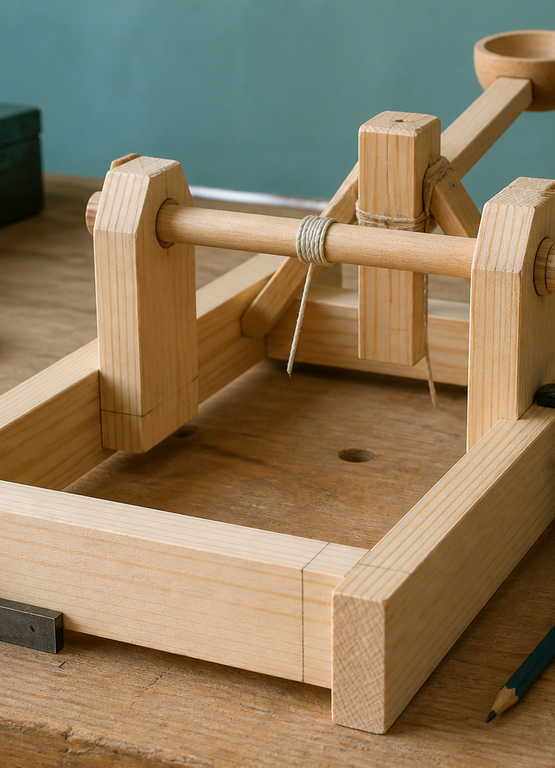
MODULE 07
Components, Assembly and Quality
Trace component interactions and use a controlled adjustment loop to improve evidence.
YEAR 8 • ENGINEERING TECHNOLOGIES AND SYSTEMS
Notes:
Teaching points
- State the learning purpose in one sentence.
- Use the image only as a conceptual project cue; it is not a plan or model specification.
Prompt
- What relationship or evidence do you expect to matter in this module?
Likely misconception
- A realistic image must show the exact project design.
Transition
- Move from the project cue to the three ideas students will learn.
[Sources]
- Year 8 Catapult student theory draft v1.0, module-07, 24 Aug 2026.
- Teacher unit sequence; core artefact manifest v1.0; theory draft module-07.
- OpenAI image generation for this course, 24 Aug 2026, conceptual only; file: catapult-assembly-quality.png.

Slide 2
MODULE 07 / ASSEMBLY AND QUALITY
The learning question
Why can one small assembly change affect several parts of the system?
1
Components form a chain
2
Fit changes motion
3
Adjust one cause at a time
RETRIEVAL WARM-UP
If a pivot position changes, what other relationships may also change?
YEAR 8 CATAPULT • MODULE 07
02
Notes:
Teaching points
- Frame the module as a cumulative learning sequence.
- Invite a brief retrieval response before introducing new content.
Prompt
- If a pivot position changes, what other relationships may also change?
Likely misconception
- The three ideas are separate facts rather than parts of one explanation.
Transition
- Tell students that each theory slide will supply evidence for the final response.
[Sources]
- Year 8 Catapult student theory draft v1.0, module-07, 24 Aug 2026.
- Teacher unit sequence; core artefact manifest v1.0; theory draft module-07.
- Native pathway diagram authored for this deck from the approved module sequence.

Slide 3
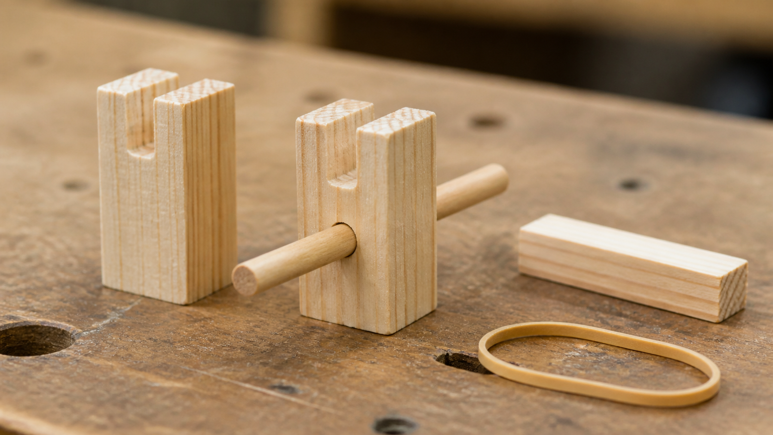
MODULE 07 / ASSEMBLY AND QUALITY
Component functions form an interaction chain
The base and frame support and locate parts; a pivot permits rotation; a lever carries motion; an energy store supplies energy; and fasteners connect components. These are functions, not a prescribed design. The key is predicting how one relationship affects the rest.
System map: choose one component change and draw arrows to every relationship that should be rechecked.
Changing one interface can alter alignment, clearance, friction and forces elsewhere.
NOTICE Trace the chain from support to pivot to motion without treating the close-up as a build instruction.
YEAR 8 CATAPULT • MODULE 07
03
Notes:
Teaching points
- The base and frame support and locate parts; a pivot permits rotation; a lever carries motion; an energy store supplies energy; and fasteners connect components. These are functions, not a prescribed design. The key is predicting how one relationship affects the rest.
- Use the visual to emphasise: Trace the chain from support to pivot to motion without treating the close-up as a build instruction.
Prompt
- System map: choose one component change and draw arrows to every relationship that should be rechecked.
Likely misconception
- Why is a component list not yet an interaction map?
Transition
- Link this idea to the next relationship in the module.
[Sources]
- Year 8 Catapult student theory draft v1.0, module-07, 24 Aug 2026.
- Teacher unit sequence; core artefact manifest v1.0; theory draft module-07.
- Teaching visual: assets/visuals/theory/m07-component-interaction.png.
- OpenAI image generation for this course, 24 Aug 2026; conceptual teaching still life; final prompt: Tight macro of an incomplete support, dowel and short lever relationship with a separate elastic loop; cropped, inactive and non-prescriptive.

Slide 4
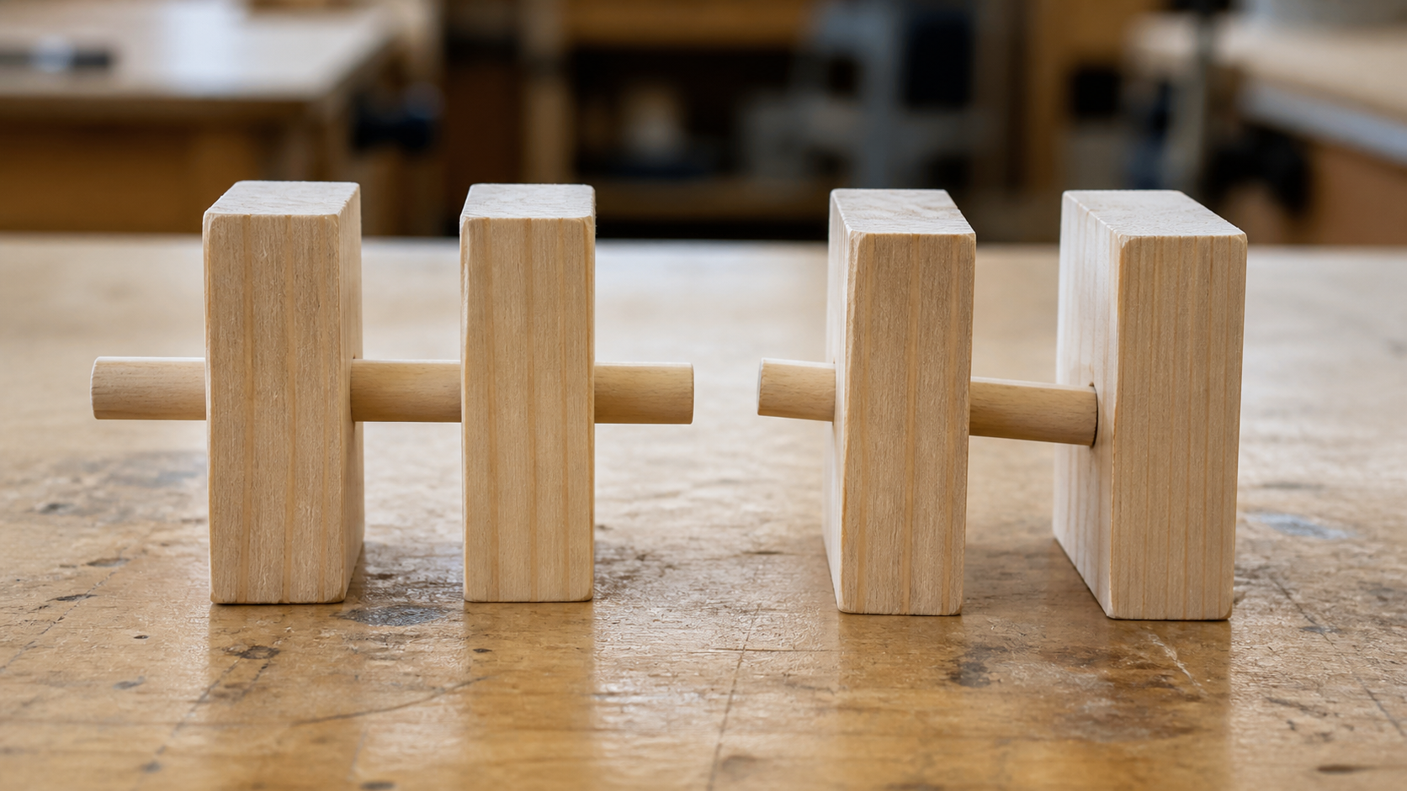
MODULE 07 / ASSEMBLY AND QUALITY
Alignment, fit and friction shape quality
Poor alignment can create rubbing, unwanted sideways forces and inconsistent movement. Friction can be useful where a fastener must hold yet wasteful where a moving relationship should travel freely. Play, stiffness, fastening and clearance must be judged together.
Alignment and fit shape movement; friction may be useful or unwanted depending on function.
Compare: where is friction helpful in the system, and where could it interfere with the intended function?
NOTICE Compare centrelines, clearance and contact; do not judge quality from neat appearance alone.
YEAR 8 CATAPULT • MODULE 07
04
Notes:
Teaching points
- Poor alignment can create rubbing, unwanted sideways forces and inconsistent movement. Friction can be useful where a fastener must hold yet wasteful where a moving relationship should travel freely. Play, stiffness, fastening and clearance must be judged together.
- Use the visual to emphasise: Compare centrelines, clearance and contact; do not judge quality from neat appearance alone.
Prompt
- Compare: where is friction helpful in the system, and where could it interfere with the intended function?
Likely misconception
- Where might friction be useful?
Transition
- Link this idea to the next relationship in the module.
[Sources]
- Year 8 Catapult student theory draft v1.0, module-07, 24 Aug 2026.
- Teacher unit sequence; core artefact manifest v1.0; theory draft module-07.
- Teaching visual: assets/visuals/theory/m07-alignment-comparison.png.
- OpenAI image generation for this course, 24 Aug 2026; conceptual teaching still life; final prompt: Split photographic comparison of two abstract paired-support models, one aligned and one misaligned; no tolerances or adjustment method.

Slide 5
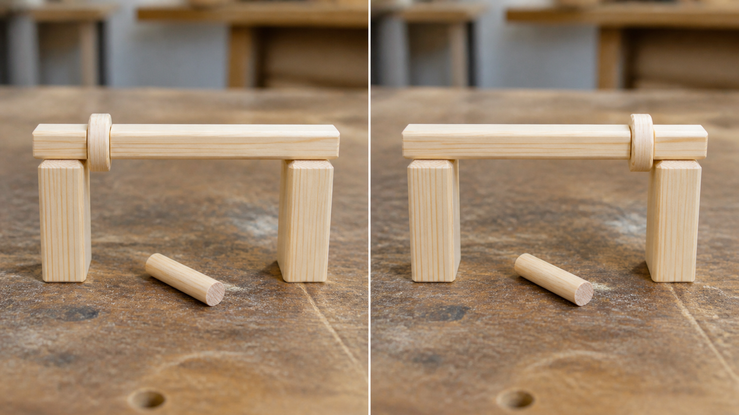
MODULE 07 / ASSEMBLY AND QUALITY
One controlled adjustment protects cause and effect
Stop at the observed behaviour, identify a likely cause and predict what one teacher-approved adjustment should change. Repeat the same relevant check and compare the new evidence. Several simultaneous changes hide which one mattered and weaken the explanation.
Evidence move: write the reason, one change, predicted effect and before-and-after comparison.
One controlled adjustment preserves cause-and-effect evidence.
NOTICE Find the single visible change and identify what should be rechecked before making another.
YEAR 8 CATAPULT • MODULE 07
05
Notes:
Teaching points
- Stop at the observed behaviour, identify a likely cause and predict what one teacher-approved adjustment should change. Repeat the same relevant check and compare the new evidence. Several simultaneous changes hide which one mattered and weaken the explanation.
- Use the visual to emphasise: Find the single visible change and identify what should be rechecked before making another.
Prompt
- Evidence move: write the reason, one change, predicted effect and before-and-after comparison.
Likely misconception
- How can excess play affect consistency?
Transition
- Prepare students to retrieve and apply all three ideas.
[Sources]
- Year 8 Catapult student theory draft v1.0, module-07, 24 Aug 2026.
- Teacher unit sequence; core artefact manifest v1.0; theory draft module-07.
- Teaching visual: assets/visuals/theory/m07-one-controlled-change.png.
- OpenAI image generation for this course, 24 Aug 2026; conceptual teaching still life; final prompt: Photographic diptych of the same abstract interface with one spacer repositioned and everything else unchanged; no result claim.

Slide 6
MODULE 07 / ASSEMBLY AND QUALITY
Stop. Think. Explain.
Answer silently first. Then justify one answer with a partner.
1
Why is a component list not yet an interaction map?
2
Where might friction be useful?
3
How can excess play affect consistency?
4
Why should several features not change at once?
YEAR 8 CATAPULT • MODULE 07
06
Notes:
Teaching points
- Give individual thinking time before partner discussion.
- Ask for evidence or a because-clause, not just the answer.
Prompt
- Which answer changed after discussion, and what evidence changed it?
Likely misconception
- Retrieval is a memory race rather than a chance to repair understanding.
Transition
- Use the strongest unresolved question to launch the evidence scaffold.
[Sources]
- Year 8 Catapult student theory draft v1.0, module-07, 24 Aug 2026.
- Teacher unit sequence; core artefact manifest v1.0; theory draft module-07.
- Questions derived from the approved module theory; no external asset used.

Slide 7
MODULE 07 / ASSEMBLY AND QUALITY
Build the evidence, not just an answer
THE QUESTION
One adjustment reduces friction but increases sideways movement. Explain the system trade-off and identify the evidence required before accepting the change.
READ
Underline the decision
SELECT
Choose precise evidence
EXPLAIN
Connect with theory
CHECK
Answer every part
SENTENCE SUPPORT
The adjustment improves … but it also changes … This trade-off matters because … I would accept it only if the evidence shows …
YEAR 8 CATAPULT • MODULE 07
07
Notes:
Teaching points
- Model how to select evidence before writing the explanation.
- Read the sentence support aloud, then let students change its wording to suit their evidence.
Prompt
- One adjustment reduces friction but increases sideways movement. Explain the system trade-off and identify the evidence required before accepting the change.
Likely misconception
- Longer writing is automatically stronger evidence.
Transition
- Move from the scaffold to a concise exit ticket and evidence-save action.
[Sources]
- Year 8 Catapult student theory draft v1.0, module-07, 24 Aug 2026.
- Teacher unit sequence; core artefact manifest v1.0; theory draft module-07.
- Read–Select–Explain–Check scaffold follows the TAS course presentation standard.

Slide 8
BEFORE YOU PACK UP …
Close the design loop
1. One interaction I can map …
SAVE
YOUR
EVIDENCE
2. One quality check linked to function …
3. One adjustment I can explain with cause and effect …
Evidence destination: your module response and folio where your teacher directs.
Next: use repeated data and controlled redesign to make a defensible recommendation.
YEAR 8 CATAPULT • MODULE 07
08
Notes:
Teaching points
- Collect a short answer to each exit prompt.
- Make the evidence destination explicit without turning the slide into assessment administration.
Prompt
- Which exit response best shows a changed decision or deeper explanation?
Likely misconception
- The exit ticket is a generic summary with no next evidence action.
Transition
- Next: use repeated data and controlled redesign to make a defensible recommendation.
[Sources]
- Year 8 Catapult student theory draft v1.0, module-07, 24 Aug 2026.
- Teacher unit sequence; core artefact manifest v1.0; theory draft module-07.
- Exit-evidence structure follows the TAS course presentation standard.

