Slide 1
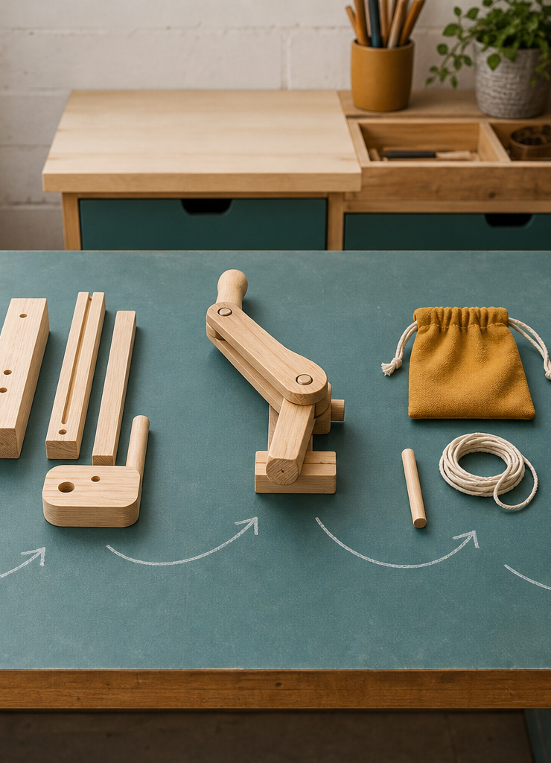
MODULE 09
Engineering Report and Sustainability
Build an engineering report that links claims to evidence and makes a balanced sustainability judgement.
YEAR 8 • ENGINEERING TECHNOLOGIES AND SYSTEMS
Notes:
Teaching points
- State the learning purpose in one sentence.
- Use the image only as a conceptual project cue; it is not a plan or model specification.
Prompt
- What relationship or evidence do you expect to matter in this module?
Likely misconception
- A realistic image must show the exact project design.
Transition
- Move from the project cue to the three ideas students will learn.
[Sources]
- Year 8 Catapult student theory draft v1.0, module-09, 24 Aug 2026.
- Catapult Booklet 2026.pdf, pp. 18–21; source map; theory draft module-09.
- OpenAI image generation for this course, 24 Aug 2026, conceptual only; file: timber-life-cycle-still-life.png.

Slide 2
MODULE 09 / REPORT AND SUSTAINABILITY
The learning question
How does a report turn project records into a credible engineering conclusion?
1
Report the design journey
2
Link claim, evidence and reasoning
3
Think across a life cycle
RETRIEVAL WARM-UP
Why does a limitation strengthen rather than weaken an honest conclusion?
YEAR 8 CATAPULT • MODULE 09
02
Notes:
Teaching points
- Frame the module as a cumulative learning sequence.
- Invite a brief retrieval response before introducing new content.
Prompt
- Why does a limitation strengthen rather than weaken an honest conclusion?
Likely misconception
- The three ideas are separate facts rather than parts of one explanation.
Transition
- Tell students that each theory slide will supply evidence for the final response.
[Sources]
- Year 8 Catapult student theory draft v1.0, module-09, 24 Aug 2026.
- Catapult Booklet 2026.pdf, pp. 18–21; source map; theory draft module-09.
- Native pathway diagram authored for this deck from the approved module sequence.

Slide 3

MODULE 09 / REPORT AND SUSTAINABILITY
A report follows the design journey
A clear engineering report moves from brief and design decision through production evidence, test method, results, discussion, sustainability and conclusion. The conclusion answers the original problem using the strongest evidence and states limits such as few trials or unresolved variation.
Structure: place one existing project record into the report section where it can do the most explanatory work.
An engineering report follows the evidence from need and decisions to testing, evaluation and conclusion.
NOTICE Trace which record answers each stage and where a limitation would be acknowledged.
YEAR 8 CATAPULT • MODULE 09
03
Notes:
Teaching points
- A clear engineering report moves from brief and design decision through production evidence, test method, results, discussion, sustainability and conclusion. The conclusion answers the original problem using the strongest evidence and states limits such as few trials or unresolved variation.
- Use the visual to emphasise: Trace which record answers each stage and where a limitation would be acknowledged.
Prompt
- Structure: place one existing project record into the report section where it can do the most explanatory work.
Likely misconception
- What should a conclusion answer?
Transition
- Link this idea to the next relationship in the module.
[Sources]
- Year 8 Catapult student theory draft v1.0, module-09, 24 Aug 2026.
- Catapult Booklet 2026.pdf, pp. 18–21; source map; theory draft module-09.
- Teaching visual: assets/visuals/theory/m09-report-evidence-journey.png.
- OpenAI image generation for this course, 24 Aug 2026; conceptual teaching still life; final prompt: Teacher-created photo-essay desk arranged left to right with brief folder, concept, production photo, blank results sheet, repair item and conclusion notebook.

Slide 4

MODULE 09 / REPORT AND SUSTAINABILITY
Claim, evidence and reasoning build credibility
A claim is a focused judgement. Evidence is the specific observation, measurement, drawing, photograph or production record that supports it. Reasoning uses engineering knowledge to explain the connection. A folder full of unlabelled photos is not automatically strong evidence.
A claim gains credibility when selected evidence is connected to engineering reasoning.
Improve: choose one clear item, label what it shows and explain why it matters to the claim.
NOTICE Identify the one feature the evidence shows and the idea needed to explain why it matters.
YEAR 8 CATAPULT • MODULE 09
04
Notes:
Teaching points
- A claim is a focused judgement. Evidence is the specific observation, measurement, drawing, photograph or production record that supports it. Reasoning uses engineering knowledge to explain the connection. A folder full of unlabelled photos is not automatically strong evidence.
- Use the visual to emphasise: Identify the one feature the evidence shows and the idea needed to explain why it matters.
Prompt
- Improve: choose one clear item, label what it shows and explain why it matters to the claim.
Likely misconception
- How is evidence different from reasoning?
Transition
- Link this idea to the next relationship in the module.
[Sources]
- Year 8 Catapult student theory draft v1.0, module-09, 24 Aug 2026.
- Catapult Booklet 2026.pdf, pp. 18–21; source map; theory draft module-09.
- Teaching visual: assets/visuals/theory/m09-claim-evidence-reasoning.png.
- OpenAI image generation for this course, 24 Aug 2026; conceptual teaching still life; final prompt: Close-up generic pine feature beside one teacher-created photo print, blank observation card and open blank notebook; no claim, result or student work.

Slide 5

MODULE 09 / REPORT AND SUSTAINABILITY
Sustainability is a life-cycle judgement
Environmental, social and economic effects interact. Consider sourcing, processing, material efficiency, lifespan, repair, waste, people, access, time and cost. Calling timber natural or recyclable does not prove the whole solution is sustainable; the judgement must match available evidence.
Balance: identify one benefit, one cost or trade-off and one missing piece of life-cycle evidence.
Sustainability is a life-cycle judgement across environmental, social and economic trade-offs.
NOTICE Look beyond the material label: consider sourcing, waste, useful life, repair and end of life.
YEAR 8 CATAPULT • MODULE 09
05
Notes:
Teaching points
- Environmental, social and economic effects interact. Consider sourcing, processing, material efficiency, lifespan, repair, waste, people, access, time and cost. Calling timber natural or recyclable does not prove the whole solution is sustainable; the judgement must match available evidence.
- Use the visual to emphasise: Look beyond the material label: consider sourcing, waste, useful life, repair and end of life.
Prompt
- Balance: identify one benefit, one cost or trade-off and one missing piece of life-cycle evidence.
Likely misconception
- Why are selected, labelled photos stronger than a large folder?
Transition
- Prepare students to retrieve and apply all three ideas.
[Sources]
- Year 8 Catapult student theory draft v1.0, module-09, 24 Aug 2026.
- Catapult Booklet 2026.pdf, pp. 18–21; source map; theory draft module-09.
- Teaching visual: assets/visuals/theory/m09-life-cycle-judgement.png.
- OpenAI image generation for this course, 24 Aug 2026; conceptual teaching still life; final prompt: Durable generic timber object beside a worn replaceable part, repair materials and reusable offcuts; no certification or green claim.

Slide 6
MODULE 09 / REPORT AND SUSTAINABILITY
Stop. Think. Explain.
Answer silently first. Then justify one answer with a partner.
1
What should a conclusion answer?
2
How is evidence different from reasoning?
3
Why are selected, labelled photos stronger than a large folder?
4
Why is ‘natural’ not enough to prove sustainability?
YEAR 8 CATAPULT • MODULE 09
06
Notes:
Teaching points
- Give individual thinking time before partner discussion.
- Ask for evidence or a because-clause, not just the answer.
Prompt
- Which answer changed after discussion, and what evidence changed it?
Likely misconception
- Retrieval is a memory race rather than a chance to repair understanding.
Transition
- Use the strongest unresolved question to launch the evidence scaffold.
[Sources]
- Year 8 Catapult student theory draft v1.0, module-09, 24 Aug 2026.
- Catapult Booklet 2026.pdf, pp. 18–21; source map; theory draft module-09.
- Questions derived from the approved module theory; no external asset used.

Slide 7
MODULE 09 / REPORT AND SUSTAINABILITY
Build the evidence, not just an answer
THE QUESTION
A redesign improves consistency but uses more material and production time. Write a balanced judgement across environmental, social and economic effects, then state missing evidence.
READ
Underline the decision
SELECT
Choose precise evidence
EXPLAIN
Connect with theory
CHECK
Answer every part
SENTENCE SUPPORT
The redesign improves … Environmentally … Socially … Economically … Overall … This judgement is limited because …
YEAR 8 CATAPULT • MODULE 09
07
Notes:
Teaching points
- Model how to select evidence before writing the explanation.
- Read the sentence support aloud, then let students change its wording to suit their evidence.
Prompt
- A redesign improves consistency but uses more material and production time. Write a balanced judgement across environmental, social and economic effects, then state missing evidence.
Likely misconception
- Longer writing is automatically stronger evidence.
Transition
- Move from the scaffold to a concise exit ticket and evidence-save action.
[Sources]
- Year 8 Catapult student theory draft v1.0, module-09, 24 Aug 2026.
- Catapult Booklet 2026.pdf, pp. 18–21; source map; theory draft module-09.
- Read–Select–Explain–Check scaffold follows the TAS course presentation standard.

Slide 8
BEFORE YOU PACK UP …
Close the design loop
1. One claim I can support …
SAVE
YOUR
EVIDENCE
2. One record I can turn into evidence …
3. One sustainability trade-off I can explain …
Evidence destination: your module response and folio where your teacher directs.
Next: demonstrate function, evaluate against evidence and connect systems thinking responsibly.
YEAR 8 CATAPULT • MODULE 09
08
Notes:
Teaching points
- Collect a short answer to each exit prompt.
- Make the evidence destination explicit without turning the slide into assessment administration.
Prompt
- Which exit response best shows a changed decision or deeper explanation?
Likely misconception
- The exit ticket is a generic summary with no next evidence action.
Transition
- Next: demonstrate function, evaluate against evidence and connect systems thinking responsibly.
[Sources]
- Year 8 Catapult student theory draft v1.0, module-09, 24 Aug 2026.
- Catapult Booklet 2026.pdf, pp. 18–21; source map; theory draft module-09.
- Exit-evidence structure follows the TAS course presentation standard.

