Slide 1
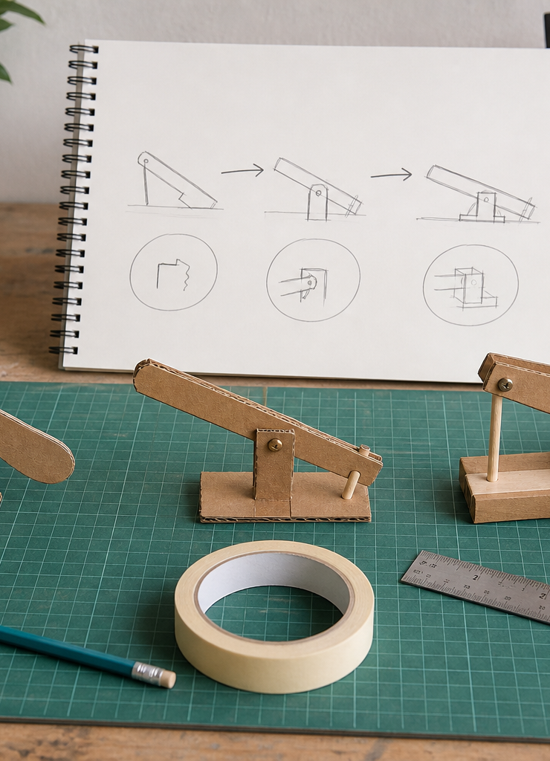
MODULE 10
Demonstration, Evaluation and Connected Systems
Communicate evidence, evaluate a trade-off and approach Aboriginal engineering systems with context first.
YEAR 8 • ENGINEERING TECHNOLOGIES AND SYSTEMS
Notes:
Teaching points
- State the learning purpose in one sentence.
- Use the image only as a conceptual project cue; it is not a plan or model specification.
Prompt
- What relationship or evidence do you expect to matter in this module?
Likely misconception
- A realistic image must show the exact project design.
Transition
- Move from the project cue to the three ideas students will learn.
[Sources]
- Year 8 Catapult student theory draft v1.0, module-10, 24 Aug 2026.
- Catapult Booklet 2026.pdf, pp. 18–19 and 27–31; Heritage NSW on Baiame’s Ngunnhu; Gunditj Mirring and UNESCO on Budj Bim; cultural-source brief; theory draft module-10.
- OpenAI image generation for this course, 24 Aug 2026, conceptual only; file: prototype-redesign-sequence.png.

Slide 2
MODULE 10 / EVALUATION AND CONNECTED SYSTEMS
The learning question
How do we close the design loop with honest evidence and respectful systems thinking?
1
Demonstrate through evidence
2
Evaluate product and process
3
Context before systems comparison
RETRIEVAL WARM-UP
Why is maximum performance not automatically the strongest demonstration?
YEAR 8 CATAPULT • MODULE 10
02
Notes:
Teaching points
- Frame the module as a cumulative learning sequence.
- Invite a brief retrieval response before introducing new content.
Prompt
- Why is maximum performance not automatically the strongest demonstration?
Likely misconception
- The three ideas are separate facts rather than parts of one explanation.
Transition
- Tell students that each theory slide will supply evidence for the final response.
[Sources]
- Year 8 Catapult student theory draft v1.0, module-10, 24 Aug 2026.
- Catapult Booklet 2026.pdf, pp. 18–19 and 27–31; Heritage NSW on Baiame’s Ngunnhu; Gunditj Mirring and UNESCO on Budj Bim; cultural-source brief; theory draft module-10.
- Native pathway diagram authored for this deck from the approved module sequence.

Slide 3
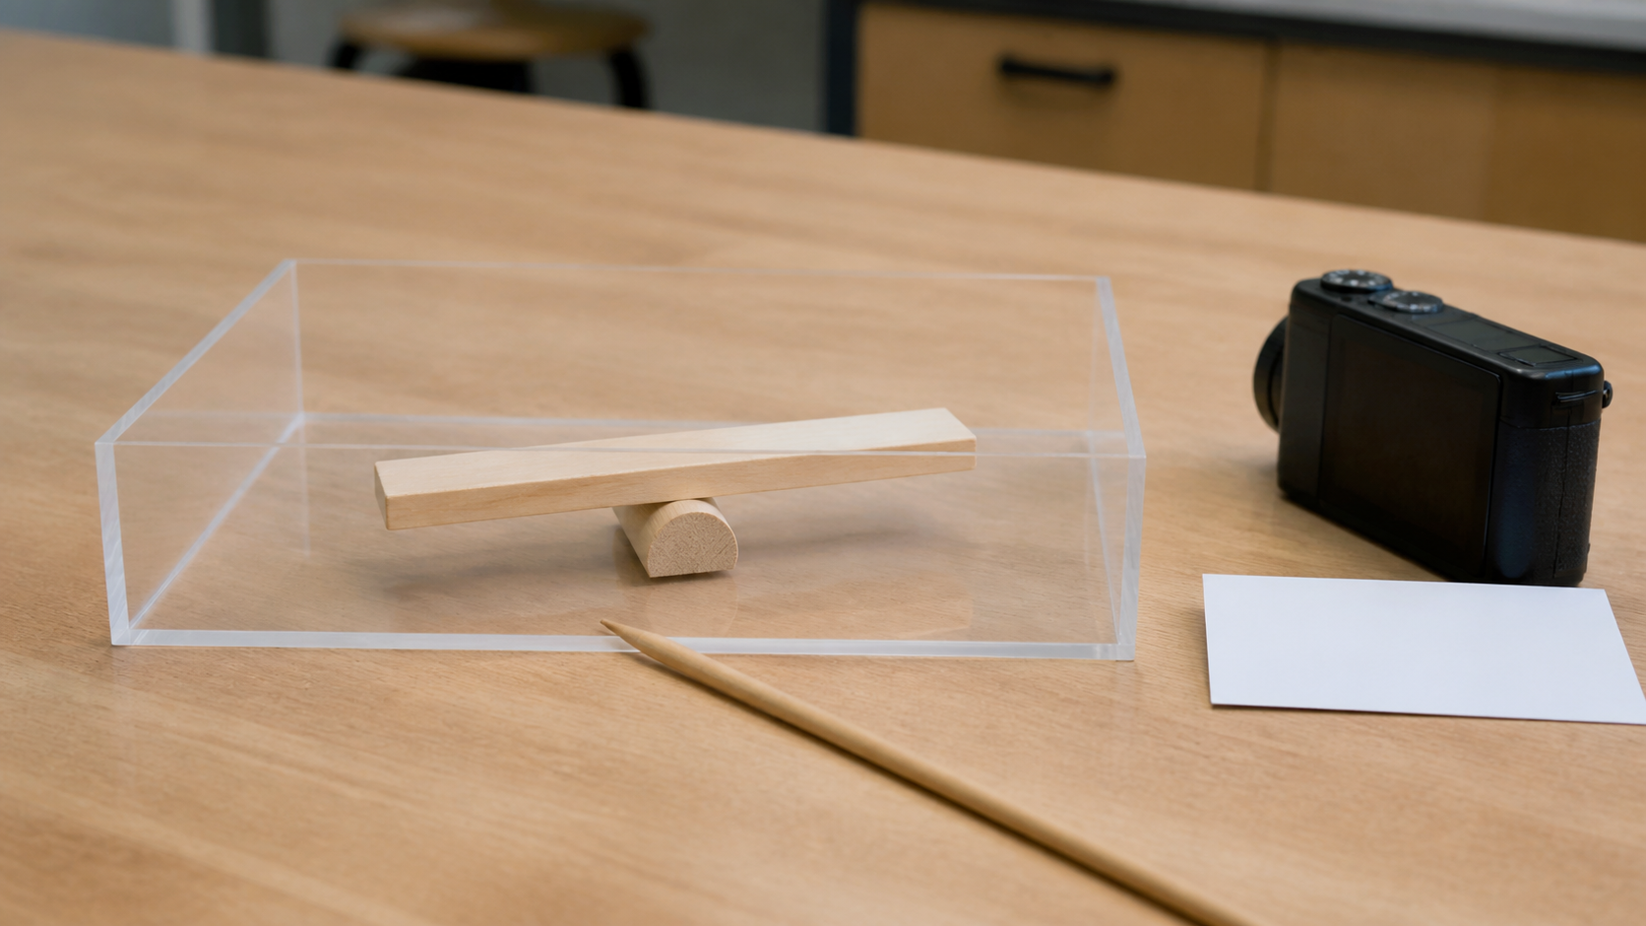
MODULE 10 / EVALUATION AND CONNECTED SYSTEMS
A demonstration directs attention to evidence
A demonstration identifies the system purpose, points out key component relationships and makes the evidence visible. Controlled, repeatable behaviour often communicates more engineering knowledge than dramatic motion. Every operating condition remains teacher controlled; student preparation centres on explanation and recording.
Communication: decide what the audience should notice and which evidence will connect it to a design decision.
A demonstration directs attention to purpose, relationships and evidence—not maximum performance.
NOTICE Decide what the audience should watch and which observation would connect to the design decision.
YEAR 8 CATAPULT • MODULE 10
03
Notes:
Teaching points
- A demonstration identifies the system purpose, points out key component relationships and makes the evidence visible. Controlled, repeatable behaviour often communicates more engineering knowledge than dramatic motion. Every operating condition remains teacher controlled; student preparation centres on explanation and recording.
- Use the visual to emphasise: Decide what the audience should watch and which observation would connect to the design decision.
Prompt
- Communication: decide what the audience should notice and which evidence will connect it to a design decision.
Likely misconception
- What makes a demonstration evidence-centred?
Transition
- Link this idea to the next relationship in the module.
[Sources]
- Year 8 Catapult student theory draft v1.0, module-10, 24 Aug 2026.
- Catapult Booklet 2026.pdf, pp. 18–19 and 27–31; Heritage NSW on Baiame’s Ngunnhu; Gunditj Mirring and UNESCO on Budj Bim; cultural-source brief; theory draft module-10.
- Teaching visual: assets/visuals/theory/m10-evidence-centred-demonstration.png.
- OpenAI image generation for this course, 24 Aug 2026; conceptual teaching still life; final prompt: Unloaded abstract lever teaching model behind a clear boundary with camera, blank card and pointer; no person, projectile, launch or result.

Slide 4
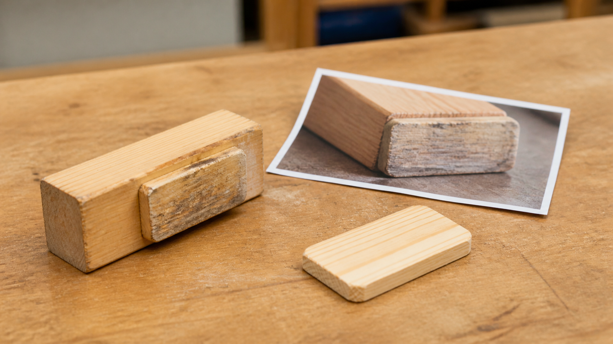
MODULE 10 / EVALUATION AND CONNECTED SYSTEMS
Evaluation links a criterion to a realistic improvement
Product, process, personal and environmental evaluation reveal different parts of the design journey. A strong judgement follows criterion, evidence, judgement and improvement. The proposed improvement addresses a likely cause and considers how the wider system could also change.
Evaluation links a confirmed criterion to evidence, judgement and a realistic improvement.
Evaluate: choose one confirmed criterion and follow it through evidence, judgement and one checkable improvement.
NOTICE Trace one criterion through the evidence and locate the improvement tied to a likely cause.
YEAR 8 CATAPULT • MODULE 10
04
Notes:
Teaching points
- Product, process, personal and environmental evaluation reveal different parts of the design journey. A strong judgement follows criterion, evidence, judgement and improvement. The proposed improvement addresses a likely cause and considers how the wider system could also change.
- Use the visual to emphasise: Trace one criterion through the evidence and locate the improvement tied to a likely cause.
Prompt
- Evaluate: choose one confirmed criterion and follow it through evidence, judgement and one checkable improvement.
Likely misconception
- How do product and process evaluation differ?
Transition
- Link this idea to the next relationship in the module.
[Sources]
- Year 8 Catapult student theory draft v1.0, module-10, 24 Aug 2026.
- Catapult Booklet 2026.pdf, pp. 18–19 and 27–31; Heritage NSW on Baiame’s Ngunnhu; Gunditj Mirring and UNESCO on Budj Bim; cultural-source brief; theory draft module-10.
- Teaching visual: assets/visuals/theory/m10-evaluation-to-improvement.png.
- OpenAI image generation for this course, 24 Aug 2026; conceptual teaching still life; final prompt: Generic nonfunctional prototype segment beside one selected teacher-created photo and separate possible replacement piece; no criterion text or result.

Slide 5
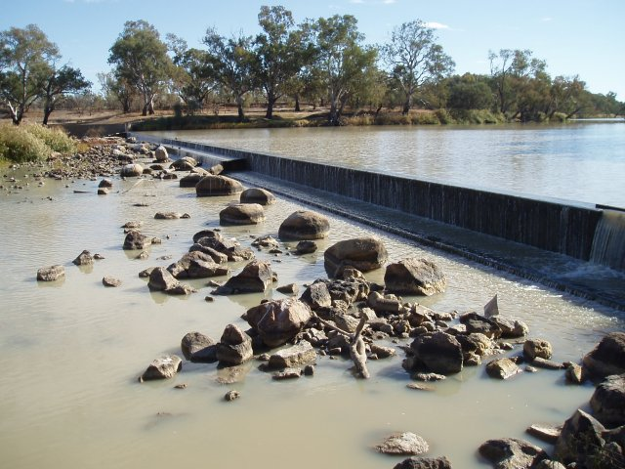
MODULE 10 / EVALUATION AND CONNECTED SYSTEMS
Custodianship and continuing knowledge are part of the system
Heritage NSW identifies Ngemba people as custodians of Baiame’s Ngunnhu, where dry-stone walls and holding ponds work with changing Barwon River flows. In Gunditjmara Country, Budj Bim connects volcanic landscape, waterways and aquaculture systems with continuing knowledge and care; UNESCO records at least 6,600 years of deliberate management.
Baiame’s Ngunnhu / Brewarrina Aboriginal Fish Traps.
Discussion: how do people, knowledge, responsibility and care change a systems explanation of these places?
B. Hanna · NSW OEH · CC BY 4.0 · Wikimedia Commons.
NOTICE Notice the relationship among river flow, stone walls and pools, then read the named Ngemba custodianship and wider cultural context.
YEAR 8 CATAPULT • MODULE 10
05
Notes:
Teaching points
- Heritage NSW identifies Ngemba people as custodians of Baiame’s Ngunnhu, where dry-stone walls and holding ponds work with changing Barwon River flows. In Gunditjmara Country, Budj Bim connects volcanic landscape, waterways and aquaculture systems with continuing knowledge and care; UNESCO records at least 6,600 years of deliberate management.
- Use the visual to emphasise: Notice the relationship among river flow, stone walls and pools, then read the named Ngemba custodianship and wider cultural context.
Prompt
- Discussion: how do people, knowledge, responsibility and care change a systems explanation of these places?
Likely misconception
- What four parts build a useful evaluation?
Transition
- Prepare students to retrieve and apply all three ideas.
[Sources]
- Year 8 Catapult student theory draft v1.0, module-10, 24 Aug 2026.
- Catapult Booklet 2026.pdf, pp. 18–19 and 27–31; Heritage NSW on Baiame’s Ngunnhu; Gunditj Mirring and UNESCO on Budj Bim; cultural-source brief; theory draft module-10.
- Teaching visual: assets/visuals/presentation/baiames-ngunnhu-brewarrina.png.
- Baiame’s Ngunnhu / Brewarrina Aboriginal Fish Traps. B. Hanna, © State of New South Wales and Office of Environment and Heritage, CC BY 4.0, via Wikimedia Commons. File-format conversion to PNG only; no crop.

Slide 6
MODULE 10 / EVALUATION AND CONNECTED SYSTEMS
Stop. Think. Explain.
Answer silently first. Then justify one answer with a partner.
1
What makes a demonstration evidence-centred?
2
How do product and process evaluation differ?
3
What four parts build a useful evaluation?
4
What must come before systems language in Aboriginal engineering learning?
YEAR 8 CATAPULT • MODULE 10
06
Notes:
Teaching points
- Give individual thinking time before partner discussion.
- Ask for evidence or a because-clause, not just the answer.
Prompt
- Which answer changed after discussion, and what evidence changed it?
Likely misconception
- Retrieval is a memory race rather than a chance to repair understanding.
Transition
- Use the strongest unresolved question to launch the evidence scaffold.
[Sources]
- Year 8 Catapult student theory draft v1.0, module-10, 24 Aug 2026.
- Catapult Booklet 2026.pdf, pp. 18–19 and 27–31; Heritage NSW on Baiame’s Ngunnhu; Gunditj Mirring and UNESCO on Budj Bim; cultural-source brief; theory draft module-10.
- Questions derived from the approved module theory; no external asset used.

Slide 7
MODULE 10 / EVALUATION AND CONNECTED SYSTEMS
Build the evidence, not just an answer
THE QUESTION
A system meets one confirmed criterion but falls short on another. Explain the trade-off, recommend one evidence-based improvement and predict how it could affect the wider system.
READ
Underline the decision
SELECT
Choose precise evidence
EXPLAIN
Connect with theory
CHECK
Answer every part
SENTENCE SUPPORT
The system meets … because … It falls short on … The trade-off is … I recommend … and would check …
YEAR 8 CATAPULT • MODULE 10
07
Notes:
Teaching points
- Model how to select evidence before writing the explanation.
- Read the sentence support aloud, then let students change its wording to suit their evidence.
Prompt
- A system meets one confirmed criterion but falls short on another. Explain the trade-off, recommend one evidence-based improvement and predict how it could affect the wider system.
Likely misconception
- Longer writing is automatically stronger evidence.
Transition
- Move from the scaffold to a concise exit ticket and evidence-save action.
[Sources]
- Year 8 Catapult student theory draft v1.0, module-10, 24 Aug 2026.
- Catapult Booklet 2026.pdf, pp. 18–19 and 27–31; Heritage NSW on Baiame’s Ngunnhu; Gunditj Mirring and UNESCO on Budj Bim; cultural-source brief; theory draft module-10.
- Read–Select–Explain–Check scaffold follows the TAS course presentation standard.

Slide 8
BEFORE YOU PACK UP …
Close the design loop
1. One evidence point I can present clearly …
SAVE
YOUR
EVIDENCE
2. One balanced judgement I can defend …
3. One way I will keep cultural context first …
Evidence destination: your module response and folio where your teacher directs.
Next: save your evidence and follow the teacher’s directions for the final course hand-in.
YEAR 8 CATAPULT • MODULE 10
08
Notes:
Teaching points
- Collect a short answer to each exit prompt.
- Make the evidence destination explicit without turning the slide into assessment administration.
Prompt
- Which exit response best shows a changed decision or deeper explanation?
Likely misconception
- The exit ticket is a generic summary with no next evidence action.
Transition
- Next: save your evidence and follow the teacher’s directions for the final course hand-in.
[Sources]
- Year 8 Catapult student theory draft v1.0, module-10, 24 Aug 2026.
- Catapult Booklet 2026.pdf, pp. 18–19 and 27–31; Heritage NSW on Baiame’s Ngunnhu; Gunditj Mirring and UNESCO on Budj Bim; cultural-source brief; theory draft module-10.
- Exit-evidence structure follows the TAS course presentation standard.

