Slide 1
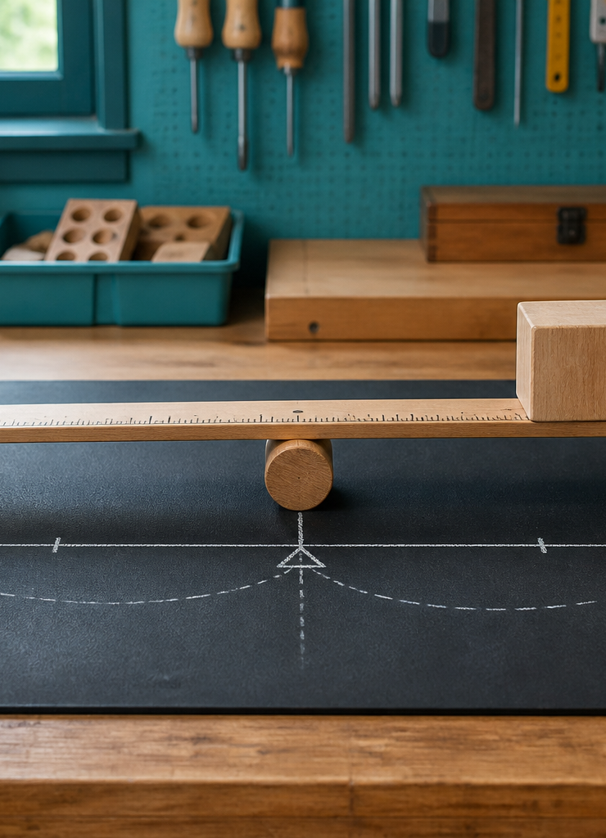
MODULE 03
Siege Engines, Levers and the Woomera
Compare systems through energy and lever relationships while keeping cultural context first.
YEAR 8 • ENGINEERING TECHNOLOGIES AND SYSTEMS
Notes:
Teaching points
- State the learning purpose in one sentence.
- Use the image only as a conceptual project cue; it is not a plan or model specification.
Prompt
- What relationship or evidence do you expect to matter in this module?
Likely misconception
- A realistic image must show the exact project design.
Transition
- Move from the project cue to the three ideas students will learn.
[Sources]
- Year 8 Catapult student theory draft v1.0, module-03, 24 Aug 2026.
- Catapult Booklet 2026.pdf, pp. 16 and 26–27; Woomeras with Jared Thomas, South Australian Museum; AIATSIS Western Desert Woomera; cultural-source brief; theory draft module-03.
- OpenAI image generation for this course, 24 Aug 2026, conceptual only; file: lever-moment-still-life.png.

Slide 2
MODULE 03 / LEVERS AND CONTEXT
The learning question
How can similar broad purposes be achieved through different system relationships?
1
Energy stores differ
2
Levers create trade-offs
3
Cultural context comes first
RETRIEVAL WARM-UP
What two questions reveal more than simply naming a historical system?
YEAR 8 CATAPULT • MODULE 03
02
Notes:
Teaching points
- Frame the module as a cumulative learning sequence.
- Invite a brief retrieval response before introducing new content.
Prompt
- What two questions reveal more than simply naming a historical system?
Likely misconception
- The three ideas are separate facts rather than parts of one explanation.
Transition
- Tell students that each theory slide will supply evidence for the final response.
[Sources]
- Year 8 Catapult student theory draft v1.0, module-03, 24 Aug 2026.
- Catapult Booklet 2026.pdf, pp. 16 and 26–27; Woomeras with Jared Thomas, South Australian Museum; AIATSIS Western Desert Woomera; cultural-source brief; theory draft module-03.
- Native pathway diagram authored for this deck from the approved module sequence.

Slide 3
MODULE 03 / LEVERS AND CONTEXT
Similar outputs can begin with different energy stores
Historical projectile systems did not all store and transfer energy in the same way. Comparing where energy is stored, which component moves, how the frame manages forces and what must be reset reveals distinct system relationships without ranking one design as universally superior.
TORSIONAL STORE
GRAVITATIONAL STORE
Twisted material stores energy
A raised mass stores energy
Compare: identify the energy store and one component relationship in each of two systems.
NOTICE Similar broad outputs can come from different internal systems.
YEAR 8 CATAPULT • MODULE 03
03
Notes:
Teaching points
- Historical projectile systems did not all store and transfer energy in the same way. Comparing where energy is stored, which component moves, how the frame manages forces and what must be reset reveals distinct system relationships without ranking one design as universally superior.
- Use the visual to emphasise: Similar broad outputs can come from different internal systems.
Prompt
- Compare: identify the energy store and one component relationship in each of two systems.
Likely misconception
- Why should systems be compared through energy stores and relationships?
Transition
- Link this idea to the next relationship in the module.
[Sources]
- Year 8 Catapult student theory draft v1.0, module-03, 24 Aug 2026.
- Catapult Booklet 2026.pdf, pp. 16 and 26–27; Woomeras with Jared Thomas, South Australian Museum; AIATSIS Western Desert Woomera; cultural-source brief; theory draft module-03.
- Editable native diagram authored for this deck from the approved course theory.

Slide 4
MODULE 03 / LEVERS AND CONTEXT
A moment combines force and distance
A lever turns around a pivot. Its moment—the turning effect—depends on the force and the perpendicular distance from the pivot. Changing arm lengths changes force-and-motion trade-offs; it does not create energy for free. The frame, pivot, stiffness and alignment remain part of the decision.
MOMENT
FORCE × PERPENDICULAR DISTANCE
Turning effect • Both factors matter
Reason: if the distance from the pivot changes, what other system effects should be checked?
NOTICE Lever geometry changes a trade-off; it does not provide free energy.
YEAR 8 CATAPULT • MODULE 03
04
Notes:
Teaching points
- A lever turns around a pivot. Its moment—the turning effect—depends on the force and the perpendicular distance from the pivot. Changing arm lengths changes force-and-motion trade-offs; it does not create energy for free. The frame, pivot, stiffness and alignment remain part of the decision.
- Use the visual to emphasise: Lever geometry changes a trade-off; it does not provide free energy.
Prompt
- Reason: if the distance from the pivot changes, what other system effects should be checked?
Likely misconception
- What two factors determine a lever moment?
Transition
- Link this idea to the next relationship in the module.
[Sources]
- Year 8 Catapult student theory draft v1.0, module-03, 24 Aug 2026.
- Catapult Booklet 2026.pdf, pp. 16 and 26–27; Woomeras with Jared Thomas, South Australian Museum; AIATSIS Western Desert Woomera; cultural-source brief; theory draft module-03.
- Editable native diagram authored for this deck from the approved course theory.

Slide 5
MODULE 03 / LEVERS AND CONTEXT
Jared Thomas explains lever action in context
Jared Thomas, a Nukunu person and South Australian Museum curator, publicly explains that an object commonly called a woomera or spear-thrower can extend the user’s arm. He also demonstrates several practical functions. Forms, names, uses and connected knowledge vary across Countries.
JARED THOMAS — NUKUNU
PURPOSES + CONTEXT
ONE LEVER OBSERVATION
Discussion: how does the lever explanation help without reducing the technology to one purpose or one universal account?
NOTICE Source and context lead. This neutral schematic is not an object reconstruction.
YEAR 8 CATAPULT • MODULE 03
05
Notes:
Teaching points
- Jared Thomas, a Nukunu person and South Australian Museum curator, publicly explains that an object commonly called a woomera or spear-thrower can extend the user’s arm. He also demonstrates several practical functions. Forms, names, uses and connected knowledge vary across Countries.
- Use the visual to emphasise: Source and context lead. This neutral schematic is not an object reconstruction.
Prompt
- Discussion: how does the lever explanation help without reducing the technology to one purpose or one universal account?
Likely misconception
- Why does a longer arm not create free energy?
Transition
- Prepare students to retrieve and apply all three ideas.
[Sources]
- Year 8 Catapult student theory draft v1.0, module-03, 24 Aug 2026.
- Catapult Booklet 2026.pdf, pp. 16 and 26–27; Woomeras with Jared Thomas, South Australian Museum; AIATSIS Western Desert Woomera; cultural-source brief; theory draft module-03.
- Editable native diagram authored for this deck from the approved course theory.

Slide 6
MODULE 03 / LEVERS AND CONTEXT
Stop. Think. Explain.
Answer silently first. Then justify one answer with a partner.
1
Why should systems be compared through energy stores and relationships?
2
What two factors determine a lever moment?
3
Why does a longer arm not create free energy?
4
What must come before any mechanical comparison involving a woomera?
YEAR 8 CATAPULT • MODULE 03
06
Notes:
Teaching points
- Give individual thinking time before partner discussion.
- Ask for evidence or a because-clause, not just the answer.
Prompt
- Which answer changed after discussion, and what evidence changed it?
Likely misconception
- Retrieval is a memory race rather than a chance to repair understanding.
Transition
- Use the strongest unresolved question to launch the evidence scaffold.
[Sources]
- Year 8 Catapult student theory draft v1.0, module-03, 24 Aug 2026.
- Catapult Booklet 2026.pdf, pp. 16 and 26–27; Woomeras with Jared Thomas, South Australian Museum; AIATSIS Western Desert Woomera; cultural-source brief; theory draft module-03.
- Questions derived from the approved module theory; no external asset used.

Slide 7
MODULE 03 / LEVERS AND CONTEXT
Build the evidence, not just an answer
THE QUESTION
Compare two historical systems with different energy stores. Explain their force, motion and reset trade-offs without ranking one culture or design as superior.
READ
Underline the decision
SELECT
Choose precise evidence
EXPLAIN
Connect with theory
CHECK
Answer every part
SENTENCE SUPPORT
System A stores energy in … while System B … This changes … The trade-off is … Neither can be ranked without …
YEAR 8 CATAPULT • MODULE 03
07
Notes:
Teaching points
- Model how to select evidence before writing the explanation.
- Read the sentence support aloud, then let students change its wording to suit their evidence.
Prompt
- Compare two historical systems with different energy stores. Explain their force, motion and reset trade-offs without ranking one culture or design as superior.
Likely misconception
- Longer writing is automatically stronger evidence.
Transition
- Move from the scaffold to a concise exit ticket and evidence-save action.
[Sources]
- Year 8 Catapult student theory draft v1.0, module-03, 24 Aug 2026.
- Catapult Booklet 2026.pdf, pp. 16 and 26–27; Woomeras with Jared Thomas, South Australian Museum; AIATSIS Western Desert Woomera; cultural-source brief; theory draft module-03.
- Read–Select–Explain–Check scaffold follows the TAS course presentation standard.

Slide 8
BEFORE YOU PACK UP …
Close the design loop
1. One system comparison I can justify …
SAVE
YOUR
EVIDENCE
2. One lever trade-off I can explain …
3. One phrase that keeps cultural context first …
Evidence destination: your module response and folio where your teacher directs.
Next: follow energy transfers, apply Newton’s laws and plan fair prototype evidence.
YEAR 8 CATAPULT • MODULE 03
08
Notes:
Teaching points
- Collect a short answer to each exit prompt.
- Make the evidence destination explicit without turning the slide into assessment administration.
Prompt
- Which exit response best shows a changed decision or deeper explanation?
Likely misconception
- The exit ticket is a generic summary with no next evidence action.
Transition
- Next: follow energy transfers, apply Newton’s laws and plan fair prototype evidence.
[Sources]
- Year 8 Catapult student theory draft v1.0, module-03, 24 Aug 2026.
- Catapult Booklet 2026.pdf, pp. 16 and 26–27; Woomeras with Jared Thomas, South Australian Museum; AIATSIS Western Desert Woomera; cultural-source brief; theory draft module-03.
- Exit-evidence structure follows the TAS course presentation standard.

