Slide 1

BEFORE YOU BEGIN
What do you already know—and what evidence would prove it?
FOOTSTOOL · MODULE 1
Workshop readiness
Read the theory, check your understanding and save your own evidence.
BEFORE YOU BEGIN
What do you already know—and what evidence would prove it?
Notes:
[Sources]
- Footstool module 1 authorised theory data and linked course visual.

Slide 2
Three ideas build one evidence trail
Move from understanding → safe application → evidence you can explain.
01
02
03
Shared workshop conduct
A shared workshop works best when everyone follows the same directions.
Hazards, risks and controls
A hazard is anything with the potential to cause harm.
Readiness and asking for help
Being ready means more than having materials nearby.
2
Notes:
[Sources]
- Footstool module 1 authorised theory data and linked course visual.

Slide 3
THEORY 1 OF 3
Shared workshop conduct
01 A shared workshop works best when everyone follows the same directions.
02 Workshops contain people, materials, tools and fixed equipment, so calm movement matters.
03 Responsible conduct includes responding when something is unsafe or damaged.
EVIDENCE Save a labelled note or response that explains what you learned.
An example can suggest possibilities, but the user need should control your design.
3
Notes:
[Sources]
- Footstool module 1 authorised theory data and linked course visual.

Slide 4
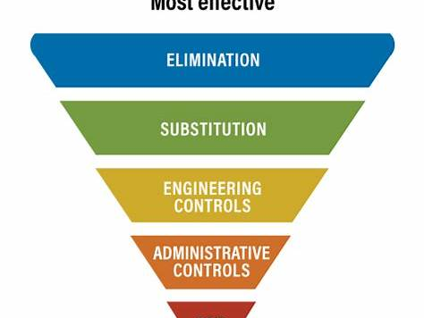
THEORY 2 OF 3
Hazards, risks and controls
01
01 A hazard is anything with the potential to cause harm.
02
02 Controls are considered from strongest to weakest: elimination, substitution, engineering controls, administrative…
03
03 Imagine a loose object left in a walkway.
Eye protection is a final protective layer, not a replacement for safer processes and secure work.
4
Notes:
[Sources]
- Footstool module 1 authorised theory data and linked course visual.

Slide 5
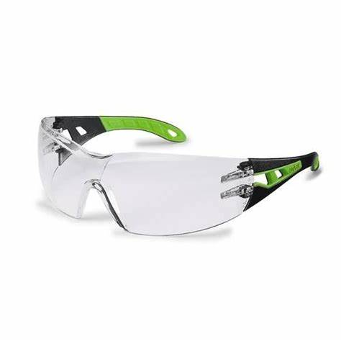
THEORY 3 OF 3
Readiness and asking for help
01 Being ready means more than having materials nearby.
02 Before beginning, pause and observe the work area.
03 A useful question explains the exact point of uncertainty.
EVIDENCE Save a labelled note or response that explains what you learned.
Compare Radiata pine's natural grain with MDF's uniform face and fine fibre edge.
5
Notes:
[Sources]
- Footstool module 1 authorised theory data and linked course visual.

Slide 6
Pause and check what you can explain
Answer aloud or jot one clear sentence for each question.
01
02
03
What is the key idea in “Shared workshop conduct”?
What evidence would show that you understood it?
What is the key idea in “Hazards, risks and controls”?
What evidence would show that you understood it?
What is the key idea in “Readiness and asking for help”?
What evidence would show that you understood it?
6
Notes:
[Sources]
- Footstool module 1 authorised theory data and linked course visual.

Slide 7
Build a response that shows your thinking
Prompt: Describe how a student should respond to one general shared-workshop situation involving movement, equipment, a hazard or pack-away. Explain how the response helps other people use the workshop safely.
READ
What is the question asking?
SELECT
Return to the precise theory.
EXPLAIN
Connect the idea to your evidence.
CHECK
Answer every part in your own words.
Sentence starter: In this situation, the student should ___ because this helps others by ___.
7
Notes:
[Sources]
- Footstool module 1 authorised theory data and linked course visual.

Slide 8
YOUR NEXT MOVE
Exit ticket: prove what you learned
1. Name one idea you can now explain.
2. Identify the evidence you will save.
3. State your next safe, accurate action.
Notes:
[Sources]
- Footstool module 1 authorised theory data and linked course visual.

