Slide 1
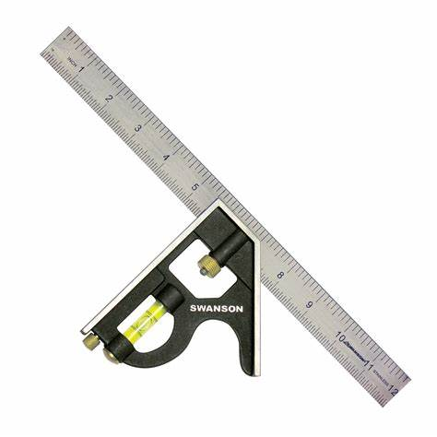
BEFORE YOU BEGIN
What do you already know—and what evidence would prove it?
FOOTSTOOL · MODULE 2
Tools and accurate references
Read the theory, check your understanding and save your own evidence.
BEFORE YOU BEGIN
What do you already know—and what evidence would prove it?
Notes:
[Sources]
- Footstool module 2 authorised theory data and linked course visual.

Slide 2
Three ideas build one evidence trail
Move from understanding → safe application → evidence you can explain.
01
02
03
Tool recognition and broad purpose
Tool recognition begins with using the approved name rather than guessing from shape, colour or size.
Measuring and marking references
Accurate work begins with the correct reference.
Safe tool decisions
A safe tool decision begins before anything is used.
2
Notes:
[Sources]
- Footstool module 2 authorised theory data and linked course visual.

Slide 3
THEORY 1 OF 3
Tool recognition and broad purpose
01 Tool recognition begins with using the approved name rather than guessing from shape, colour or size.
02 Recognising a tool also means knowing its broad purpose without assuming how it should be operated.
03 Correct selection links three things: the approved tool name, its broad purpose and the specific task information p…
EVIDENCE Save a labelled note or response that explains what you learned.
An example can suggest possibilities, but the user need should control your design.
3
Notes:
[Sources]
- Footstool module 2 authorised theory data and linked course visual.

Slide 4
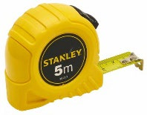
THEORY 2 OF 3
Measuring and marking references
01
01 Accurate work begins with the correct reference.
02
02 Measuring means finding or setting a required distance using a teacher-approved measuring tool.
03
03 Checking means comparing the marked information with the written plan and teacher direction before treating it as c…
Eye protection is a final protective layer, not a replacement for safer processes and secure work.
4
Notes:
[Sources]
- Footstool module 2 authorised theory data and linked course visual.

Slide 5
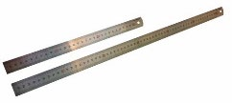
THEORY 3 OF 3
Safe tool decisions
01 A safe tool decision begins before anything is used.
02 Before tool use, check that you have teacher authorisation and that the current school SOP applies to the planned a…
03 Safe decisions also depend on what is happening nearby.
EVIDENCE Save a labelled note or response that explains what you learned.
Compare Radiata pine's natural grain with MDF's uniform face and fine fibre edge.
5
Notes:
[Sources]
- Footstool module 2 authorised theory data and linked course visual.

Slide 6
Pause and check what you can explain
Answer aloud or jot one clear sentence for each question.
01
02
03
What is the key idea in “Tool recognition and broad purpose”?
What evidence would show that you understood it?
What is the key idea in “Measuring and marking references”?
What evidence would show that you understood it?
What is the key idea in “Safe tool decisions”?
What evidence would show that you understood it?
6
Notes:
[Sources]
- Footstool module 2 authorised theory data and linked course visual.

Slide 7
Build a response that shows your thinking
Prompt: Explain how a student should identify whether a named workshop tool may suit a teacher-provided task without describing how to operate it.
READ
What is the question asking?
SELECT
Return to the precise theory.
EXPLAIN
Connect the idea to your evidence.
CHECK
Answer every part in your own words.
Sentence starter: The tool is called ___, and its broad purpose is ___. It may suit the task because ___, but the student must ___.
7
Notes:
[Sources]
- Footstool module 2 authorised theory data and linked course visual.

Slide 8
YOUR NEXT MOVE
Exit ticket: prove what you learned
1. Name one idea you can now explain.
2. Identify the evidence you will save.
3. State your next safe, accurate action.
Notes:
[Sources]
- Footstool module 2 authorised theory data and linked course visual.

