Slide 1
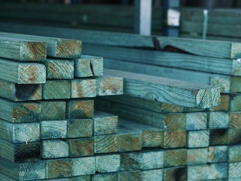
BEFORE YOU BEGIN
What do you already know—and what evidence would prove it?
FOOTSTOOL · MODULE 3
Timber properties
Read the theory, check your understanding and save your own evidence.
BEFORE YOU BEGIN
What do you already know—and what evidence would prove it?
Notes:
[Sources]
- Footstool module 3 authorised theory data and linked course visual.

Slide 2
Three ideas build one evidence trail
Move from understanding → safe application → evidence you can explain.
01
02
03
Hardwood and softwood language
Hardwood and softwood are botanical categories based on the type of tree the timber comes from.
Grain, knots and density
Grain describes the direction and visible pattern of wood fibres.
Workability and material description
Workability describes how a material responds to approved shaping, joining and finishing processes.
2
Notes:
[Sources]
- Footstool module 3 authorised theory data and linked course visual.

Slide 3
THEORY 1 OF 3
Hardwood and softwood language
01 Hardwood and softwood are botanical categories based on the type of tree the timber comes from.
02 Pine is identified as the timber used for the Footstool project.
03 Material choice involves matching useful properties to the project requirements.
EVIDENCE Save a labelled note or response that explains what you learned.
An example can suggest possibilities, but the user need should control your design.
3
Notes:
[Sources]
- Footstool module 3 authorised theory data and linked course visual.

Slide 4
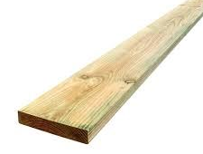
THEORY 2 OF 3
Grain, knots and density
01
01 Grain describes the direction and visible pattern of wood fibres.
02
02 A knot is evidence of where a branch grew from the tree.
03
03 Density is the amount of mass in relation to volume.
Eye protection is a final protective layer, not a replacement for safer processes and secure work.
4
Notes:
[Sources]
- Footstool module 3 authorised theory data and linked course visual.

Slide 5
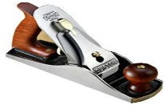
THEORY 3 OF 3
Workability and material description
01 Workability describes how a material responds to approved shaping, joining and finishing processes.
02 A useful material description begins with careful observation.
03 An evidence-based description combines several relevant observations instead of relying on one feature.
EVIDENCE Save a labelled note or response that explains what you learned.
Compare Radiata pine's natural grain with MDF's uniform face and fine fibre edge.
5
Notes:
[Sources]
- Footstool module 3 authorised theory data and linked course visual.

Slide 6
Pause and check what you can explain
Answer aloud or jot one clear sentence for each question.
01
02
03
What is the key idea in “Hardwood and softwood language”?
What evidence would show that you understood it?
What is the key idea in “Grain, knots and density”?
What evidence would show that you understood it?
What is the key idea in “Workability and material description”?
What evidence would show that you understood it?
6
Notes:
[Sources]
- Footstool module 3 authorised theory data and linked course visual.

Slide 7
Build a response that shows your thinking
Prompt: Explain why calling pine a softwood does not fully describe whether a piece is suitable for the Footstool project. Include two relevant properties that should also be considered.
READ
What is the question asking?
SELECT
Return to the precise theory.
EXPLAIN
Connect the idea to your evidence.
CHECK
Answer every part in your own words.
Sentence starter: Pine is classified as a softwood because ___. This does not fully describe its suitability because students must also consider ___ and ___.
7
Notes:
[Sources]
- Footstool module 3 authorised theory data and linked course visual.

Slide 8
YOUR NEXT MOVE
Exit ticket: prove what you learned
1. Name one idea you can now explain.
2. Identify the evidence you will save.
3. State your next safe, accurate action.
Notes:
[Sources]
- Footstool module 3 authorised theory data and linked course visual.

