Slide 1
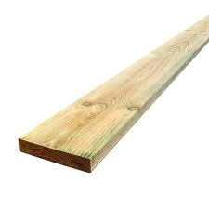
BEFORE YOU BEGIN
What do you already know—and what evidence would prove it?
FOOTSTOOL · MODULE 4
Engineered wood
Read the theory, check your understanding and save your own evidence.
BEFORE YOU BEGIN
What do you already know—and what evidence would prove it?
Notes:
[Sources]
- Footstool module 4 authorised theory data and linked course visual.

Slide 2
Three ideas build one evidence trail
Move from understanding → safe application → evidence you can explain.
01
02
03
The engineered-wood idea
Manufactured or engineered wood products are made by combining wood layers, particles or fibres through controlled…
Layers, particles and fibres
Plywood is made from thin sheets of wood called veneers.
Responsible material comparison
A responsible material comparison begins with the intended use and the teacher-provided project requirements.
2
Notes:
[Sources]
- Footstool module 4 authorised theory data and linked course visual.

Slide 3
THEORY 1 OF 3
The engineered-wood idea
01 Manufactured or engineered wood products are made by combining wood layers, particles or fibres through controlled…
02 Plywood is made from thin wood layers bonded together, usually with the grain direction changing between neighbouri…
03 A material decision should consider the product structure, visible condition, surface, edges and teacher-provided p…
EVIDENCE Save a labelled note or response that explains what you learned.
An example can suggest possibilities, but the user need should control your design.
3
Notes:
[Sources]
- Footstool module 4 authorised theory data and linked course visual.

Slide 4
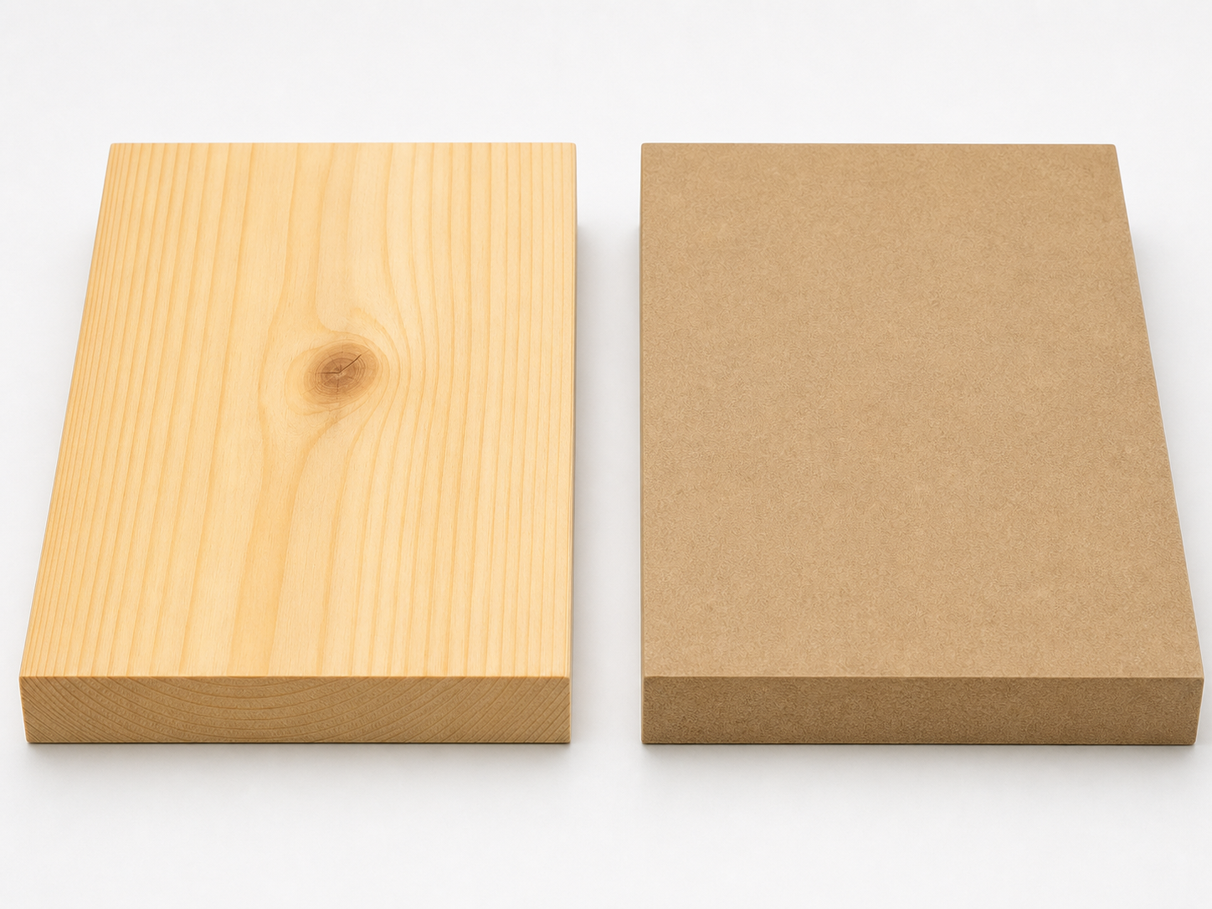
THEORY 2 OF 3
Layers, particles and fibres
01
01 Plywood is made from thin sheets of wood called veneers.
02
02 Particleboard is made from wood particles combined with adhesive and formed into a board.
03
03 Medium-density fibreboard, commonly called MDF, is made from fine wood fibres combined with adhesive.
Eye protection is a final protective layer, not a replacement for safer processes and secure work.
4
Notes:
[Sources]
- Footstool module 4 authorised theory data and linked course visual.

Slide 5
THEORY 3 OF 3
Responsible material comparison
01 A responsible material comparison begins with the intended use and the teacher-provided project requirements.
02 Workability describes how a material responds to approved shaping, joining and finishing processes.
03 Resource use is another part of responsible comparison.
EVIDENCE Save a labelled note or response that explains what you learned.
Compare Radiata pine's natural grain with MDF's uniform face and fine fibre edge.
5
Notes:
[Sources]
- Footstool module 4 authorised theory data and linked course visual.

Slide 6
Pause and check what you can explain
Answer aloud or jot one clear sentence for each question.
01
02
03
What is the key idea in “The engineered-wood idea”?
What evidence would show that you understood it?
What is the key idea in “Layers, particles and fibres”?
What evidence would show that you understood it?
What is the key idea in “Responsible material comparison”?
What evidence would show that you understood it?
6
Notes:
[Sources]
- Footstool module 4 authorised theory data and linked course visual.

Slide 7
Build a response that shows your thinking
Prompt: Compare plywood, particleboard and MDF by describing the wood elements used in each, then explain why product structure must be matched to project requirements.
READ
What is the question asking?
SELECT
Return to the precise theory.
EXPLAIN
Connect the idea to your evidence.
CHECK
Answer every part in your own words.
Sentence starter: Plywood uses ___, particleboard uses ___, and MDF uses ___. This matters because ___.
7
Notes:
[Sources]
- Footstool module 4 authorised theory data and linked course visual.

Slide 8
YOUR NEXT MOVE
Exit ticket: prove what you learned
1. Name one idea you can now explain.
2. Identify the evidence you will save.
3. State your next safe, accurate action.
Notes:
[Sources]
- Footstool module 4 authorised theory data and linked course visual.

