Slide 1
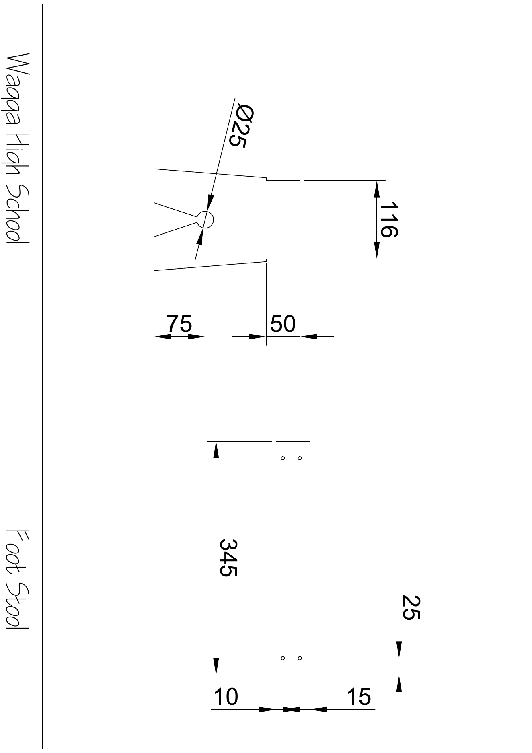
BEFORE YOU BEGIN
What do you already know—and what evidence would prove it?
FOOTSTOOL · MODULE 5
Read the original plan
Read the theory, check your understanding and save your own evidence.
BEFORE YOU BEGIN
What do you already know—and what evidence would prove it?
Notes:
[Sources]
- Footstool module 5 authorised theory data and linked course visual.

Slide 2
Three ideas build one evidence trail
Move from understanding → safe application → evidence you can explain.
01
02
03
Views and drawing information
The unchanged original two-page Wagga High School Foot Stool drawing is the authoritative reference for the product.
Dimensions, symbols and scale
Written dimensions control the intended size of a feature.
Cross-checking the original plan
Begin by opening the unchanged original two-page Footstool PDF at a size that makes the lines and written informati…
2
Notes:
[Sources]
- Footstool module 5 authorised theory data and linked course visual.

Slide 3
THEORY 1 OF 3
Views and drawing information
01 The unchanged original two-page Wagga High School Foot Stool drawing is the authoritative reference for the product.
02 A plan, also called a top view, shows the product as if it is viewed from directly above.
03 Written information gives precise details that may not be clear from appearance alone.
EVIDENCE Save a labelled note or response that explains what you learned.
An example can suggest possibilities, but the user need should control your design.
3
Notes:
[Sources]
- Footstool module 5 authorised theory data and linked course visual.

Slide 4
THEORY 2 OF 3
Dimensions, symbols and scale
01
01 Written dimensions control the intended size of a feature.
02
02 Technical drawings use symbols, line types, labels and notes to communicate information efficiently.
03
03 Scale describes a proportional relationship between the drawing and the intended object.
Eye protection is a final protective layer, not a replacement for safer processes and secure work.
4
Notes:
[Sources]
- Footstool module 5 authorised theory data and linked course visual.

Slide 5
THEORY 3 OF 3
Cross-checking the original plan
01 Begin by opening the unchanged original two-page Footstool PDF at a size that makes the lines and written informati…
02 Identify the view that shows the required feature most clearly.
03 Cross-checking means comparing the feature across related views to confirm its position and form.
EVIDENCE Save a labelled note or response that explains what you learned.
Compare Radiata pine's natural grain with MDF's uniform face and fine fibre edge.
5
Notes:
[Sources]
- Footstool module 5 authorised theory data and linked course visual.

Slide 6
Pause and check what you can explain
Answer aloud or jot one clear sentence for each question.
01
02
03
What is the key idea in “Views and drawing information”?
What evidence would show that you understood it?
What is the key idea in “Dimensions, symbols and scale”?
What evidence would show that you understood it?
What is the key idea in “Cross-checking the original plan”?
What evidence would show that you understood it?
6
Notes:
[Sources]
- Footstool module 5 authorised theory data and linked course visual.

Slide 7
Build a response that shows your thinking
Prompt: Explain how a student should use a plan view, an elevation and written information together to understand one feature on the original drawing.
READ
What is the question asking?
SELECT
Return to the precise theory.
EXPLAIN
Connect the idea to your evidence.
CHECK
Answer every part in your own words.
Sentence starter: The plan view shows ___, while the elevation shows ___. The written information helps by ___.
7
Notes:
[Sources]
- Footstool module 5 authorised theory data and linked course visual.

Slide 8
YOUR NEXT MOVE
Exit ticket: prove what you learned
1. Name one idea you can now explain.
2. Identify the evidence you will save.
3. State your next safe, accurate action.
Notes:
[Sources]
- Footstool module 5 authorised theory data and linked course visual.

