Slide 1
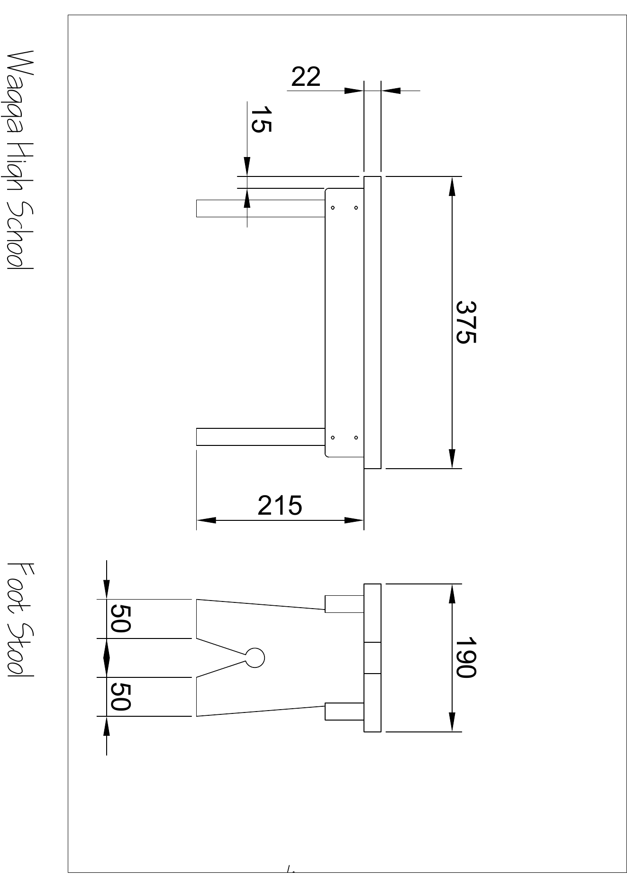
BEFORE YOU BEGIN
What do you already know—and what evidence would prove it?
FOOTSTOOL · MODULE 6
Graphical communication
Read the theory, check your understanding and save your own evidence.
BEFORE YOU BEGIN
What do you already know—and what evidence would prove it?
Notes:
[Sources]
- Footstool module 6 authorised theory data and linked course visual.

Slide 2
Three ideas build one evidence trail
Move from understanding → safe application → evidence you can explain.
01
02
03
Third-angle projection
Third-angle projection is a drawing system that represents an object through related two-dimensional views.
Line and view relationships
Technical drawings use different line types to communicate different kinds of information.
Isometric communication
An isometric drawing is a three-dimensional-looking communication view.
2
Notes:
[Sources]
- Footstool module 6 authorised theory data and linked course visual.

Slide 3
THEORY 1 OF 3
Third-angle projection
01 Third-angle projection is a drawing system that represents an object through related two-dimensional views.
02 The front view shows the object as seen directly from its selected front.
03 Related views should be compared by looking for matching positions and aligned features.
EVIDENCE Save a labelled note or response that explains what you learned.
An example can suggest possibilities, but the user need should control your design.
3
Notes:
[Sources]
- Footstool module 6 authorised theory data and linked course visual.

Slide 4
THEORY 2 OF 3
Line and view relationships
01
01 Technical drawings use different line types to communicate different kinds of information.
02
02 Dimension lines communicate the extent of a written measurement and connect it to the relevant feature.
03
03 Related views represent the same object from different directions, so shared features should align.
Eye protection is a final protective layer, not a replacement for safer processes and secure work.
4
Notes:
[Sources]
- Footstool module 6 authorised theory data and linked course visual.

Slide 5
THEORY 3 OF 3
Isometric communication
01 An isometric drawing is a three-dimensional-looking communication view.
02 Isometric drawings use three principal directions.
03 An isometric view can help a student recognise the general shape, position and relationship of features.
EVIDENCE Save a labelled note or response that explains what you learned.
Compare Radiata pine's natural grain with MDF's uniform face and fine fibre edge.
5
Notes:
[Sources]
- Footstool module 6 authorised theory data and linked course visual.

Slide 6
Pause and check what you can explain
Answer aloud or jot one clear sentence for each question.
01
02
03
What is the key idea in “Third-angle projection”?
What evidence would show that you understood it?
What is the key idea in “Line and view relationships”?
What evidence would show that you understood it?
What is the key idea in “Isometric communication”?
What evidence would show that you understood it?
6
Notes:
[Sources]
- Footstool module 6 authorised theory data and linked course visual.

Slide 7
Build a response that shows your thinking
Prompt: Explain how the front, plan and side views work together in third-angle projection to communicate one object.
READ
What is the question asking?
SELECT
Return to the precise theory.
EXPLAIN
Connect the idea to your evidence.
CHECK
Answer every part in your own words.
Sentence starter: The front view shows ___, the plan view shows ___, and the side view shows ___. Together, they help the reader ___.
7
Notes:
[Sources]
- Footstool module 6 authorised theory data and linked course visual.

Slide 8
YOUR NEXT MOVE
Exit ticket: prove what you learned
1. Name one idea you can now explain.
2. Identify the evidence you will save.
3. State your next safe, accurate action.
Notes:
[Sources]
- Footstool module 6 authorised theory data and linked course visual.

