Slide 1
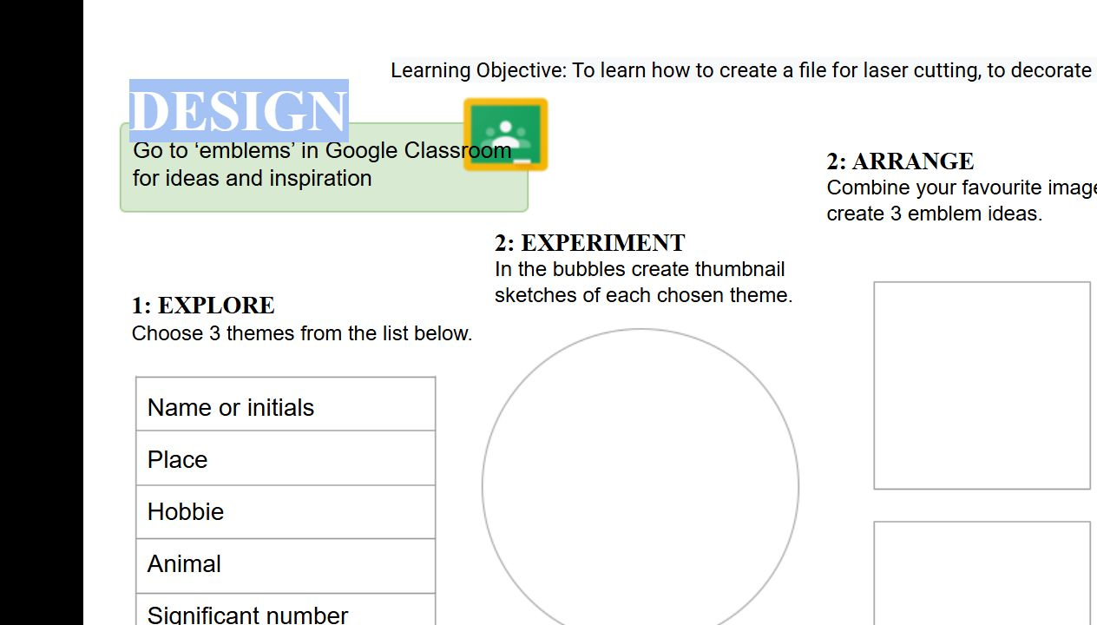
BEFORE YOU BEGIN
What do you already know—and what evidence would prove it?
FOOTSTOOL · MODULE 7
Personal emblem design
Read the theory, check your understanding and save your own evidence.
BEFORE YOU BEGIN
What do you already know—and what evidence would prove it?
Notes:
[Sources]
- Footstool module 7 authorised theory data and linked course visual.

Slide 2
Three ideas build one evidence trail
Move from understanding → safe application → evidence you can explain.
01
02
03
Researching a personal emblem
A personal emblem communicates something about you through a small, recognisable design.
Developing three emblem concepts
Begin by choosing useful ideas from your personal-theme research.
Criteria, selection and refinement
Design criteria are clear points used to compare ideas fairly.
2
Notes:
[Sources]
- Footstool module 7 authorised theory data and linked course visual.

Slide 3
THEORY 1 OF 3
Researching a personal emblem
01 A personal emblem communicates something about you through a small, recognisable design.
02 Collect several visual references for each theme.
03 Select useful features from your research and translate them into your own simple shapes.
EVIDENCE Save a labelled note or response that explains what you learned.
An example can suggest possibilities, but the user need should control your design.
3
Notes:
[Sources]
- Footstool module 7 authorised theory data and linked course visual.

Slide 4
THEORY 2 OF 3
Developing three emblem concepts
01
01 Begin by choosing useful ideas from your personal-theme research.
02
02 Develop three quick thumbnail drawings that explore genuinely different concepts.
03
03 Add brief annotations beside each thumbnail to explain the selected theme, the arrangement of shapes and the intend…
Eye protection is a final protective layer, not a replacement for safer processes and secure work.
4
Notes:
[Sources]
- Footstool module 7 authorised theory data and linked course visual.

Slide 5
THEORY 3 OF 3
Criteria, selection and refinement
01 Design criteria are clear points used to compare ideas fairly.
02 Compare the three concepts side by side and record useful pros and cons for each one.
03 Select one concept and justify the choice using more than personal preference.
EVIDENCE Save a labelled note or response that explains what you learned.
Compare Radiata pine's natural grain with MDF's uniform face and fine fibre edge.
5
Notes:
[Sources]
- Footstool module 7 authorised theory data and linked course visual.

Slide 6
Pause and check what you can explain
Answer aloud or jot one clear sentence for each question.
01
02
03
What is the key idea in “Researching a personal emblem”?
What evidence would show that you understood it?
What is the key idea in “Developing three emblem concepts”?
What evidence would show that you understood it?
What is the key idea in “Criteria, selection and refinement”?
What evidence would show that you understood it?
6
Notes:
[Sources]
- Footstool module 7 authorised theory data and linked course visual.

Slide 7
Build a response that shows your thinking
Prompt: Identify three possible personal themes for an emblem, explain the meaning of each and describe one simple visual feature that could represent each theme without copying a finished design.
READ
What is the question asking?
SELECT
Return to the precise theory.
EXPLAIN
Connect the idea to your evidence.
CHECK
Answer every part in your own words.
Sentence starter: My three themes are ___, ___ and ___. They matter to me because ___. A simple feature I could explore for each is ___.
7
Notes:
[Sources]
- Footstool module 7 authorised theory data and linked course visual.

Slide 8
YOUR NEXT MOVE
Exit ticket: prove what you learned
1. Name one idea you can now explain.
2. Identify the evidence you will save.
3. State your next safe, accurate action.
Notes:
[Sources]
- Footstool module 7 authorised theory data and linked course visual.

