Slide 1
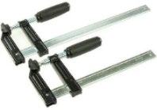
BEFORE YOU BEGIN
What do you already know—and what evidence would prove it?
FOOTSTOOL · MODULE 8
Progress and quality evidence
Read the theory, check your understanding and save your own evidence.
BEFORE YOU BEGIN
What do you already know—and what evidence would prove it?
Notes:
[Sources]
- Footstool module 8 authorised theory data and linked course visual.

Slide 2
Three ideas build one evidence trail
Move from understanding → safe application → evidence you can explain.
01
02
03
Observing practical progress
A process log is a clear record of practical progress.
Recording quality evidence
Quality evidence shows what can be observed or checked rather than giving a vague opinion.
Action and next-step reflection
A useful reflection begins with a factual observation.
2
Notes:
[Sources]
- Footstool module 8 authorised theory data and linked course visual.

Slide 3
THEORY 1 OF 3
Observing practical progress
01 A process log is a clear record of practical progress.
02 An objective observation describes what could be seen, heard or compared without adding an unsupported opinion.
03 Each entry should identify what was checked and the information used for that check.
EVIDENCE Save a labelled note or response that explains what you learned.
An example can suggest possibilities, but the user need should control your design.
3
Notes:
[Sources]
- Footstool module 8 authorised theory data and linked course visual.

Slide 4
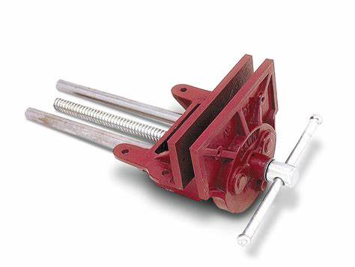
THEORY 2 OF 3
Recording quality evidence
01
01 Quality evidence shows what can be observed or checked rather than giving a vague opinion.
02
02 Evidence becomes more useful when it is linked to the relevant plan information or teacher direction.
03
03 An approved photograph can provide quality evidence when it clearly shows the feature being discussed.
Eye protection is a final protective layer, not a replacement for safer processes and secure work.
4
Notes:
[Sources]
- Footstool module 8 authorised theory data and linked course visual.

Slide 5
THEORY 3 OF 3
Action and next-step reflection
01 A useful reflection begins with a factual observation.
02 After the observation, explain a possible reason using available evidence.
03 Finish the reflection by recording the next teacher-confirmed step.
EVIDENCE Save a labelled note or response that explains what you learned.
Compare Radiata pine's natural grain with MDF's uniform face and fine fibre edge.
5
Notes:
[Sources]
- Footstool module 8 authorised theory data and linked course visual.

Slide 6
Pause and check what you can explain
Answer aloud or jot one clear sentence for each question.
01
02
03
What is the key idea in “Observing practical progress”?
What evidence would show that you understood it?
What is the key idea in “Recording quality evidence”?
What evidence would show that you understood it?
What is the key idea in “Action and next-step reflection”?
What evidence would show that you understood it?
6
Notes:
[Sources]
- Footstool module 8 authorised theory data and linked course visual.

Slide 7
Build a response that shows your thinking
Prompt: Write one process-log entry that includes a lesson reference, the broad task attempted, one objective observation and what was checked. Do not include construction steps.
READ
What is the question asking?
SELECT
Return to the precise theory.
EXPLAIN
Connect the idea to your evidence.
CHECK
Answer every part in your own words.
Sentence starter: During lesson ___, I attempted ___. I observed ___. I checked this against ___.
7
Notes:
[Sources]
- Footstool module 8 authorised theory data and linked course visual.

Slide 8
YOUR NEXT MOVE
Exit ticket: prove what you learned
1. Name one idea you can now explain.
2. Identify the evidence you will save.
3. State your next safe, accurate action.
Notes:
[Sources]
- Footstool module 8 authorised theory data and linked course visual.

