Slide 1
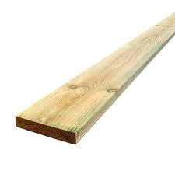
BEFORE YOU BEGIN
What do you already know—and what evidence would prove it?
FOOTSTOOL · MODULE 9
Function and testing
Read the theory, check your understanding and save your own evidence.
BEFORE YOU BEGIN
What do you already know—and what evidence would prove it?
Notes:
[Sources]
- Footstool module 9 authorised theory data and linked course visual.

Slide 2
Three ideas build one evidence trail
Move from understanding → safe application → evidence you can explain.
01
02
03
Function vocabulary
Function describes how well a product performs its intended purpose.
Testing with evidence
A fair functional judgement begins by naming the criterion being considered.
Planning a functional improvement
A functional improvement should begin with one limitation supported by evidence.
2
Notes:
[Sources]
- Footstool module 9 authorised theory data and linked course visual.

Slide 3
THEORY 1 OF 3
Function vocabulary
01 Function describes how well a product performs its intended purpose.
02 Stable means resisting unwanted movement during intended use.
03 Efficient means achieving the intended result without unnecessary use of time, effort or resources.
EVIDENCE Save a labelled note or response that explains what you learned.
An example can suggest possibilities, but the user need should control your design.
3
Notes:
[Sources]
- Footstool module 9 authorised theory data and linked course visual.

Slide 4
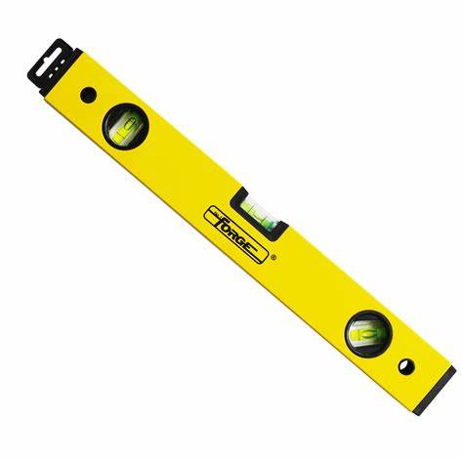
THEORY 2 OF 3
Testing with evidence
01
01 A fair functional judgement begins by naming the criterion being considered.
02
02 The check or observation must match the chosen criterion and follow teacher direction.
03
03 Record what happened using specific, objective language.
Eye protection is a final protective layer, not a replacement for safer processes and secure work.
4
Notes:
[Sources]
- Footstool module 9 authorised theory data and linked course visual.

Slide 5
THEORY 3 OF 3
Planning a functional improvement
01 A functional improvement should begin with one limitation supported by evidence.
02 A proposed improvement should respond directly to the evidenced limitation.
03 Predict how the proposed improvement may affect function by linking it to the selected criterion.
EVIDENCE Save a labelled note or response that explains what you learned.
Compare Radiata pine's natural grain with MDF's uniform face and fine fibre edge.
5
Notes:
[Sources]
- Footstool module 9 authorised theory data and linked course visual.

Slide 6
Pause and check what you can explain
Answer aloud or jot one clear sentence for each question.
01
02
03
What is the key idea in “Function vocabulary”?
What evidence would show that you understood it?
What is the key idea in “Testing with evidence”?
What evidence would show that you understood it?
What is the key idea in “Planning a functional improvement”?
What evidence would show that you understood it?
6
Notes:
[Sources]
- Footstool module 9 authorised theory data and linked course visual.

Slide 7
Build a response that shows your thinking
Prompt: Use at least three function terms to explain what evidence would be needed before making claims about a product's performance.
READ
What is the question asking?
SELECT
Return to the precise theory.
EXPLAIN
Connect the idea to your evidence.
CHECK
Answer every part in your own words.
Sentence starter: To describe the product as ___, I would need evidence that ___. To describe it as ___, I would check ___. I cannot yet claim ___ because ___.
7
Notes:
[Sources]
- Footstool module 9 authorised theory data and linked course visual.

Slide 8
YOUR NEXT MOVE
Exit ticket: prove what you learned
1. Name one idea you can now explain.
2. Identify the evidence you will save.
3. State your next safe, accurate action.
Notes:
[Sources]
- Footstool module 9 authorised theory data and linked course visual.

