Slide 1
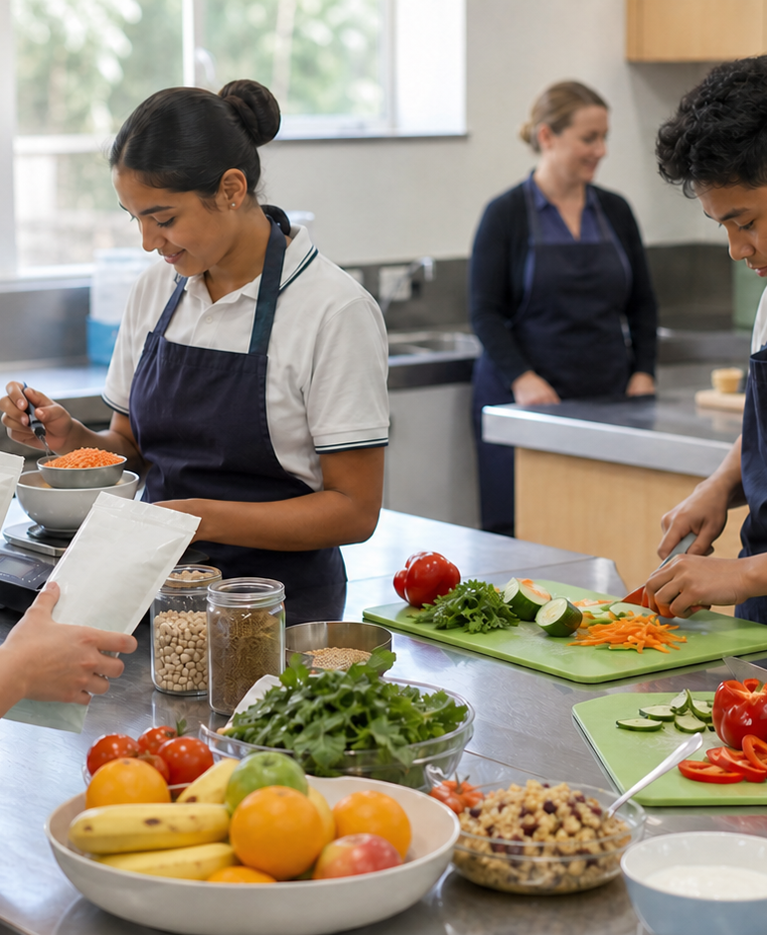
MODULE 1 · YEAR 9 FOOD TECHNOLOGY
Ready to work safely
Students use hygiene, food-safety and risk-management reasoning to prepare for practical food work and respond calmly when conditions change.
Notice → Question → Evidence → Decision
1 / 8
Notes:
Frame the module around one defensible food decision. Use the context image to elicit what students notice before naming the three sections.
Pause for a student explanation before revealing or summarising the next idea.
[Sources]
- https://curriculum.nsw.edu.au/learning-areas/tas/food-technology-7-10-2025/outcomes
- Generated visual asset: C:\Users\scowell1\Documents\Codex\2026-08-28\new-tas-course-site-builder-plugin-2\outputs\year-9-food-selection-and-health\assets\visual-m01-board.png
- Generated course identity asset: C:\Users\scowell1\Documents\Codex\2026-08-28\new-tas-course-site-builder-plugin-2\outputs\year-9-food-selection-and-health\assets\food-selection-health-hero.png

Slide 2
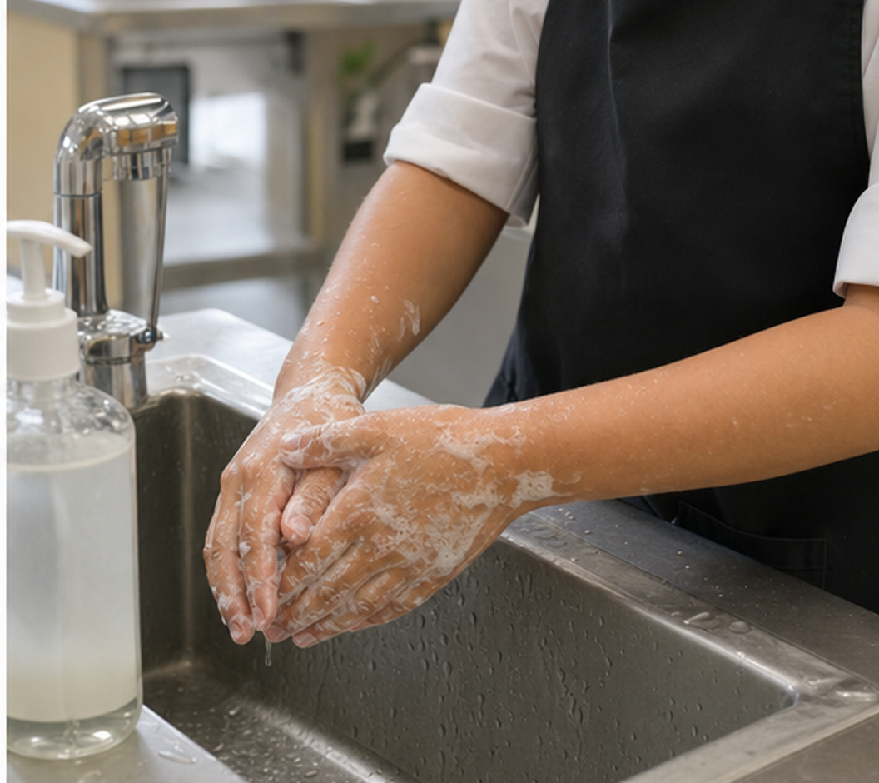
CONCEPT 1 · NOTICE AND EXPLAIN
1.2
Personal hygiene and readiness
Explain how personal preparation interrupts contamination pathways and make a defensible readiness decision before handling food.
• I can connect each hygiene action to a contamination pathway it controls.
• I can distinguish clean-looking from food-safe.
• I can complete and justify a person-to-place readiness check.
Do not just spot differences: explain the contamination pathway controlled by each change.
FOOD SELECTION & HEALTH · MODULE 1
2 / 8
Notes:
Teach the learning intention through the visual. Ask students to state what the image can support and what it cannot prove. Address the first likely misconception before moving on.
Pause for a student explanation before revealing or summarising the next idea.
[Sources]
- https://www.foodauthority.nsw.gov.au/consumer/food-at-home
- https://www.foodstandards.gov.au/consumer/safety
- https://curriculum.nsw.edu.au/learning-areas/tas/food-technology-7-10-2025/outcomes
- Generated visual asset: C:\Users\scowell1\Documents\Codex\2026-08-28\new-tas-course-site-builder-plugin-2\outputs\year-9-food-selection-and-health\_project\evidence\presentations\crops\module-01-q2.png

Slide 3
SECTION 1.1 · DECIDE
1.3
Contamination-chain photo audit
Practise connecting visible preparation choices to invisible transfer pathways.
Scene A: phone just used, loose hair, dry hands and a shared bench. Scene B: phone stored, hair restrained, hands washed and a clear bench. Mark what is visible; infer pathways cautiously.
1
2
3
Mark possible biological, physical or allergen sources in the first scene.
Draw how one contaminant could reach ready-to-eat food.
Match each arrow to a control in the prepared scene.
Evidence to keep: An annotated contamination chain and revised five-point checklist, labelled formative practice.
FOOD SELECTION & HEALTH · MODULE 1
3 / 8
Notes:
Keep the class moving through three clear stages. Invite one group to defend a choice using the concept language, then name the evidence students should retain.
Pause for a student explanation before revealing or summarising the next idea.
[Sources]
- https://www.foodauthority.nsw.gov.au/consumer/food-at-home
- https://www.foodstandards.gov.au/consumer/safety
- https://curriculum.nsw.edu.au/learning-areas/tas/food-technology-7-10-2025/outcomes

Slide 4
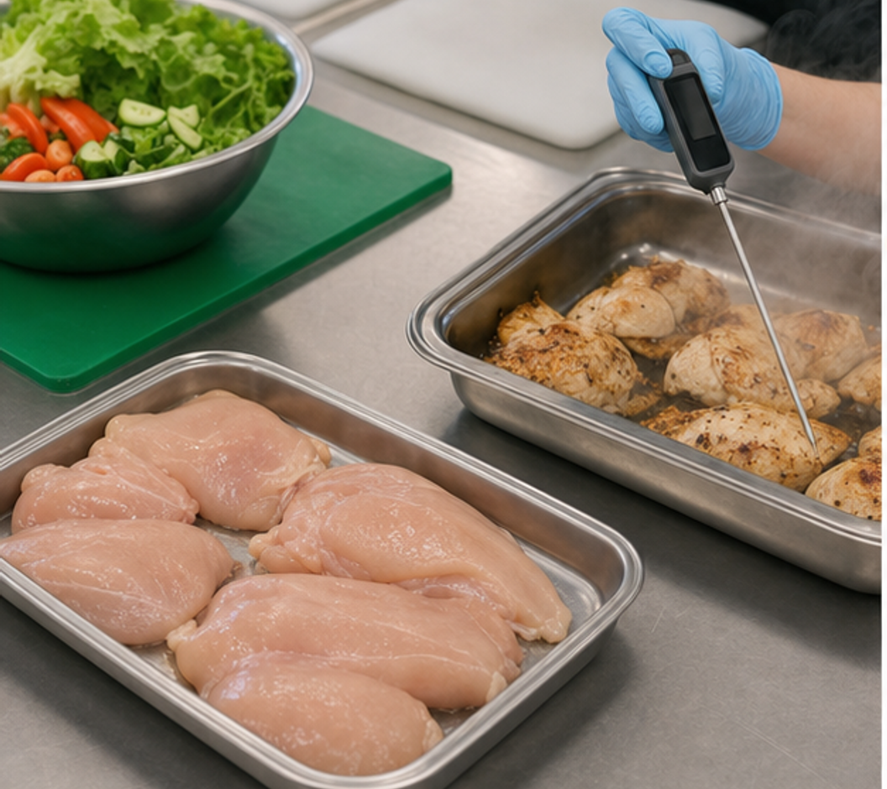
CONCEPT 2 · NOTICE AND EXPLAIN
1.4
Contamination, temperature and food safety
Classify food hazards and use separation, cleaning, temperature and cumulative-time evidence to choose safe handling actions.
• I can distinguish biological, chemical, physical and allergen hazards.
• I can trace cross-contamination and place a control at the transfer point.
• I can apply Australian temperature and two-hour/four-hour guidance.
Trace each hazard's journey and place the earliest practical control.
FOOD SELECTION & HEALTH · MODULE 1
4 / 8
Notes:
Teach the learning intention through the visual. Ask students to state what the image can support and what it cannot prove. Address the first likely misconception before moving on.
Pause for a student explanation before revealing or summarising the next idea.
[Sources]
- https://www.foodstandards.gov.au/consumer/safety
- https://www.foodstandards.gov.au/business/food-safety/2-hour-4-hour-rule
- https://www.foodauthority.nsw.gov.au/consumer/food-at-home
- Generated visual asset: C:\Users\scowell1\Documents\Codex\2026-08-28\new-tas-course-site-builder-plugin-2\outputs\year-9-food-selection-and-health\_project\evidence\presentations\crops\module-01-q3.png

Slide 5
SECTION 1.2 · HIGHER-ORDER RESPONSE
1.5
Compare, decide and explain
Analyse a lunch-preparation scene where raw food, ready-to-eat salad and chilled filling share a bench. Identify four hazards, trace their transfer or growth pathways, and justify controls using separation, cleaning, time and temperature.
STIMULUS — Scenario: a raw-chicken packet, ready-to-eat salad, chilled filling and a phone share one bench; the salad knife changes hands; food has been out for 70 minutes.
Build the response
Strong evidence
• Classify at least four hazards.
• Trace each source-to-food or source-to-person route.
• Place the earliest practical control on each route.
• Applies hazard categories accurately.
• Explains transfer and growth mechanisms.
• Uses Australian temperature and time guidance correctly.
FOOD SELECTION & HEALTH · MODULE 1
5 / 8
Notes:
Model a claim, evidence and reasoning chain without dictating the response. Ask students to locate the trade-off or limit that keeps the conclusion defensible.
Pause for a student explanation before revealing or summarising the next idea.
[Sources]
- https://www.foodstandards.gov.au/consumer/safety
- https://www.foodstandards.gov.au/business/food-safety/2-hour-4-hour-rule
- https://www.foodauthority.nsw.gov.au/consumer/food-at-home

Slide 6
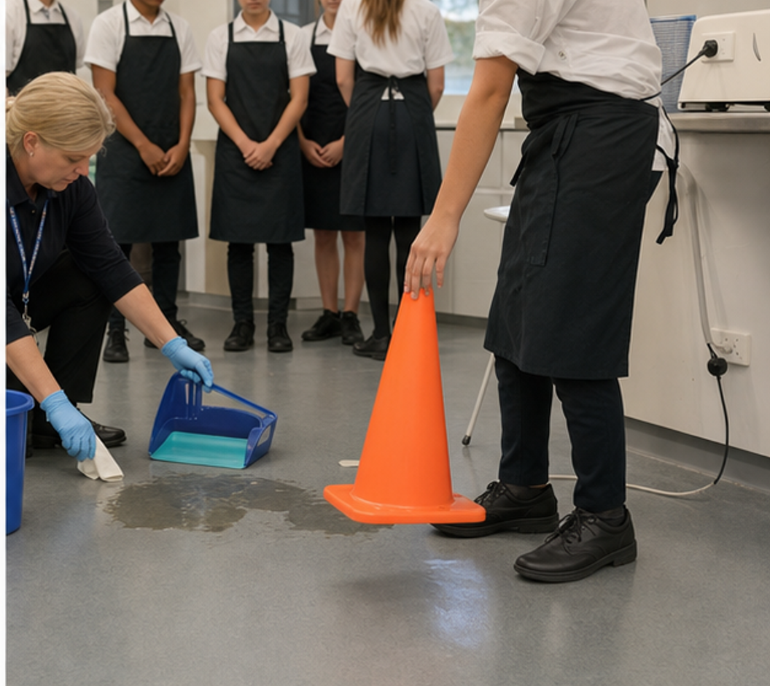
CONCEPT 3 · NOTICE AND EXPLAIN
1.6
Safe decisions and incident response
Use a calm stop–isolate–tell process and evidence-based risk reasoning to prevent escalation.
• I can distinguish a hazard, a risk and a control.
• I can choose a proportionate response without acting beyond my training.
• I can explain how near-miss information improves planning.
For each incident, identify hazard, risk and the first action that prevents escalation.
FOOD SELECTION & HEALTH · MODULE 1
6 / 8
Notes:
Teach the learning intention through the visual. Ask students to state what the image can support and what it cannot prove. Address the first likely misconception before moving on.
Pause for a student explanation before revealing or summarising the next idea.
[Sources]
- https://www.safework.nsw.gov.au/hazards-a-z
- https://www.foodauthority.nsw.gov.au/consumer/food-at-home
- https://www.healthdirect.gov.au/burns-and-scalds
- Generated visual asset: C:\Users\scowell1\Documents\Codex\2026-08-28\new-tas-course-site-builder-plugin-2\outputs\year-9-food-selection-and-health\_project\evidence\presentations\crops\module-01-q4.png

Slide 7
INVESTIGATION · EVIDENCE HANDOFF
1.7
Apply the three ideas together
First-action decision carousel
Rehearse calm, proportionate incident decisions.
• Cross out actions beyond student training.
• Add one preventive workflow change.
• Peer-check that the change breaks the pathway.
Keep: Four decision records and one expanded before-and-after redesign.
FOOD SELECTION & HEALTH · MODULE 1
7 / 8
Notes:
Use this as the handoff from explanation to applied evidence. The activity should remain formative unless the teacher explicitly links it to an approved formal task.
Pause for a student explanation before revealing or summarising the next idea.
[Sources]
- https://www.safework.nsw.gov.au/hazards-a-z
- https://www.foodauthority.nsw.gov.au/consumer/food-at-home
- https://www.healthdirect.gov.au/burns-and-scalds
- Generated visual asset: C:\Users\scowell1\Documents\Codex\2026-08-28\new-tas-course-site-builder-plugin-2\outputs\year-9-food-selection-and-health\_project\evidence\presentations\crops\module-01-q4.png

Slide 8
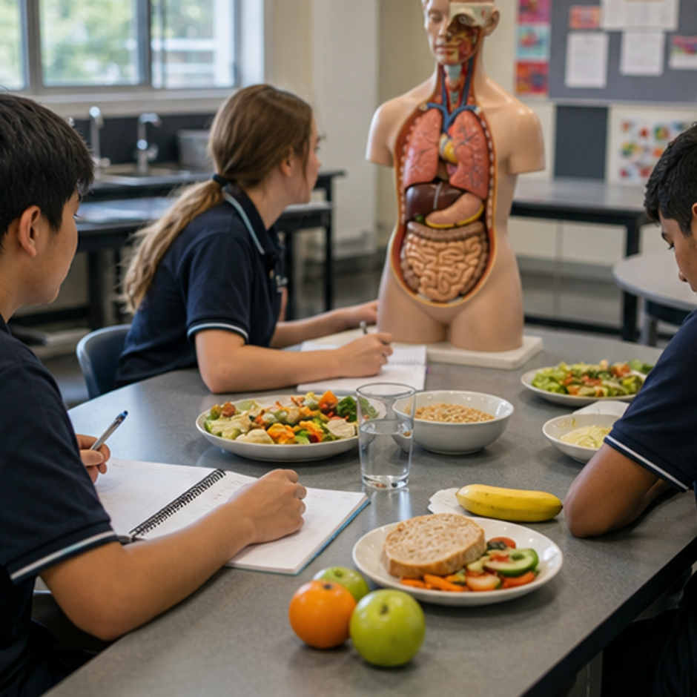
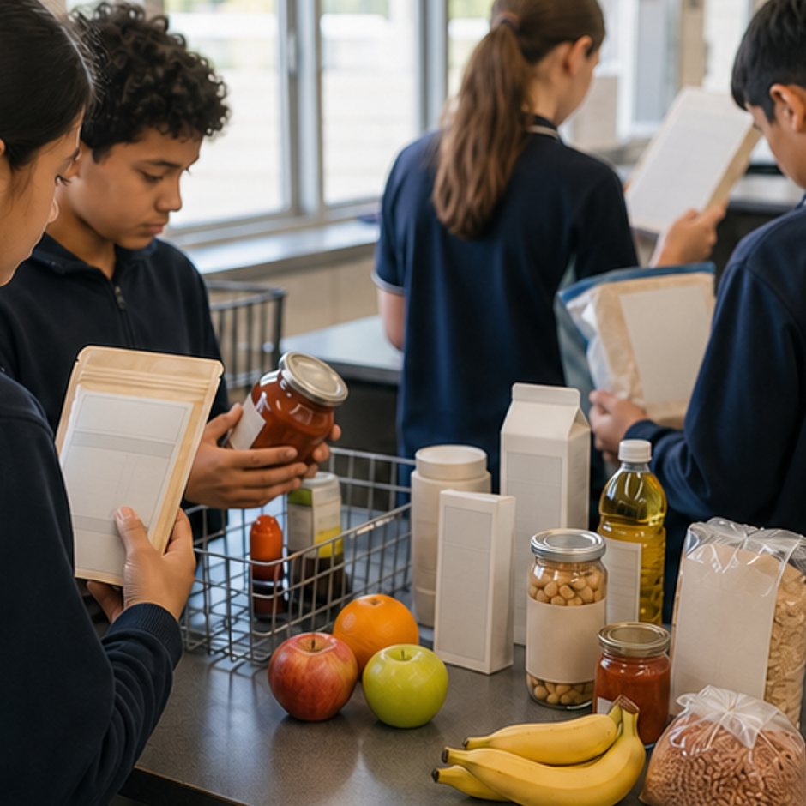
REVIEW · REPAIR · KEEP
Can you defend the decision?
• 1. Why wash hands again after putting a phone away?
• 2. Which example is a biological food hazard?
• 3. Which statement distinguishes hazard from risk?
Where this connects next
Save as “M1.3 Near-miss redesign” with before-and-after workflow sketches and one measure of success.
Save selected evidence in My folio. Browser saving is not submission.
8 / 8
Notes:
Use the three prompts as an exit check. Reopen a section package where reasoning is weak, then direct students to the relevant folio stage.
Pause for a student explanation before revealing or summarising the next idea.
[Sources]
- https://curriculum.nsw.edu.au/learning-areas/tas/food-technology-7-10-2025/outcomes
- Generated course identity asset: C:\Users\scowell1\Documents\Codex\2026-08-28\new-tas-course-site-builder-plugin-2\outputs\year-9-food-selection-and-health\assets\food-selection-health-hero.png
- Generated adjacent-module context asset: C:\Users\scowell1\Documents\Codex\2026-08-28\new-tas-course-site-builder-plugin-2\outputs\year-9-food-selection-and-health\_project\evidence\presentations\crops\module-02-q1.png
- Generated adjacent-module context asset: C:\Users\scowell1\Documents\Codex\2026-08-28\new-tas-course-site-builder-plugin-2\outputs\year-9-food-selection-and-health\_project\evidence\presentations\crops\module-03-q1.png

