Slide 1
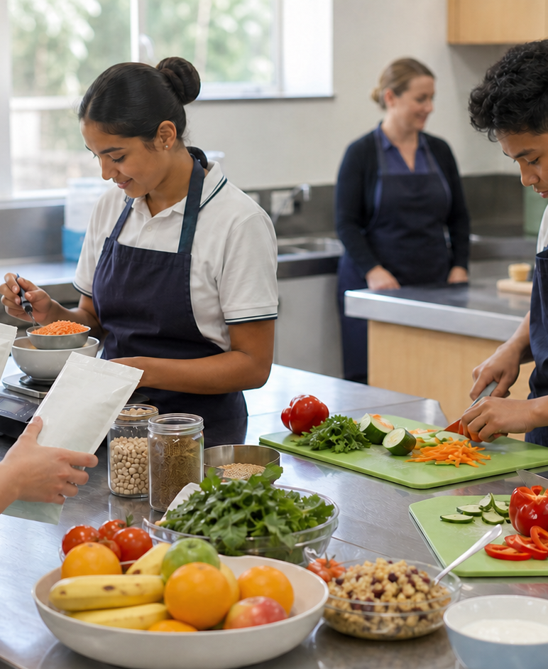
MODULE 2 · YEAR 9 FOOD TECHNOLOGY
Food and the body
Students explain how nutrients, energy and digestion interact, then apply that understanding to balanced choices without moralising individual foods.
Notice → Question → Evidence → Decision
1 / 8
Notes:
Frame the module around one defensible food decision. Use the context image to elicit what students notice before naming the three sections.
Pause for a student explanation before revealing or summarising the next idea.
[Sources]
- https://curriculum.nsw.edu.au/learning-areas/tas/food-technology-7-10-2025/outcomes
- Generated visual asset: C:\Users\scowell1\Documents\Codex\2026-08-28\new-tas-course-site-builder-plugin-2\outputs\year-9-food-selection-and-health\assets\visual-m02-board.png
- Generated course identity asset: C:\Users\scowell1\Documents\Codex\2026-08-28\new-tas-course-site-builder-plugin-2\outputs\year-9-food-selection-and-health\assets\food-selection-health-hero.png

Slide 2
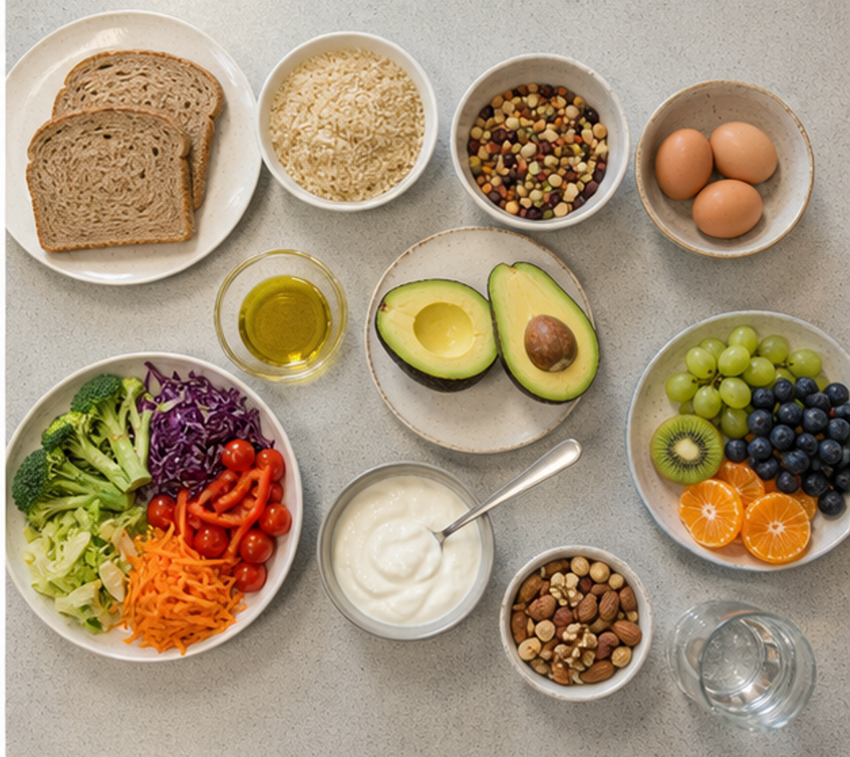
CONCEPT 1 · NOTICE AND EXPLAIN
2.2
Six nutrients and their roles
Explain the main roles of carbohydrate, protein, fat, vitamins, minerals and water, and connect varied foods to complementary body functions.
• I can distinguish energy-yielding nutrients from regulatory nutrients.
• I can link each nutrient group to varied food sources.
• I can explain why one food or supplement cannot replace variety.
Choose two foods and explain how their nutrient contributions overlap and complement each other.
FOOD SELECTION & HEALTH · MODULE 2
2 / 8
Notes:
Teach the learning intention through the visual. Ask students to state what the image can support and what it cannot prove. Address the first likely misconception before moving on.
Pause for a student explanation before revealing or summarising the next idea.
[Sources]
- https://www.eatforhealth.gov.au/nutrient-reference-values
- https://www.eatforhealth.gov.au/guidelines/australian-guide-healthy-eating
- https://curriculum.nsw.edu.au/learning-areas/tas/food-technology-7-10-2025/outcomes
- Generated visual asset: C:\Users\scowell1\Documents\Codex\2026-08-28\new-tas-course-site-builder-plugin-2\outputs\year-9-food-selection-and-health\_project\evidence\presentations\crops\module-02-q2.png

Slide 3
SECTION 2.1 · DECIDE
2.3
More than one nutrient
Break the one-food–one-nutrient misconception.
1
2
3
Choose six foods from at least four food groups.
Attach at least two defensible nutrient labels to each.
Place foods across one or more function zones.
Evidence to keep: A photographed sorting mat and 100-word explanation of one complementary pairing.
FOOD SELECTION & HEALTH · MODULE 2
3 / 8
Notes:
Keep the class moving through three clear stages. Invite one group to defend a choice using the concept language, then name the evidence students should retain.
Pause for a student explanation before revealing or summarising the next idea.
[Sources]
- https://www.eatforhealth.gov.au/nutrient-reference-values
- https://www.eatforhealth.gov.au/guidelines/australian-guide-healthy-eating
- https://curriculum.nsw.edu.au/learning-areas/tas/food-technology-7-10-2025/outcomes

Slide 4
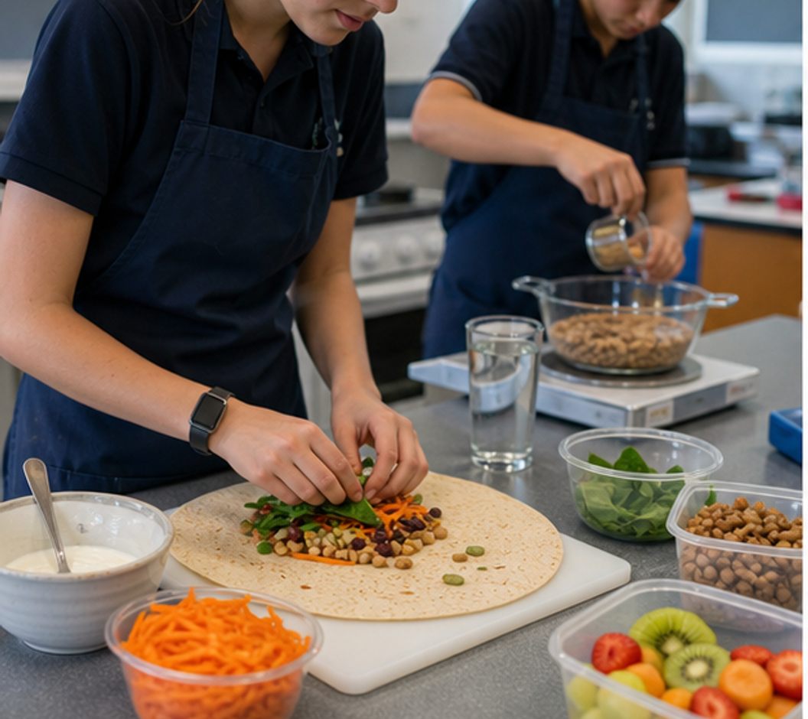
CONCEPT 2 · NOTICE AND EXPLAIN
2.4
Energy, growth and repair
Explain energy balance and nutrient density, then apply both ideas to a realistic adolescent meal decision.
• I can explain energy intake and use over time.
• I can distinguish kilojoules from nutrient density.
• I can justify a choice using context, portion and overall pattern.
Compare energy, nutrients, portion and how long each meal needs to sustain the eater.
FOOD SELECTION & HEALTH · MODULE 2
4 / 8
Notes:
Teach the learning intention through the visual. Ask students to state what the image can support and what it cannot prove. Address the first likely misconception before moving on.
Pause for a student explanation before revealing or summarising the next idea.
[Sources]
- https://www.eatforhealth.gov.au/guidelines
- https://www.eatforhealth.gov.au/eating-well/healthy-eating-throughout-all-life
- https://www.foodstandards.gov.au/consumer/labelling/panels
- Generated visual asset: C:\Users\scowell1\Documents\Codex\2026-08-28\new-tas-course-site-builder-plugin-2\outputs\year-9-food-selection-and-health\_project\evidence\presentations\crops\module-02-q3.png

Slide 5
SECTION 2.2 · HIGHER-ORDER RESPONSE
2.5
Compare, decide and explain
Compare two lunch options for a Year 9 student with afternoon sport or physical practical work. Justify the stronger fit using energy, nutrient density, portion and pattern, then explain what could change the decision.
STIMULUS — Alex eats at 1.00 pm and has 80 minutes of sport at 3.30 pm. A: wholegrain chicken-and-salad wrap, plain yoghurt, banana and water. B: cheese-and-cracker snack pack, apple purée, 300 mL flavoured milk and water. Portion, allergy, cultural and medical details are not supplied.
Build the response
Strong evidence
• Describe the eater's activity and timing.
• Compare options on a common basis and realistic portion.
• Identify carbohydrate, protein, plant-food and fluid contributions.
• Keeps kilojoules and nutrient density distinct.
• Connects choice to growth, activity and repair.
• Considers portion and pattern.
FOOD SELECTION & HEALTH · MODULE 2
5 / 8
Notes:
Model a claim, evidence and reasoning chain without dictating the response. Ask students to locate the trade-off or limit that keeps the conclusion defensible.
Pause for a student explanation before revealing or summarising the next idea.
[Sources]
- https://www.eatforhealth.gov.au/guidelines
- https://www.eatforhealth.gov.au/eating-well/healthy-eating-throughout-all-life
- https://www.foodstandards.gov.au/consumer/labelling/panels

Slide 6
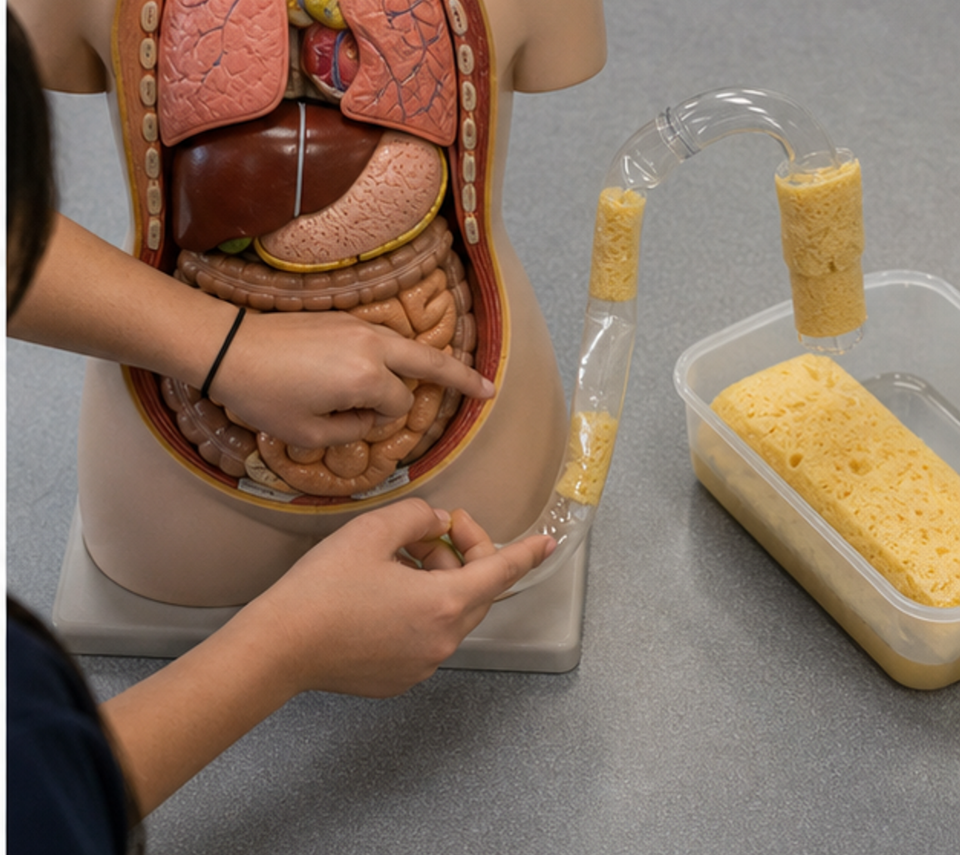
CONCEPT 3 · NOTICE AND EXPLAIN
2.6
Digestion and nutrient absorption
Trace mechanical and chemical processing through the digestive system and explain how structure supports absorption.
• I can sequence major digestive organs and roles.
• I can distinguish digestion from absorption.
• I can explain enzymes, bile, villi, water and fibre.
Trace one bite: name each change and decide whether digestion or absorption is occurring.
FOOD SELECTION & HEALTH · MODULE 2
6 / 8
Notes:
Teach the learning intention through the visual. Ask students to state what the image can support and what it cannot prove. Address the first likely misconception before moving on.
Pause for a student explanation before revealing or summarising the next idea.
[Sources]
- https://www.healthdirect.gov.au/digestive-system
- https://www.eatforhealth.gov.au/nutrient-reference-values
- https://www.youtube.com/watch?v=Og5xAdC8EUI
- Generated visual asset: C:\Users\scowell1\Documents\Codex\2026-08-28\new-tas-course-site-builder-plugin-2\outputs\year-9-food-selection-and-health\_project\evidence\presentations\crops\module-02-q4.png

Slide 7
INVESTIGATION · EVIDENCE HANDOFF
2.7
Apply the three ideas together
Digestive journey relay
Rehearse organ order and separate movement, digestion and absorption.
• Transform food into smaller molecule cards where justified.
• Move absorbable molecules into blood or lymph lanes.
• Explain and correct one misplaced card.
Keep: An annotated pathway and explanation of why the small intestine is the main absorption site.
FOOD SELECTION & HEALTH · MODULE 2
7 / 8
Notes:
Use this as the handoff from explanation to applied evidence. The activity should remain formative unless the teacher explicitly links it to an approved formal task.
Pause for a student explanation before revealing or summarising the next idea.
[Sources]
- https://www.healthdirect.gov.au/digestive-system
- https://www.eatforhealth.gov.au/nutrient-reference-values
- https://www.youtube.com/watch?v=Og5xAdC8EUI
- Generated visual asset: C:\Users\scowell1\Documents\Codex\2026-08-28\new-tas-course-site-builder-plugin-2\outputs\year-9-food-selection-and-health\_project\evidence\presentations\crops\module-02-q4.png

Slide 8
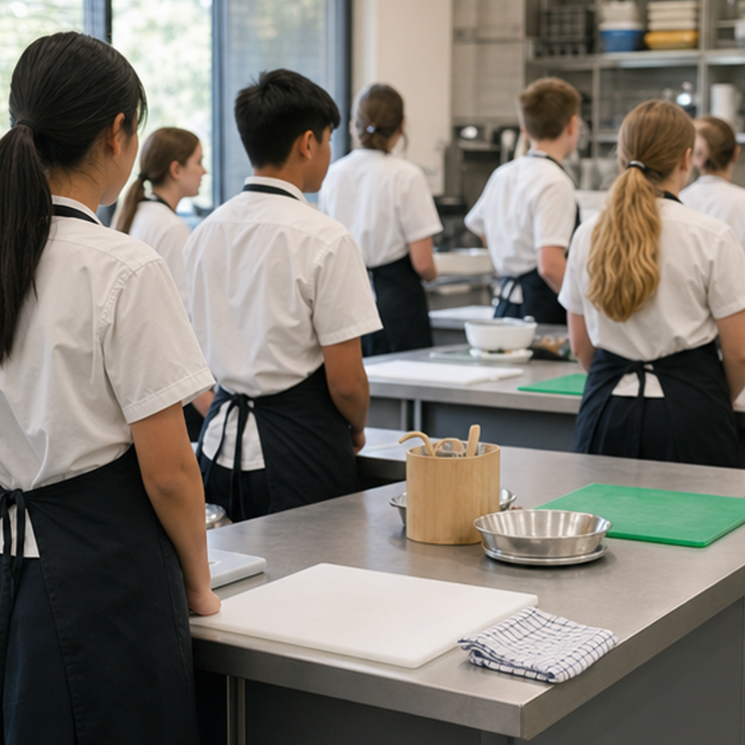
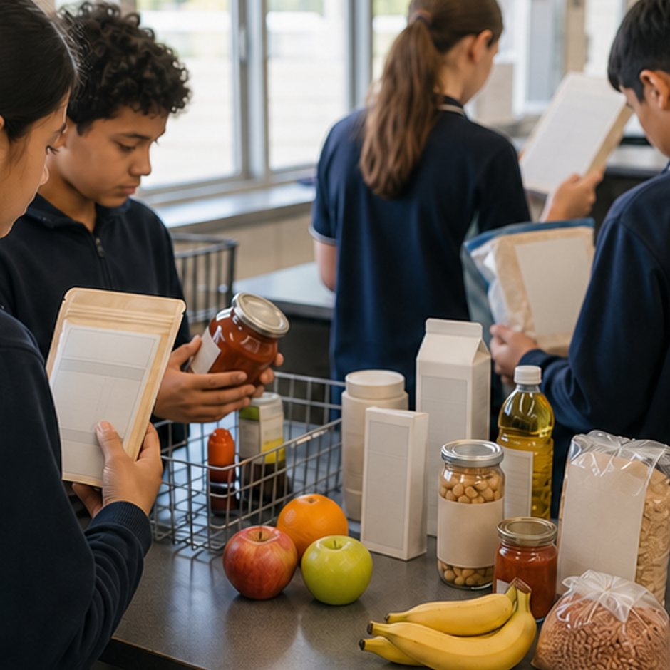
REVIEW · REPAIR · KEEP
Can you defend the decision?
• 1. Which three nutrients can supply energy measured in kilojoules?
• 2. What does a kilojoule measure?
• 3. What is the difference between digestion and absorption?
Where this connects next
Save as “M2.3 Journey of a mixed meal” with an organ flow and digestion-versus-absorption key.
Save selected evidence in My folio. Browser saving is not submission.
8 / 8
Notes:
Use the three prompts as an exit check. Reopen a section package where reasoning is weak, then direct students to the relevant folio stage.
Pause for a student explanation before revealing or summarising the next idea.
[Sources]
- https://curriculum.nsw.edu.au/learning-areas/tas/food-technology-7-10-2025/outcomes
- Generated course identity asset: C:\Users\scowell1\Documents\Codex\2026-08-28\new-tas-course-site-builder-plugin-2\outputs\year-9-food-selection-and-health\assets\food-selection-health-hero.png
- Generated adjacent-module context asset: C:\Users\scowell1\Documents\Codex\2026-08-28\new-tas-course-site-builder-plugin-2\outputs\year-9-food-selection-and-health\_project\evidence\presentations\crops\module-01-q1.png
- Generated adjacent-module context asset: C:\Users\scowell1\Documents\Codex\2026-08-28\new-tas-course-site-builder-plugin-2\outputs\year-9-food-selection-and-health\_project\evidence\presentations\crops\module-03-q1.png

