Slide 1
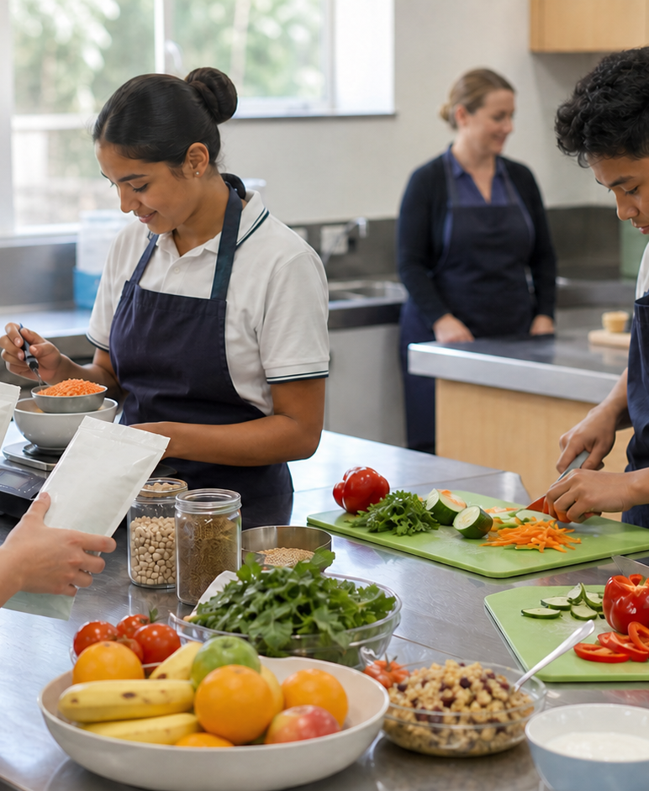
MODULE 3 · YEAR 9 FOOD TECHNOLOGY
Reading food evidence
Students read Australian food labels, make fair comparisons and evaluate claims so decisions are based on evidence rather than package persuasion.
Notice → Question → Evidence → Decision
1 / 8
Notes:
Frame the module around one defensible food decision. Use the context image to elicit what students notice before naming the three sections.
Pause for a student explanation before revealing or summarising the next idea.
[Sources]
- https://curriculum.nsw.edu.au/learning-areas/tas/food-technology-7-10-2025/outcomes
- Generated visual asset: C:\Users\scowell1\Documents\Codex\2026-08-28\new-tas-course-site-builder-plugin-2\outputs\year-9-food-selection-and-health\assets\visual-m03-board.png
- Generated course identity asset: C:\Users\scowell1\Documents\Codex\2026-08-28\new-tas-course-site-builder-plugin-2\outputs\year-9-food-selection-and-health\assets\food-selection-health-hero.png

Slide 2
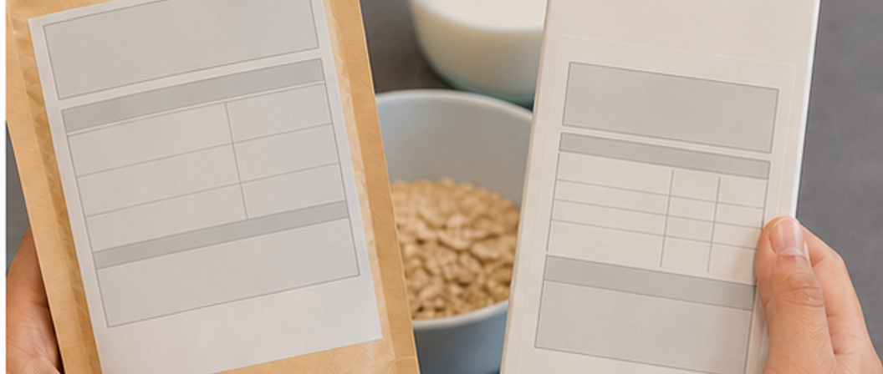
CONCEPT 1 · NOTICE AND EXPLAIN
3.2
Ingredients, servings and nutrition panels
Locate and interpret Australian label evidence including ingredient order, allergens, serving information and per 100 g or 100 mL data.
• I can explain what ingredient order does and does not reveal.
• I can use per serve and per 100 g or 100 mL for different decisions.
• I can combine nutrition, allergen, date and storage evidence.
FICTIONAL PRACTICE YOGHURT A — Serve 170 g. Per serve / per 100 g: energy 510 / 300 kJ; protein 11.9 / 7.0 g; fat 4.3 / 2.5 g; sugars 8.5 / 5.0 g; sodium 85 / 50 mg. Ingredients: milk, milk solids, cream, live cultures. Contains milk. Use by 10 Sep 20XX. Keep at or below 5°C. Claim: no added sugar; contains naturally occurring milk sugars.
Start with the question, then choose the label zone that can answer it.
FOOD SELECTION & HEALTH · MODULE 3
2 / 8
Notes:
Teach the learning intention through the visual. Ask students to state what the image can support and what it cannot prove. Address the first likely misconception before moving on.
Pause for a student explanation before revealing or summarising the next idea.
[Sources]
- https://www.foodstandards.gov.au/consumer/labelling/panels
- https://www.foodstandards.gov.au/consumer/labelling/ingredients
- https://www.foodstandards.gov.au/consumer/labelling/allergen-labelling
- Generated visual asset: C:\Users\scowell1\Documents\Codex\2026-08-28\new-tas-course-site-builder-plugin-2\outputs\year-9-food-selection-and-health\_project\evidence\presentations\crops\module-03-q2.png

Slide 3
SECTION 3.1 · DECIDE
3.3
Three-pass label scan
Build an efficient routine for safety, comparison and portion evidence.
1
2
3
Highlight allergens, date and storage.
Circle serve size and compare per 100 g.
Underline the first three ingredients and sugar terms.
Evidence to keep: Two annotated labels and an evidence-versus-inference record.
FOOD SELECTION & HEALTH · MODULE 3
3 / 8
Notes:
Keep the class moving through three clear stages. Invite one group to defend a choice using the concept language, then name the evidence students should retain.
Pause for a student explanation before revealing or summarising the next idea.
[Sources]
- https://www.foodstandards.gov.au/consumer/labelling/panels
- https://www.foodstandards.gov.au/consumer/labelling/ingredients
- https://www.foodstandards.gov.au/consumer/labelling/allergen-labelling

Slide 4
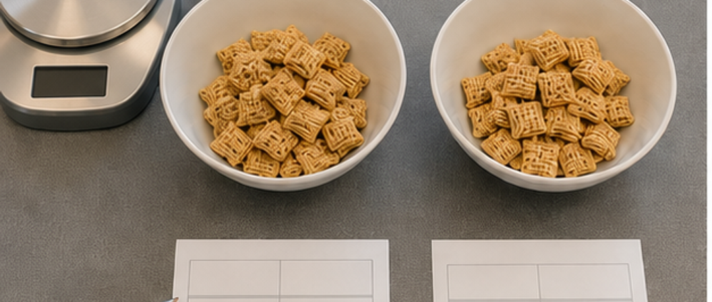
CONCEPT 2 · NOTICE AND EXPLAIN
3.4
Comparing foods fairly
Use a repeatable evidence process to compare like products for a stated purpose and make a conditional recommendation.
• I can define the comparison purpose before selecting nutrients.
• I can use a common amount and then account for actual portion.
• I can make a conditional recommendation with trade-offs.
FICTIONAL YOGHURTS — A: serve 170 g; per 100 g: 300 kJ, protein 7.0 g, sugars 5.0 g. B: serve 125 g; per 100 g: 400 kJ, protein 4.5 g, sugars 13.0 g. Both contain milk and require refrigeration. Compare per 100 g first, then the whole tub.
Compare per 100 g, calculate the planned portion, then make a context-bound recommendation.
FOOD SELECTION & HEALTH · MODULE 3
4 / 8
Notes:
Teach the learning intention through the visual. Ask students to state what the image can support and what it cannot prove. Address the first likely misconception before moving on.
Pause for a student explanation before revealing or summarising the next idea.
[Sources]
- https://www.foodstandards.gov.au/consumer/labelling/panels
- https://www.eatforhealth.gov.au/guidelines
- https://www.healthstarrating.gov.au/
- Generated visual asset: C:\Users\scowell1\Documents\Codex\2026-08-28\new-tas-course-site-builder-plugin-2\outputs\year-9-food-selection-and-health\_project\evidence\presentations\crops\module-03-q3.png

Slide 5
SECTION 3.2 · HIGHER-ORDER RESPONSE
3.5
Compare, decide and explain
Compare two similar packaged foods for a Year 9 context. Make a conditional recommendation using common baseline, portion, nutrients, ingredients and one non-nutrient factor, then identify missing evidence.
STIMULUS — Use fictional yoghurt A from Slide 2 and yoghurt B from Slide 4. Audience: a Year 9 student choosing a refrigerated school snack. Compare per 100 g, then the whole tub; name missing evidence.
Build the response
Strong evidence
• Define audience, occasion and decision question.
• Check the products are comparable.
• Compare three relevant values per 100 g or 100 mL.
• Uses a common amount accurately.
• Selects criteria for the purpose.
• Shows trade-offs and uncertainty.
FOOD SELECTION & HEALTH · MODULE 3
5 / 8
Notes:
Model a claim, evidence and reasoning chain without dictating the response. Ask students to locate the trade-off or limit that keeps the conclusion defensible.
Pause for a student explanation before revealing or summarising the next idea.
[Sources]
- https://www.foodstandards.gov.au/consumer/labelling/panels
- https://www.eatforhealth.gov.au/guidelines
- https://www.healthstarrating.gov.au/

Slide 6
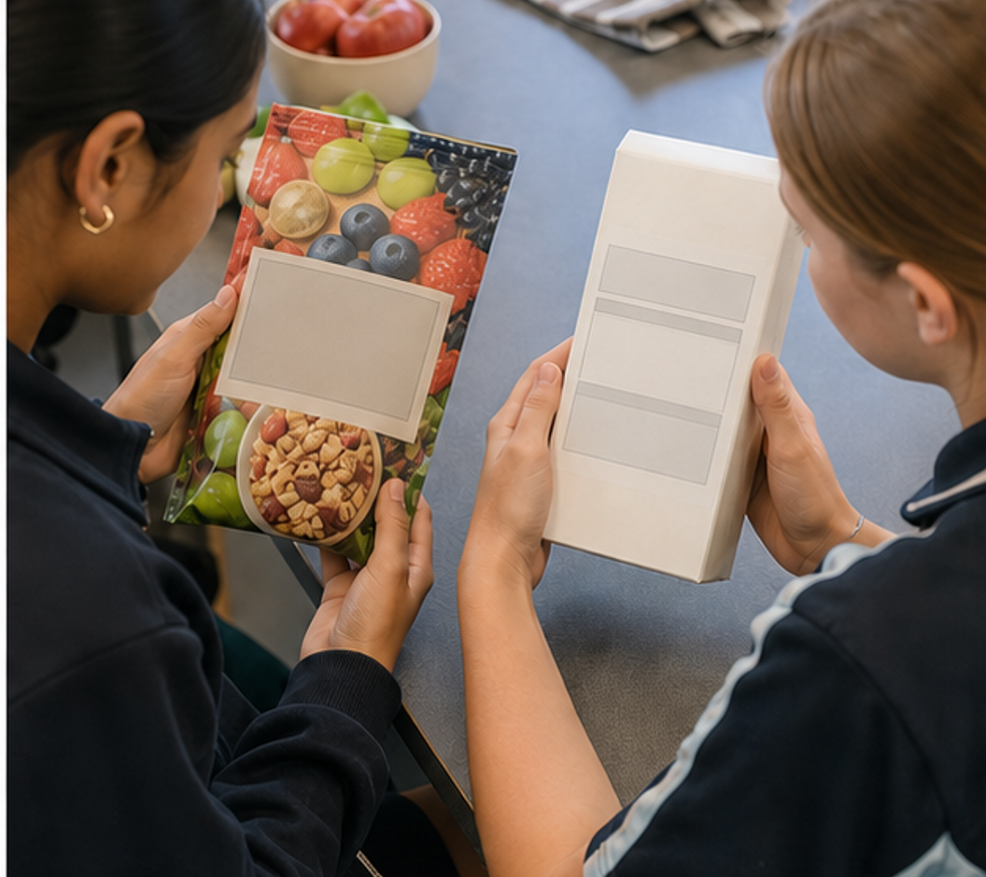
CONCEPT 3 · NOTICE AND EXPLAIN
3.6
Marketing claims, ethics and health
Evaluate food marketing and front-of-pack claims against regulated evidence, audience needs and ethical responsibilities.
• I can distinguish a marketing impression from checkable evidence.
• I can use Health Star Rating for appropriate within-category comparison.
• I can evaluate accuracy, omission, audience impact and responsibility.
FICTIONAL AD — BERRY CRUNCH: ‘Made with real berries.’ ‘Natural energy.’ ‘Fuel your best.’ Ingredients: oats 42%, yoghurt-style coating 26%, sugar, rice crisps, berry purée 2%, honey, flavour, salt. Contains gluten and milk; may contain nuts. Decide what is checkable, persuasive or missing.
Pause the first impression. Match every claim to evidence, then ask what remains unanswered.
FOOD SELECTION & HEALTH · MODULE 3
6 / 8
Notes:
Teach the learning intention through the visual. Ask students to state what the image can support and what it cannot prove. Address the first likely misconception before moving on.
Pause for a student explanation before revealing or summarising the next idea.
[Sources]
- https://www.foodstandards.gov.au/consumer/labelling/nutrition
- https://www.healthstarrating.gov.au/
- https://www.accc.gov.au/consumers/advertising-and-promotions/false-or-misleading-claims
- Generated visual asset: C:\Users\scowell1\Documents\Codex\2026-08-28\new-tas-course-site-builder-plugin-2\outputs\year-9-food-selection-and-health\_project\evidence\presentations\crops\module-03-q4.png

Slide 7
INVESTIGATION · EVIDENCE HANDOFF
3.7
Apply the three ideas together
Thirty-second impression reset
Make persuasive framing visible before full evaluation.
STIMULUS — Use the fictional Berry Crunch claim card from Slide 6; annotate each claim, ingredient evidence, omissions and a fairer rewrite.
• Check two claims against label or official evidence.
• Add one omitted health, audience or environment question.
• Rewrite the promotion more fairly.
Keep: Before-and-after impressions, evidence table and revised ethical promotion.
FOOD SELECTION & HEALTH · MODULE 3
7 / 8
Notes:
Use this as the handoff from explanation to applied evidence. The activity should remain formative unless the teacher explicitly links it to an approved formal task.
Pause for a student explanation before revealing or summarising the next idea.
[Sources]
- https://www.foodstandards.gov.au/consumer/labelling/nutrition
- https://www.healthstarrating.gov.au/
- https://www.accc.gov.au/consumers/advertising-and-promotions/false-or-misleading-claims
- Generated visual asset: C:\Users\scowell1\Documents\Codex\2026-08-28\new-tas-course-site-builder-plugin-2\outputs\year-9-food-selection-and-health\_project\evidence\presentations\crops\module-03-q4.png

Slide 8
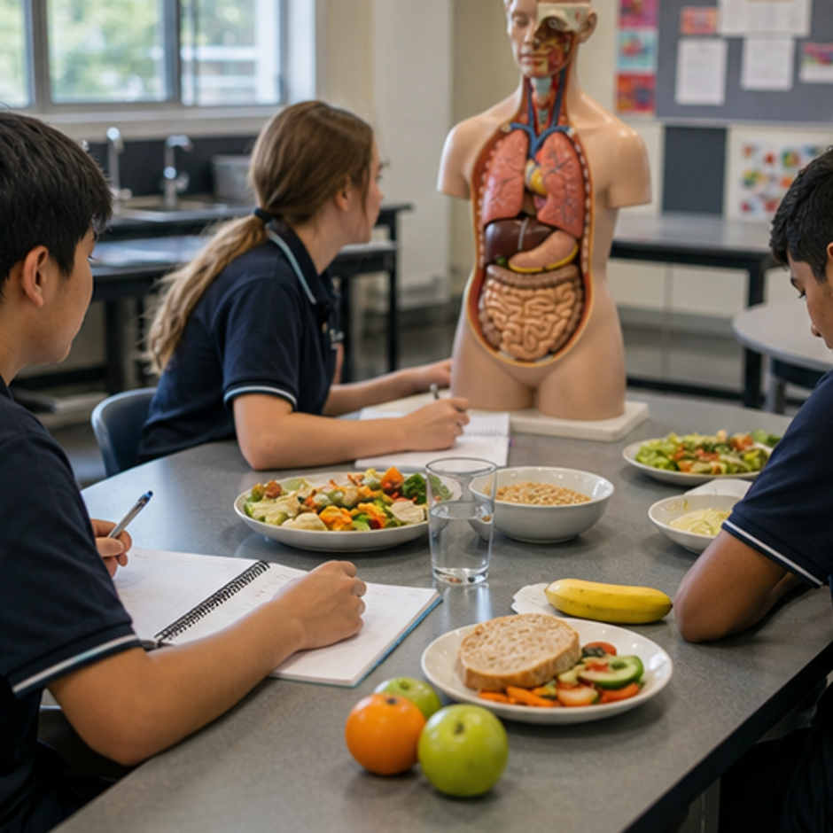
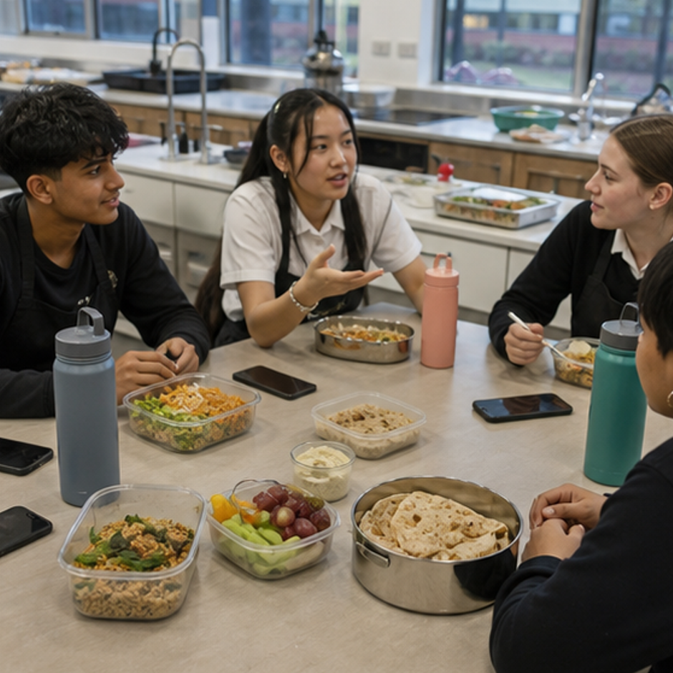
REVIEW · REPAIR · KEEP
Can you defend the decision?
• 1. What does ingredient order usually represent?
• 2. What should be decided before label criteria?
• 3. Why can a truthful front claim still be incomplete?
Where this connects next
Save as “M3.3 Claim–evidence–omission audit” with annotated promotion, source links and a fairer revised message.
Save selected evidence in My folio. Browser saving is not submission.
8 / 8
Notes:
Use the three prompts as an exit check. Reopen a section package where reasoning is weak, then direct students to the relevant folio stage.
Pause for a student explanation before revealing or summarising the next idea.
[Sources]
- https://curriculum.nsw.edu.au/learning-areas/tas/food-technology-7-10-2025/outcomes
- Generated course identity asset: C:\Users\scowell1\Documents\Codex\2026-08-28\new-tas-course-site-builder-plugin-2\outputs\year-9-food-selection-and-health\assets\food-selection-health-hero.png
- Generated adjacent-module context asset: C:\Users\scowell1\Documents\Codex\2026-08-28\new-tas-course-site-builder-plugin-2\outputs\year-9-food-selection-and-health\_project\evidence\presentations\crops\module-02-q1.png
- Generated adjacent-module context asset: C:\Users\scowell1\Documents\Codex\2026-08-28\new-tas-course-site-builder-plugin-2\outputs\year-9-food-selection-and-health\_project\evidence\presentations\crops\module-04-q1.png

