Slide 1
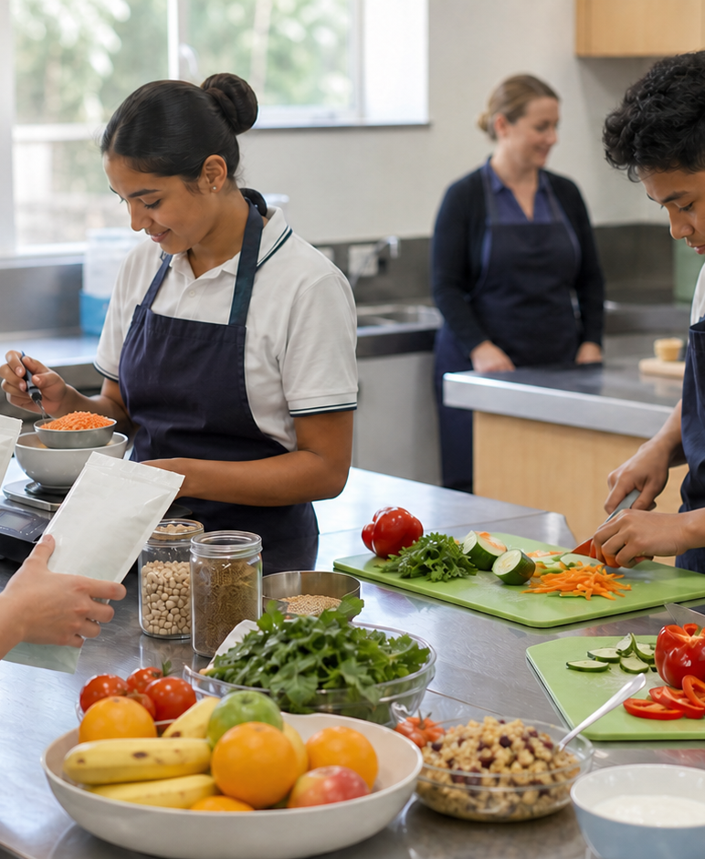
MODULE 4 · YEAR 9 FOOD TECHNOLOGY
Needs, habits and influences
Students investigate how food variety, changing life-stage needs and interacting personal, social, cultural and digital influences shape food selection without reducing health to a single food or personal trait.
Notice → Question → Evidence → Decision
1 / 8
Notes:
Frame the module around one defensible food decision. Use the context image to elicit what students notice before naming the three sections.
Pause for a student explanation before revealing or summarising the next idea.
[Sources]
- https://curriculum.nsw.edu.au/learning-areas/tas/food-technology-7-10-2025/outcomes
- Generated visual asset: C:\Users\scowell1\Documents\Codex\2026-08-28\new-tas-course-site-builder-plugin-2\outputs\year-9-food-selection-and-health\assets\visual-m04-board.png
- Generated course identity asset: C:\Users\scowell1\Documents\Codex\2026-08-28\new-tas-course-site-builder-plugin-2\outputs\year-9-food-selection-and-health\assets\food-selection-health-hero.png

Slide 2
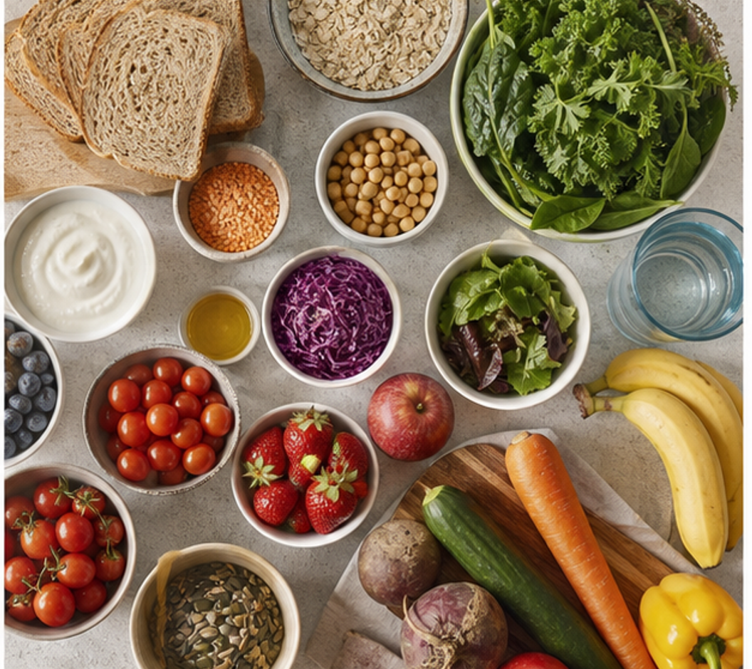
CONCEPT 1 · NOTICE AND EXPLAIN
4.2
Active non-nutrients and food variety
Investigate how water (a nutrient), fibre and naturally occurring plant compounds contribute to healthy eating patterns, and explain why variety matters more than chasing one supposed superfood.
• I can distinguish nutrients from other food components that support body functions.
• I can explain how fibre and water support digestion using an accurate cause-and-effect chain.
• I can justify a varied food choice without making a cure, detox or superfood claim.
Variety is evidence of a broader mix of food components; it is not proof that one food has special powers.
FOOD SELECTION & HEALTH · MODULE 4
2 / 8
Notes:
Teach the learning intention through the visual. Ask students to state what the image can support and what it cannot prove. Address the first likely misconception before moving on.
Pause for a student explanation before revealing or summarising the next idea.
[Sources]
- https://www.eatforhealth.gov.au/guidelines/australian-guide-healthy-eating
- https://www.eatforhealth.gov.au/
- https://www.foodstandards.gov.au/consumer/labelling/panels
- Generated visual asset: C:\Users\scowell1\Documents\Codex\2026-08-28\new-tas-course-site-builder-plugin-2\outputs\year-9-food-selection-and-health\_project\evidence\presentations\crops\module-04-q2.png

Slide 3
SECTION 4.1 · DECIDE
4.3
Variety evidence sort
Practise matching observable food features to defensible contributions while rejecting exaggerated claims.
Repair these fictional claims: ‘One berry detoxes your body.’ ‘This seed prevents illness.’ Replace certainty with what evidence can support.
1
2
3
Sort food photos by more than one possible contribution.
Match each group to a cautious evidence statement.
Identify and rewrite the two exaggerated claims.
Evidence to keep: One annotated sort, two corrected claims and a photographed or written snack redesign saved as formative practice.
FOOD SELECTION & HEALTH · MODULE 4
3 / 8
Notes:
Keep the class moving through three clear stages. Invite one group to defend a choice using the concept language, then name the evidence students should retain.
Pause for a student explanation before revealing or summarising the next idea.
[Sources]
- https://www.eatforhealth.gov.au/guidelines/australian-guide-healthy-eating
- https://www.eatforhealth.gov.au/
- https://www.foodstandards.gov.au/consumer/labelling/panels

Slide 4
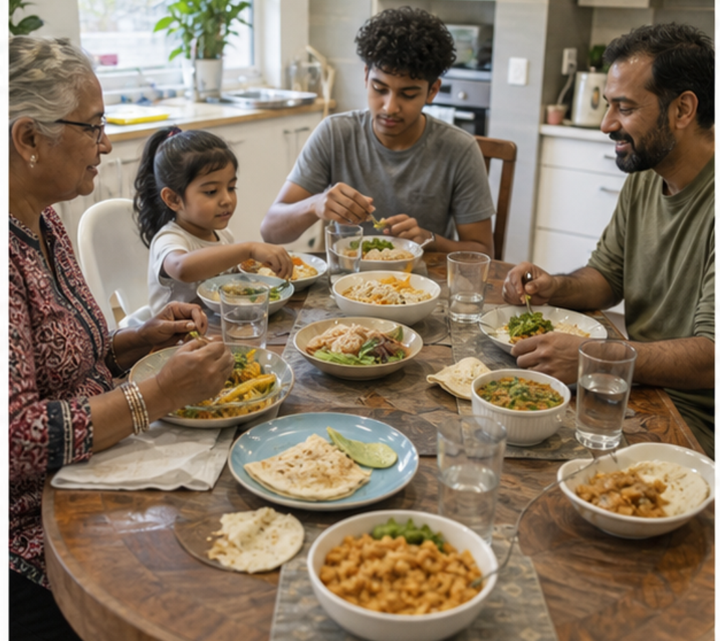
CONCEPT 2 · NOTICE AND EXPLAIN
4.4
Nutrition across the lifecycle
Explain why food and nutrient needs change across life stages and use context, rather than stereotypes, to adapt a food choice.
• I can identify factors that alter energy and nutrient needs across life stages.
• I can explain why two people in the same age group may still have different needs.
• I can adapt a meal for a stated context without diagnosing or prescribing.
Life stage guides the questions we ask; the person's actual context guides the design decision.
FOOD SELECTION & HEALTH · MODULE 4
4 / 8
Notes:
Teach the learning intention through the visual. Ask students to state what the image can support and what it cannot prove. Address the first likely misconception before moving on.
Pause for a student explanation before revealing or summarising the next idea.
[Sources]
- https://www.eatforhealth.gov.au/nutrient-reference-values
- https://www.eatforhealth.gov.au/guidelines/australian-guide-healthy-eating
- https://www.aihw.gov.au/reports-data/behaviours-risk-factors/food-nutrition/overview
- Generated visual asset: C:\Users\scowell1\Documents\Codex\2026-08-28\new-tas-course-site-builder-plugin-2\outputs\year-9-food-selection-and-health\_project\evidence\presentations\crops\module-04-q3.png

Slide 5
SECTION 4.2 · HIGHER-ORDER RESPONSE
4.5
Compare, decide and explain
Compare the needs in two lifecycle case studies and justify one food-design adaptation for each, showing which details are evidence and which still need confirmation.
STIMULUS — Case A: 14-year-old with afternoon training, limited fridge access and no stated allergy. Case B: 70-year-old cooking for one, smaller appetite and chewing difficulty; no clinical advice is supplied.
Build the response
Strong evidence
• Summarise each person's stated life stage and context without stereotypes.
• Identify one relevant nutrition or practical need in each case.
• Select one food or design feature that could respond to each need.
• Separates life-stage guidance from individual evidence
• Uses accurate cause-and-effect reasoning
• Avoids diagnosis, prescription and stereotypes
FOOD SELECTION & HEALTH · MODULE 4
5 / 8
Notes:
Model a claim, evidence and reasoning chain without dictating the response. Ask students to locate the trade-off or limit that keeps the conclusion defensible.
Pause for a student explanation before revealing or summarising the next idea.
[Sources]
- https://www.eatforhealth.gov.au/nutrient-reference-values
- https://www.eatforhealth.gov.au/guidelines/australian-guide-healthy-eating
- https://www.aihw.gov.au/reports-data/behaviours-risk-factors/food-nutrition/overview

Slide 6
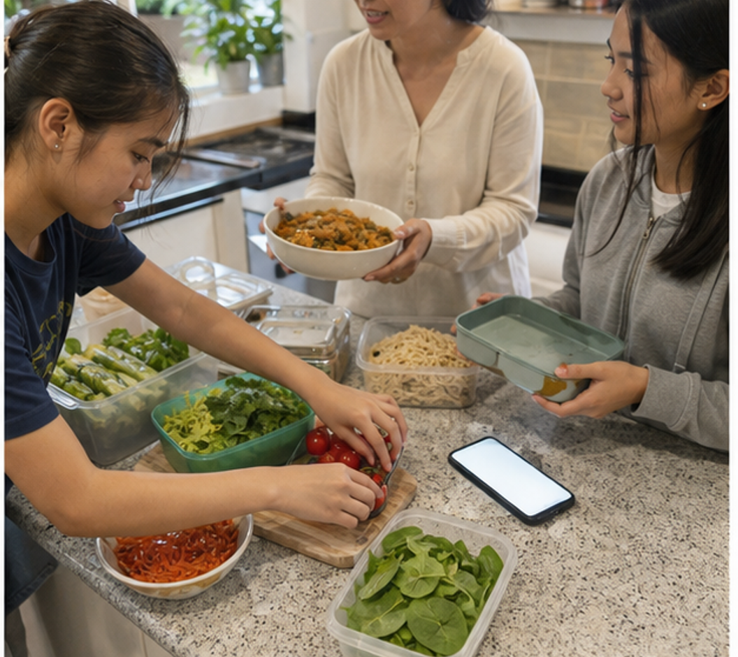
CONCEPT 3 · NOTICE AND EXPLAIN
4.6
Personal, social, cultural and digital influences
Analyse how interacting influences shape food selection and use a pause-check-decide process to make a reasoned choice.
• I can classify influences without treating any one influence as automatically good or bad.
• I can explain how two or more influences interact in a realistic choice.
• I can test a digital food claim against source, evidence and personal context.
FICTIONAL POST — ‘This natural snack suits every student and guarantees all-day energy.’ Check source, purpose, evidence, omissions and personal context.
Choices are shaped by several pressures at once; strong decisions identify those pressures before judging the person.
FOOD SELECTION & HEALTH · MODULE 4
6 / 8
Notes:
Teach the learning intention through the visual. Ask students to state what the image can support and what it cannot prove. Address the first likely misconception before moving on.
Pause for a student explanation before revealing or summarising the next idea.
[Sources]
- https://www.aihw.gov.au/reports-data/behaviours-risk-factors/food-nutrition/overview
- https://www.eatforhealth.gov.au/guidelines/australian-guide-healthy-eating
- https://www.healthstarrating.gov.au/
- Generated visual asset: C:\Users\scowell1\Documents\Codex\2026-08-28\new-tas-course-site-builder-plugin-2\outputs\year-9-food-selection-and-health\_project\evidence\presentations\crops\module-04-q4.png

Slide 7
INVESTIGATION · EVIDENCE HANDOFF
4.7
Apply the three ideas together
Influence detective
Rehearse identifying, connecting and evaluating the influences inside one everyday decision.
STIMULUS — Use the fictional ‘natural snack’ post from Slide 6; map friends, price, time, family, source, evidence and personal context.
• Draw arrows between influences that reinforce or conflict.
• Check one digital or marketing message using source, purpose, evidence and missing information.
• Complete pause-check-decide and compare a partner's equally defensible alternative.
Keep: An annotated influence map, one checked claim and a concise decision reflection saved as formative practice.
FOOD SELECTION & HEALTH · MODULE 4
7 / 8
Notes:
Use this as the handoff from explanation to applied evidence. The activity should remain formative unless the teacher explicitly links it to an approved formal task.
Pause for a student explanation before revealing or summarising the next idea.
[Sources]
- https://www.aihw.gov.au/reports-data/behaviours-risk-factors/food-nutrition/overview
- https://www.eatforhealth.gov.au/guidelines/australian-guide-healthy-eating
- https://www.healthstarrating.gov.au/
- Generated visual asset: C:\Users\scowell1\Documents\Codex\2026-08-28\new-tas-course-site-builder-plugin-2\outputs\year-9-food-selection-and-health\_project\evidence\presentations\crops\module-04-q4.png

Slide 8
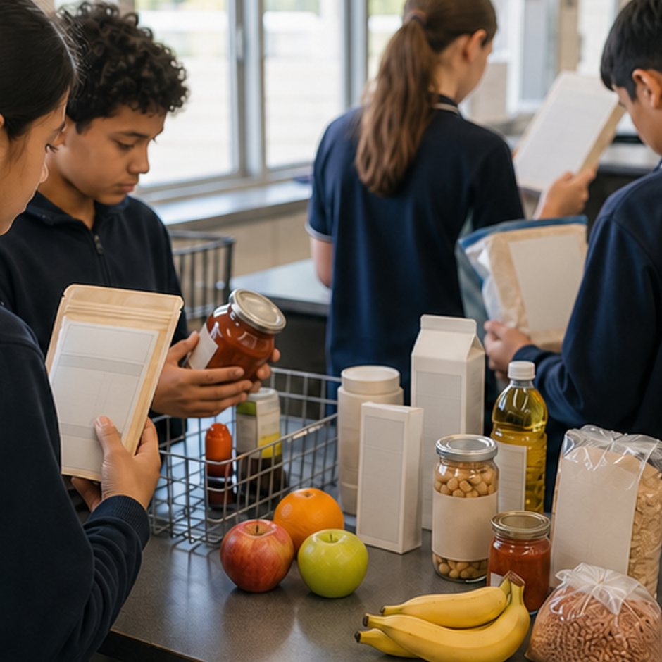
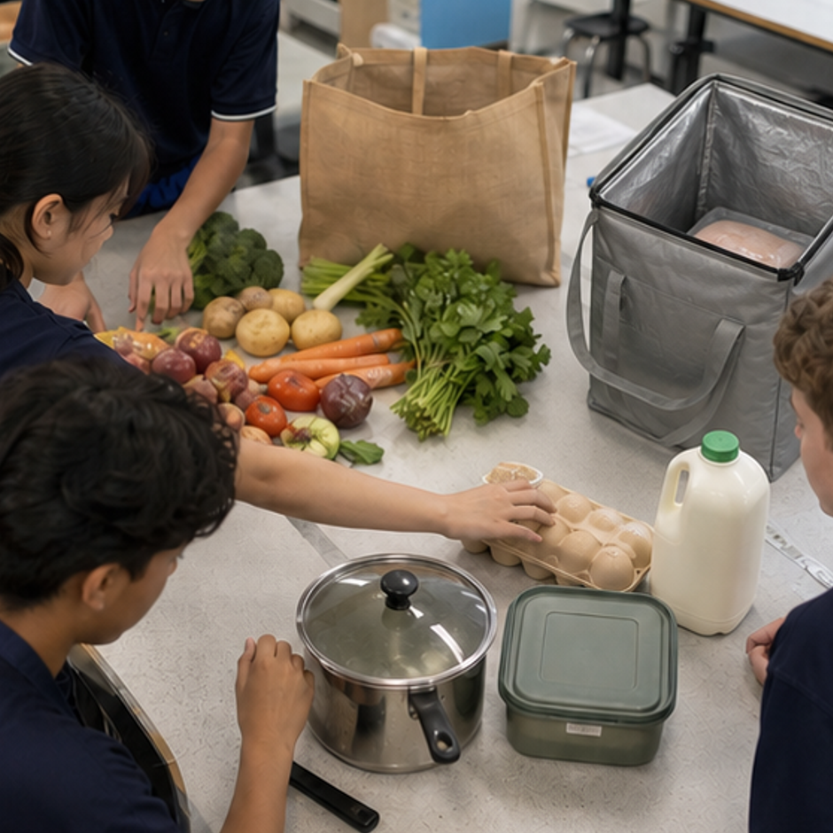
REVIEW · REPAIR · KEEP
Can you defend the decision?
• 1. Which statement best describes an active non-nutrient in this lesson?
• 2. Why is life stage only a starting point for food design?
• 3. Why is food choice described as a system?
Where this connects next
Save the influence map and pause-check-decide justification under Folio > Influences on selection.
Save selected evidence in My folio. Browser saving is not submission.
8 / 8
Notes:
Use the three prompts as an exit check. Reopen a section package where reasoning is weak, then direct students to the relevant folio stage.
Pause for a student explanation before revealing or summarising the next idea.
[Sources]
- https://curriculum.nsw.edu.au/learning-areas/tas/food-technology-7-10-2025/outcomes
- Generated course identity asset: C:\Users\scowell1\Documents\Codex\2026-08-28\new-tas-course-site-builder-plugin-2\outputs\year-9-food-selection-and-health\assets\food-selection-health-hero.png
- Generated adjacent-module context asset: C:\Users\scowell1\Documents\Codex\2026-08-28\new-tas-course-site-builder-plugin-2\outputs\year-9-food-selection-and-health\_project\evidence\presentations\crops\module-03-q1.png
- Generated adjacent-module context asset: C:\Users\scowell1\Documents\Codex\2026-08-28\new-tas-course-site-builder-plugin-2\outputs\year-9-food-selection-and-health\_project\evidence\presentations\crops\module-05-q1.png

