Slide 1
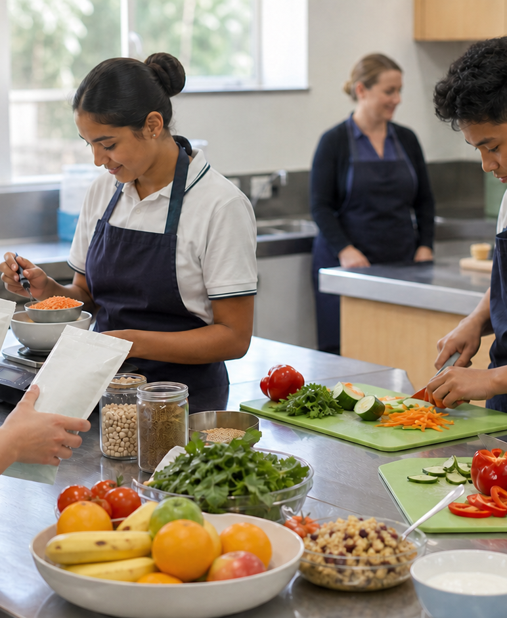
MODULE 5 · YEAR 9 FOOD TECHNOLOGY
Patterns, technology and choice
Students use population evidence to investigate Australian food-consumption patterns, examine how convenience and food technologies shape choices, and develop responsible food-solution decisions through explicit criteria and trade-offs.
Notice → Question → Evidence → Decision
1 / 8
Notes:
Frame the module around one defensible food decision. Use the context image to elicit what students notice before naming the three sections.
Pause for a student explanation before revealing or summarising the next idea.
[Sources]
- https://curriculum.nsw.edu.au/learning-areas/tas/food-technology-7-10-2025/outcomes
- Generated visual asset: C:\Users\scowell1\Documents\Codex\2026-08-28\new-tas-course-site-builder-plugin-2\outputs\year-9-food-selection-and-health\assets\visual-m05-board.png
- Generated course identity asset: C:\Users\scowell1\Documents\Codex\2026-08-28\new-tas-course-site-builder-plugin-2\outputs\year-9-food-selection-and-health\assets\food-selection-health-hero.png

Slide 2
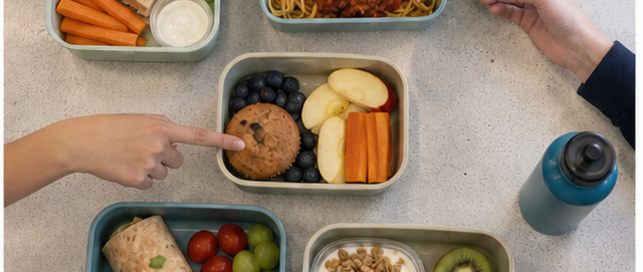
CONCEPT 1 · NOTICE AND EXPLAIN
5.2
Australian food-consumption patterns
Interpret food-consumption evidence as a population pattern, distinguish it from an individual judgement and propose a proportionate design response.
• I can distinguish a population pattern from a claim about every Australian.
• I can interpret a comparison while checking its measure, group and time period.
• I can propose a realistic response that matches the evidence and acknowledges uncertainty.
ABS DATA CARD — Australian children aged 2–17, 2023: 2.1% met the vegetables, legumes and beans recommendation; 50.7% met the fruit recommendation. These national broad-age estimates do not describe this school, explain causes or judge an individual. ABS NNPAS; released 10 July 2026.
A summary pattern is useful only when we remember the different people, settings and measurements behind it.
FOOD SELECTION & HEALTH · MODULE 5
2 / 8
Notes:
Teach the learning intention through the visual. Ask students to state what the image can support and what it cannot prove. Address the first likely misconception before moving on.
Pause for a student explanation before revealing or summarising the next idea.
[Sources]
- https://www.abs.gov.au/statistics/health/health-conditions-and-risks/dietary-behaviour
- https://www.aihw.gov.au/reports-data/behaviours-risk-factors/food-nutrition/overview
- https://www.eatforhealth.gov.au/guidelines/australian-guide-healthy-eating
- https://www.abs.gov.au/statistics/health/food-and-nutrition/consumption-food-groups-australian-dietary-guidelines/latest-release
- Generated visual asset: C:\Users\scowell1\Documents\Codex\2026-08-28\new-tas-course-site-builder-plugin-2\outputs\year-9-food-selection-and-health\_project\evidence\presentations\crops\module-05-q2.png

Slide 3
SECTION 5.1 · DECIDE
5.3
Pattern claim clinic
Practise turning government data into accurate claims, limits and testable design opportunities.
Claim A: ‘Every Australian teenager eats too few vegetables.’ Claim B: ‘ABS 2023 estimated that 2.1% of children aged 2–17 met the vegetables, legumes and beans recommendation; individual intake varies.’ Classify, repair and justify.
1
2
3
Mark source, population, date, measure and unit.
Sort claim cards into supported, overgeneralised or unsupported.
Repair two overgeneralised claims using cautious wording.
Evidence to keep: A checked data excerpt, two repaired claims and one proportionate response canvas saved as formative practice.
FOOD SELECTION & HEALTH · MODULE 5
3 / 8
Notes:
Keep the class moving through three clear stages. Invite one group to defend a choice using the concept language, then name the evidence students should retain.
Pause for a student explanation before revealing or summarising the next idea.
[Sources]
- https://www.abs.gov.au/statistics/health/health-conditions-and-risks/dietary-behaviour
- https://www.aihw.gov.au/reports-data/behaviours-risk-factors/food-nutrition/overview
- https://www.eatforhealth.gov.au/guidelines/australian-guide-healthy-eating
- https://www.abs.gov.au/statistics/health/food-and-nutrition/consumption-food-groups-australian-dietary-guidelines/latest-release

Slide 4
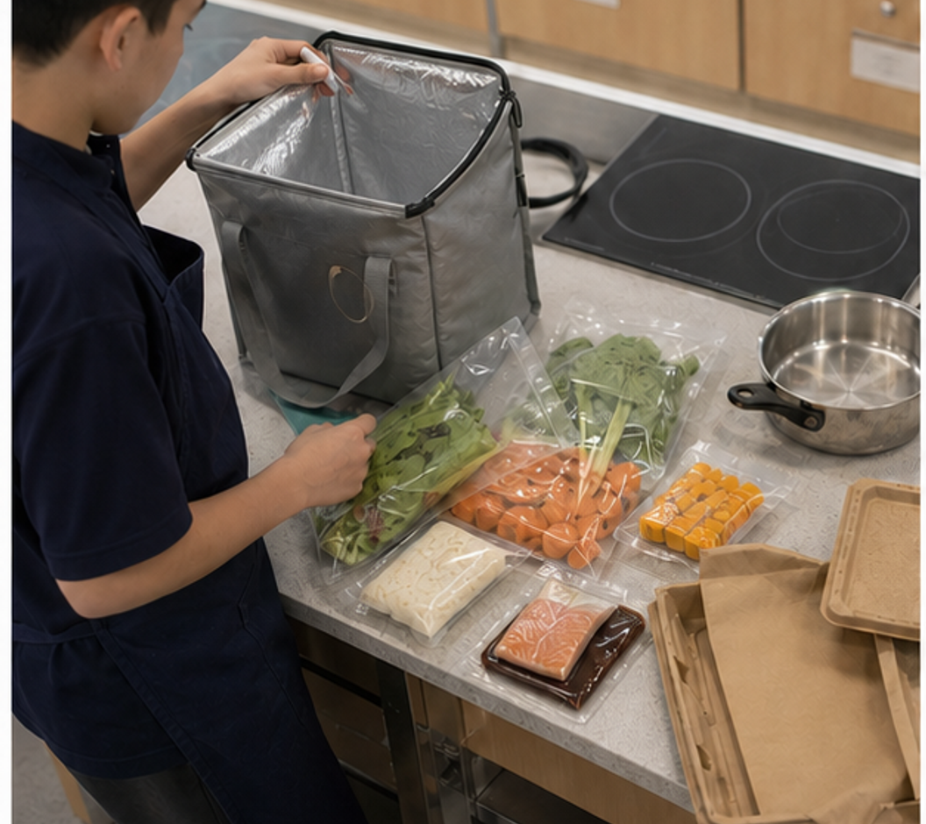
CONCEPT 2 · NOTICE AND EXPLAIN
5.4
Convenience, delivery and food technology
Investigate how processing, packaging, preservation and digital delivery change food access, safety, quality and choice, then evaluate a convenience option as a trade-off.
• I can explain a useful function of at least two food technologies.
• I can compare convenience options using more than speed or processing level.
• I can identify a food-safety control that remains important during delivery or storage.
Convenience depends on a chain of technologies and decisions; safety and responsibility do not end at checkout.
FOOD SELECTION & HEALTH · MODULE 5
4 / 8
Notes:
Teach the learning intention through the visual. Ask students to state what the image can support and what it cannot prove. Address the first likely misconception before moving on.
Pause for a student explanation before revealing or summarising the next idea.
[Sources]
- https://www.foodstandards.gov.au/consumer/safety
- https://www.foodauthority.nsw.gov.au/consumer/food-at-home
- https://www.foodstandards.gov.au/consumer/labelling/panels
- Generated visual asset: C:\Users\scowell1\Documents\Codex\2026-08-28\new-tas-course-site-builder-plugin-2\outputs\year-9-food-selection-and-health\_project\evidence\presentations\crops\module-05-q3.png

Slide 5
SECTION 5.2 · HIGHER-ORDER RESPONSE
5.5
Compare, decide and explain
Evaluate two ways of obtaining the same meal—one prepared from a convenience product and one ordered through delivery—and recommend the better fit for a stated user and situation.
STIMULUS — A: chilled supermarket pasta meal carried in an insulated bag and reheated at school. B: the same pasta style ordered hot by delivery at lunch. Compare time, facilities, temperature control, cost, packaging and waste.
Build the response
Strong evidence
• Define the user's purpose, available time, facilities and constraints.
• Trace the technologies and handling stages in each option.
• Compare nutrition evidence, allergen suitability, safety, total cost, appeal, packaging and waste.
• Uses a complete set of relevant criteria
• Explains preservation or delivery mechanisms accurately
• Recommendation responds to the stated user
FOOD SELECTION & HEALTH · MODULE 5
5 / 8
Notes:
Model a claim, evidence and reasoning chain without dictating the response. Ask students to locate the trade-off or limit that keeps the conclusion defensible.
Pause for a student explanation before revealing or summarising the next idea.
[Sources]
- https://www.foodstandards.gov.au/consumer/safety
- https://www.foodauthority.nsw.gov.au/consumer/food-at-home
- https://www.foodstandards.gov.au/consumer/labelling/panels

Slide 6
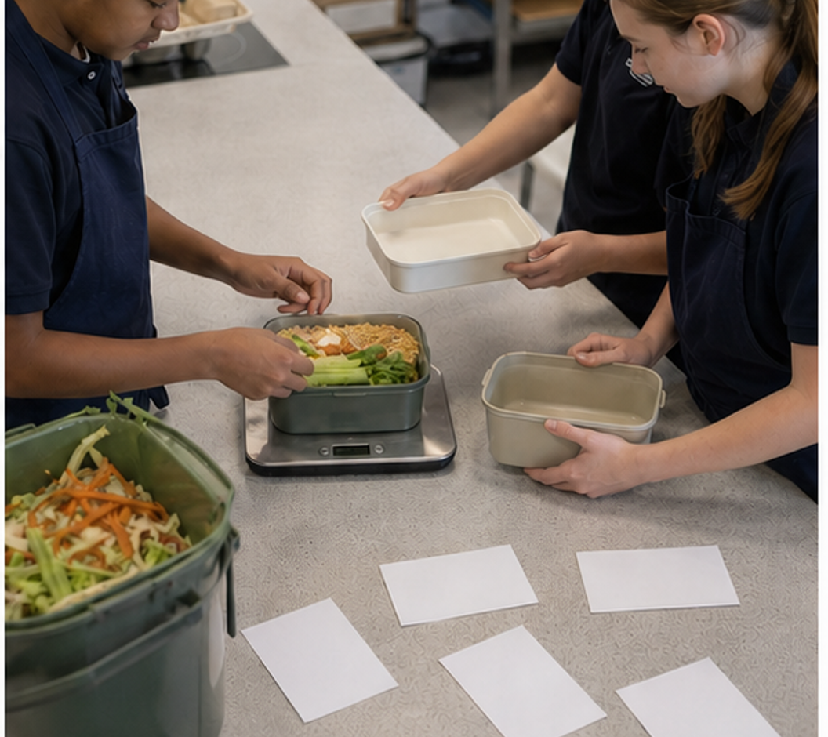
CONCEPT 3 · NOTICE AND EXPLAIN
5.6
Designing responsible food solutions
Use a food-design process to turn a defined need into an evidence-based solution, manage trade-offs and evaluate the result against explicit criteria.
• I can convert a need into measurable criteria and realistic constraints.
• I can justify design choices using nutrition, safety, appeal, access and responsibility evidence.
• I can evaluate a prototype honestly and propose a specific improvement.
Responsible solutions are justified against the same criteria, then improved with evidence from testing.
FOOD SELECTION & HEALTH · MODULE 5
6 / 8
Notes:
Teach the learning intention through the visual. Ask students to state what the image can support and what it cannot prove. Address the first likely misconception before moving on.
Pause for a student explanation before revealing or summarising the next idea.
[Sources]
- https://curriculum.nsw.edu.au/learning-areas/tas/food-technology-7-10-2025/outcomes
- https://www.eatforhealth.gov.au/guidelines/australian-guide-healthy-eating
- https://www.foodstandards.gov.au/consumer/safety
- https://www.foodstandards.gov.au/consumer/labelling/panels
- Generated visual asset: C:\Users\scowell1\Documents\Codex\2026-08-28\new-tas-course-site-builder-plugin-2\outputs\year-9-food-selection-and-health\_project\evidence\presentations\crops\module-05-q4.png

Slide 7
INVESTIGATION · EVIDENCE HANDOFF
5.7
Apply the three ideas together
Design decision matrix sprint
Practise comparing alternatives fairly and making an evidence-based selection before practical work.
• Score three concepts and record evidence for every score.
• Stress-test the leading concept against one changed constraint.
• Write a recommendation and one prototype test rather than treating the score as automatic truth.
Keep: A completed decision matrix, evidence notes and a stress-tested recommendation saved as formative practice.
FOOD SELECTION & HEALTH · MODULE 5
7 / 8
Notes:
Use this as the handoff from explanation to applied evidence. The activity should remain formative unless the teacher explicitly links it to an approved formal task.
Pause for a student explanation before revealing or summarising the next idea.
[Sources]
- https://curriculum.nsw.edu.au/learning-areas/tas/food-technology-7-10-2025/outcomes
- https://www.eatforhealth.gov.au/guidelines/australian-guide-healthy-eating
- https://www.foodstandards.gov.au/consumer/safety
- https://www.foodstandards.gov.au/consumer/labelling/panels
- Generated visual asset: C:\Users\scowell1\Documents\Codex\2026-08-28\new-tas-course-site-builder-plugin-2\outputs\year-9-food-selection-and-health\_project\evidence\presentations\crops\module-05-q4.png

Slide 8
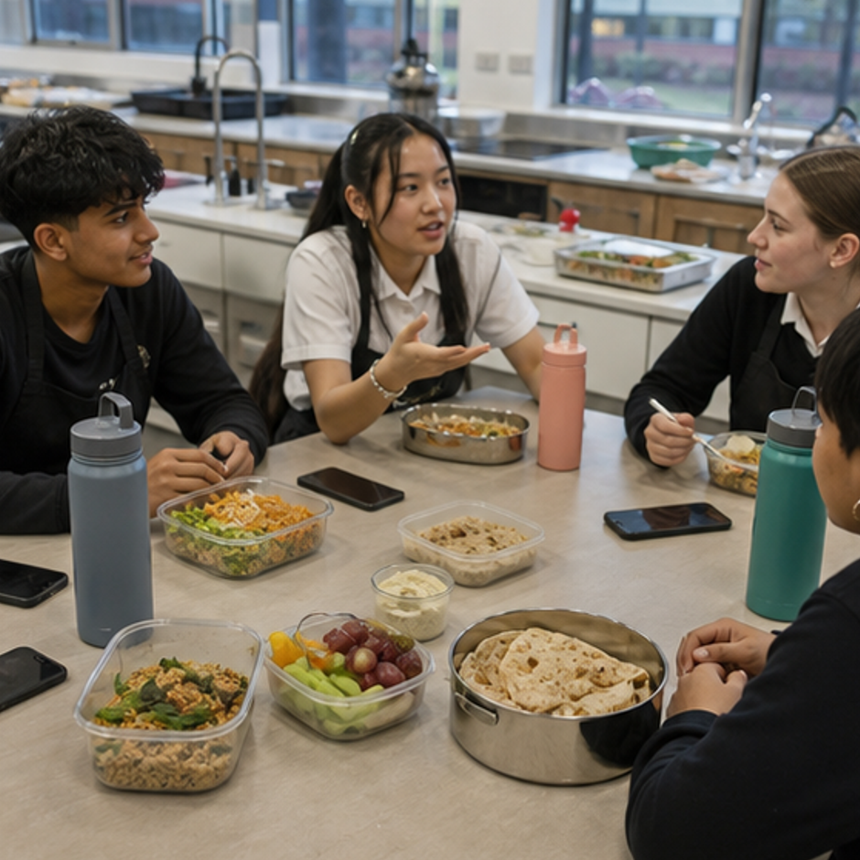
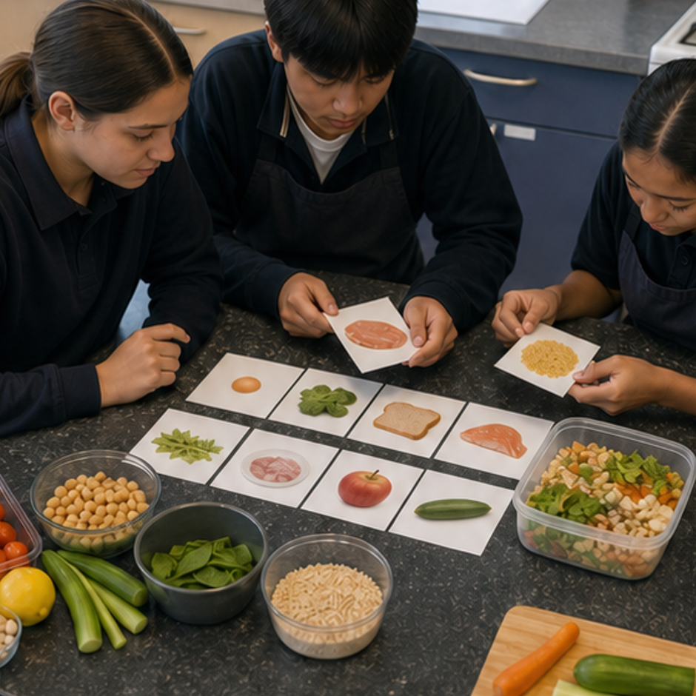
REVIEW · REPAIR · KEEP
Can you defend the decision?
• 1. What does a food-consumption pattern describe?
• 2. Which example shows why processing is not automatically negative?
• 3. Which brief is most useful for beginning food design?
Where this connects next
Save the criteria matrix, two concepts, selection justification and test plan under Folio > Responsible food design.
Save selected evidence in My folio. Browser saving is not submission.
8 / 8
Notes:
Use the three prompts as an exit check. Reopen a section package where reasoning is weak, then direct students to the relevant folio stage.
Pause for a student explanation before revealing or summarising the next idea.
[Sources]
- https://curriculum.nsw.edu.au/learning-areas/tas/food-technology-7-10-2025/outcomes
- Generated course identity asset: C:\Users\scowell1\Documents\Codex\2026-08-28\new-tas-course-site-builder-plugin-2\outputs\year-9-food-selection-and-health\assets\food-selection-health-hero.png
- Generated adjacent-module context asset: C:\Users\scowell1\Documents\Codex\2026-08-28\new-tas-course-site-builder-plugin-2\outputs\year-9-food-selection-and-health\_project\evidence\presentations\crops\module-04-q1.png
- Generated adjacent-module context asset: C:\Users\scowell1\Documents\Codex\2026-08-28\new-tas-course-site-builder-plugin-2\outputs\year-9-food-selection-and-health\_project\evidence\presentations\crops\module-06-q1.png

