Slide 1
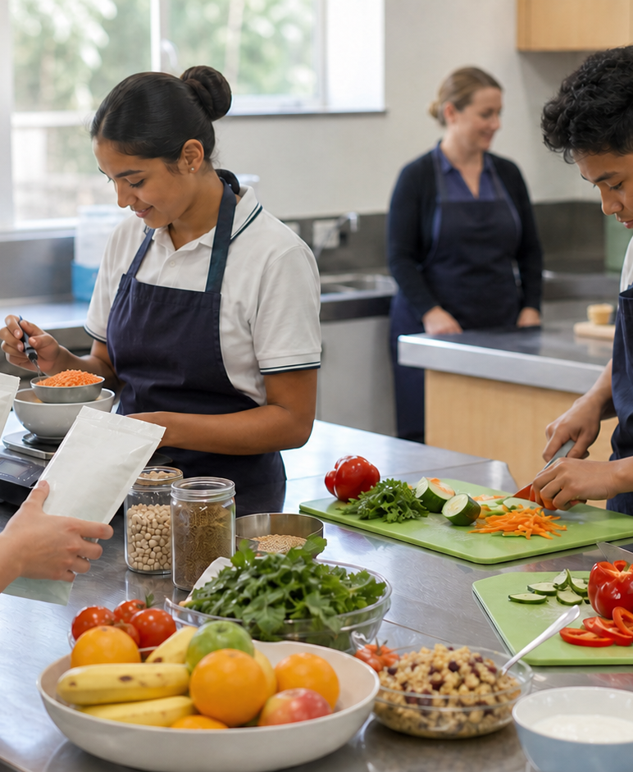
MODULE 6 · YEAR 9 FOOD TECHNOLOGY
Health, guidance and HelloEats
Students explain under- and overnutrition as patterns rather than judgements, investigate selected nutrition-related conditions without diagnosis or stigma, and use Australian guidance to develop a draft-only HelloEats concept.
Notice → Question → Evidence → Decision
1 / 8
Notes:
Frame the module around one defensible food decision. Use the context image to elicit what students notice before naming the three sections.
Pause for a student explanation before revealing or summarising the next idea.
[Sources]
- https://curriculum.nsw.edu.au/learning-areas/tas/food-technology-7-10-2025/outcomes
- Generated visual asset: C:\Users\scowell1\Documents\Codex\2026-08-28\new-tas-course-site-builder-plugin-2\outputs\year-9-food-selection-and-health\assets\visual-m06-board.png
- Generated course identity asset: C:\Users\scowell1\Documents\Codex\2026-08-28\new-tas-course-site-builder-plugin-2\outputs\year-9-food-selection-and-health\assets\food-selection-health-hero.png

Slide 2
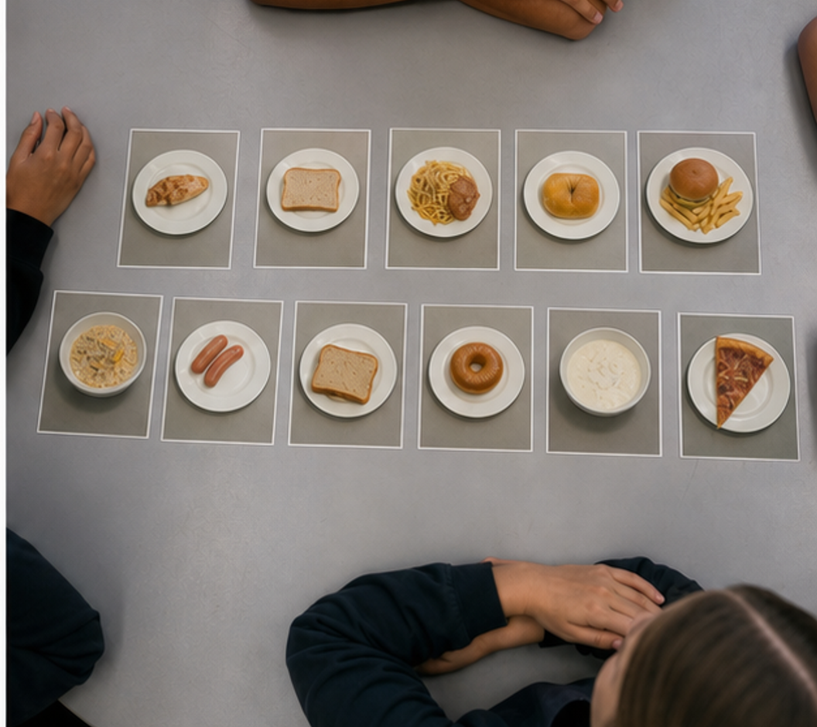
CONCEPT 1 · NOTICE AND EXPLAIN
6.2
Under- and overnutrition
Explain undernutrition and overnutrition as forms of malnutrition that arise from patterns and circumstances, and evaluate support responses without judging or diagnosing individuals.
• I can distinguish insufficient energy, insufficient nutrients and excessive or imbalanced intake.
• I can explain how biological, social and environmental factors can interact over time.
• I can recommend a respectful, evidence-based support response within a student's role.
Undernutrition and overnutrition are investigated through patterns, mechanisms and context—not by judging a person or one meal.
FOOD SELECTION & HEALTH · MODULE 6
2 / 8
Notes:
Teach the learning intention through the visual. Ask students to state what the image can support and what it cannot prove. Address the first likely misconception before moving on.
Pause for a student explanation before revealing or summarising the next idea.
[Sources]
- https://www.aihw.gov.au/reports-data/behaviours-risk-factors/food-nutrition/overview
- https://www.eatforhealth.gov.au/
- https://www.eatforhealth.gov.au/guidelines/australian-guide-healthy-eating
- Generated visual asset: C:\Users\scowell1\Documents\Codex\2026-08-28\new-tas-course-site-builder-plugin-2\outputs\year-9-food-selection-and-health\_project\evidence\presentations\crops\module-06-q2.png

Slide 3
SECTION 6.1 · DECIDE
6.3
Pattern–mechanism–support triads
Practise separating observed evidence, a possible nutrition mechanism and a safe response.
Case A: repeated small meals because food access is unreliable. Case B: frequent energy-dense meals but limited variety. Case C: one low-intake day during illness. Separate a repeated pattern from one-day evidence.
1
2
3
Underline only observable evidence in each case.
Match a possible mechanism using may or could language.
Add context cards that might strengthen or weaken the interpretation.
Evidence to keep: Three completed evidence–mechanism–support triads with a boundary explanation saved as formative practice.
FOOD SELECTION & HEALTH · MODULE 6
3 / 8
Notes:
Keep the class moving through three clear stages. Invite one group to defend a choice using the concept language, then name the evidence students should retain.
Pause for a student explanation before revealing or summarising the next idea.
[Sources]
- https://www.aihw.gov.au/reports-data/behaviours-risk-factors/food-nutrition/overview
- https://www.eatforhealth.gov.au/
- https://www.eatforhealth.gov.au/guidelines/australian-guide-healthy-eating

Slide 4
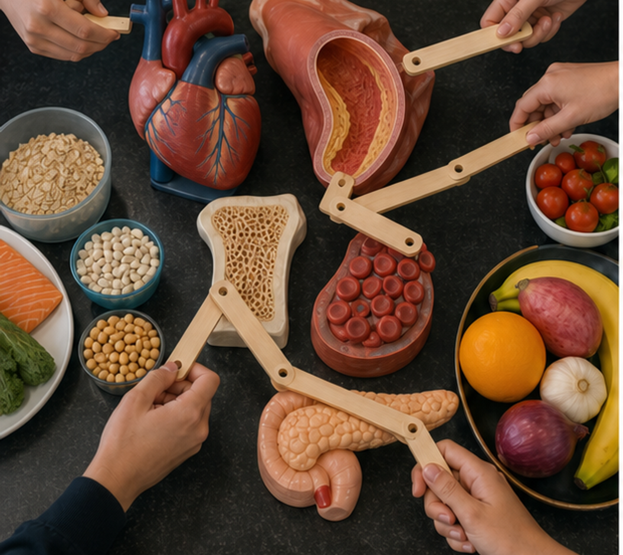
CONCEPT 2 · NOTICE AND EXPLAIN
6.4
Nutrition-related conditions and prevention
Explain how food patterns can influence risk for selected nutrition-related conditions while recognising multiple causes, risk reduction and the need for professional diagnosis.
• I can explain one relevant mechanism for anaemia, cardiovascular disease, osteoporosis or type 2 diabetes.
• I can distinguish a modifiable risk or protective factor from a diagnosis or guarantee.
• I can communicate about body size and health without stigma or unsupported assumptions.
Nutrition can influence risk through known mechanisms, but every condition has multiple interacting causes and needs professional diagnosis.
FOOD SELECTION & HEALTH · MODULE 6
4 / 8
Notes:
Teach the learning intention through the visual. Ask students to state what the image can support and what it cannot prove. Address the first likely misconception before moving on.
Pause for a student explanation before revealing or summarising the next idea.
[Sources]
- https://www.aihw.gov.au/reports-data/behaviours-risk-factors/food-nutrition/overview
- https://www.eatforhealth.gov.au/
- https://www.eatforhealth.gov.au/guidelines/australian-guide-healthy-eating
- Generated visual asset: C:\Users\scowell1\Documents\Codex\2026-08-28\new-tas-course-site-builder-plugin-2\outputs\year-9-food-selection-and-health\_project\evidence\presentations\crops\module-06-q3.png

Slide 5
SECTION 6.2 · HIGHER-ORDER RESPONSE
6.5
Compare, decide and explain
Choose one nutrition-related condition from the section and explain its mechanism, interacting risk and protective factors, and a food-design response that supports health without promising prevention or treatment.
Build the response
Strong evidence
• Describe the body system and what changes in the selected condition.
• Explain one nutrition-related mechanism accurately.
• Distinguish modifiable, non-modifiable and environmental factors.
• Mechanism is accurate and age appropriate
• Risk language avoids certainty and blame
• Design response is inclusive and evidence based
FOOD SELECTION & HEALTH · MODULE 6
5 / 8
Notes:
Model a claim, evidence and reasoning chain without dictating the response. Ask students to locate the trade-off or limit that keeps the conclusion defensible.
Pause for a student explanation before revealing or summarising the next idea.
[Sources]
- https://www.aihw.gov.au/reports-data/behaviours-risk-factors/food-nutrition/overview
- https://www.eatforhealth.gov.au/
- https://www.eatforhealth.gov.au/guidelines/australian-guide-healthy-eating

Slide 6
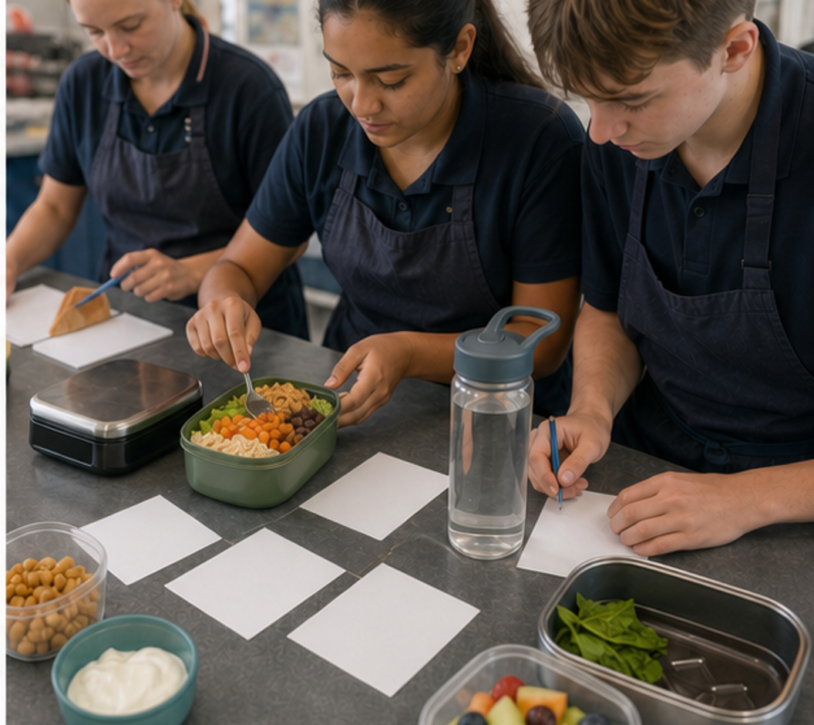
CONCEPT 3 · NOTICE AND EXPLAIN
6.6
Australian guidance and the HelloEats challenge
Use Australian food guidance and label evidence to justify a responsible ready-to-eat meal concept while keeping the work formative and separate from the current teacher-issued notification.
• I can use the Australian Guide to Healthy Eating, a nutrition panel and an ingredient list for their different purposes.
• I can interpret the Health Star Rating as a comparison aid, not a complete judgement of a food or eating pattern.
• I can keep a draft HelloEats concept formative and separate from the current teacher-issued notification.
EVIDENCE ROLES — AGHE: food-group pattern. NIP: per 100 g comparison. Ingredients/allergens: contents and safety. HSR: within-category aid only. Use the current teacher-issued notification; this website/deck does not set dates, marks, submission or practical conditions.
Use guidance and label evidence for the draft; use the current teacher-issued notification for any formal task or practical.
FOOD SELECTION & HEALTH · MODULE 6
6 / 8
Notes:
Teach the learning intention through the visual. Ask students to state what the image can support and what it cannot prove. Address the first likely misconception before moving on.
Pause for a student explanation before revealing or summarising the next idea.
[Sources]
- https://www.eatforhealth.gov.au/guidelines/australian-guide-healthy-eating
- https://www.foodstandards.gov.au/consumer/labelling/panels
- https://www.healthstarrating.gov.au/
- https://curriculum.nsw.edu.au/learning-areas/tas/food-technology-7-10-2025/outcomes
- Generated visual asset: C:\Users\scowell1\Documents\Codex\2026-08-28\new-tas-course-site-builder-plugin-2\outputs\year-9-food-selection-and-health\_project\evidence\presentations\crops\module-06-q4.png

Slide 7
INVESTIGATION · EVIDENCE HANDOFF
6.7
Apply the three ideas together
Draft HelloEats evidence sprint
Integrate guidance, label comparison and responsible design while keeping formative work separate from formal assessment.
STIMULUS — Use the evidence card from Slide 6. Keep the concept formative and not submitted.
• Sketch a ready-to-eat concept and annotate food-group, appeal, cost and packaging decisions.
• Add safety and allergen questions without inventing a practical recipe.
• Mark the concept formative and not submitted; follow the current teacher-issued notification for any formal conditions.
Keep: A draft concept canvas and product comparison saved as formative practice; not submitted.
FOOD SELECTION & HEALTH · MODULE 6
7 / 8
Notes:
Use this as the handoff from explanation to applied evidence. The activity should remain formative unless the teacher explicitly links it to an approved formal task.
Pause for a student explanation before revealing or summarising the next idea.
[Sources]
- https://www.eatforhealth.gov.au/guidelines/australian-guide-healthy-eating
- https://www.foodstandards.gov.au/consumer/labelling/panels
- https://www.healthstarrating.gov.au/
- https://curriculum.nsw.edu.au/learning-areas/tas/food-technology-7-10-2025/outcomes
- Generated visual asset: C:\Users\scowell1\Documents\Codex\2026-08-28\new-tas-course-site-builder-plugin-2\outputs\year-9-food-selection-and-health\_project\evidence\presentations\crops\module-06-q4.png

Slide 8
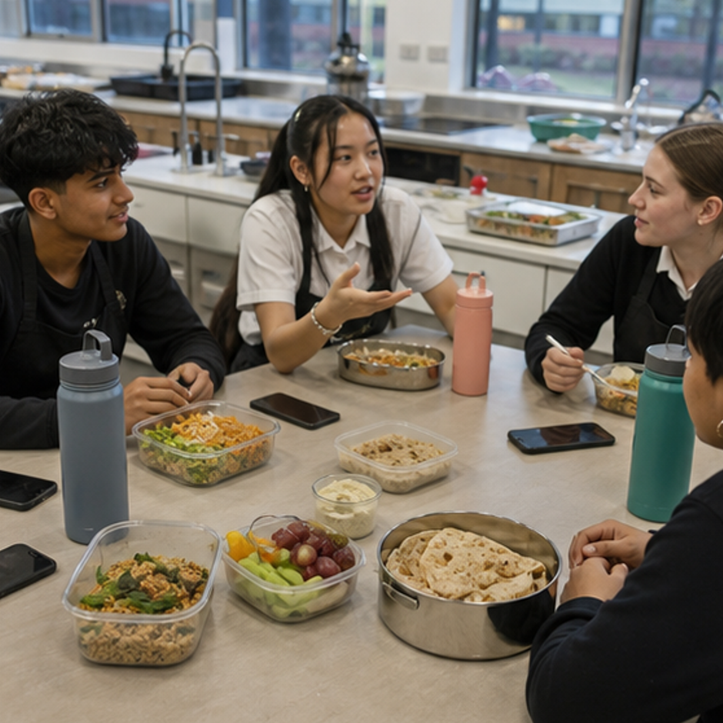
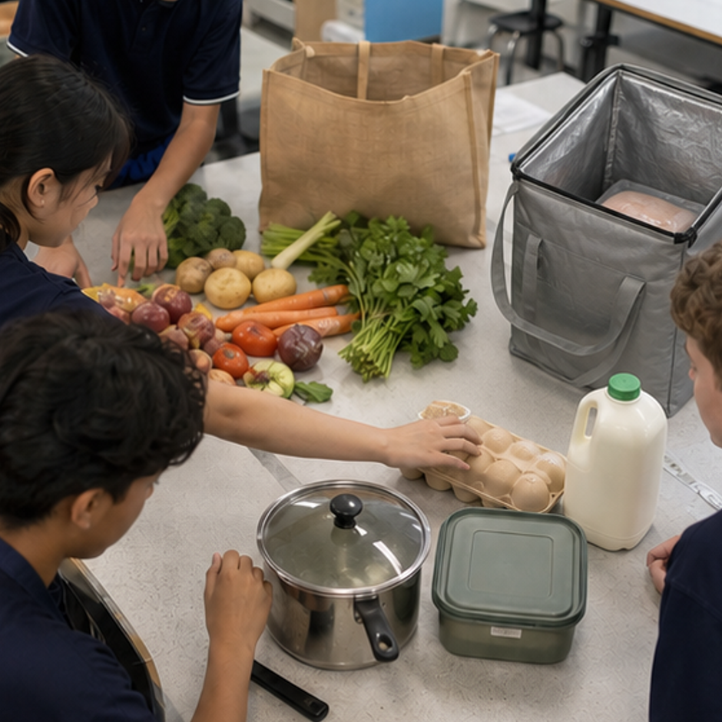
REVIEW · REPAIR · KEEP
Can you defend the decision?
• 1. Which statement best defines malnutrition in this section?
• 2. What does a risk factor mean?
• 3. What is the main job of the Australian Guide to Healthy Eating?
Where this connects next
Save the draft concept board, product comparison and source list under Folio > Draft HelloEats concept. Label it formative learning evidence, not submission.
Save selected evidence in My folio. Browser saving is not submission.
8 / 8
Notes:
Use the three prompts as an exit check. Reopen a section package where reasoning is weak, then direct students to the relevant folio stage.
Pause for a student explanation before revealing or summarising the next idea.
[Sources]
- https://curriculum.nsw.edu.au/learning-areas/tas/food-technology-7-10-2025/outcomes
- Generated course identity asset: C:\Users\scowell1\Documents\Codex\2026-08-28\new-tas-course-site-builder-plugin-2\outputs\year-9-food-selection-and-health\assets\food-selection-health-hero.png
- Generated adjacent-module context asset: C:\Users\scowell1\Documents\Codex\2026-08-28\new-tas-course-site-builder-plugin-2\outputs\year-9-food-selection-and-health\_project\evidence\presentations\crops\module-04-q1.png
- Generated adjacent-module context asset: C:\Users\scowell1\Documents\Codex\2026-08-28\new-tas-course-site-builder-plugin-2\outputs\year-9-food-selection-and-health\_project\evidence\presentations\crops\module-05-q1.png

