Slide 1
BBQ AND CASE · MODULE 2
Drawings, rails and accurate setup
Use verified drawings, stock information, datums and quality gates before irreversible work.
Weeks 3–4
Notes:
[Sources]
- bbq-case/data.js
[/Sources]

Slide 2
RETRIEVAL
Start with what you already know
Think first. Discuss your reasoning, then check it against the module.
1
According to the theory, selecting metal stock involves choosing what?
2
Where must the exact stock grades and sizes be confirmed?
3
Which factor should be considered when judging a suitable stock form?
BBQ and Case · Module 2
02
Notes:
[Sources]
- bbq-case/data.js
[/Sources]

Slide 3
ROADMAP
Three ideas organise this module
Work through them in order, then complete the checks and written evidence.
01
02
03
Selecting stock form by function and manufacture
Turning drawings into freehand sketches and a spreadsheet cutting list
Datums, orientation and quality gates for rails and end caps
BBQ and Case · Module 2
03
Notes:
[Sources]
- bbq-case/data.js
[/Sources]

Slide 4
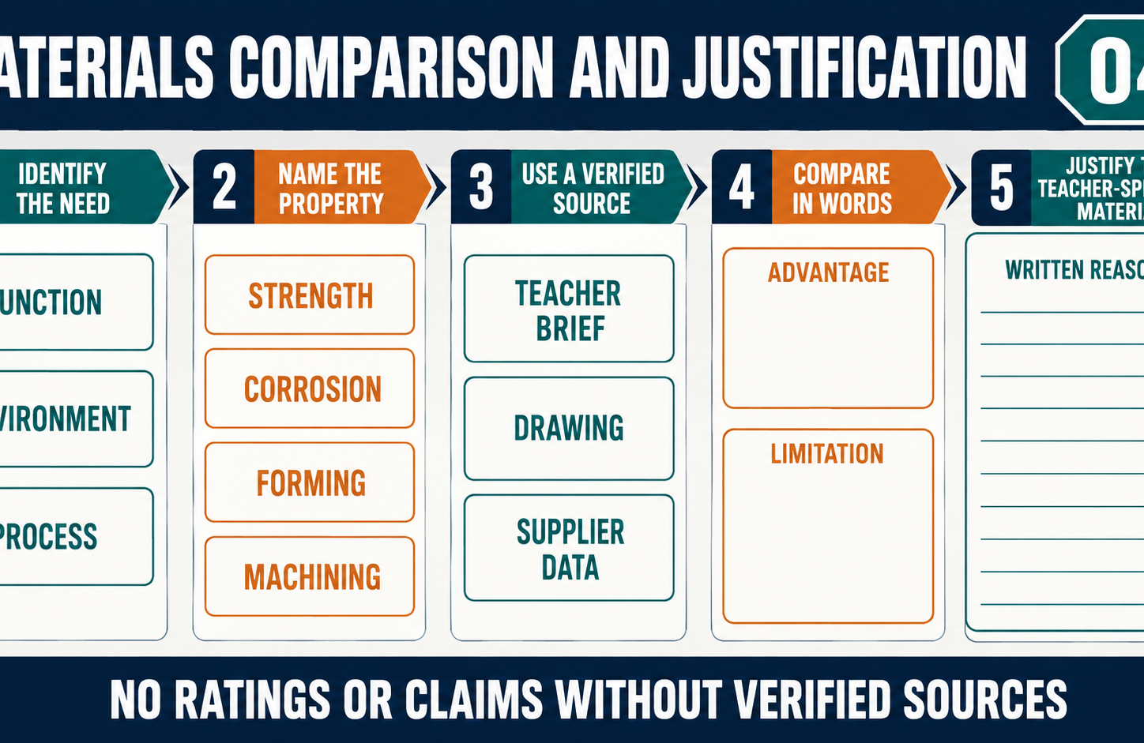
THEORY 1
Selecting stock form by function and manufacture
Use the key ideas to interpret the project evidence and make a controlled decision.
• Select stock form by function, properties and manufacturing needs.
• Consider joining access, available processes and material waste.
• Use issued drawings to confirm all grades, sizes and quantities.
BBQ and Case · Module 2
04
Notes:
[Sources]
- bbq-case/data.js
[/Sources]

Slide 5
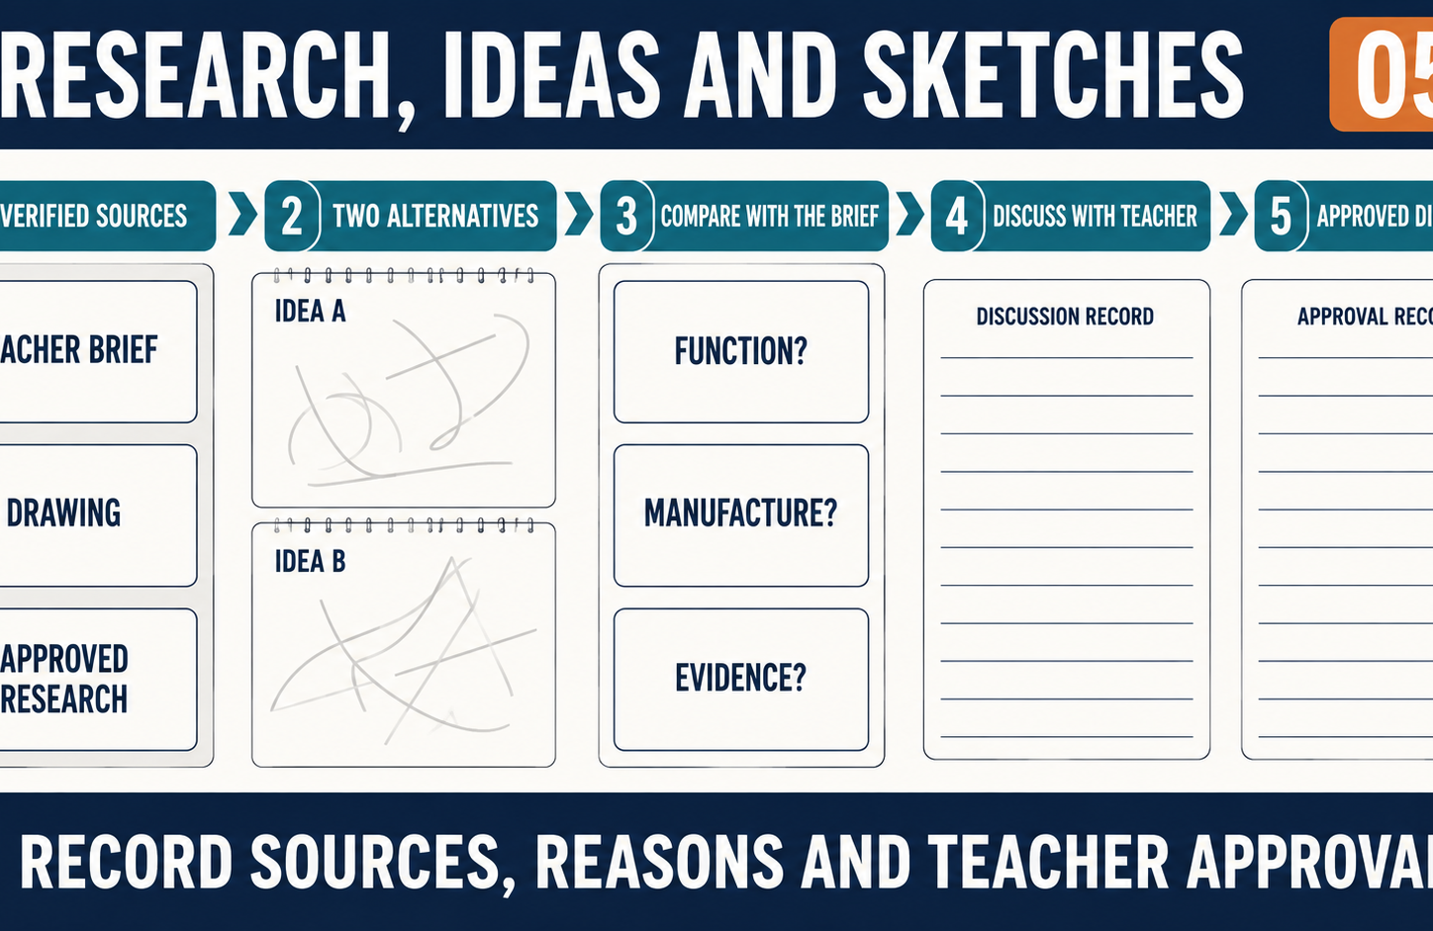
THEORY 2
Turning drawings into freehand sketches and a spreadsheet cutting list
Use the key ideas to interpret the project evidence and make a controlled decision.
• Read and cross-check all views, notes and written dimensions.
• Enter only verified component data into the spreadsheet.
• Record revisions and recheck information before cutting.
BBQ and Case · Module 2
05
Notes:
[Sources]
- bbq-case/data.js
[/Sources]

Slide 6
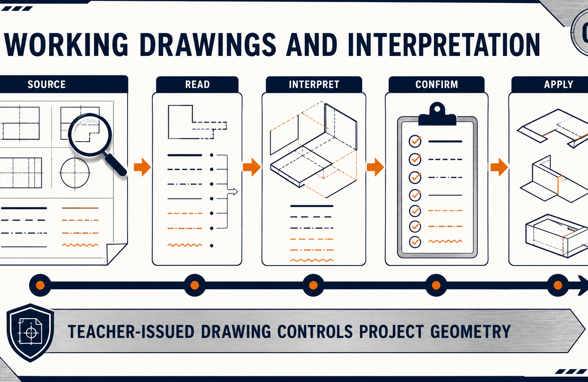
THEORY 3
Datums, orientation and quality gates for rails and end caps
Use the key ideas to interpret the project evidence and make a controlled decision.
• Use consistent datums to limit cumulative marking error.
• Identify orientation, matching parts and waste sides clearly.
• Complete reversible checks before irreversible processing begins.
BBQ and Case · Module 2
06
Notes:
[Sources]
- bbq-case/data.js
[/Sources]

Slide 7
LEARNING CHECK
Can you explain each idea without guessing?
Answer in your own words before opening the online knowledge checks.
01
According to the theory, selecting metal stock involves choosing what?
02
What should students do before marking or cutting material?
03
What is a datum used for during marking out?
BBQ and Case · Module 2
07
Notes:
[Sources]
- bbq-case/data.js
[/Sources]

Slide 8
WRITTEN RESPONSE
Use evidence, then explain your thinking
The example shows an appropriate level of detail; do not copy it as your own response.
YOUR PROMPT
APPROPRIATE RESPONSE EXAMPLE
Justify one teacher-specified stock form using function, manufacturability, availability and finish requirements.
A suitable response identifies the verified requirement or observation, names the evidence source, explains why the decision follows from it, and labels unresolved details as Teacher to confirm.
Complete the response online, check your evidence, then save or print it as directed.
BBQ and Case · Module 2
08
Notes:
[Sources]
- bbq-case/data.js
[/Sources]

