Slide 1
BBQ AND CASE · MODULE 3
Joining and controlled assembly
Connect drilled features, teacher-approved processes and inspection evidence.
Weeks 5–6
Notes:
[Sources]
- bbq-case/data.js
[/Sources]

Slide 2
RETRIEVAL
Start with what you already know
Think first. Discuss your reasoning, then check it against the module.
1
Why is a drilled hole treated as a designed feature?
2
Where should the centre position for a hole be traced from?
3
What should students confirm before drilling begins?
BBQ and Case · Module 3
02
Notes:
[Sources]
- bbq-case/data.js
[/Sources]

Slide 3
ROADMAP
Three ideas organise this module
Work through them in order, then complete the checks and written evidence.
01
02
03
Hole location is a design feature, not just a mark
Drill-press principles behind the teacher-issued SOP
Inspecting drilled features and responding to faults
BBQ and Case · Module 3
03
Notes:
[Sources]
- bbq-case/data.js
[/Sources]

Slide 4
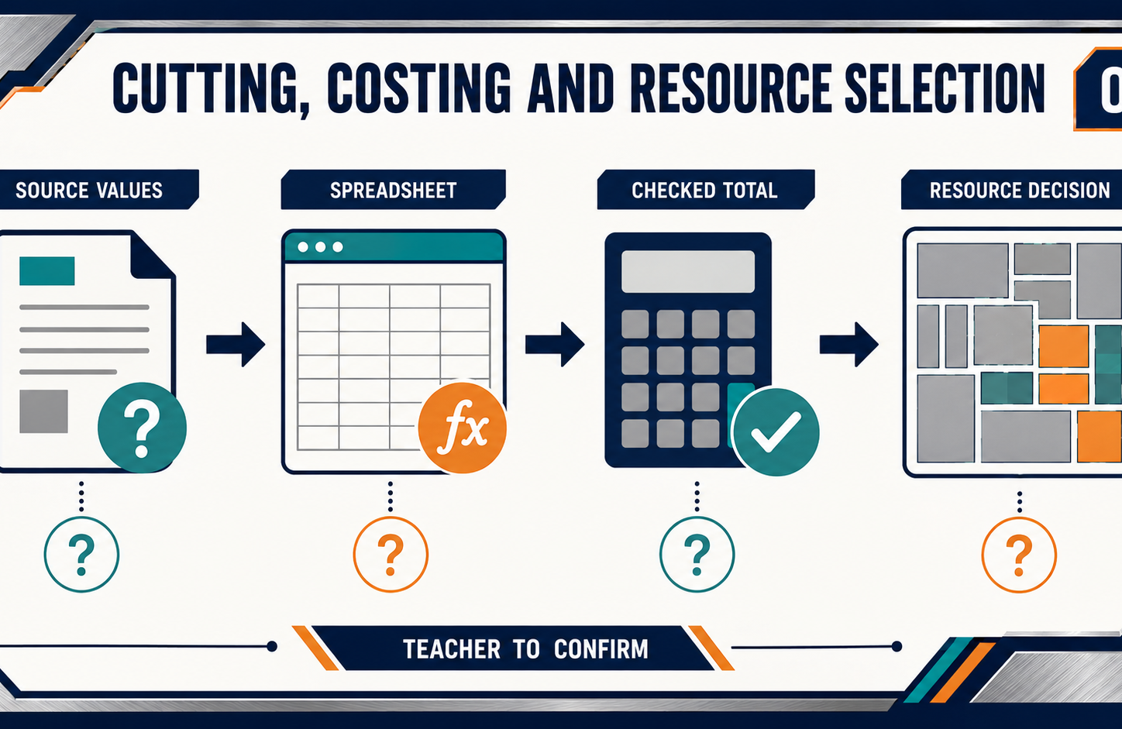
THEORY 1
Hole location is a design feature, not just a mark
Use the key ideas to interpret the project evidence and make a controlled decision.
• Trace every hole location back to verified drawing information.
• Confirm datums, orientation and component identity before drilling.
• Check marked centres before the process becomes irreversible.
BBQ and Case · Module 3
04
Notes:
[Sources]
- bbq-case/data.js
[/Sources]

Slide 5
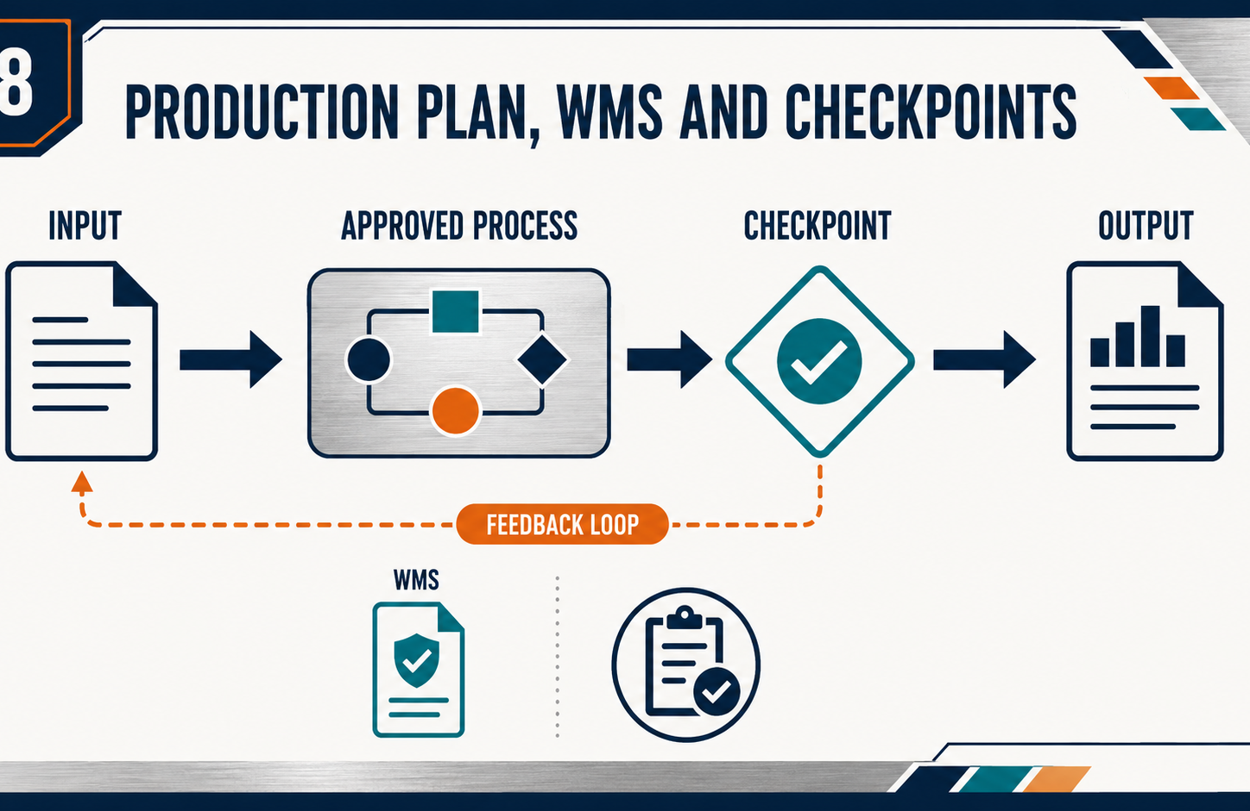
THEORY 2
Drill-press principles behind the teacher-issued SOP
Use the key ideas to interpret the project evidence and make a controlled decision.
• Understand the purpose behind each authorised drill-press requirement.
• Control movement, clearance, feed and inspection throughout the task.
• Follow the current SOP rather than relying on memory or general knowledge.
BBQ and Case · Module 3
05
Notes:
[Sources]
- bbq-case/data.js
[/Sources]

Slide 6
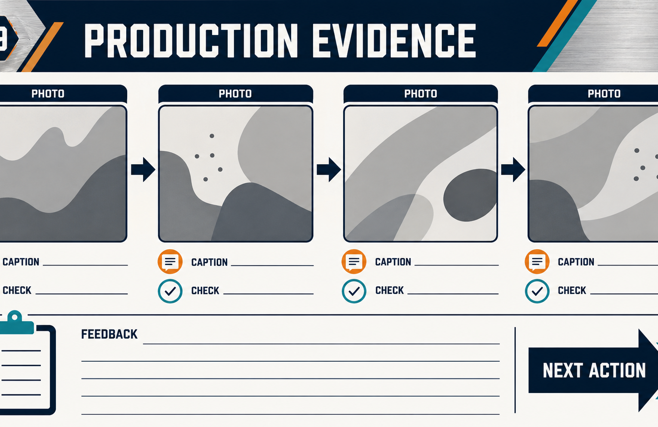
THEORY 3
Inspecting drilled features and responding to faults
Use the key ideas to interpret the project evidence and make a controlled decision.
• Compare drilled features with approved drawings and criteria.
• Record the fault before deciding what may have caused it.
• Obtain teacher review before attempting any rework.
BBQ and Case · Module 3
06
Notes:
[Sources]
- bbq-case/data.js
[/Sources]

Slide 7
LEARNING CHECK
Can you explain each idea without guessing?
Answer in your own words before opening the online knowledge checks.
01
Why is a drilled hole treated as a designed feature?
02
What does authorisation confirm before drill-press work begins?
03
What is inspection mainly comparing after drilling?
BBQ and Case · Module 3
07
Notes:
[Sources]
- bbq-case/data.js
[/Sources]

Slide 8
WRITTEN RESPONSE
Use evidence, then explain your thinking
The example shows an appropriate level of detail; do not copy it as your own response.
YOUR PROMPT
APPROPRIATE RESPONSE EXAMPLE
Explain how one confirmed hole feature will be transferred, checked and recorded before drilling.
A suitable response identifies the verified requirement or observation, names the evidence source, explains why the decision follows from it, and labels unresolved details as Teacher to confirm.
Complete the response online, check your evidence, then save or print it as directed.
BBQ and Case · Module 3
08
Notes:
[Sources]
- bbq-case/data.js
[/Sources]

