Slide 1
BBQ AND CASE · MODULE 4
WMS and repeatable work
Plan lathe work, dimensional control and teacher review through documented hold points.
Weeks 7–8
Notes:
[Sources]
- bbq-case/data.js
[/Sources]

Slide 2
RETRIEVAL
Start with what you already know
Think first. Discuss your reasoning, then check it against the module.
1
What is the main purpose of a lathe Work Method Statement according to the theory?
2
Which item should a WMS identify before machining begins?
3
Why are hold points included in a lathe WMS?
BBQ and Case · Module 4
02
Notes:
[Sources]
- bbq-case/data.js
[/Sources]

Slide 3
ROADMAP
Three ideas organise this module
Work through them in order, then complete the checks and written evidence.
01
02
03
Reading a lathe operation through the WMS
Cutting action, reference surfaces and dimensional control
Surface quality, fit and documented teacher review
BBQ and Case · Module 4
03
Notes:
[Sources]
- bbq-case/data.js
[/Sources]

Slide 4
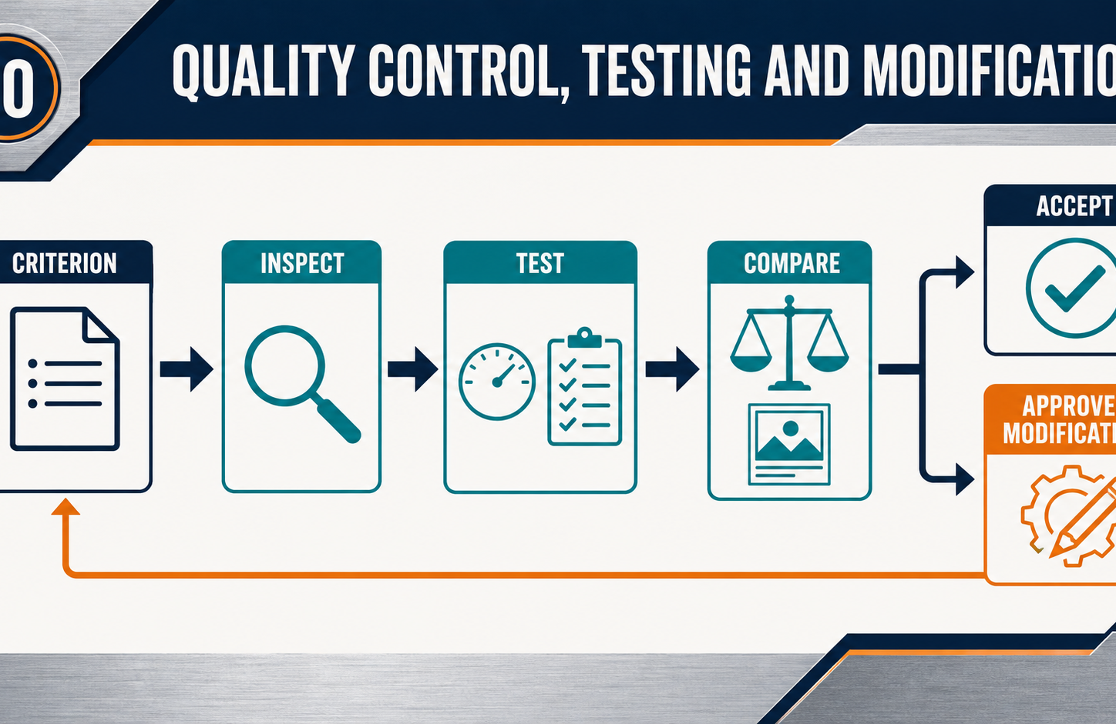
THEORY 1
Reading a lathe operation through the WMS
Use the key ideas to interpret the project evidence and make a controlled decision.
• Connect the drawing, workpiece and approved process through the WMS.
• Use hold points before irreversible machining stages continue.
• Stop and report any change from approved conditions.
BBQ and Case · Module 4
04
Notes:
[Sources]
- bbq-case/data.js
[/Sources]

Slide 5
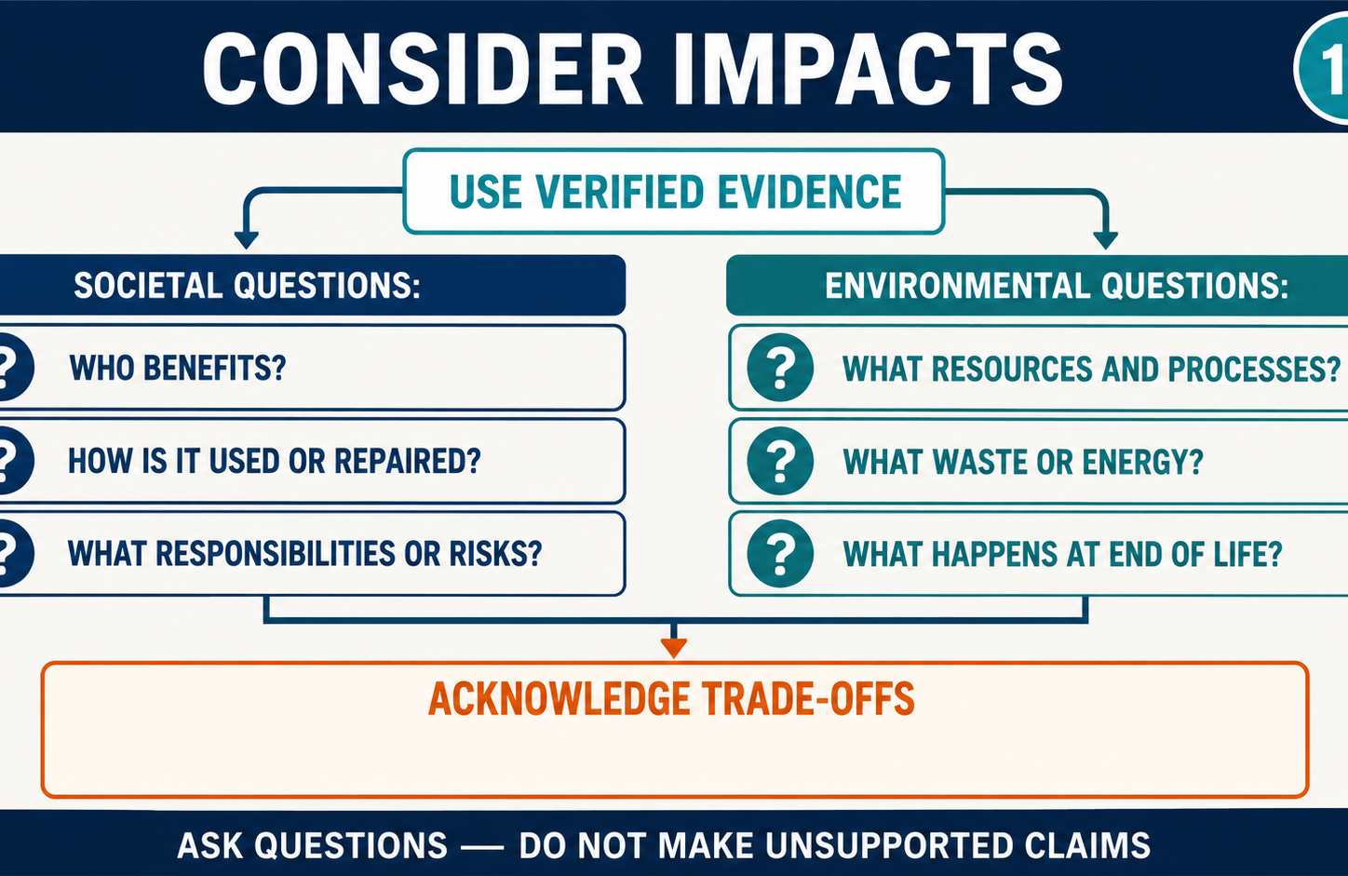
THEORY 2
Cutting action, reference surfaces and dimensional control
Use the key ideas to interpret the project evidence and make a controlled decision.
• Controlled cutting removes material through deliberate, progressive decisions.
• Preserve a consistent reference surface to limit cumulative error.
• Accept dimensions through verified checks, not appearance alone.
BBQ and Case · Module 4
05
Notes:
[Sources]
- bbq-case/data.js
[/Sources]

Slide 6
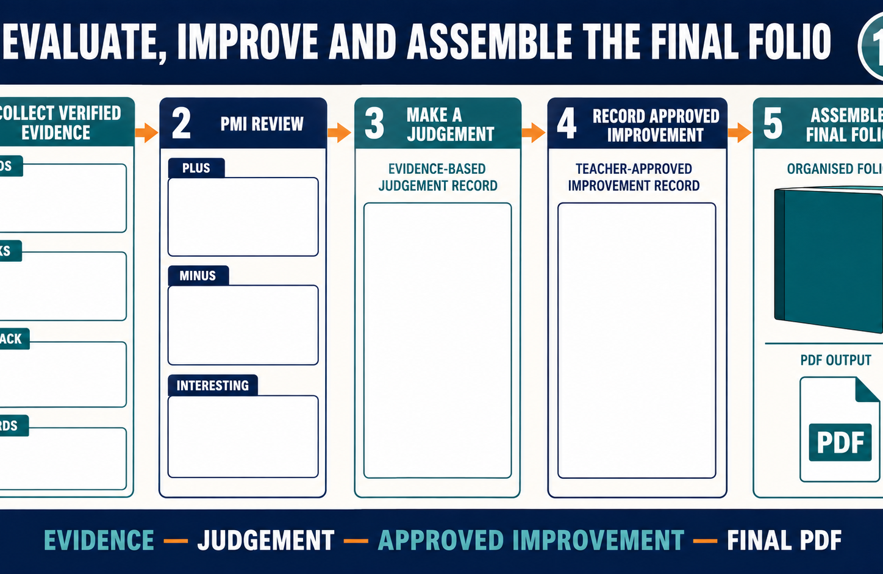
THEORY 3
Surface quality, fit and documented teacher review
Use the key ideas to interpret the project evidence and make a controlled decision.
• Judge size, form, surface condition and fit together.
• Record doubtful results honestly and separate affected work.
• Seek teacher direction before acceptance or rework.
BBQ and Case · Module 4
06
Notes:
[Sources]
- bbq-case/data.js
[/Sources]

Slide 7
LEARNING CHECK
Can you explain each idea without guessing?
Answer in your own words before opening the online knowledge checks.
01
What is the main purpose of a lathe Work Method Statement according to the theory?
02
Why should material be removed progressively during lathe work?
03
Which combination should be used to assess a machined feature?
BBQ and Case · Module 4
07
Notes:
[Sources]
- bbq-case/data.js
[/Sources]

Slide 8
WRITTEN RESPONSE
Use evidence, then explain your thinking
The example shows an appropriate level of detail; do not copy it as your own response.
YOUR PROMPT
APPROPRIATE RESPONSE EXAMPLE
Explain how one drawing requirement would be traced through a WMS step, control and inspection record.
A suitable response identifies the verified requirement or observation, names the evidence source, explains why the decision follows from it, and labels unresolved details as Teacher to confirm.
Complete the response online, check your evidence, then save or print it as directed.
BBQ and Case · Module 4
08
Notes:
[Sources]
- bbq-case/data.js
[/Sources]

