Slide 1
BBQ AND CASE · MODULE 6
Industry and environmental responsibility
Control stability and assembly while considering supported industry and environmental evidence.
Weeks 11–12
Notes:
[Sources]
- bbq-case/data.js
[/Sources]

Slide 2
RETRIEVAL
Start with what you already know
Think first. Discuss your reasoning, then check it against the module.
1
According to the theory, what does stable support begin with?
2
Why should leg components be prepared from consistent datums?
3
What is the purpose of orientation marks?
BBQ and Case · Module 6
02
Notes:
[Sources]
- bbq-case/data.js
[/Sources]

Slide 3
ROADMAP
Three ideas organise this module
Work through them in order, then complete the checks and written evidence.
01
02
03
Stability begins with geometry and matched components
Assembly order, access and hold points
Quality assurance during structural assembly
BBQ and Case · Module 6
03
Notes:
[Sources]
- bbq-case/data.js
[/Sources]

Slide 4
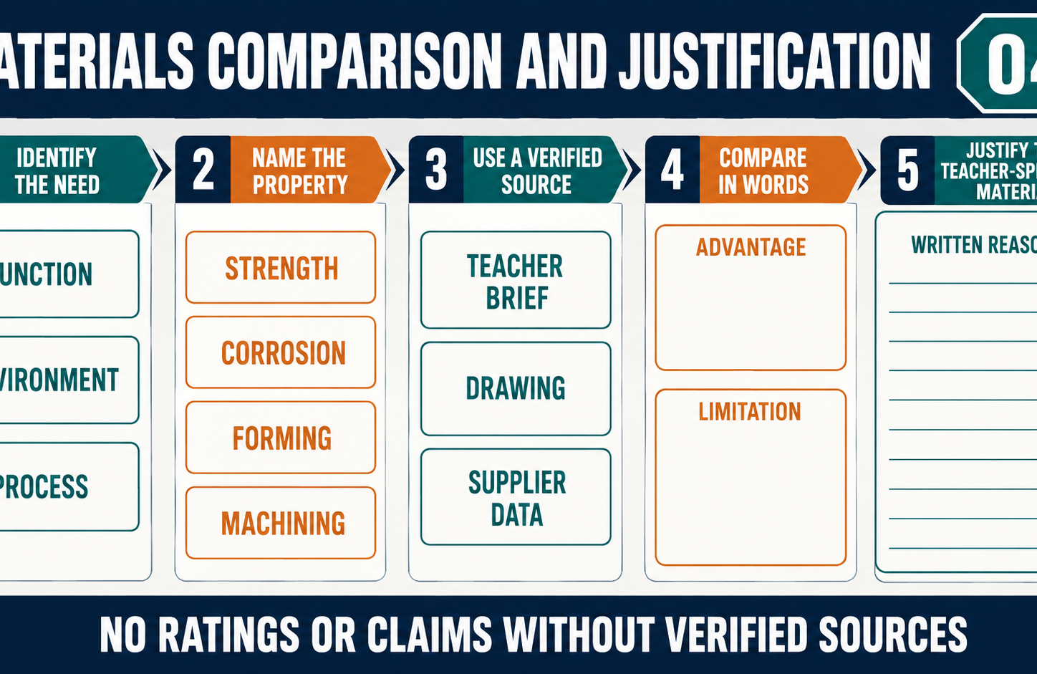
THEORY 1
Stability begins with geometry and matched components
Use the key ideas to interpret the project evidence and make a controlled decision.
• Prepare matched components from consistent reference points.
• Diagnose geometric causes rather than reacting to visible symptoms.
• Measure and seek teacher review before making corrections.
BBQ and Case · Module 6
04
Notes:
[Sources]
- bbq-case/data.js
[/Sources]

Slide 5
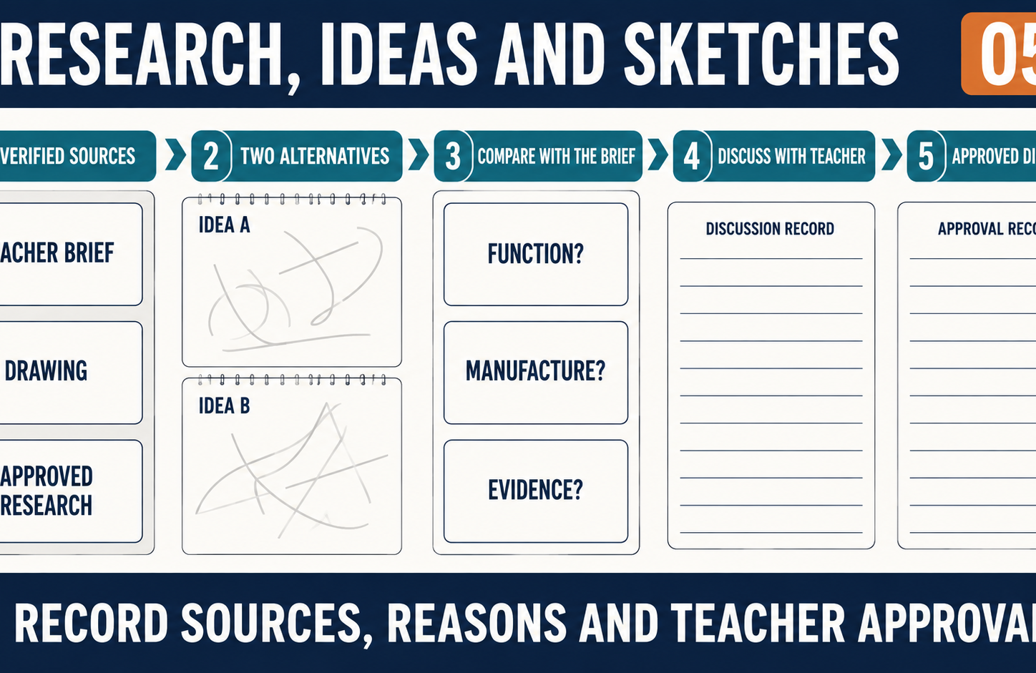
THEORY 2
Assembly order, access and hold points
Use the key ideas to interpret the project evidence and make a controlled decision.
• Consider access, alignment, inspection and finishing before assembly proceeds.
• Use hold points to protect verified work from cumulative error.
• Document any teacher-approved change to the production sequence.
BBQ and Case · Module 6
05
Notes:
[Sources]
- bbq-case/data.js
[/Sources]

Slide 6
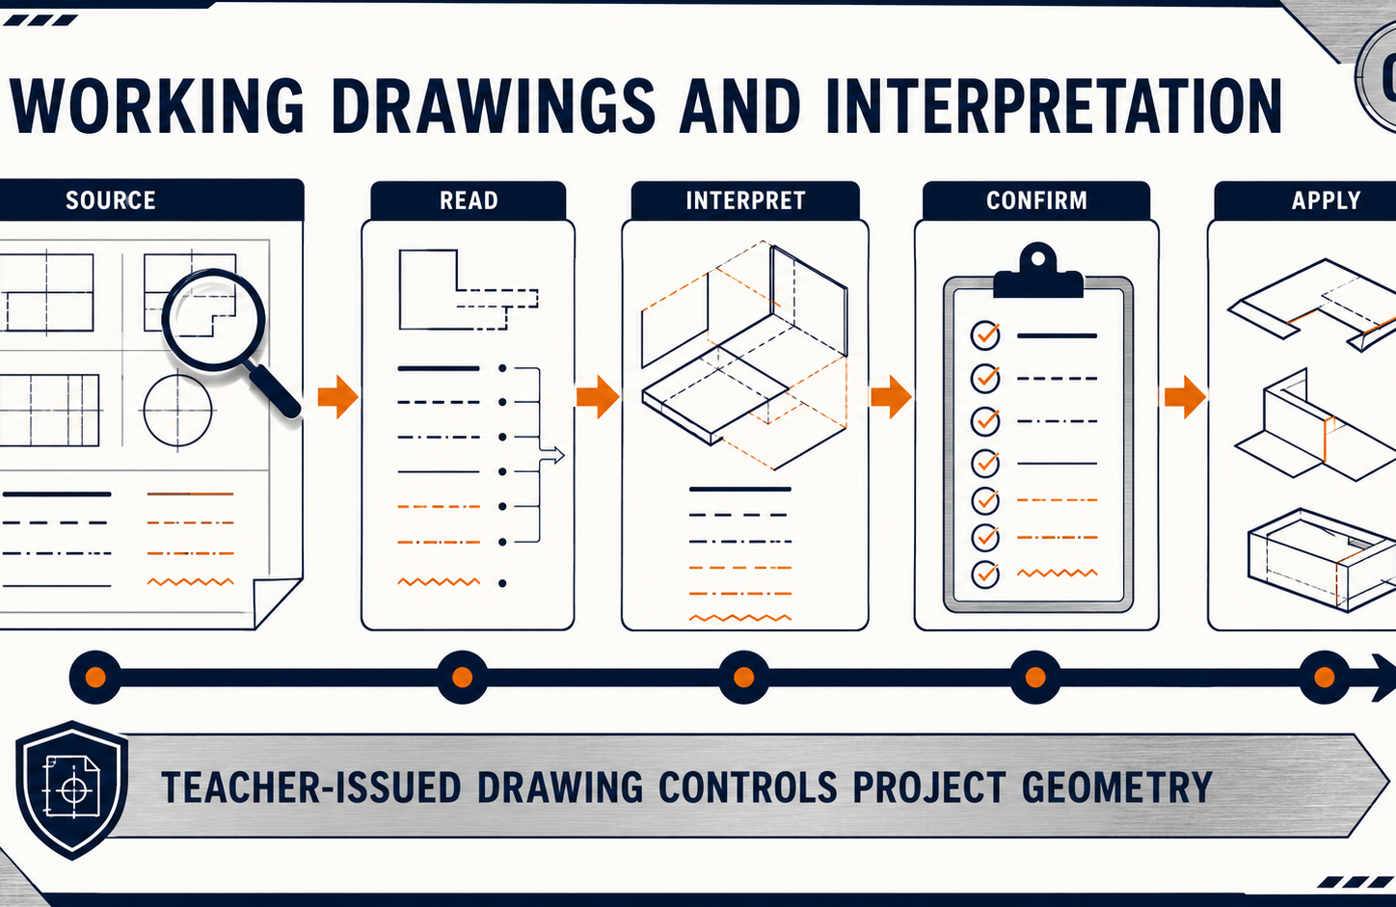
THEORY 3
Quality assurance during structural assembly
Use the key ideas to interpret the project evidence and make a controlled decision.
• Quality control checks stages; quality assurance links the whole project.
• Use traceable photographs, annotations and inspection records.
• Record non-conformance and obtain teacher authorisation before rework.
BBQ and Case · Module 6
06
Notes:
[Sources]
- bbq-case/data.js
[/Sources]

Slide 7
LEARNING CHECK
Can you explain each idea without guessing?
Answer in your own words before opening the online knowledge checks.
01
According to the theory, what does stable support begin with?
02
Why is the approved assembly sequence treated as a production decision rather than just a task list?
03
What is the main role of quality control during structural assembly?
BBQ and Case · Module 6
07
Notes:
[Sources]
- bbq-case/data.js
[/Sources]

Slide 8
WRITTEN RESPONSE
Use evidence, then explain your thinking
The example shows an appropriate level of detail; do not copy it as your own response.
YOUR PROMPT
APPROPRIATE RESPONSE EXAMPLE
Explain how matched-component checks can prevent accumulated error in the leg assembly.
A suitable response identifies the verified requirement or observation, names the evidence source, explains why the decision follows from it, and labels unresolved details as Teacher to confirm.
Complete the response online, check your evidence, then save or print it as directed.
BBQ and Case · Module 6
08
Notes:
[Sources]
- bbq-case/data.js
[/Sources]

