Slide 1
BBQ AND CASE · MODULE 7
Preparation and finishes
Prepare surfaces and apply the teacher-specified finish system through controlled stages.
Weeks 13–14
Notes:
[Sources]
- bbq-case/data.js
[/Sources]

Slide 2
RETRIEVAL
Start with what you already know
Think first. Discuss your reasoning, then check it against the module.
1
Why does finish performance begin with surface condition?
2
According to the theory, applying more finish cannot correct:
3
Which stage produces the required surface condition before any finish is applied?
BBQ and Case · Module 7
02
Notes:
[Sources]
- bbq-case/data.js
[/Sources]

Slide 3
ROADMAP
Three ideas organise this module
Work through them in order, then complete the checks and written evidence.
01
02
03
Surface condition controls finish performance
Selecting and applying a finish from authoritative information
Finish inspection, maintenance and environmental responsibility
BBQ and Case · Module 7
03
Notes:
[Sources]
- bbq-case/data.js
[/Sources]

Slide 4
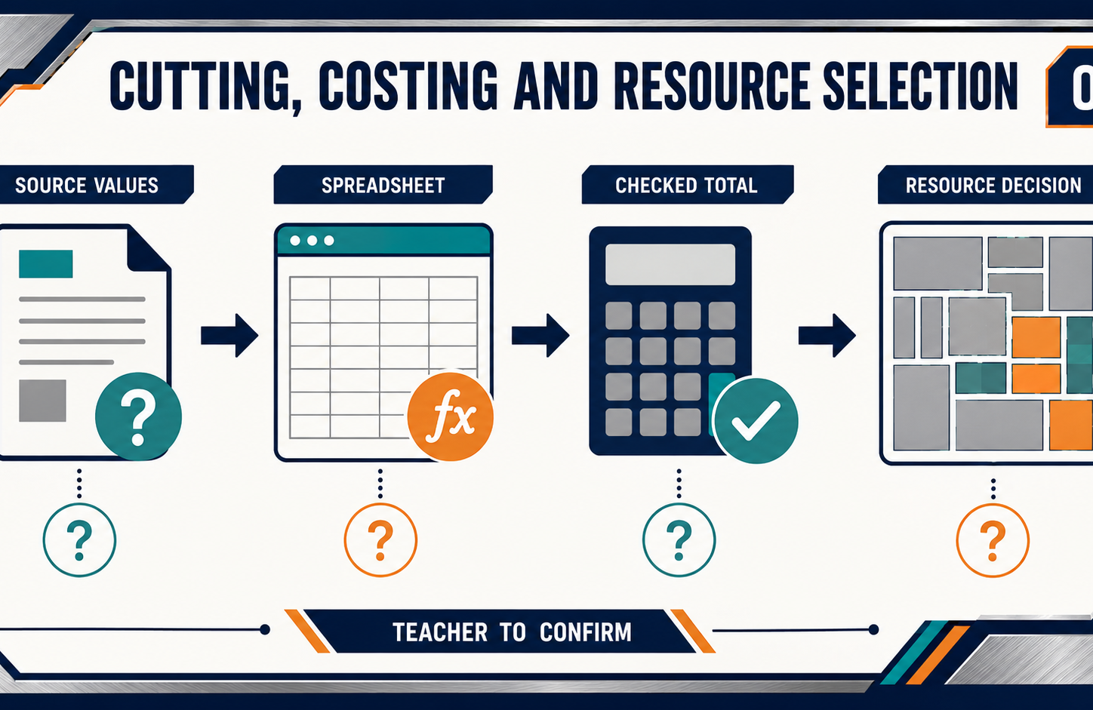
THEORY 1
Surface condition controls finish performance
Use the key ideas to interpret the project evidence and make a controlled decision.
• Finish quality depends on consistent, clean surface preparation.
• Preparation, application, drying and curing are different stages.
• Record surface checks before applying the specified finish.
BBQ and Case · Module 7
04
Notes:
[Sources]
- bbq-case/data.js
[/Sources]

Slide 5
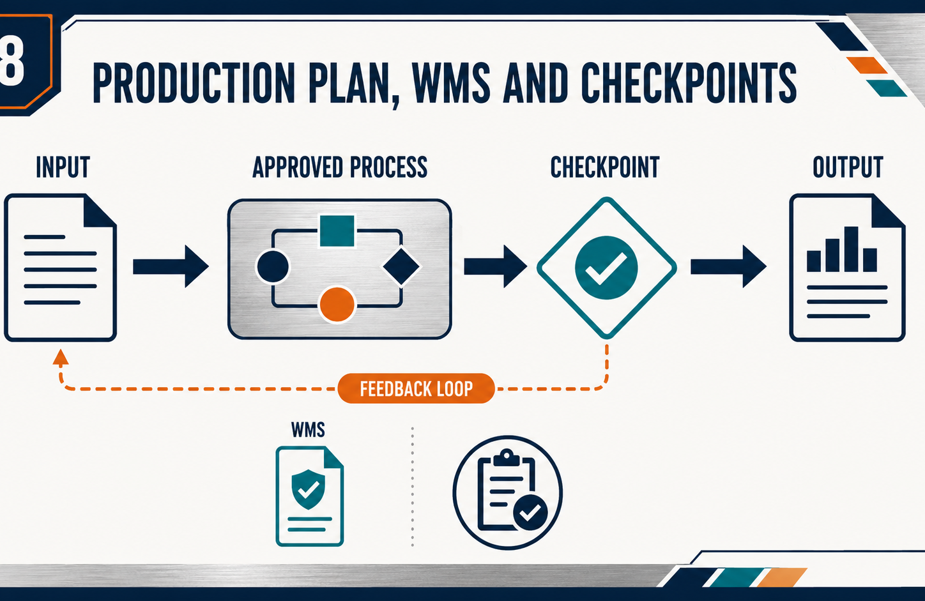
THEORY 2
Selecting and applying a finish from authoritative information
Use the key ideas to interpret the project evidence and make a controlled decision.
• Justify finishes using confirmed performance and maintenance criteria.
• Use current labels, SDS and technical information as evidence.
• Follow teacher authorisation and the demonstrated school process.
BBQ and Case · Module 7
05
Notes:
[Sources]
- bbq-case/data.js
[/Sources]

Slide 6
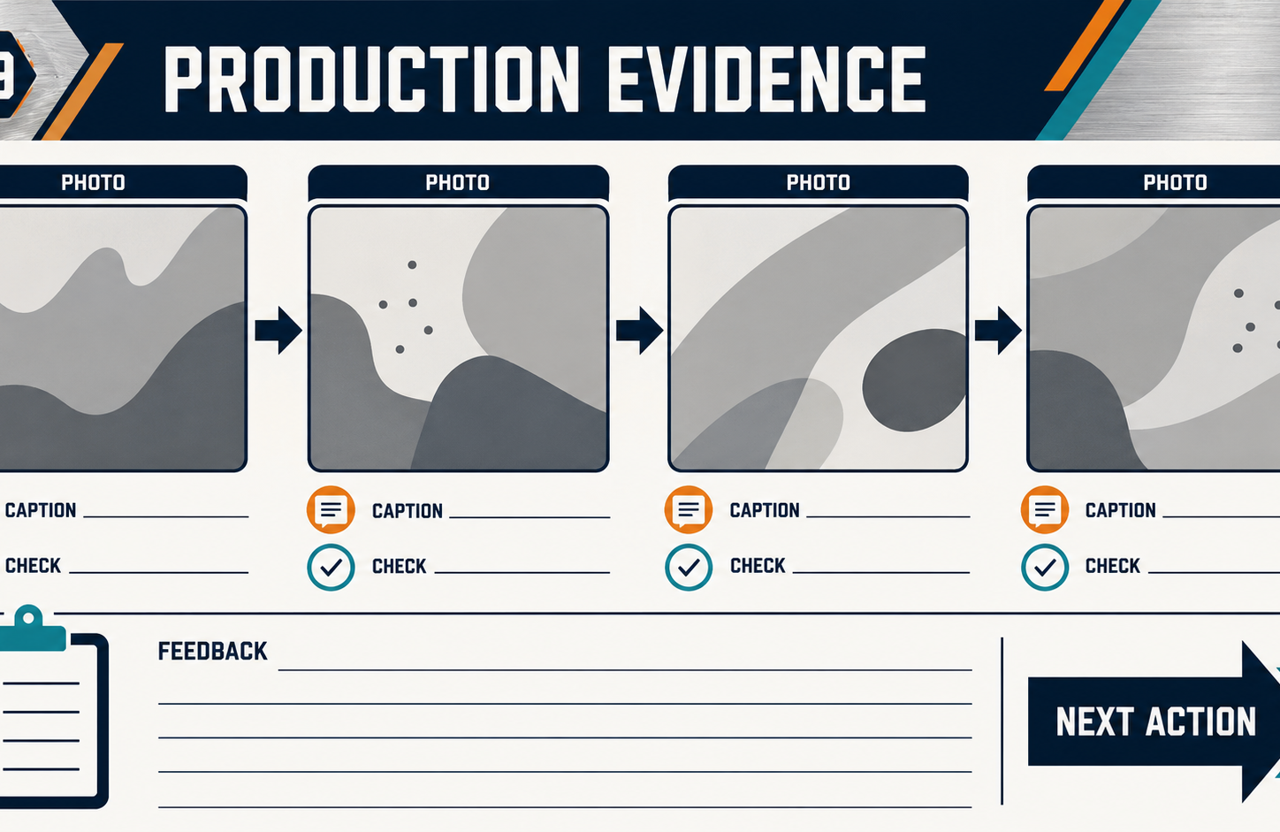
THEORY 3
Finish inspection, maintenance and environmental responsibility
Use the key ideas to interpret the project evidence and make a controlled decision.
• Compare finish quality with approved criteria and record clear evidence.
• Protect the surface throughout the specified drying and curing stages.
• Evaluate maintenance, repairability, waste and expected service life.
BBQ and Case · Module 7
06
Notes:
[Sources]
- bbq-case/data.js
[/Sources]

Slide 7
LEARNING CHECK
Can you explain each idea without guessing?
Answer in your own words before opening the online knowledge checks.
01
Why does finish performance begin with surface condition?
02
What should primarily justify the selection of a finish?
03
What should finish inspection primarily compare the completed surface against?
BBQ and Case · Module 7
07
Notes:
[Sources]
- bbq-case/data.js
[/Sources]

Slide 8
WRITTEN RESPONSE
Use evidence, then explain your thinking
The example shows an appropriate level of detail; do not copy it as your own response.
YOUR PROMPT
APPROPRIATE RESPONSE EXAMPLE
Document the before-condition, confirmed preparation process and inspection evidence for one surface.
A suitable response identifies the verified requirement or observation, names the evidence source, explains why the decision follows from it, and labels unresolved details as Teacher to confirm.
Complete the response online, check your evidence, then save or print it as directed.
BBQ and Case · Module 7
08
Notes:
[Sources]
- bbq-case/data.js
[/Sources]

