Slide 1
BBQ AND CASE · MODULE 8
Case development and quality
Interpret developments, control bending and verify case relationships without inventing geometry.
Weeks 15–16
Notes:
[Sources]
- bbq-case/data.js
[/Sources]

Slide 2
RETRIEVAL
Start with what you already know
Think first. Discuss your reasoning, then check it against the module.
1
What is the main purpose of a development?
2
Why must a development be read together with the teacher-issued case drawings?
3
What is the purpose of reference lines in a development?
BBQ and Case · Module 8
02
Notes:
[Sources]
- bbq-case/data.js
[/Sources]

Slide 3
ROADMAP
Three ideas organise this module
Work through them in order, then complete the checks and written evidence.
01
02
03
From three-dimensional case to flat development
Bending sequence, accumulated error and case fit
Hinges and handle as an evidence-based design problem
BBQ and Case · Module 8
03
Notes:
[Sources]
- bbq-case/data.js
[/Sources]

Slide 4
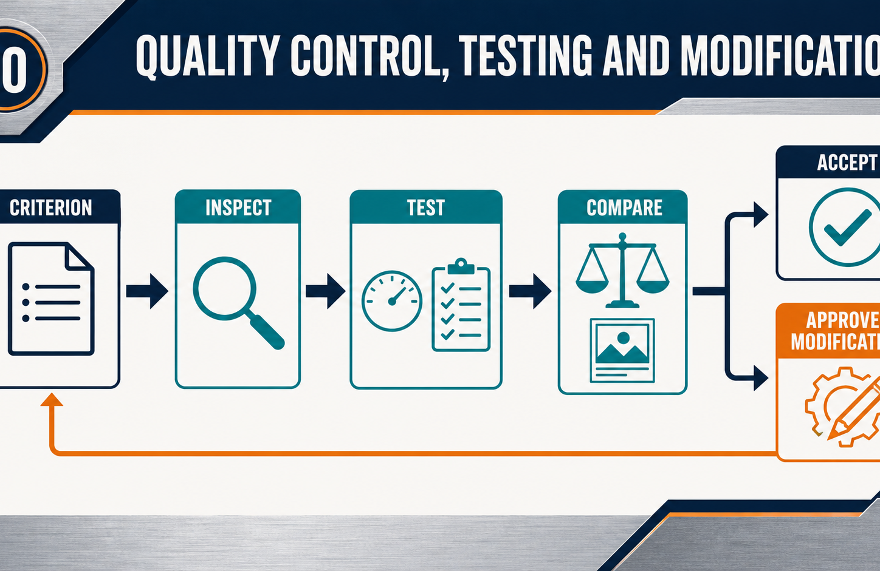
THEORY 1
From three-dimensional case to flat development
Use the key ideas to interpret the project evidence and make a controlled decision.
• Read the development as connected surfaces, not separate shapes.
• Preserve reference lines and orientation throughout production.
• Use only drawing-controlled allowances and approved sequence information.
BBQ and Case · Module 8
04
Notes:
[Sources]
- bbq-case/data.js
[/Sources]

Slide 5
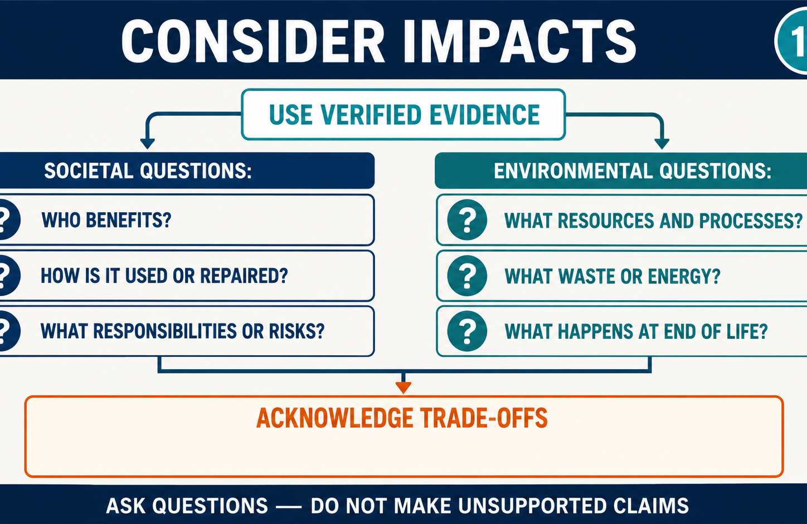
THEORY 2
Bending sequence, accumulated error and case fit
Use the key ideas to interpret the project evidence and make a controlled decision.
• Each forming stage affects later geometry, access and alignment.
• Consistent datums and intermediate checks limit accumulated error.
• Report unexpected fit or material response before continuing.
BBQ and Case · Module 8
05
Notes:
[Sources]
- bbq-case/data.js
[/Sources]

Slide 6
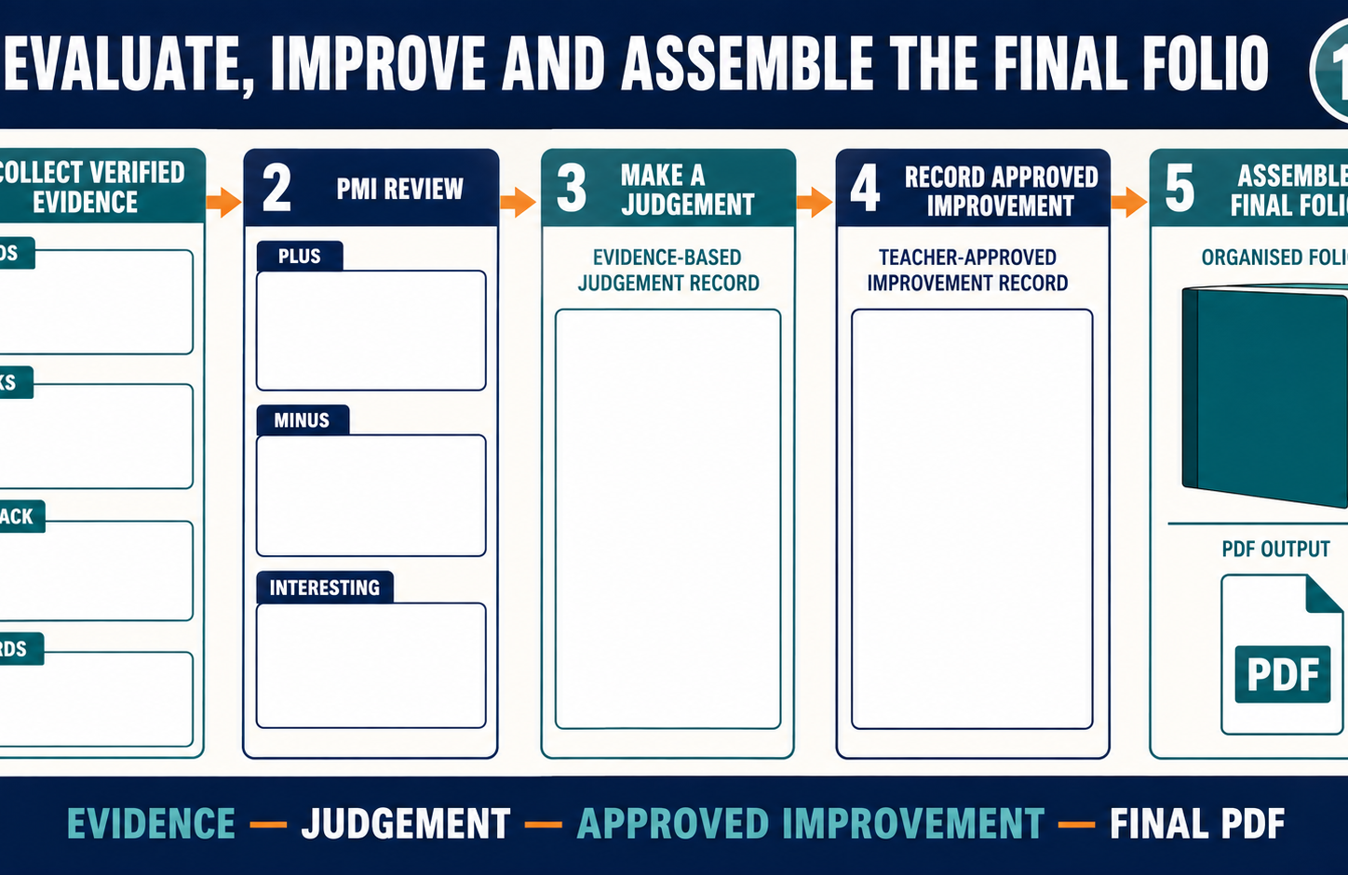
THEORY 3
Hinges and handle as an evidence-based design problem
Use the key ideas to interpret the project evidence and make a controlled decision.
• Define confirmed constraints before generating possible arrangements.
• Compare alternatives using approved functional and manufacturing criteria.
• Record trial evidence and seek teacher approval before finalising.
BBQ and Case · Module 8
06
Notes:
[Sources]
- bbq-case/data.js
[/Sources]

Slide 7
LEARNING CHECK
Can you explain each idea without guessing?
Answer in your own words before opening the online knowledge checks.
01
What is the main purpose of a development?
02
Why should the teacher-issued bending sequence be followed?
03
What should students do before generating hinge and handle arrangements?
BBQ and Case · Module 8
07
Notes:
[Sources]
- bbq-case/data.js
[/Sources]

Slide 8
WRITTEN RESPONSE
Use evidence, then explain your thinking
The example shows an appropriate level of detail; do not copy it as your own response.
YOUR PROMPT
APPROPRIATE RESPONSE EXAMPLE
Annotate a teacher-issued development to explain the role of one reference, one formed feature and one hold point.
A suitable response identifies the verified requirement or observation, names the evidence source, explains why the decision follows from it, and labels unresolved details as Teacher to confirm.
Complete the response online, check your evidence, then save or print it as directed.
BBQ and Case · Module 8
08
Notes:
[Sources]
- bbq-case/data.js
[/Sources]

