Slide 1
FOLDING CAMPING SHOVEL · MODULE 2
Risk, WMS and time/action planning
Connect risk controls, current procedures, hold points and time decisions.
Weeks 3–4
Notes:
[Sources]
- folding-camping-shovel/data.js
[/Sources]

Slide 2
RETRIEVAL
Start with what you already know
Think first. Discuss your reasoning, then check it against the module.
1
What should students identify before planning manufacture of the shovel head?
2
Why should the drawing be read together with the teacher demonstration?
3
What is the main purpose of datums during manufacture?
Folding Camping Shovel · Module 2
02
Notes:
[Sources]
- folding-camping-shovel/data.js
[/Sources]

Slide 3
ROADMAP
Three ideas organise this module
Work through them in order, then complete the checks and written evidence.
01
02
03
Translating the shovel-head drawing into a controlled sequence
Material behaviour during forming and shaping
Checking head geometry, edges and assembly readiness
Folding Camping Shovel · Module 2
03
Notes:
[Sources]
- folding-camping-shovel/data.js
[/Sources]

Slide 4
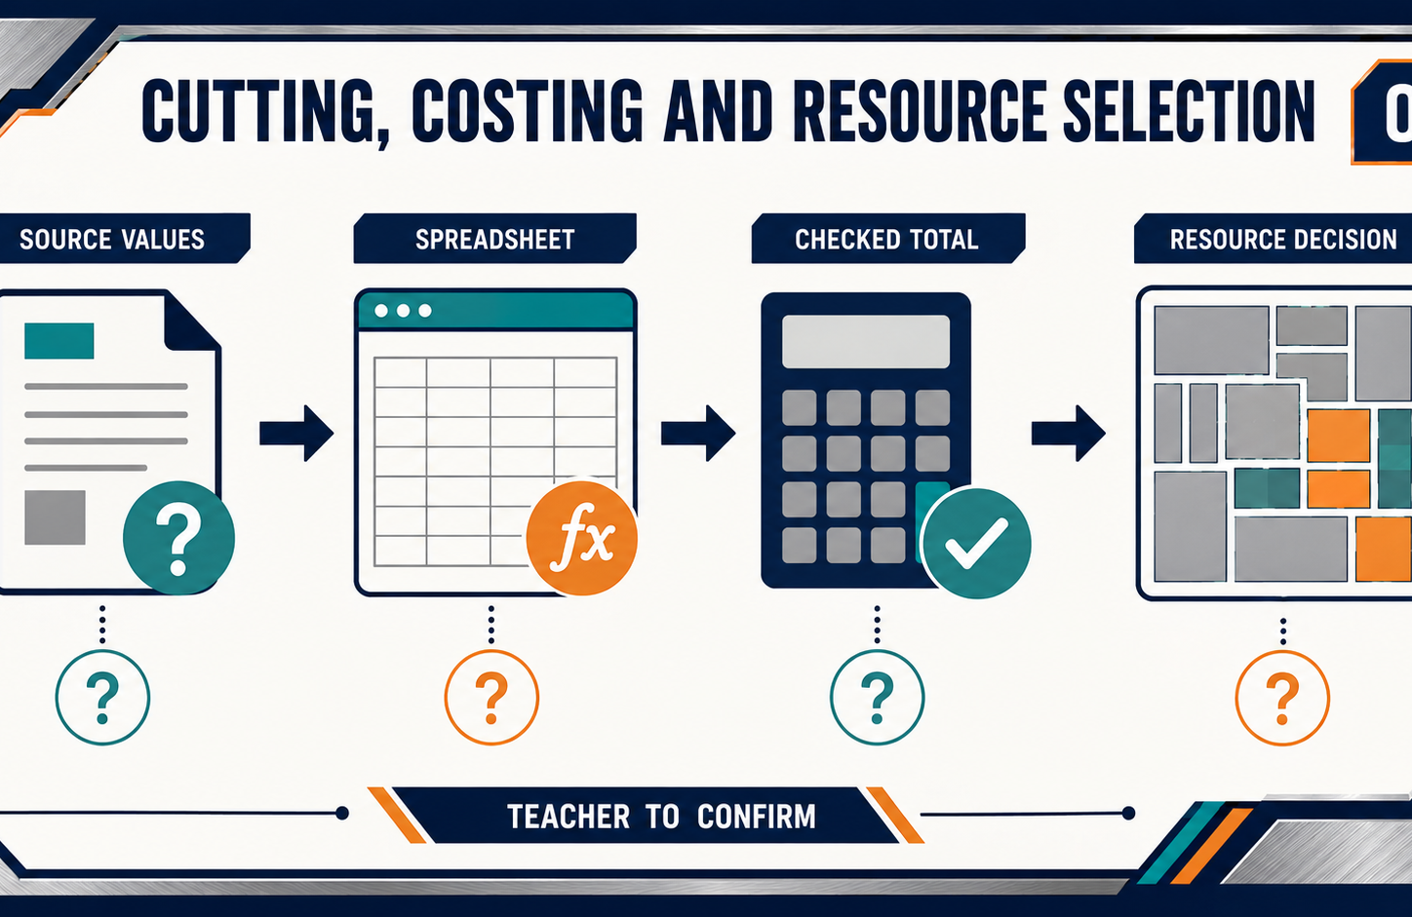
THEORY 1
Translating the shovel-head drawing into a controlled sequence
Use the key ideas to interpret the project evidence and make a controlled decision.
• Establish datums, orientation and dependencies before manufacture.
• Inspect features before later work relies on them.
• Keep the drawing, component and production record traceable.
Folding Camping Shovel · Module 2
04
Notes:
[Sources]
- folding-camping-shovel/data.js
[/Sources]

Slide 5
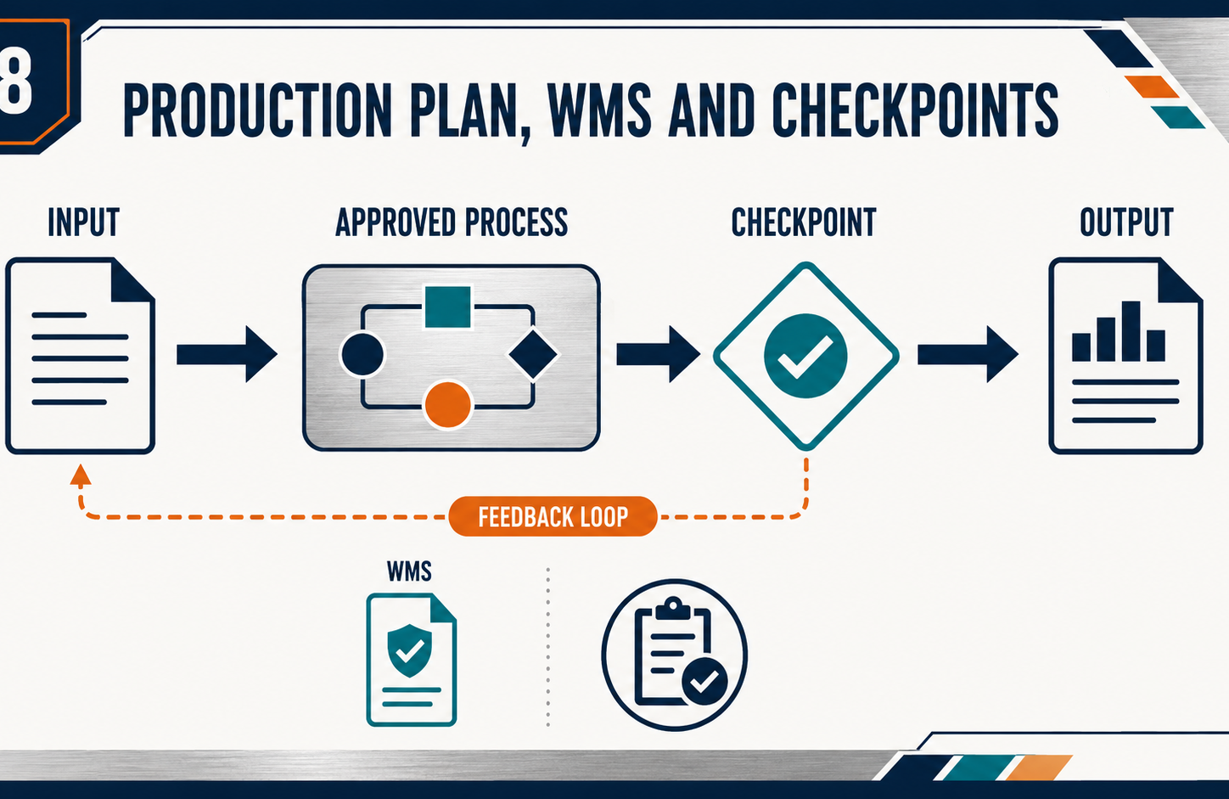
THEORY 2
Material behaviour during forming and shaping
Use the key ideas to interpret the project evidence and make a controlled decision.
• Link material behaviour only to verified properties and processes.
• Observe changes in shape, resistance and surface condition.
• Record unexpected behaviour before making further changes.
Folding Camping Shovel · Module 2
05
Notes:
[Sources]
- folding-camping-shovel/data.js
[/Sources]

Slide 6
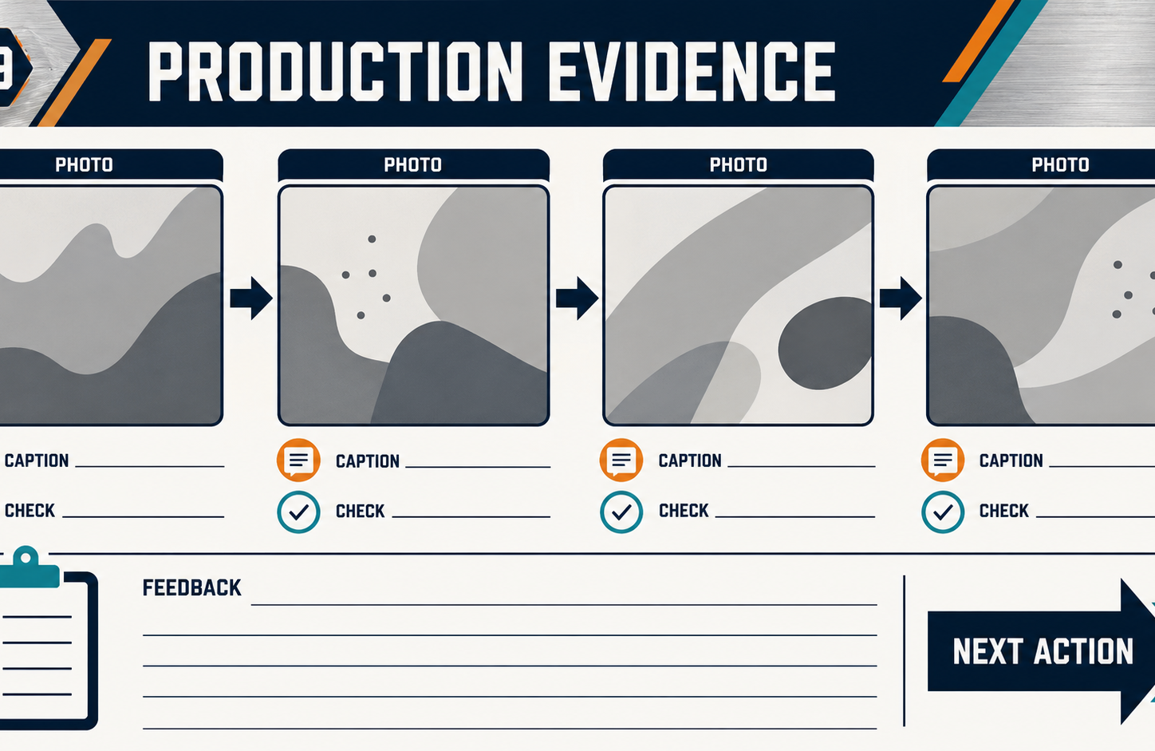
THEORY 3
Checking head geometry, edges and assembly readiness
Use the key ideas to interpret the project evidence and make a controlled decision.
• Compare geometry, features and edge condition with confirmed criteria.
• Record observed faults before proposing likely causes.
• Obtain teacher review before proceeding to later assembly stages.
Folding Camping Shovel · Module 2
06
Notes:
[Sources]
- folding-camping-shovel/data.js
[/Sources]

Slide 7
LEARNING CHECK
Can you explain each idea without guessing?
Answer in your own words before opening the online knowledge checks.
01
What should students identify before planning manufacture of the shovel head?
02
Which property describes a material's ability to change shape without failing?
03
What should the completed shovel head be compared with during inspection?
Folding Camping Shovel · Module 2
07
Notes:
[Sources]
- folding-camping-shovel/data.js
[/Sources]

Slide 8
WRITTEN RESPONSE
Use evidence, then explain your thinking
The example shows an appropriate level of detail; do not copy it as your own response.
YOUR PROMPT
APPROPRIATE RESPONSE EXAMPLE
Convert one confirmed drawing feature into a plan entry containing reference, operation category, check and evidence.
A suitable response identifies the verified requirement or observation, names the evidence source, explains why the decision follows from it, and labels unresolved details as Teacher to confirm.
Complete the response online, check your evidence, then save or print it as directed.
Folding Camping Shovel · Module 2
08
Notes:
[Sources]
- folding-camping-shovel/data.js
[/Sources]

