Slide 1
FOLDING CAMPING SHOVEL · MODULE 3
Alloys and shovel-head production
Relate material properties, forming and industry practice to the authorised shovel project.
Weeks 5–6
Notes:
[Sources]
- folding-camping-shovel/data.js
[/Sources]

Slide 2
RETRIEVAL
Start with what you already know
Think first. Discuss your reasoning, then check it against the module.
1
What should metal-lathe SOP evidence primarily demonstrate?
2
According to the theory, what should strong SOP evidence identify?
3
Where must exact machining actions come from?
Folding Camping Shovel · Module 3
02
Notes:
[Sources]
- folding-camping-shovel/data.js
[/Sources]

Slide 3
ROADMAP
Three ideas organise this module
Work through them in order, then complete the checks and written evidence.
01
02
03
Metal-lathe SOP evidence for handle and end-plug work
Functional fits connect dimensions to movement and assembly
Threads as controlled geometry and evidence
Folding Camping Shovel · Module 3
03
Notes:
[Sources]
- folding-camping-shovel/data.js
[/Sources]

Slide 4
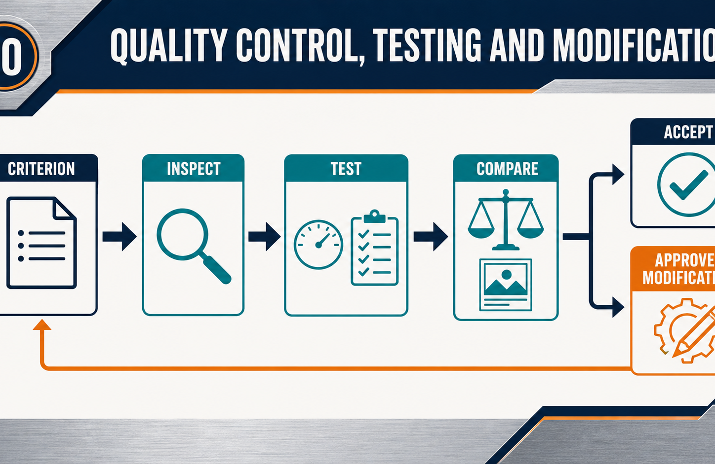
THEORY 1
Metal-lathe SOP evidence for handle and end-plug work
Use the key ideas to interpret the project evidence and make a controlled decision.
• SOP evidence must show understanding, not copied compliance.
• Report changed conditions before machining continues.
• Link inspection evidence to the drawing and approved criteria.
Folding Camping Shovel · Module 3
04
Notes:
[Sources]
- folding-camping-shovel/data.js
[/Sources]

Slide 5
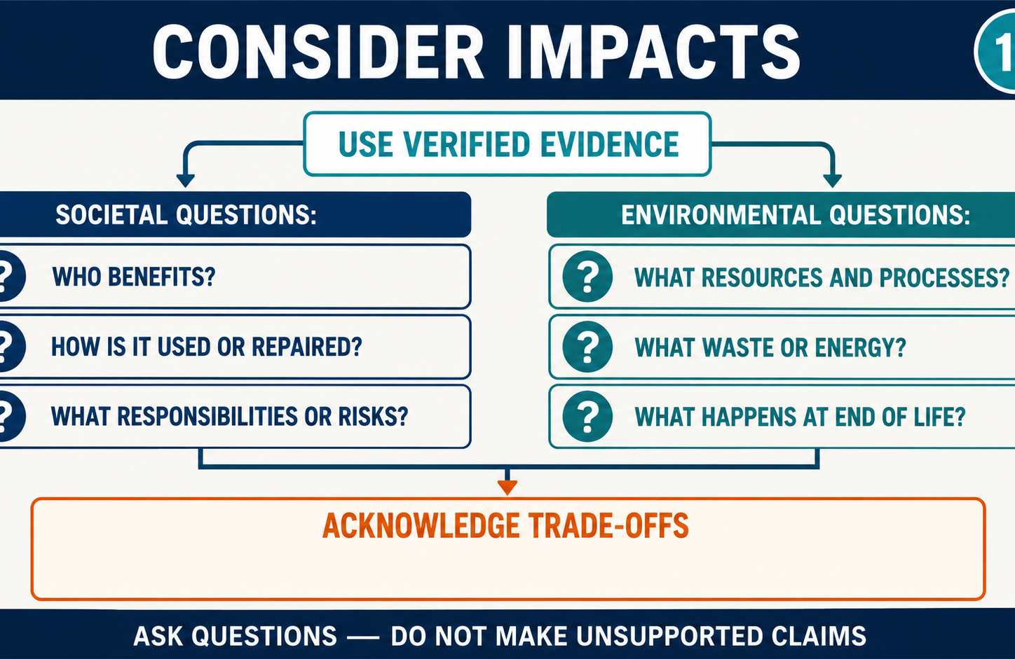
THEORY 2
Functional fits connect dimensions to movement and assembly
Use the key ideas to interpret the project evidence and make a controlled decision.
• Clearance, transition and interference describe general fit relationships.
• The drawing and teacher determine the required project fit.
• Link dimensional checks to movement, alignment and serviceability.
Folding Camping Shovel · Module 3
05
Notes:
[Sources]
- folding-camping-shovel/data.js
[/Sources]

Slide 6
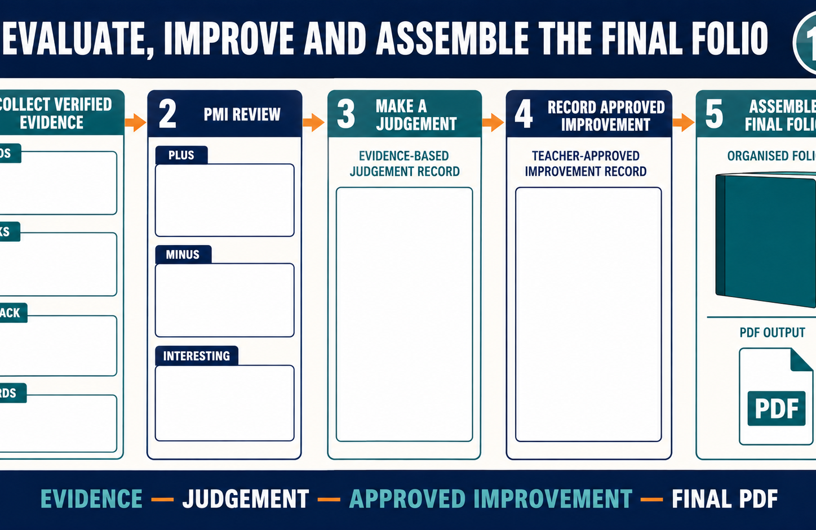
THEORY 3
Threads as controlled geometry and evidence
Use the key ideas to interpret the project evidence and make a controlled decision.
• Use correct thread vocabulary to interpret drawing information.
• Matching form, size and condition control successful engagement.
• Inspect specified threads using the teacher-approved checking method.
Folding Camping Shovel · Module 3
06
Notes:
[Sources]
- folding-camping-shovel/data.js
[/Sources]

Slide 7
LEARNING CHECK
Can you explain each idea without guessing?
Answer in your own words before opening the online knowledge checks.
01
What should metal-lathe SOP evidence primarily demonstrate?
02
What does a functional fit describe?
03
What does the pitch of a thread describe?
Folding Camping Shovel · Module 3
07
Notes:
[Sources]
- folding-camping-shovel/data.js
[/Sources]

Slide 8
WRITTEN RESPONSE
Use evidence, then explain your thinking
The example shows an appropriate level of detail; do not copy it as your own response.
YOUR PROMPT
APPROPRIATE RESPONSE EXAMPLE
Explain the purpose of two teacher-confirmed SOP controls and the evidence that they were applied.
A suitable response identifies the verified requirement or observation, names the evidence source, explains why the decision follows from it, and labels unresolved details as Teacher to confirm.
Complete the response online, check your evidence, then save or print it as directed.
Folding Camping Shovel · Module 3
08
Notes:
[Sources]
- folding-camping-shovel/data.js
[/Sources]

