Slide 1
FOLDING CAMPING SHOVEL · MODULE 5
Pivot, RPM, assembly and evaluation
Apply calculations, verify assembly quality and complete the final evidence trail.
Weeks 9–10
Notes:
[Sources]
- folding-camping-shovel/data.js
[/Sources]

Slide 2
RETRIEVAL
Start with what you already know
Think first. Discuss your reasoning, then check it against the module.
1
Why is the handle and pivot assembly described as a functional quality gate?
2
Before final finishing or handover, what should students confirm first?
3
According to the theory, how should fit be assessed?
Folding Camping Shovel · Module 5
02
Notes:
[Sources]
- folding-camping-shovel/data.js
[/Sources]

Slide 3
ROADMAP
Three ideas organise this module
Work through them in order, then complete the checks and written evidence.
01
02
03
Handle and pivot assembly as a functional quality gate
Societal and environmental impact report with evidence
PMI, project report and authentic Task 2 submission
Folding Camping Shovel · Module 5
03
Notes:
[Sources]
- folding-camping-shovel/data.js
[/Sources]

Slide 4
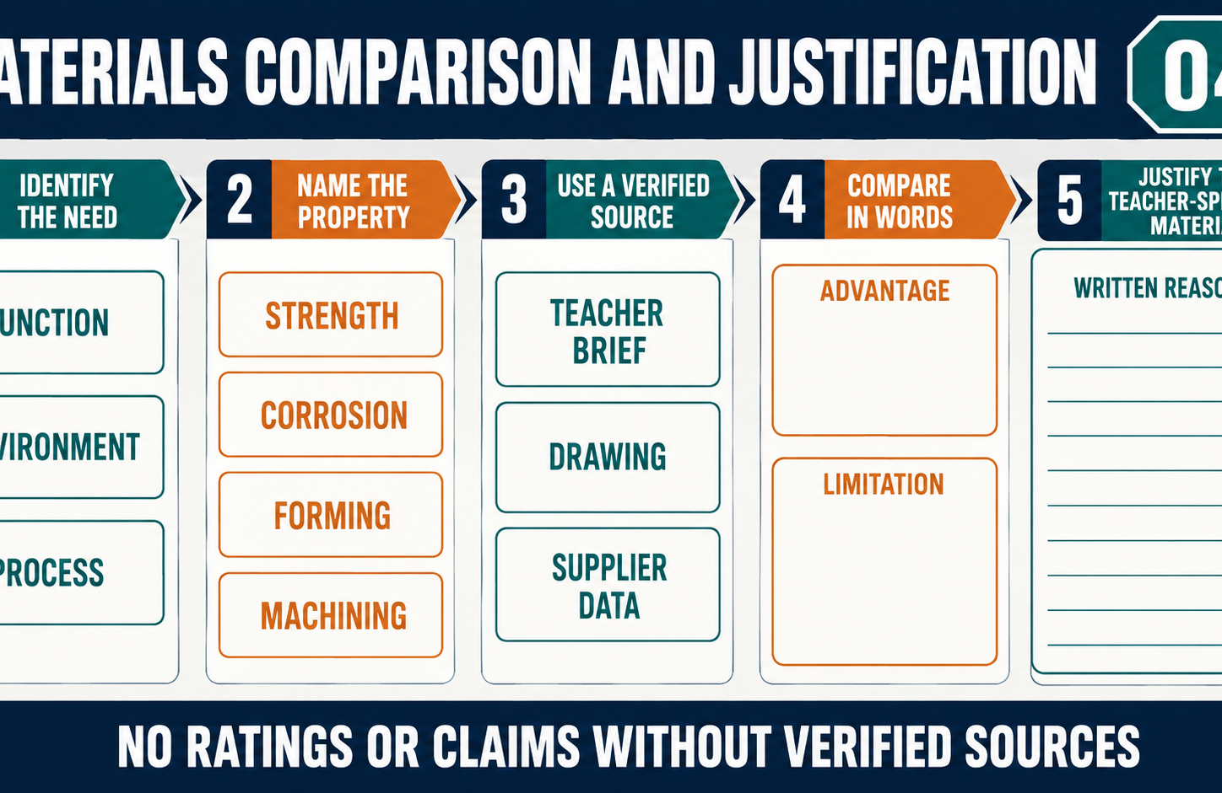
THEORY 1
Handle and pivot assembly as a functional quality gate
Use the key ideas to interpret the project evidence and make a controlled decision.
• Verify identity, orientation, fit and movement before final completion.
• Use reversible trial assembly to diagnose relationships between parts.
• Obtain teacher review before rework, finishing or handover.
Folding Camping Shovel · Module 5
04
Notes:
[Sources]
- folding-camping-shovel/data.js
[/Sources]

Slide 5
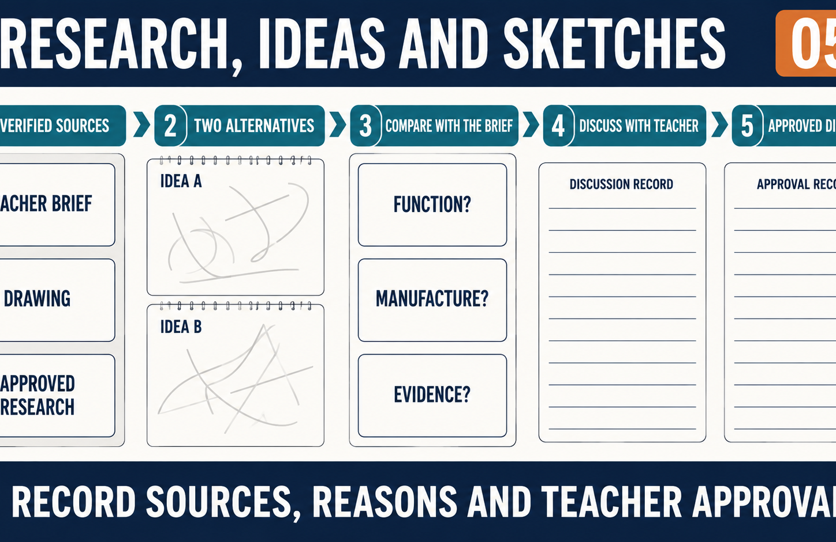
THEORY 2
Societal and environmental impact report with evidence
Use the key ideas to interpret the project evidence and make a controlled decision.
• Base impact judgements on actual project records and credible sources.
• Explain trade-offs across value, durability, resources and waste.
• State evidence limits and avoid unsupported sustainability claims.
Folding Camping Shovel · Module 5
05
Notes:
[Sources]
- folding-camping-shovel/data.js
[/Sources]

Slide 6
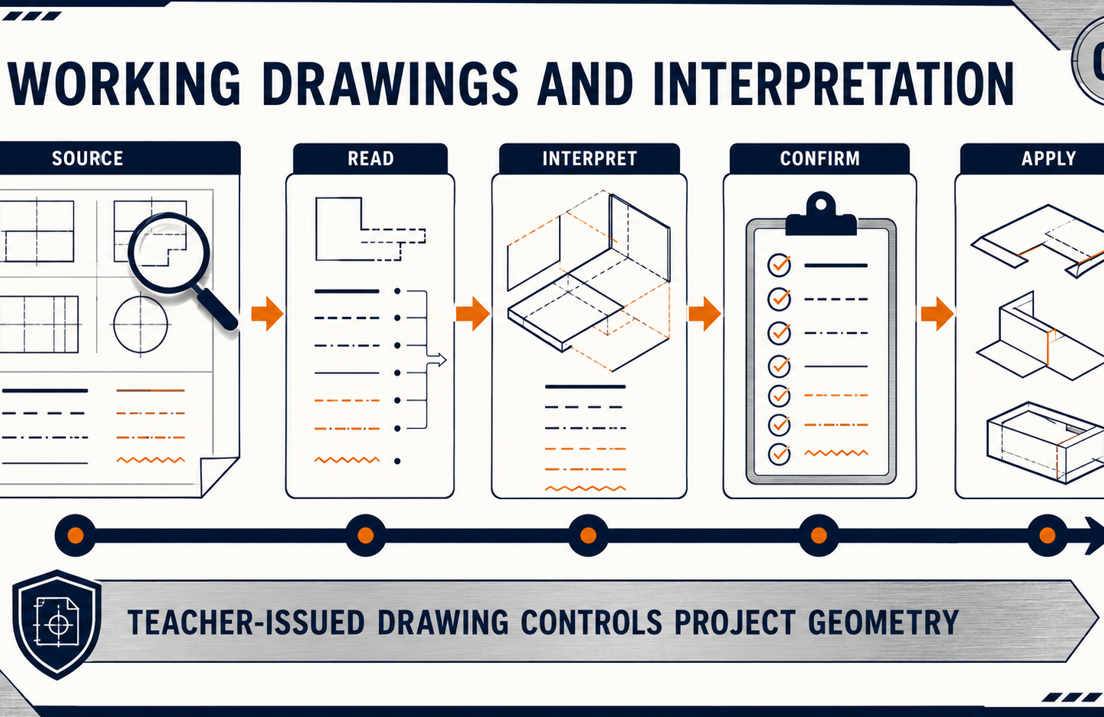
THEORY 3
PMI, project report and authentic Task 2 submission
Use the key ideas to interpret the project evidence and make a controlled decision.
• Consolidate planning, production, cost, quality and impact evidence.
• Use accurate captions and report the as-built project honestly.
• Acknowledge sources, assistance, limitations and unresolved details.
Folding Camping Shovel · Module 5
06
Notes:
[Sources]
- folding-camping-shovel/data.js
[/Sources]

Slide 7
LEARNING CHECK
Can you explain each idea without guessing?
Answer in your own words before opening the online knowledge checks.
01
Why is the handle and pivot assembly described as a functional quality gate?
02
What should be the main basis for judging the completed shovel's impacts?
03
What is the main purpose of the final PMI evaluation and project report?
Folding Camping Shovel · Module 5
07
Notes:
[Sources]
- folding-camping-shovel/data.js
[/Sources]

Slide 8
WRITTEN RESPONSE
Use evidence, then explain your thinking
The example shows an appropriate level of detail; do not copy it as your own response.
YOUR PROMPT
APPROPRIATE RESPONSE EXAMPLE
Write an assembly quality-gate record covering confirmed criterion, movement evidence, issue diagnosis and teacher-confirmed action.
A suitable response identifies the verified requirement or observation, names the evidence source, explains why the decision follows from it, and labels unresolved details as Teacher to confirm.
Complete the response online, check your evidence, then save or print it as directed.
Folding Camping Shovel · Module 5
08
Notes:
[Sources]
- folding-camping-shovel/data.js
[/Sources]

