Slide 1
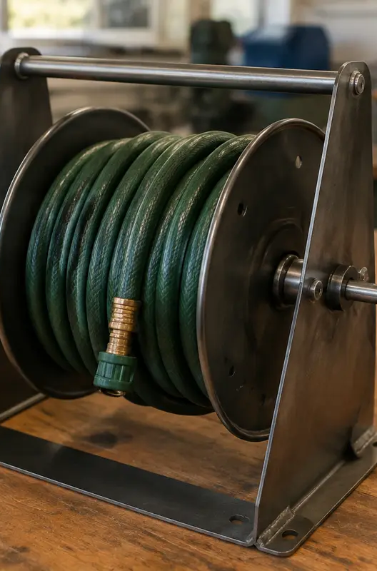
HOSE REEL HOLDER · MODULE 1
Project purpose and workshop readiness
Understand the hose-reel-holder brief, identify constraints and build the safety habits required before practical work.
Weeks 1–2
Notes:
[Sources]
- guided/data.js
[/Sources]

Slide 2
RETRIEVAL
Start with what you already know
Think first. Discuss your reasoning, then check it against the module.
1
Where should the holder’s exact shape and details come from?
2
Which statement best describes a design requirement?
Hose Reel Holder · Module 1
02
Notes:
[Sources]
- guided/data.js
[/Sources]

Slide 3
ROADMAP
Three ideas organise this module
Work through them in order, then complete the checks and written evidence.
01
02
03
Meet the project: function, users and constraints
Workshop entry and machine permission
Learn from the unsafe scenario
Hose Reel Holder · Module 1
03
Notes:
[Sources]
- guided/data.js
[/Sources]

Slide 4
THEORY 1
Meet the project: function, users and constraints
Use the key ideas to interpret the project evidence and make a controlled decision.
• The Hose Reel Holder is an outdoor mild-steel project designed to store and support a garden hose reel in a stable, practical position.
• Every design has constraints.
• Understand the purpose and constraints before beginning practical work.
Understand the purpose and constraints before beginning practical work.
Hose Reel Holder · Module 1
04
Notes:
[Sources]
- guided/data.js
[/Sources]

Slide 5
THEORY 2
Workshop entry and machine permission
Use the key ideas to interpret the project evidence and make a controlled decision.
• Safety is paramount.
• Before beginning, check the work area, the approved tool and the intended setup.
• Permission applies to the person, the machine, the setup and the task.
Permission applies to the person, the machine, the setup and the task.
Hose Reel Holder · Module 1
05
Notes:
[Sources]
- guided/data.js
[/Sources]

Slide 6
THEORY 3
Learn from the unsafe scenario
Use the key ideas to interpret the project evidence and make a controlled decision.
• Alex rushes into the workshop without putting on safety glasses or clearing his bag.
• The safe response is to stop, make the area safe, secure the material using the demonstrated setup and seek teacher direction.
• Safe practical work begins before the tool is switched on.
Safe practical work begins before the tool is switched on.
Hose Reel Holder · Module 1
06
Notes:
[Sources]
- guided/data.js
[/Sources]

Slide 7
LEARNING CHECK
Can you explain each idea without guessing?
Answer in your own words before opening the online knowledge checks.
01
Where should the holder’s exact shape and details come from?
Hose Reel Holder · Module 1
07
Notes:
[Sources]
- guided/data.js
[/Sources]

Slide 8
WRITTEN RESPONSE
Use evidence, then explain your thinking
The example shows an appropriate level of detail; do not copy it as your own response.
YOUR PROMPT
APPROPRIATE RESPONSE EXAMPLE
Identify one user need and two likely constraints for the Hose Reel Holder. Explain how each could affect the finished project.
One user need is stable, convenient hose storage. Outdoor exposure is one constraint, so the steel needs the teacher-approved protective finish. Available workshop time and tools are another constraint, so I must follow the issued plan and approved processes.
Complete the response online, check your evidence, then save or print it as directed.
Hose Reel Holder · Module 1
08
Notes:
[Sources]
- guided/data.js
[/Sources]

