Slide 1
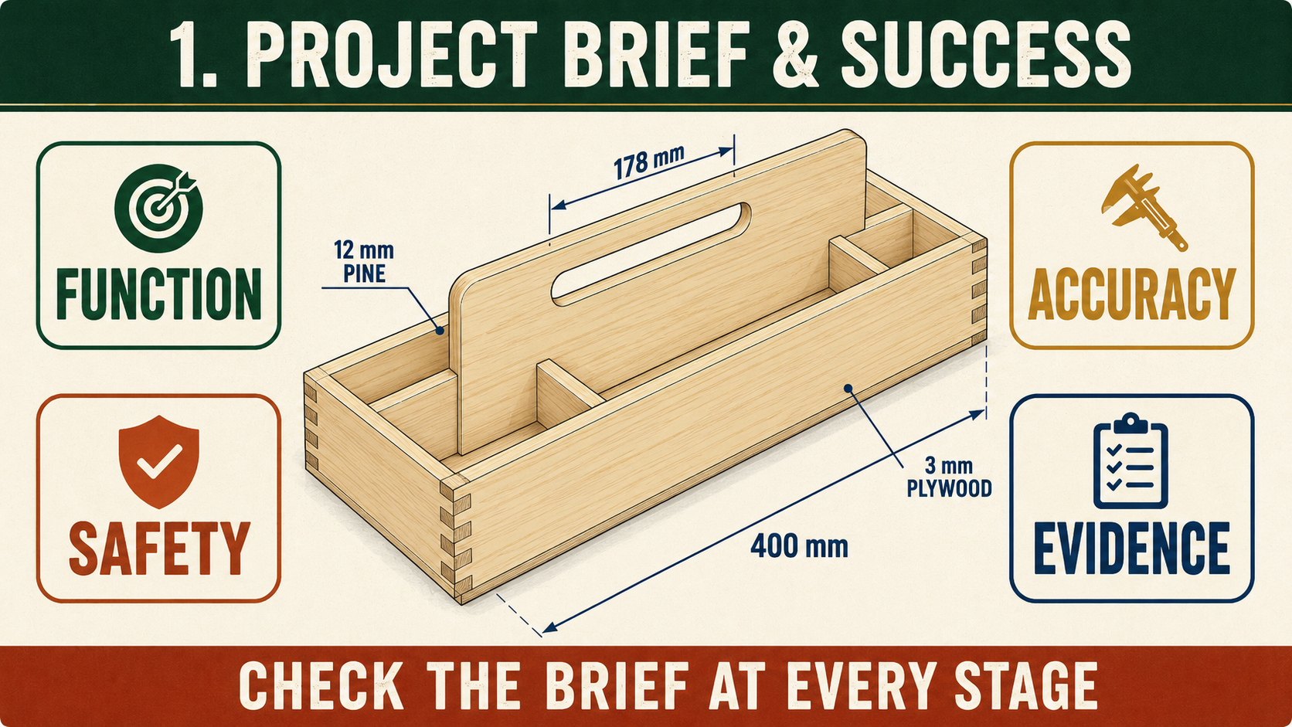
CARRY-ALL
Weeks 1–2 · 1/8
Brief, plans and workshop safety
Weeks 1–2 guided learning
Read the theory. Check your understanding. Save useful evidence.
Notes:
Introduce the module purpose and connect it to the current project stage.
[Sources]
- Authorised local course theory: weeks1-2/index.html

Slide 2
CARRY-ALL
Weeks 1–2 · 2/8
What you will learn
Use the module in order. Each idea supports the checks and written evidence that follow.
1
Understanding the Carry-All brief and success criteria
2
Reading the Carry-All working drawing without scaling
3
Managing Carry-All hazards, risks and the SWMS
Notes:
Preview the learning sequence without giving check answers.
[Sources]
- Authorised local course theory: weeks1-2/index.html

Slide 3
CARRY-ALL
Weeks 1–2 · 3/8
Understanding the Carry-All brief and success criteria
Main idea
The Barbecue Carry-All brief asks you to manufacture a practical timber tray or carry-all that is strong, accurate, safe to use and finished to an appropriate standard.
Check 2
The supplied working drawing and your teacher’s directions are the main sources of truth.
Check 3
They control the shape, parts, materials, joints and construction requirements.
Return to the module page for the full explanation, visual and section video.
Notes:
Teach the source-grounded theory for Understanding the Carry-All brief and success criteria.
[Sources]
- Authorised local course theory: weeks1-2/index.html

Slide 4
CARRY-ALL
Weeks 1–2 · 4/8
Reading the Carry-All working drawing without scaling
Main idea
The Carry-All working drawing is the main graphical instruction for manufacture.
Check 2
It communicates the shape, arrangement and relationship of the sides, bottom, central handle or handle panel, dividers, joints, rebates and housings.
Check 3
The drawing must be read together with teacher directions because local workshop procedures, approved tools and safe methods are controlled by your teacher, the SWMS…
Return to the module page for the full explanation, visual and section video.
Notes:
Teach the source-grounded theory for Reading the Carry-All working drawing without scaling.
[Sources]
- Authorised local course theory: weeks1-2/index.html

Slide 5
CARRY-ALL
Weeks 1–2 · 5/8
Managing Carry-All hazards, risks and the SWMS
Main idea
Safe work begins by understanding three connected terms: hazard, risk and control.
Check 2
A hazard is something with the potential to cause harm, such as sharp edges, dust, moving equipment, unstable workpieces, adhesive or finishing products.
Check 3
Risk is the chance that the hazard will cause harm and how serious that harm could be.
Return to the module page for the full explanation, visual and section video.
Notes:
Teach the source-grounded theory for Managing Carry-All hazards, risks and the SWMS.
[Sources]
- Authorised local course theory: weeks1-2/index.html

Slide 6
CARRY-ALL
Weeks 1–2 · 6/8
Pause and check your understanding
What is the controlling idea?
Understanding the Carry-All brief and success criteria
Which check would prevent a mistake?
Reading the Carry-All working drawing without scaling
What evidence would show your decision?
Managing Carry-All hazards, risks and the SWMS
Notes:
Use these prompts for retrieval before students open the interactive checks.
[Sources]
- Authorised local course theory: weeks1-2/index.html

Slide 7
CARRY-ALL
Weeks 1–2 · 7/8
Build a stronger written response
Read
Underline the command word and the project detail.
Select
Return to the exact theory section and choose relevant evidence.
Explain
Connect the decision, reason and likely result.
Check
Make sure the response answers the question and stays source-accurate.
Notes:
Model the response process without supplying an answer to a live student question.
[Sources]
- Authorised local course theory: weeks1-2/index.html

Slide 8
CARRY-ALL
Weeks 1–2 · 8/8
Exit ticket
Before you finish this module, answer these in your own words:
1. One idea I can now explain: Understanding the Carry-All brief and success criteria
2. One practical check I must remember before the next stage
3. One piece of evidence I should save or improve
Return to the module page to complete the checks, written response and folio evidence.
Notes:
Students complete the exit ticket, then return to the website to save evidence.
[Sources]
- Authorised local course theory: weeks1-2/index.html

