Slide 1
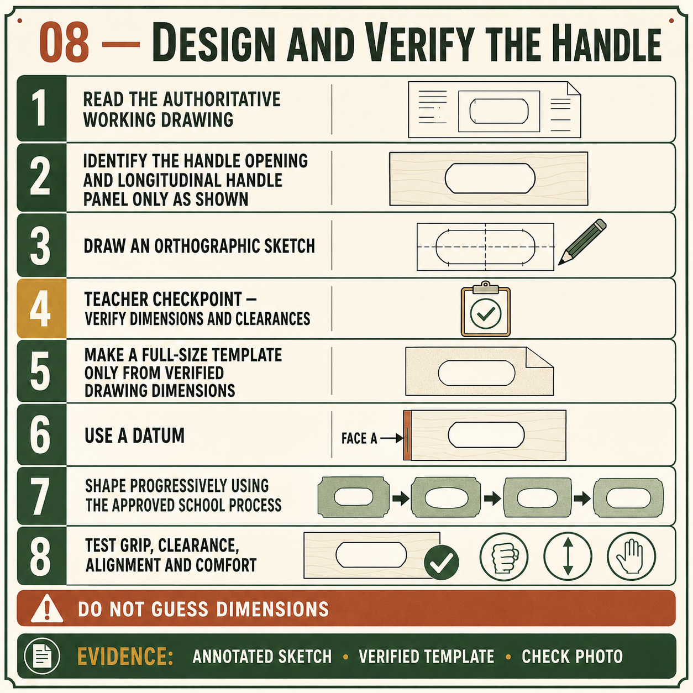
CARRY-ALL
Weeks 11–12 · 1/8
Handle design, drawing and shaping
Weeks 11–12 guided learning
Read the theory. Check your understanding. Save useful evidence.
Notes:
Introduce the module purpose and connect it to the current project stage.
[Sources]
- Authorised local course theory: weeks11-12/index.html

Slide 2
CARRY-ALL
Weeks 11–12 · 2/8
What you will learn
Use the module in order. Each idea supports the checks and written evidence that follow.
1
Designing a practical Carry-All handle
2
Communicating the handle through orthogonal drawing and a template
3
Shaping and refining the Carry-All handle safely
Notes:
Preview the learning sequence without giving check answers.
[Sources]
- Authorised local course theory: weeks11-12/index.html

Slide 3
CARRY-ALL
Weeks 11–12 · 3/8
Designing a practical Carry-All handle
Main idea
The Carry-All handle is a working part of the product, not just a decorative opening.
Check 2
It must allow the Carry-All to be lifted and carried while remaining connected to the central handle or handle panel and the surrounding structure.
Check 3
The approved working drawing shows a written 178 mm handle opening.
Return to the module page for the full explanation, visual and section video.
Notes:
Teach the source-grounded theory for Designing a practical Carry-All handle.
[Sources]
- Authorised local course theory: weeks11-12/index.html

Slide 4
CARRY-ALL
Weeks 11–12 · 4/8
Communicating the handle through orthogonal drawing and…
Main idea
Orthogonal drawing communicates the Carry-All handle by showing it from separate straight-on directions.
Check 2
A front view can show the overall form of the handle opening and its relationship to the central handle panel.
Check 3
A side view can communicate the thickness and position of that panel within the Carry-All structure.
Return to the module page for the full explanation, visual and section video.
Notes:
Teach the source-grounded theory for Communicating the handle through orthogonal drawing and a template.
[Sources]
- Authorised local course theory: weeks11-12/index.html

Slide 5
CARRY-ALL
Weeks 11–12 · 5/8
Shaping and refining the Carry-All handle safely
Main idea
Shaping the Carry-All handle should be completed in controlled stages rather than trying to reach the final line in one operation.
Check 2
The approved drawing or verified template establishes the handle opening and its position on the central handle panel.
Check 3
The marked boundary must remain visible during the early stages so there is enough material for careful refinement.
Return to the module page for the full explanation, visual and section video.
Notes:
Teach the source-grounded theory for Shaping and refining the Carry-All handle safely.
[Sources]
- Authorised local course theory: weeks11-12/index.html

Slide 6
CARRY-ALL
Weeks 11–12 · 6/8
Pause and check your understanding
What is the controlling idea?
Designing a practical Carry-All handle
Which check would prevent a mistake?
Communicating the handle through orthogonal drawing and a template
What evidence would show your decision?
Shaping and refining the Carry-All handle safely
Notes:
Use these prompts for retrieval before students open the interactive checks.
[Sources]
- Authorised local course theory: weeks11-12/index.html

Slide 7
CARRY-ALL
Weeks 11–12 · 7/8
Build a stronger written response
Read
Underline the command word and the project detail.
Select
Return to the exact theory section and choose relevant evidence.
Explain
Connect the decision, reason and likely result.
Check
Make sure the response answers the question and stays source-accurate.
Notes:
Model the response process without supplying an answer to a live student question.
[Sources]
- Authorised local course theory: weeks11-12/index.html

Slide 8
CARRY-ALL
Weeks 11–12 · 8/8
Exit ticket
Before you finish this module, answer these in your own words:
1. One idea I can now explain: Designing a practical Carry-All handle
2. One practical check I must remember before the next stage
3. One piece of evidence I should save or improve
Return to the module page to complete the checks, written response and folio evidence.
Notes:
Students complete the exit ticket, then return to the website to save evidence.
[Sources]
- Authorised local course theory: weeks11-12/index.html

