Slide 1
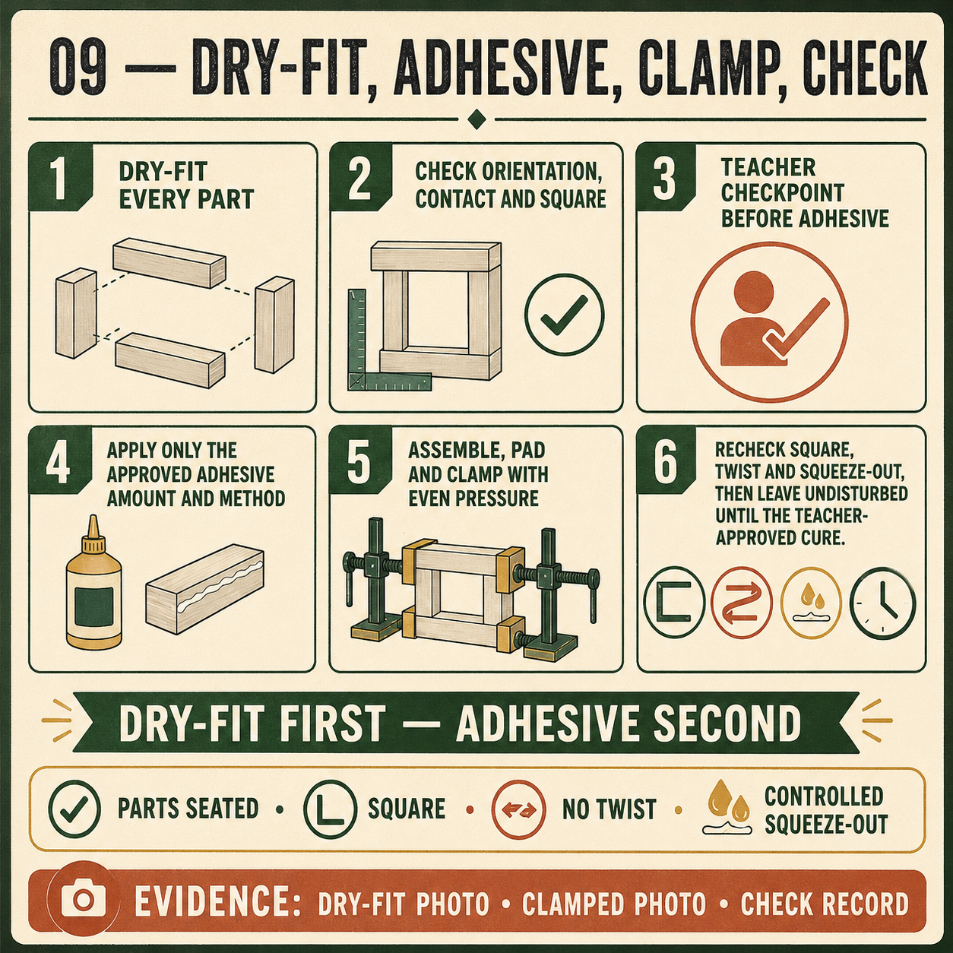
CARRY-ALL
Weeks 13–14 · 1/8
Adhesive assembly and workshop care
Weeks 13–14 guided learning
Read the theory. Check your understanding. Save useful evidence.
Notes:
Introduce the module purpose and connect it to the current project stage.
[Sources]
- Authorised local course theory: weeks13-14/index.html

Slide 2
CARRY-ALL
Weeks 13–14 · 2/8
What you will learn
Use the module in order. Each idea supports the checks and written evidence that follow.
1
Choosing and using an adhesive for assembly
2
Clamping the Carry-All square and true
3
Maintaining tools and organising the workspace
Notes:
Preview the learning sequence without giving check answers.
[Sources]
- Authorised local course theory: weeks13-14/index.html

Slide 3
CARRY-ALL
Weeks 13–14 · 3/8
Choosing and using an adhesive for assembly
Main idea
Adhesive helps the Carry-All components remain joined after the dry-fit checks are complete.
Check 2
It works across the fitted surfaces of the required rebate-butt corners, housings and other approved assembly areas.
Check 3
Adhesive should support accurately manufactured rebate-and-housing features, not replace them.
Return to the module page for the full explanation, visual and section video.
Notes:
Teach the source-grounded theory for Choosing and using an adhesive for assembly.
[Sources]
- Authorised local course theory: weeks13-14/index.html

Slide 4
CARRY-ALL
Weeks 13–14 · 4/8
Clamping the Carry-All square and true
Main idea
Clamping holds the Carry-All components in their correct positions while the approved adhesive develops strength.
Check 2
Good clamping begins with planning, not pressure.
Check 3
The sides, base, dividers, central handle or handle panel, corner joints, rebates and housings should already have passed a full dry-fit check.
Return to the module page for the full explanation, visual and section video.
Notes:
Teach the source-grounded theory for Clamping the Carry-All square and true.
[Sources]
- Authorised local course theory: weeks13-14/index.html

Slide 5
CARRY-ALL
Weeks 13–14 · 5/8
Maintaining tools and organising the workspace
Main idea
Maintaining tools and organising the workspace are part of safe and accurate Carry-All manufacture.
Check 2
Before using any teacher-approved tool, check its general condition and confirm that it appears suitable for the task.
Check 3
Look for obvious damage, loose parts, contamination, worn surfaces or anything unusual.
Return to the module page for the full explanation, visual and section video.
Notes:
Teach the source-grounded theory for Maintaining tools and organising the workspace.
[Sources]
- Authorised local course theory: weeks13-14/index.html

Slide 6
CARRY-ALL
Weeks 13–14 · 6/8
Pause and check your understanding
What is the controlling idea?
Choosing and using an adhesive for assembly
Which check would prevent a mistake?
Clamping the Carry-All square and true
What evidence would show your decision?
Maintaining tools and organising the workspace
Notes:
Use these prompts for retrieval before students open the interactive checks.
[Sources]
- Authorised local course theory: weeks13-14/index.html

Slide 7
CARRY-ALL
Weeks 13–14 · 7/8
Build a stronger written response
Read
Underline the command word and the project detail.
Select
Return to the exact theory section and choose relevant evidence.
Explain
Connect the decision, reason and likely result.
Check
Make sure the response answers the question and stays source-accurate.
Notes:
Model the response process without supplying an answer to a live student question.
[Sources]
- Authorised local course theory: weeks13-14/index.html

Slide 8
CARRY-ALL
Weeks 13–14 · 8/8
Exit ticket
Before you finish this module, answer these in your own words:
1. One idea I can now explain: Choosing and using an adhesive for assembly
2. One practical check I must remember before the next stage
3. One piece of evidence I should save or improve
Return to the module page to complete the checks, written response and folio evidence.
Notes:
Students complete the exit ticket, then return to the website to save evidence.
[Sources]
- Authorised local course theory: weeks13-14/index.html

